Slide 1
A.A. 2025-2026 MOLECULAR METHODS and BIOINFORMATICS Master degree in Evolutionary Biology School of Science University of Padova
Teachers: Prof. STEFANIA BORTOLUZZI
Prof. GIANLUCA OCCHI
Collaborators: Dr. Enrico Gaffo
Dr. Silvia Orsi Dr. Dalle Nogare Mattia
Dr. Puggina Daniele

Slide 2
COURSE ORGANIZATION
Ist semester, Ist year
11 training credits (CFU):
56 h frontal lessons (7 CFU)
64 h practical sessions and laboratory activities (4 CFU)
Teaching hours | MOLECULAR METHODS | BIOINFORMATICS
Frontal | 28 | 28
Practical | 28 | 28
Common activities (JC) | 8

Slide 3
COURSE SKEDULE
First part of the semester
 | MON | TUE | WED | THU | FRI | SAT | SUN
PROF. BORTOLUZZI
PROF. OCCHI
From the second half of November
 | MON | TUE | WED | THU | FRI | SAT | SUN
PROF. BORTOLUZZI
PROF. OCCHI
Bioinfo practice WED afternoon, starting from October 22
Molecular Biology labs start January 7 2026

Slide 4
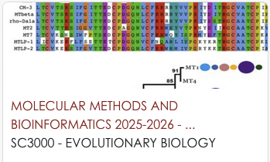
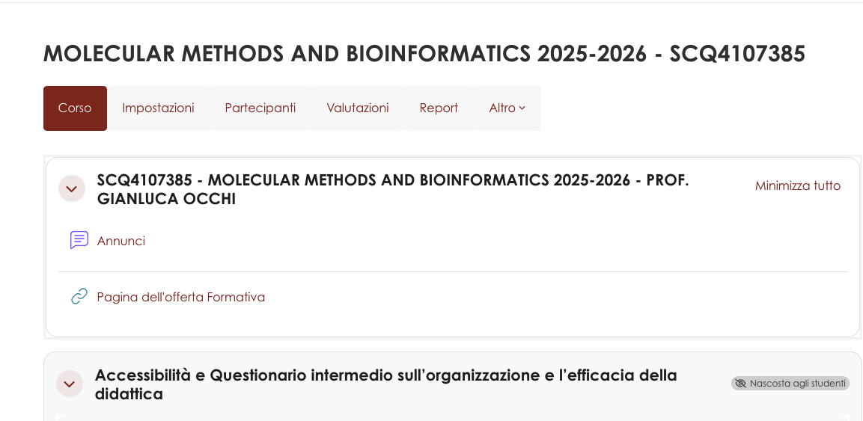
COURSE
MATERIALS
MOODLE

Slide 5
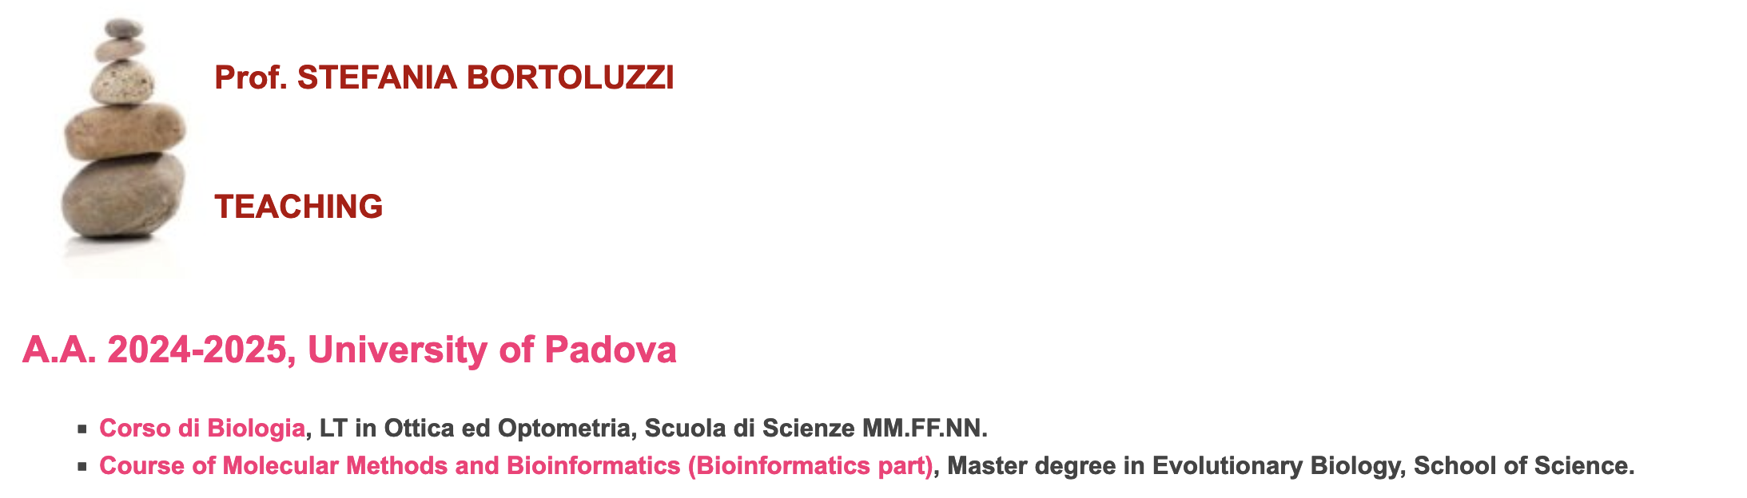
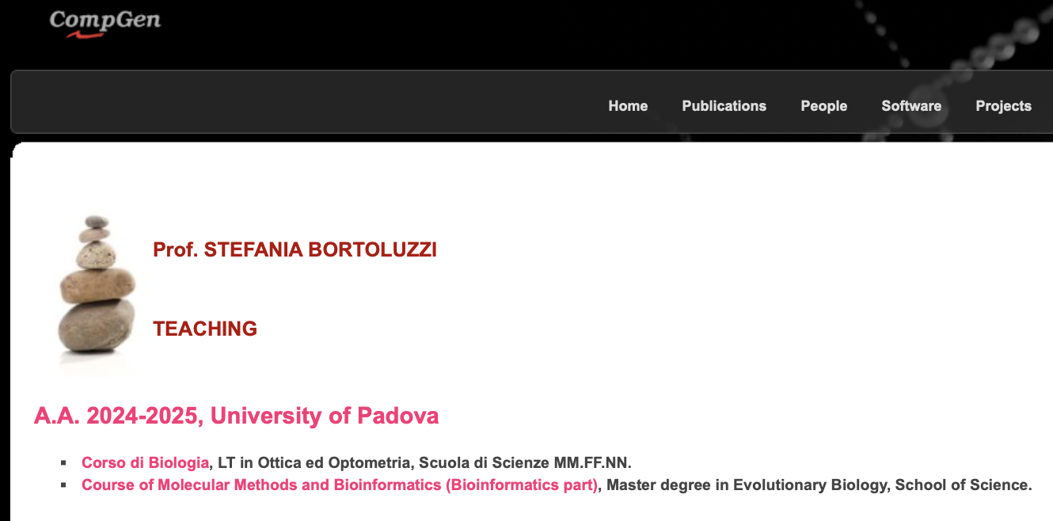
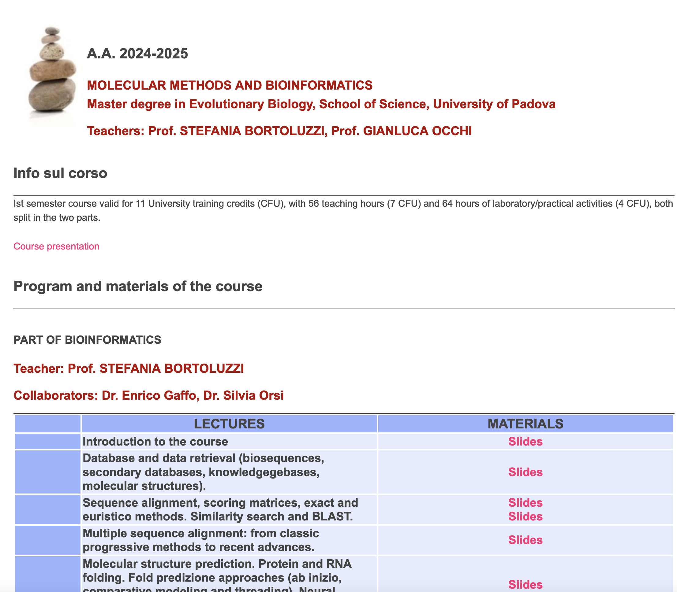
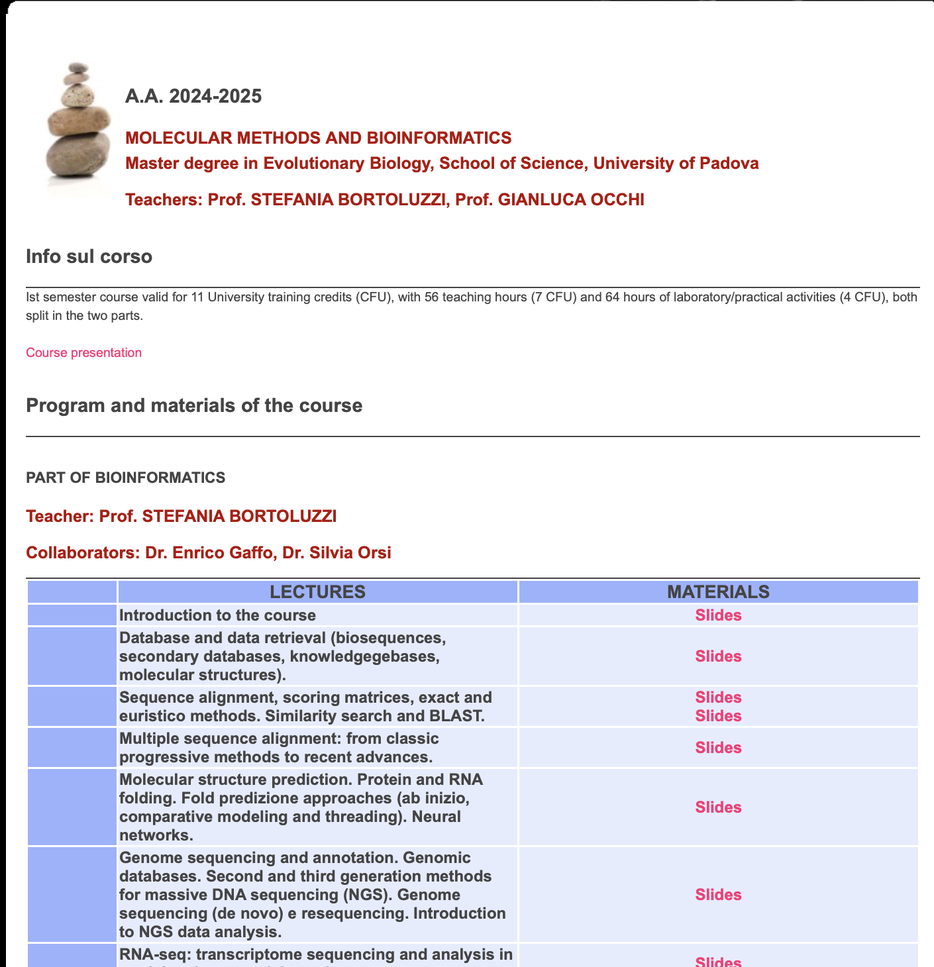
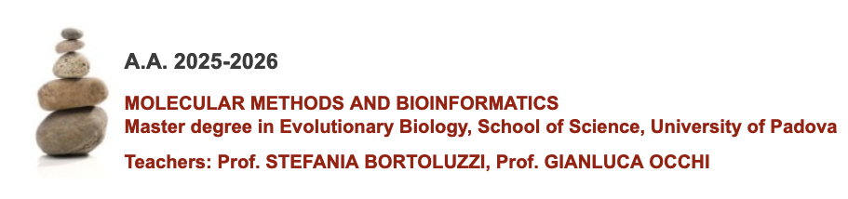
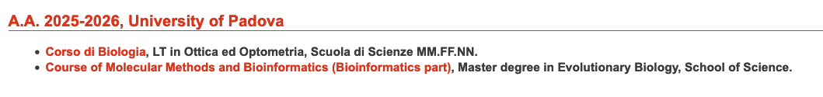
WEB SITE http://compgen.bio.unipd.it/~stefania/Didattica/
BIOINFO
MATERIALS

Slide 6
How your final mark will be defined?
Practical activities will be evaluated
JC will give a bonus
Written exam about the course and practical activities topics
Two separate tests for Bioinformatics and Molecular methods
Marks of one part will be kept (the student will be allowed to repeat the test of only one part, if the other has been passed)

Slide 7
MOLECULAR METHODS – Lecture contents
Brief introduction and basic concepts related to the molecular biology of the gene
Recombinant DNA technologies
Sequencing techniques and molecular markers in evolutionary biology
Study of gene variability and function by mutagenesis
Genome Editing Techniques
Methodologies for the analysis of macromolecules by blotting (Northern, Southern, Western)
Introduction to animal and plant transgenesis

Slide 8
MOLECULAR METHODS - Exercises
1 – DNA extraction from buccal swab (Salting Out Method)
2 – Amplification of a DNA fragment by PCR
3 – Purification and cloning in a plasmid vector
4 – Transformations of competent E. Coli cells and plating
5 – Colony PCR for screening recombinants
6 – Plasmid DNA extraction and primer-mediated mutagenesis
7 – Discrimination of mutants by restriction endonucleases

Slide 9
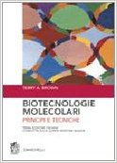
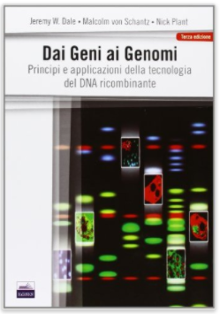
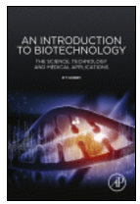
RECOMMENDED BOOKS and MATERIALS
Brown TA, Biotecnologie molecolari. Principi e tecniche - Zanichelli, 2011.
€ 46,50
Lesson material Practice session material
Dale JW,von Schantz M,Plant N, Dai Geni ai Genomi - EdiSES, 2013.
€ 27,00
Godbey WT, www.sciencedirect.com/science/book/9781907568282
2014

Slide 10
BIOINFORMATICS – MAIN TOPICS
Nucleic acids and protein sequence alignment, substitution matrices, sequence alignment algorithms, heuristic vs exact algorithms.
Multiple sequence alignment, progressive and consistency based methods, jury methods
Similarity search, BLASTA
Databases and data retrieval (biosequences, secondary databases and knowledgebases, structure databases).
Notes:
Introduzione al sequenziamento e all'annotazione del genoma. Risorse genomiche. Cenni di genomica comparativa.
Sequenziamento NGS. Genome sequencing (de novo) e resequencing. Cenni su Metodi di mappaggio per l'analisi di dati NGS.
RNA-seq: sequenziamento, annotazione e analisi del trascrittoma in specie modello e non modello.

Slide 11
BIOINFORMATICS – MAIN TOPICS
Prediction of the three-dimensional structure of biomolecules. Folding of proteins (ab initio, comparative modeling and threading methods) and RNAs.
NGS sequencing. Genome sequencing (de novo) and resequencing. Notes on mapping methods for the analysis of NGS data.
RNA-seq: sequencing, annotation and analysis of the transcriptome in model and non-model species.
Introduction to genome sequencing and annotation. Genomic resources. Notes on comparative genomics.
Notes:
Introduzione al sequenziamento e all'annotazione del genoma. Risorse genomiche. Cenni di genomica comparativa.
Sequenziamento NGS. Genome sequencing (de novo) e resequencing. Cenni su Metodi di mappaggio per l'analisi di dati NGS.
RNA-seq: sequenziamento, annotazione e analisi del trascrittoma in specie modello e non modello.

Slide 12
BIOINFORMATICS – PRACTICAL SESSIONS
1 - Introduction to bioinformatic data and the UCSC Genome browser
3 - Introduction to Unix operating systems and the shell
2 - Software installation session (take laptops)
4 - Advanced use of the shell
5 - BLAST and sequence alignment
6 - Mapping of reads on the reference genome and identification of variants
7 - Quantification of gene expression levels through RNA-Seq
Notes:
Introduzione al sequenziamento e all'annotazione del genoma. Risorse genomiche. Cenni di genomica comparativa.
Sequenziamento NGS. Genome sequencing (de novo) e resequencing. Cenni su Metodi di mappaggio per l'analisi di dati NGS.
RNA-seq: sequenziamento, annotazione e analisi del trascrittoma in specie modello e non modello.

Slide 13
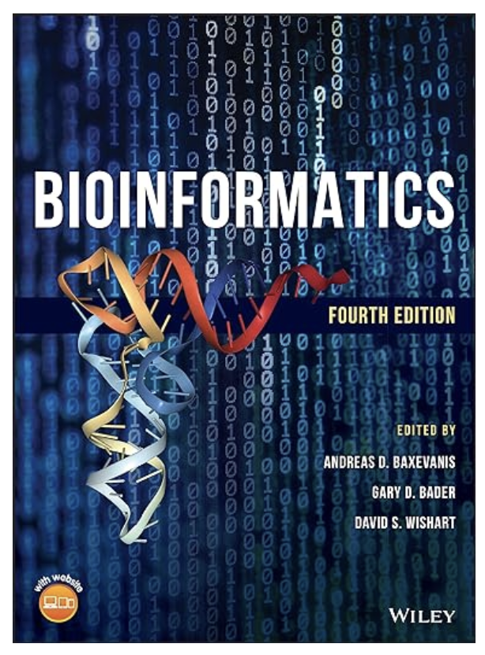
RECOMMENDED BOOKS and MATERIALS
Lecture ppts
Practical session materials
Online resources
Book:
Bioinformatics 4th Edition
Baxevanis et al. 2020

Slide 14
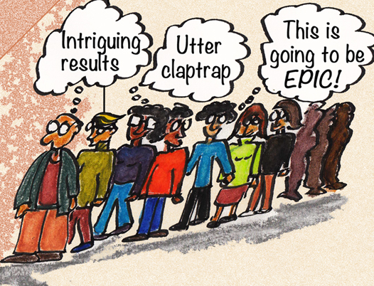

Group definition
Study and discussion in groups and with teachers
PPT Presentation 15 minutes
Collegial discussion
Scientific article choice
Journal club
In groups
Everyone participates
It is evaluated
Flipped classroom
Possible dates:
Thursday 4 and 10 December 2025

