Slide 1
A.A. 2025-2026
Master degree in Evolutionary Biology
School of Science
University of Padova
MOLECULAR METHODS and BIOINFORMATICS
Prof. STEFANIA BORTOLUZZI

Slide 2
Outline
Transcriptomics today
RNA-seq features and advantages
Transcriptome sequencing goals
Analysis pipelines

Slide 3
Transcriptome definition and dynamics
QUALITY
QUANTITY
The set of all RNA molecules produced in one cell, or in a population of cells, at a given time
Amount/concentration information is needed in addition to molecule identification
Identification of expressed RNA molecules
Expression level
  Development
  Differentiation
  Response to environment
  Disease
The transcriptome continuosly changes
  Transcriptome variation depends on:
    Genetic/epigenetic changes of the genome
    Emergent properties of the transcriptome itself as a complex system
  Many regulatory RNAs
  Many layers of genes expression regulation
Notes:
The transcriptome can be defined as the whole set of RNA molecules produced in one cell, or in a population of cells, at a given time.
So, the first information relevant to transcriptome characterization is linked to quality and it is the identification of expressed RNA sequences
The second aspect of transcriptome characterization is quantitative, and relies in the measurement of the expression level of each molecule
The transcriptome is highly dynamic and changes during development, differentiation...
The transcriptome varies in responses to changes in the genome state and to gene expression regulation, which is exerted at almost all levels of the complex gene expression pathway.
The transcriptome is a complex system with emergent properties not fully predictable by genome analysis.
In fact, many RNAs have regulatory roles.

Slide 4
>70% transcribed in “dark matter”
DNA
Transcription
Transcription
Alternative TSSs
Processing
RNA transcripts/precursors
Splicing
Nuclear export
Processing
Polyadenylation
Silencing
Editing
Editing
Turn-over
Turn-over
Trans-splicing
Sequestration
Sequestration
mRNA
ncRNA
Translation
miRNAs
snRNAs
lncRNAs
proteins
piRNAs
snoRNAs
circRNAs
Diverse functional roles for ncRNAs uncovered
siRNAs
tRFs
?
Notes:
Da transcibed dark matter a increase appreciation of the biological role or RNAs and integractions thereof
Concept of “transcribed dark matter”, i.e. transcripts with unknown function and meaning

Slide 5
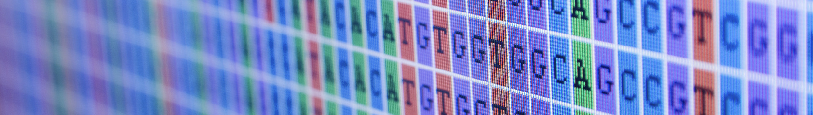
DNA and RNA seq
GENOME
TRASCRIPTOME
DE-NOVO
RE-SEQUENCING
LONG
SHORT
AMPLICON
EXOME
WHOLE
GENOME
CODING
NON CODING
miRNA
OTHER
Pros
Lot of data
High discovery power
Many applications
Cons
Lot of data
Complex analysis
Different biological questions

Slide 6
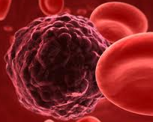
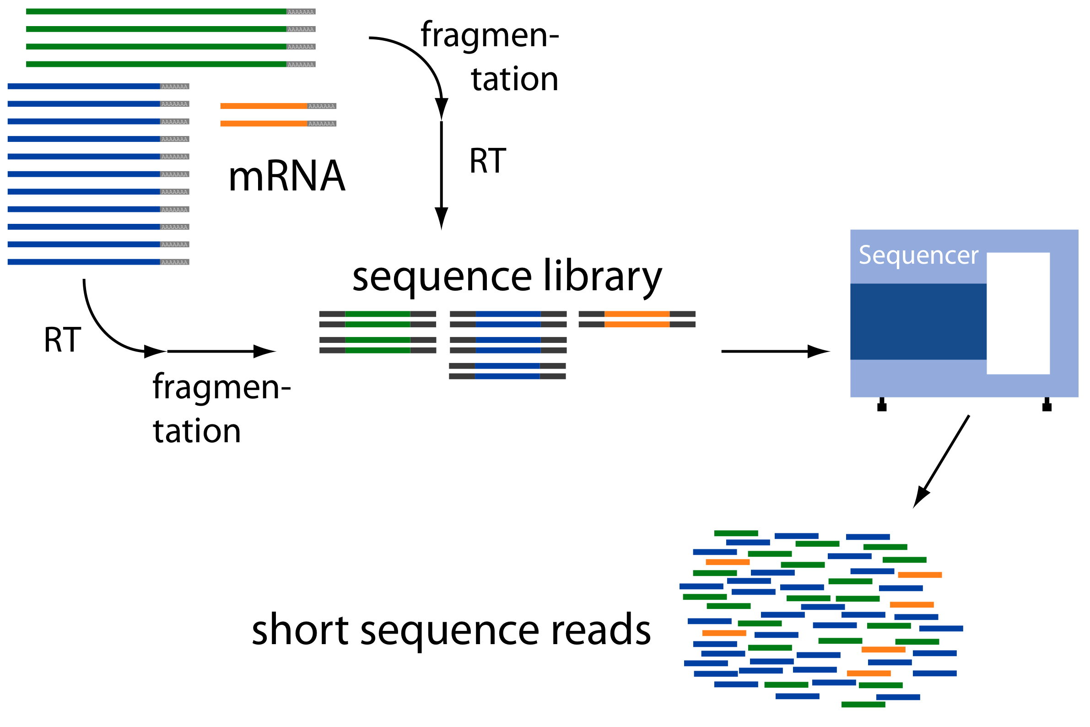
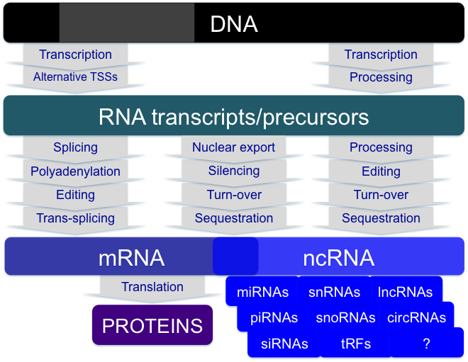
RNA-seq: cDNA sequencing using NGS
Cells/Biosamples
Library preparation
Sequencing
Computational analysis
To get information about a sample's RNA content
For reverse engineering the genome state
Notes:
The deep sequencing of cDNA is known as RNA-seq.
RNA-seq projects ground on RNA extraction from a biosample, cDNA library preparation and sequencing. The result of a sequencing run is, for each sample, a pool of many short sequences called reads. These reads are the starting point for extensive computational analyses to in some way go back in the processes I showed before, to get information about the RNA content of a sample and ultimately to reverse engineering the genome state.
to catalogue all species of RNA transcripts, but also to determine the transcriptional structure of genes, in terms of their start sites, 5′ and 3′ ends, splicing patterns and to detect other post-transcriptional modifications. The analysis of several samples from different cell types or states allows to quantify transcriptome dynamuycs under different conditions.

Slide 7
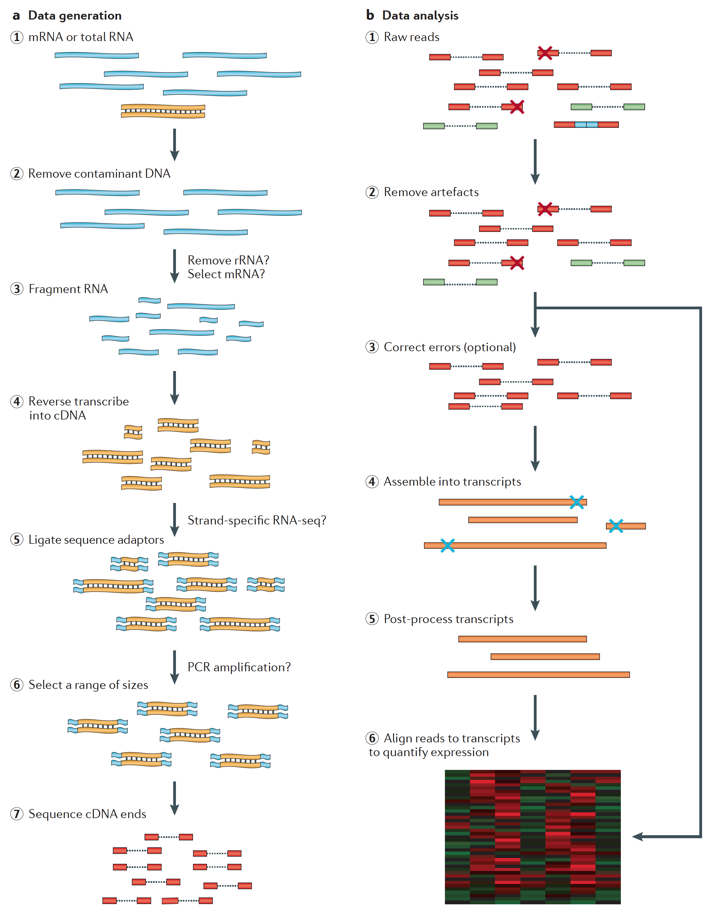
From RNA -> sequence data
DNA (fragmented) enters here
Martin J.A. and Wang Z., Nat. Rev. Genet. (2011) 12:671–682

Slide 8
Raw sequencing data are only the starting point for a long journey
Sequencing raw data processing, cleaning and filtering
Assembly
Reads mapping to reference sequence
Genome
Transcriptome
Annotation by similarity
Differential expression
Gene/transcript discovery
Post-processing
Variants
sRNAs
….
Notes:
Sequence reads are stored in a digitalized format in huge text Sequences are in FASTQ format including both DNA sequence and per base quality information
As for genomic sequences, DNA sequence is not informative per se…
…In fact raw sequencing data are only the starting point for a long journey. As you see in my outline, there are three main steps for RNA-seq data analysis
The first one regards raw sequencing data preprocessing, cleaning and filtering
The second step relies on reads mapping to reference sequences. Normally, the genome sequence is used as reference for mapping but also the known transcriptome can be used. Indeed, reads can be first assembled and then obtained longer consensus sequences can be mapped to genome.
The the post-processing phase starts with genome-mapping data and can comprise more or less complex and customized analyses, to answer several questions focusing for instance on differential expression, on discovery of new expressed elements, on variants calling or on smallRNAs

Slide 9
Advantages of RNA-seq:
- wide expression range
- better estimation
Expression (Log₁₀ scale)
Expression
7 orders of magnitude
Spearman correlation | 0.59
Log2 RNA-seq
RNAseq-based (read count)
Different samples, same classes: CTR-BM, PMF
Many miRNAs are weakly expressed
Mean expression values per class and per technique
ARRAYS: larger sample size
sRNAseq: larger range in expression estimates
Log2 Array-based
4 orders of magnitude
Array-based
Notes:
RNA-seq has considerable advantages over microarrays
First of all it measures expression in a wide range
Here you see a scatterplot showing gene expression estimated obtained using Affymetrix arrays (in abscissa) and using read count from RNA-seq data (in the ordinate).
The values are positively and significantly correlated but you can see that RNA-seq can quantify gene expression in a range spanning many orders of magnitude, with a precision proportional to the achieved sequencing depth.
More important, when a gene is highly expressed according to arrays, it is so also in RNA-seq data, but differently a considerable group of genes that are scored as weakly expressed according to array estimation, are scattered over the whole range of read counts.

Slide 10
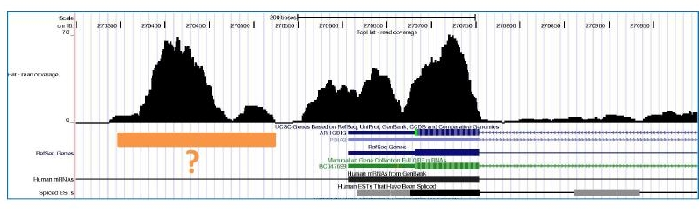
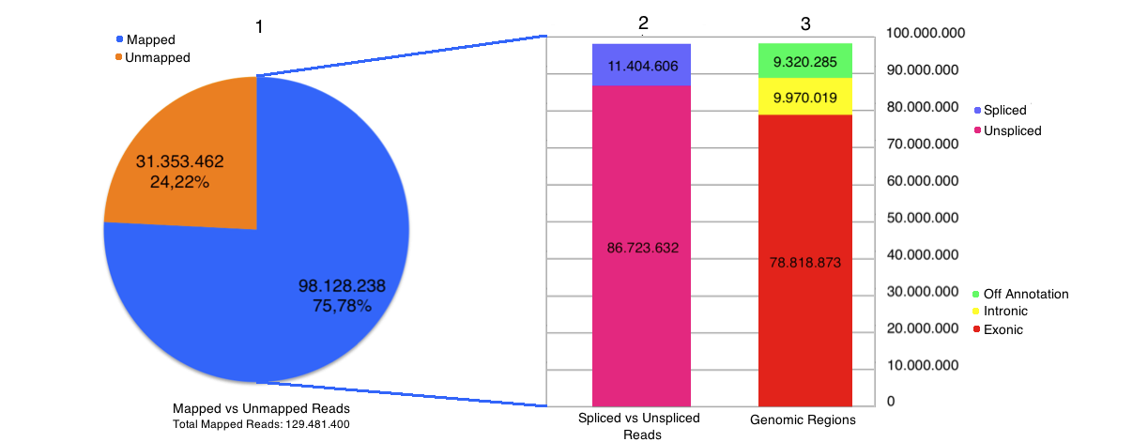
Advantages of RNA-seq: discovery power
New exon? This is not possible using microarrays
A typical read
mapping result
after integration
with gene
annotations
RNA-seq <sample
≈130,000,000 reads
Notes:
In the picture you see a region of the human genome, visualised using the UCSC Genome Browser.
The region we are showing contains the first part of a known gene.
The thick line is the first exon of the gene and the thin line is the first intron.
On the top, the black mountains you see are basically a barplot showing the per base coverage of RNA-seq reads mapped to the region
We can appreciate that the gene is expressed in the considered sample, in fact exon one is covered by many reads.
Moreover, the region upstream the annotatated exon is also covered and we have identified a possible new expressed element being an additional exon of the gene or part of an overlapping gene.
Definitly this is not possible with microarrays, and the example illustrates the discovery power of RNA-seq

Slide 11
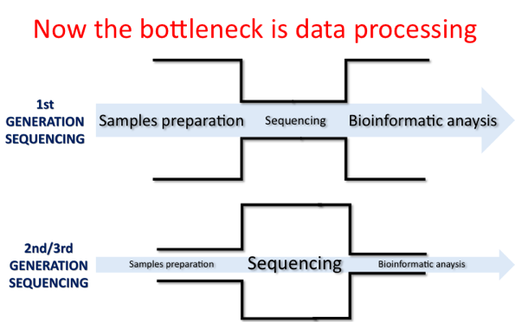
NGS for transcriptomics: features
Many data … Illumina HiSeq → 400 million reads/lane
Short reads … (≅100 nt) much shorter than most elements of interest
High error rate … with rate and type depending on technology
Several protocols for library preparation … with different purposes and possibly introducing biases
Strand specificity
Uneven sequencing coverage… compared to genome-seq
Notes:
Amplification-free protocols
ploy A enrichment
Strand-specific protocols

Slide 12
RNA-seq comes in different flavours
  Experimental Design
  Poly(A) enrichment or ribosomal RNA depletion?
  Single-end or Paired end?
  Stranded or not?
  How much sequencing data to collect?

Slide 13
What is your aim?
  Transcriptome assembly: remove all ribosomal RNA (and maybe enrich for only polyA+ transcripts)
  Differential gene expression: enrich for Poly(A)
    BUT – If you are aiming to obtain information about long non-coding RNAs or circular RNAs use Total RNA
  Metatranscriptomics: remove all the host materials
    Remove rRNA by molecular methods prior to sequencing
    Remove host mRNA by computational methods post-sequencing
PolyA enrichment vs Total RNA?
Selected RNA removal?
Ribosomal RNA removal (ribodepletion)?

Slide 14
  Technical replicates
    Illumina has low technical variation unlike microarrays
    Technical replicates are unnecessary
  Batch effects
    Best to sequence everything for an experiment at the same time
    If you are preparing the libraries, be consistent & make them simultaneously
  Biological replicates
    This is essential for your experiment to have any statistical power
    At least 3, but the more the better (power analysis)
  For transcriptome assembly
    RNA can be pooled from various sources to ensure the most robust transcriptome
    Pooling can also be done after sequencing, but before assembly
  For differential gene expression
    Pooling RNA from multiple biological replicates is usually not advisable
    Only do so if you have multiple pools from each experimental condition

Slide 15
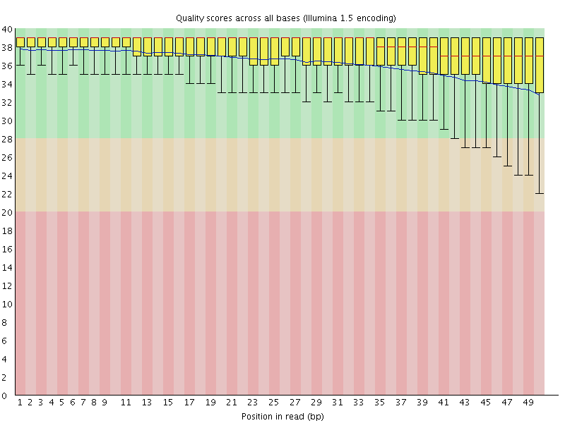
Transcriptome Analysis - Quality Check
  FastQC is a great tool that enables the quality assessment
Good quality!

Slide 16
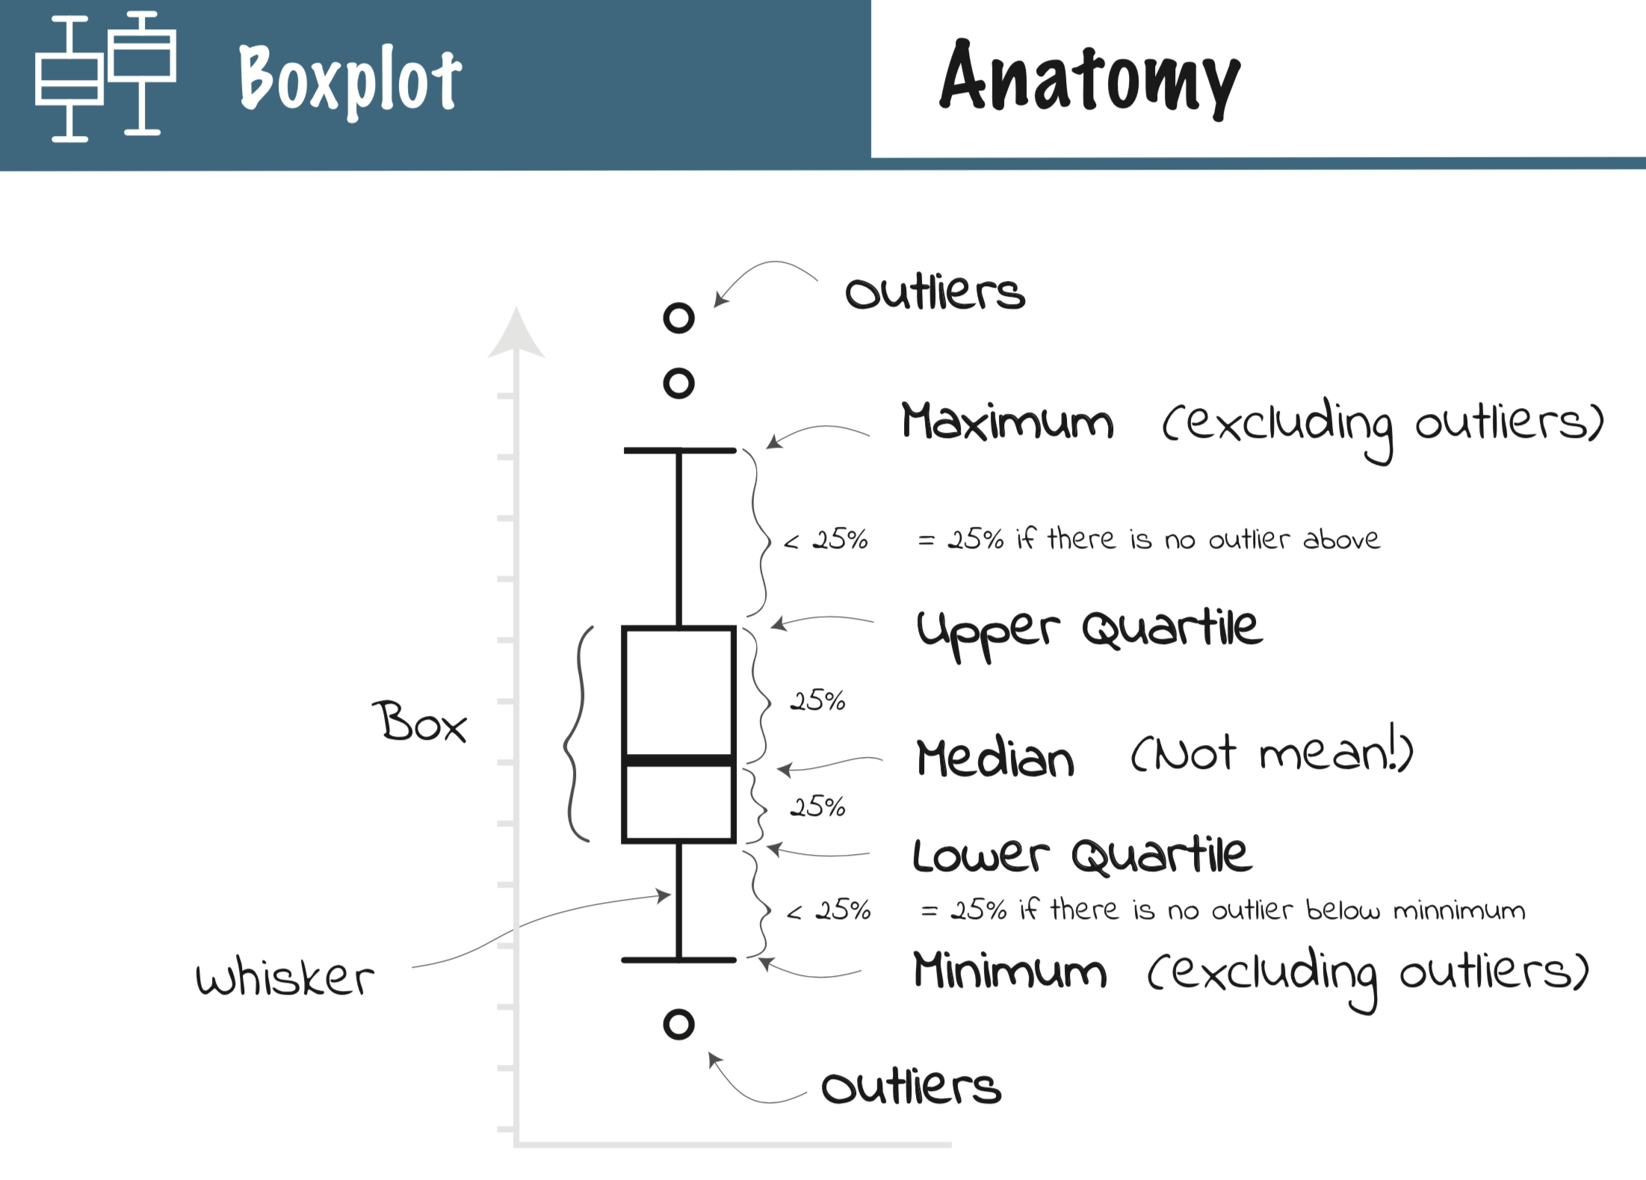

Slide 17
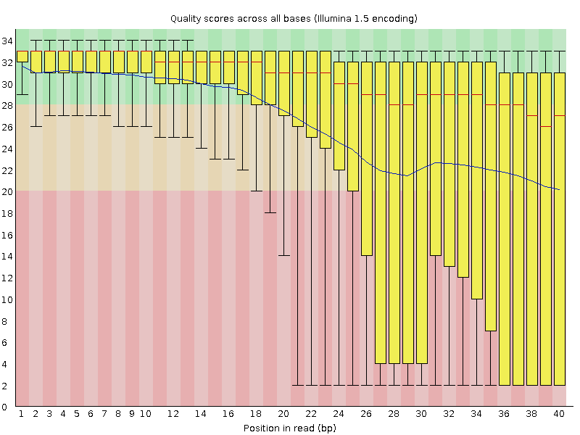
Transcriptome Analysis - Quality Check
  FastQC is a great tool that enables the quality assessment
Good quality!
Poor quality!
  Poor quality at the ends → “quality trimmers” like trimmomatic, fastx-toolkit, …
  Left-over adapter sequences in the reads must be removed
  After trimming: rerun the data through FastQC to check the resulting data

Slide 18
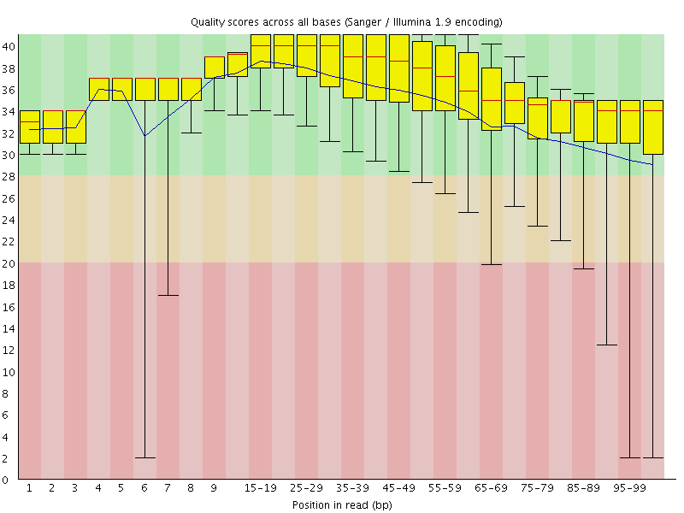
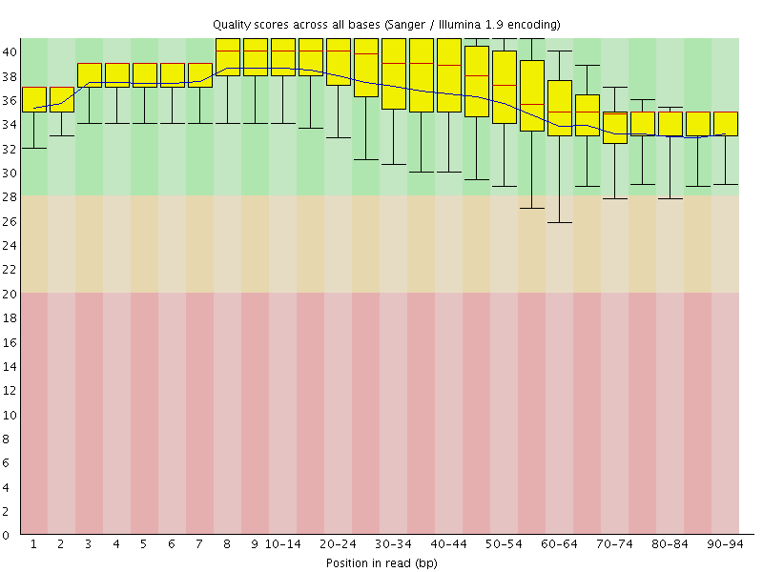
Transcriptome Analysis
Quality Checks
Before quality trimming
After quality trimming

Slide 19


Available reference genome?
YES
NO
Reads to genome mapping for transcriptome reconstruction
De novo transcriptome assembly

Slide 20
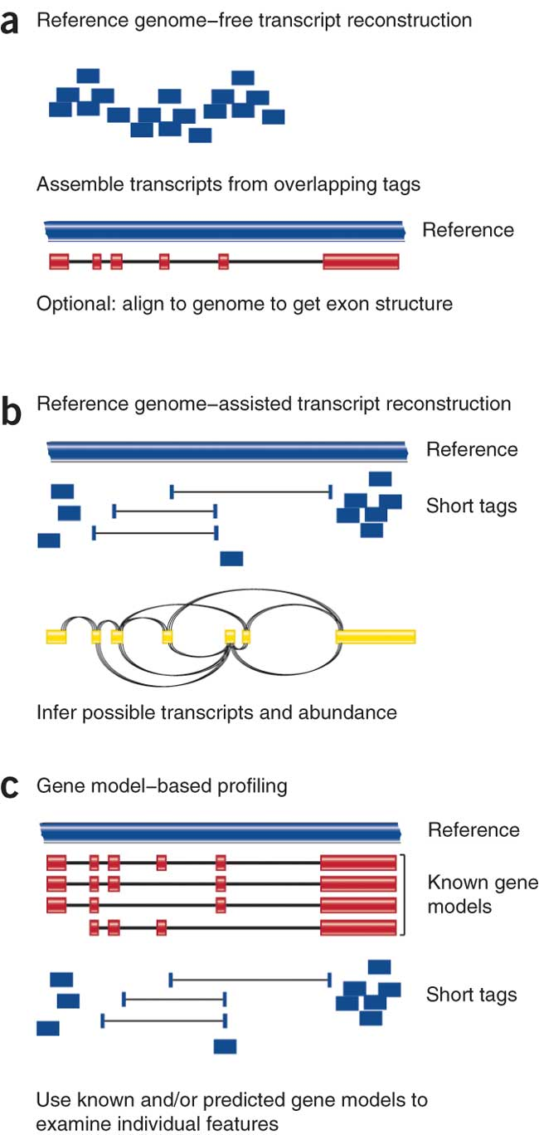
Three RNA-seq mapping strategies
De novo assembly
Align to transcriptome
Align to reference genome
Diagrams from Cloonan & Grimmond, Nature Methods 2010

Slide 21
RNA-seq read to genome mapping is complex
Mapping: arranging and aligning the reads to a reference sequence (reference not from the same individual)
E.g. TopHat, BWA, GSNAP, STAR
Read mapping
RNA-seq data
Reference genome
+ annotations
RNA
AAAAAAAA
Genome
RNA-seq reads can be spliced
spliced reads are informative
Notes:
As you know, when a transcript sequence is aligned to the genome, it splits in many exons separated by large introns
Reads are short produced by fragmentation and sequencing of transcripts.
Reads can then align to the genome in two ways
Some on them can map inside a single exon
Other reads can span exon-exon junction and thus align to the genome only if split into two parts and aligned allowing large gap alignments
Anyway, spliced reads are particularly informative since they are useful for transcript isoform reconstruction

Slide 22
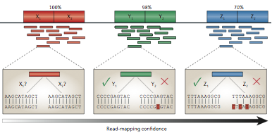
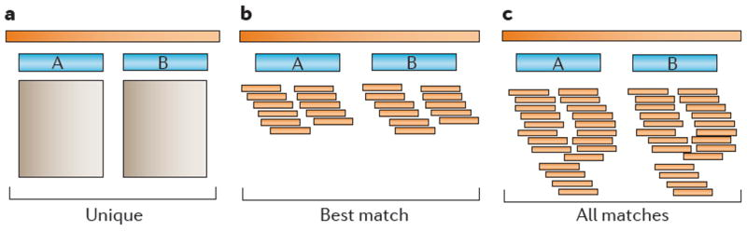
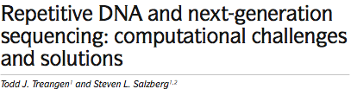
Repetitive sequences: the “multiple mapping” problem
50% of the human genome is repetitive
Large gene families share similar sequences
Evolutionary recent paralogs
Segmental duplications
NGS cleaned read length <100 bp
Split reads
The higher the similarity within the repeats, the lower the read mapping confidence
Different strategies for multi-mapping reads threatment deeply change the final result
Notes:
Large eukaryotic genomes are highly repetitive.
Repeat sequences take up about one half of the human genome which contains as well large gene families sharing more or less similar regions.
Besides, recent parlog genes can be very similar since they had not ime to diverge after duplication
On the other hand, reads are shorter than 100 nt and splitted reads are much shorter

Slide 23
Paired-end sequencing
Paired-end reads are a couple of reads derived from the same molecule, with known distance between the reads
100 nt
200-800 nt
100 nt
Single-end read
Read1
ATGTTCCATAAGC…
Paired-end reads
Read1
ATGTTCCATAAGC…
Read2
CCGTAATGGCATG…

Slide 24

Paired-end sequencing
Paired-end reads are a couple of reads derived from the same molecule, with known distance between the reads
100 nt
200-800 nt
100 nt
Reference
Repeats
Since it is improbable that both reads align to repetitive regions
paired-end reads reduce the “multiple mapping” problem
Notes:
With different sequencing technologies it is possible to use the paired-end sequencing approach to obtain a pair of short reads corresponding to both ends of the same DNA molecule.
Thus paired reads are separated in the original sequence by a defined distance
…

Slide 25
Paired-end sequencing
Paired-end reads are a couple of reads derived from the same molecule, with known distance between the reads
Paired ends increase isoform deconvolution confidence
P₁ originates from isoform 1 or 2 but not 3.
P₂ and P₃ originate from isoform 1
100 nt
200-800 nt
100 nt
P₁
P₂
P₃
Isoform 1
Isoform 2
Isoform 3
Notes:
Paired end reads are also useful for the process of alternative transcripts deconvolution.
As in my example, a small set of paired-end reads mapped to the same gene can tell us from which isoforms they come from.
Due to the position on the second read, this on the left the read pair number one may originate from isoform 1 or 2 but not from 3
Moreover, P2 nd P3 can originate only from isoform 1

Slide 26
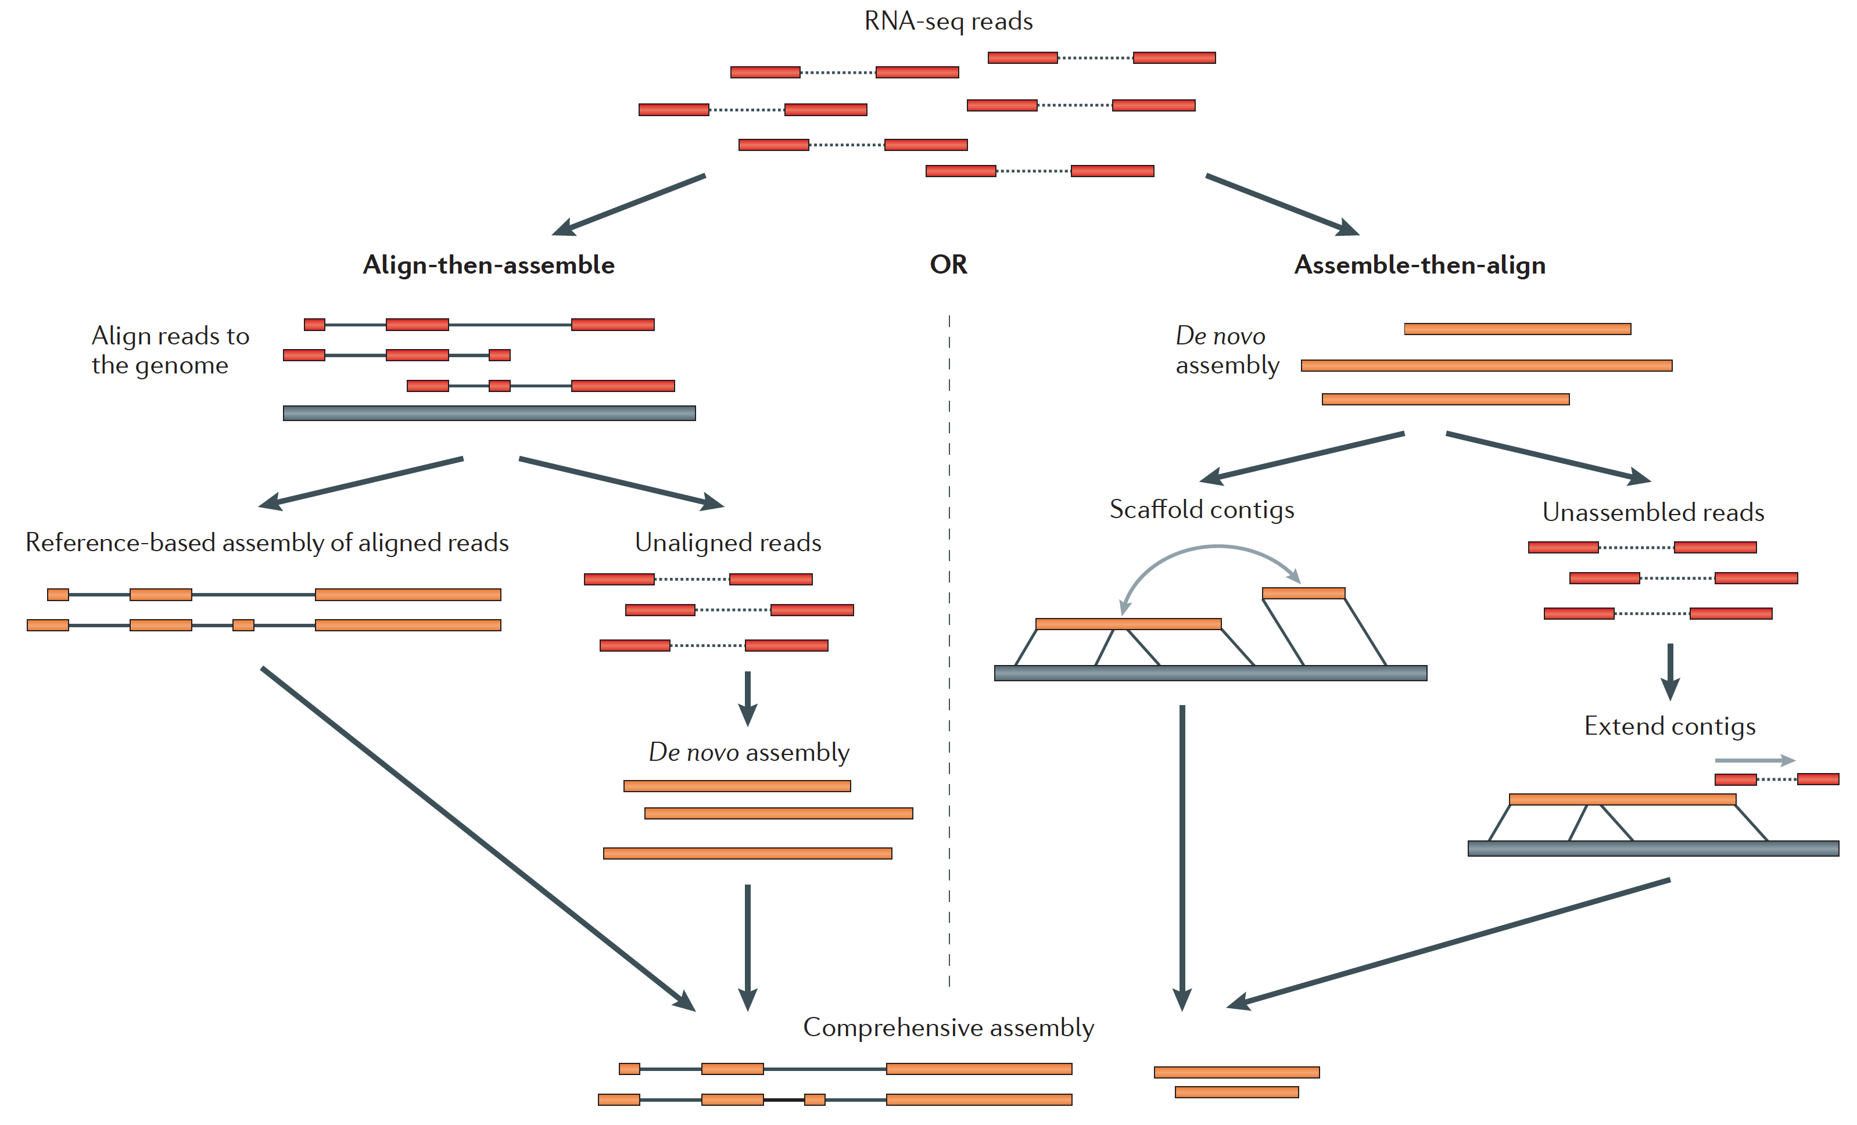
Reference-based transcriptome assembly
De novo transcriptome assembly
Martin J.A. and Wang Z., Nat. Rev. Genet. (2011) 12:671–682
Notes:
Transcriptome assembly, de novo, reference-based
http://trinityrnaseq.sourceforge.net/

Slide 27
Reference-based transcriptome assembly
Used when the genome sequence is known
  Transcriptome data are not available
  Transcriptome information is available but not good enough,
    i.e. missing isoforms of genes, or unknown non-coding regions
  The existing transcriptome information is for a different tissue type
  Cufflinks and Scripture are two reference-based transcriptome assemblers

Slide 28
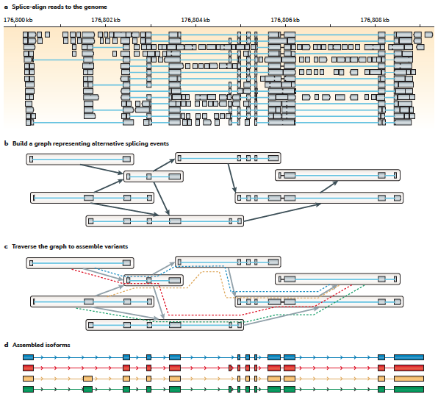
Reference-based transcriptome assembly
Martin J.A. and Wang Z., Nat. Rev. Genet. (2011) 12:671–682

Slide 29
Cufflinks
Cufflinks assembles transcripts, estimates their abundances, and tests for differential expression in RNA-Seq samples
Aligned RNA-Seq reads are assembled into a parsimonious set of transcripts
The relative abundances of transcripts are estimated based on how many reads support each one
Sequence-specific biases, introduced during the library preparation, that challenge the assumption of uniform coverage, are corrected
Multiple mapping of reads is taken into account
Notes:
To estimate isoform-level abundances, one must assign fragments to individual transcripts, which may be difficult because a read may align to multiple isoforms of the same gene.
sequence-specific biases which are caused by primers used either in PCR or reverse transcription.

Slide 30
De novo transcriptome assembly
Used when very little information is available for the genome
  Often the first step in putting together information about an unknown genome
  Amount of data needed for a good de novo assembly is higher than what is needed for a reference-based assembly
  Can be used for genome annotation, once the genome is assembled
  Trinity, Oases, TransABySS, are examples of well-regarded transcriptome assemblers
Notes:
Transcriptome assembly, de novo, reference-based
http://trinityrnaseq.sourceforge.net/

Slide 31
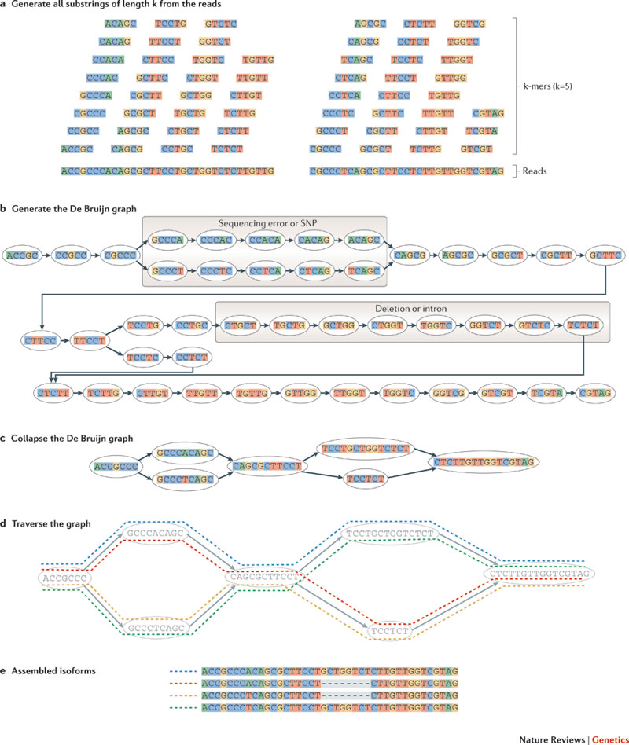
De novo transcriptome assembly
(De Bruijn graph construction)
Martin J.A. and Wang Z., Nat. Rev. Genet. (2011) 12:671–682

Slide 32
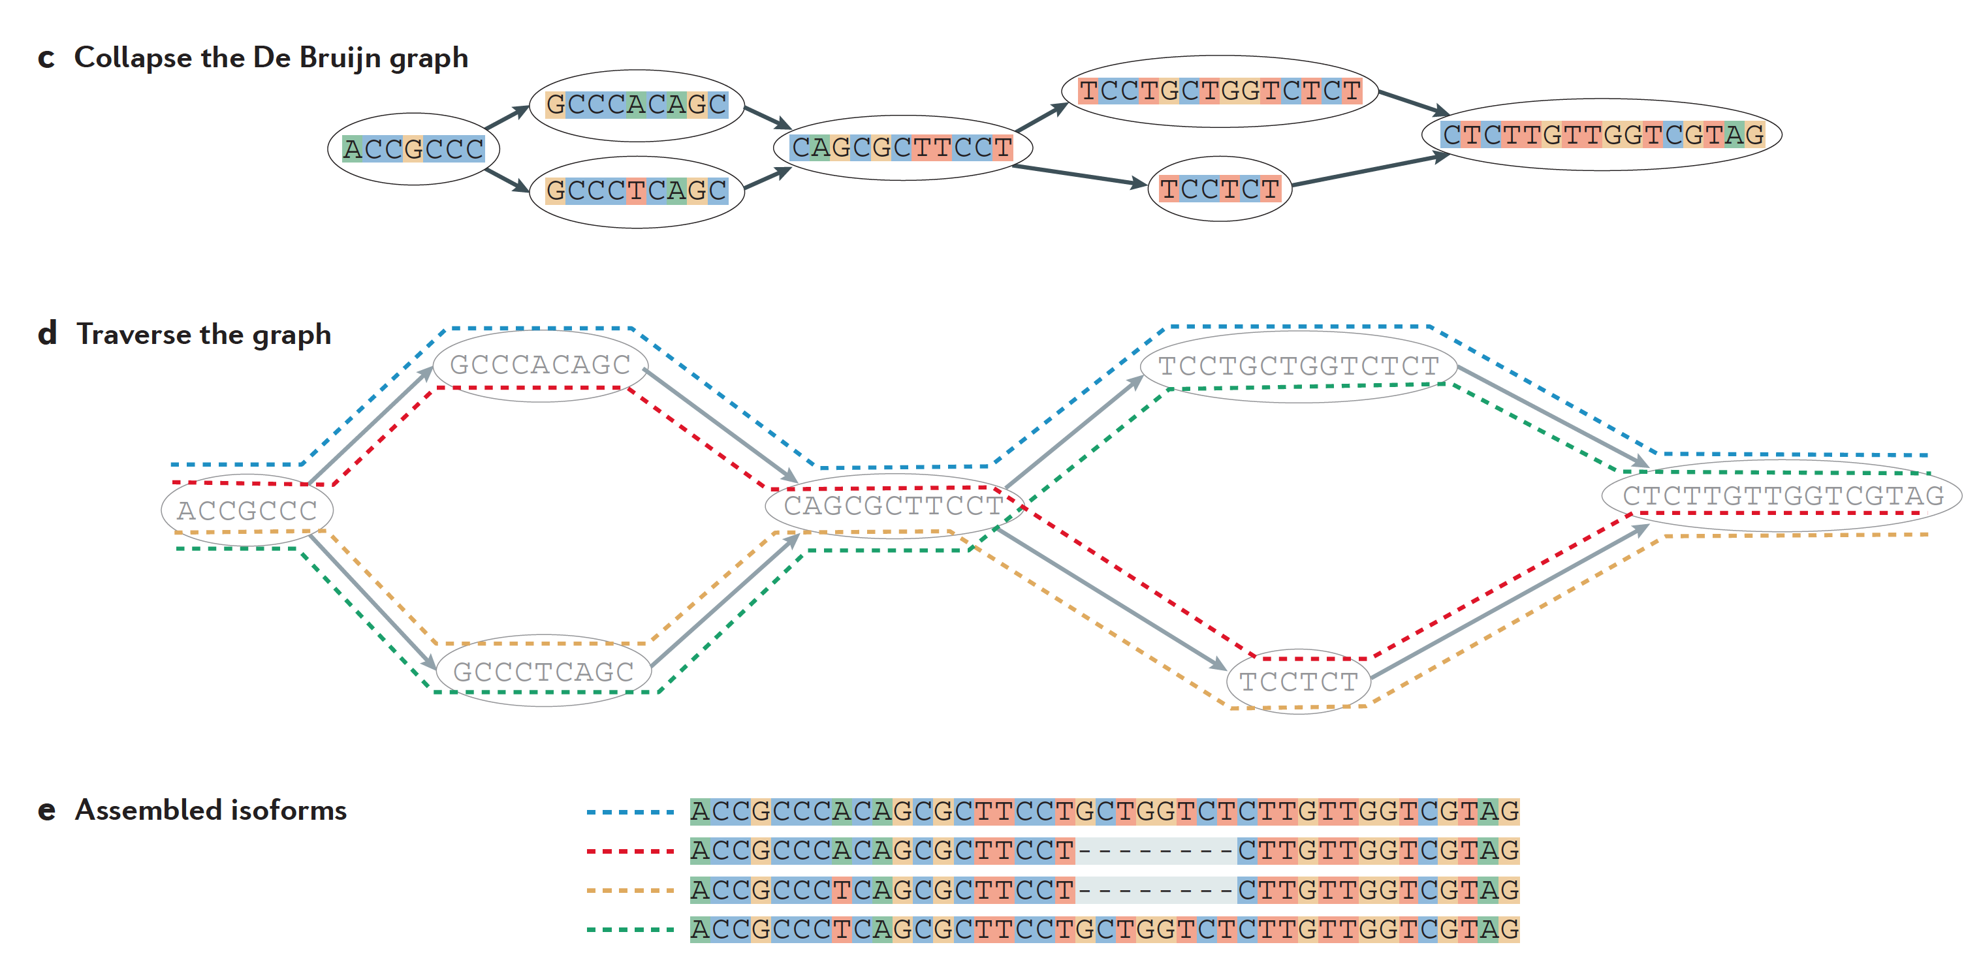
De novo transcriptome assembly
Martin J.A. and Wang Z., Nat. Rev. Genet. (2011) 12:671–682

Slide 33
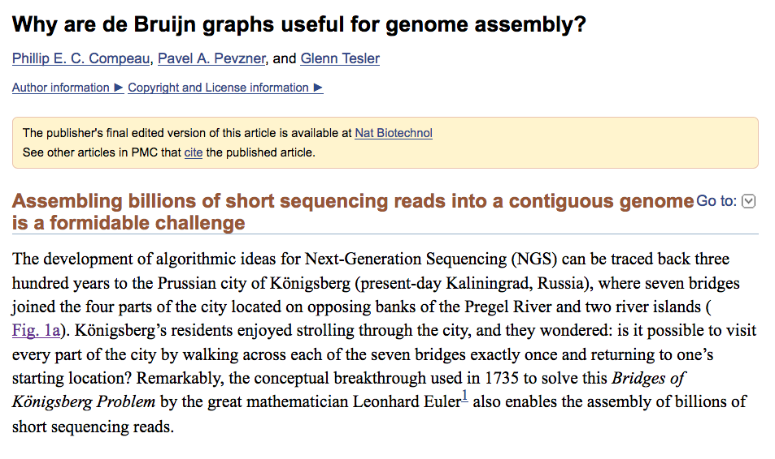
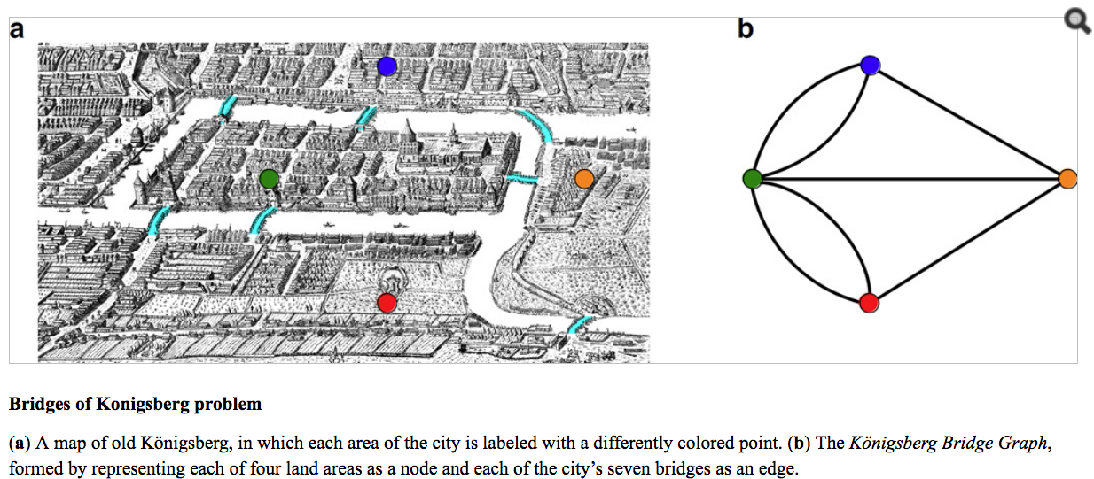

Slide 34
In 1946, the Dutch mathematician Nicolaas de Bruijn became interested in the Superstring Problem: find a shortest circular superstring that contains all possible substrings of length k (k-mers) in a given alphabet.
There exist n^{k} k-mers in an alphabet containing n symbols: for example, given the alphabet {A,T,G,C}, there are 4³ = 64 trinucleotides.
If our alphabet is instead {0,1}, then all possible 3-mers are simply given by all 3-digit binary numbers: 000, 001, 010, 011, 100, 101, 110, 111.
The circular superstring “0001110100” not only contains all 3-mers but is also as short as possible, since it contains each 3-mer exactly once.
But how can one construct such a superstring for all k-mers in the case of an arbitrary k and an arbitrary alphabet? De Bruijn answered this question by borrowing Euler’s solution of the Bridges of Königsberg Problem → De Bruijn graphs

Slide 35
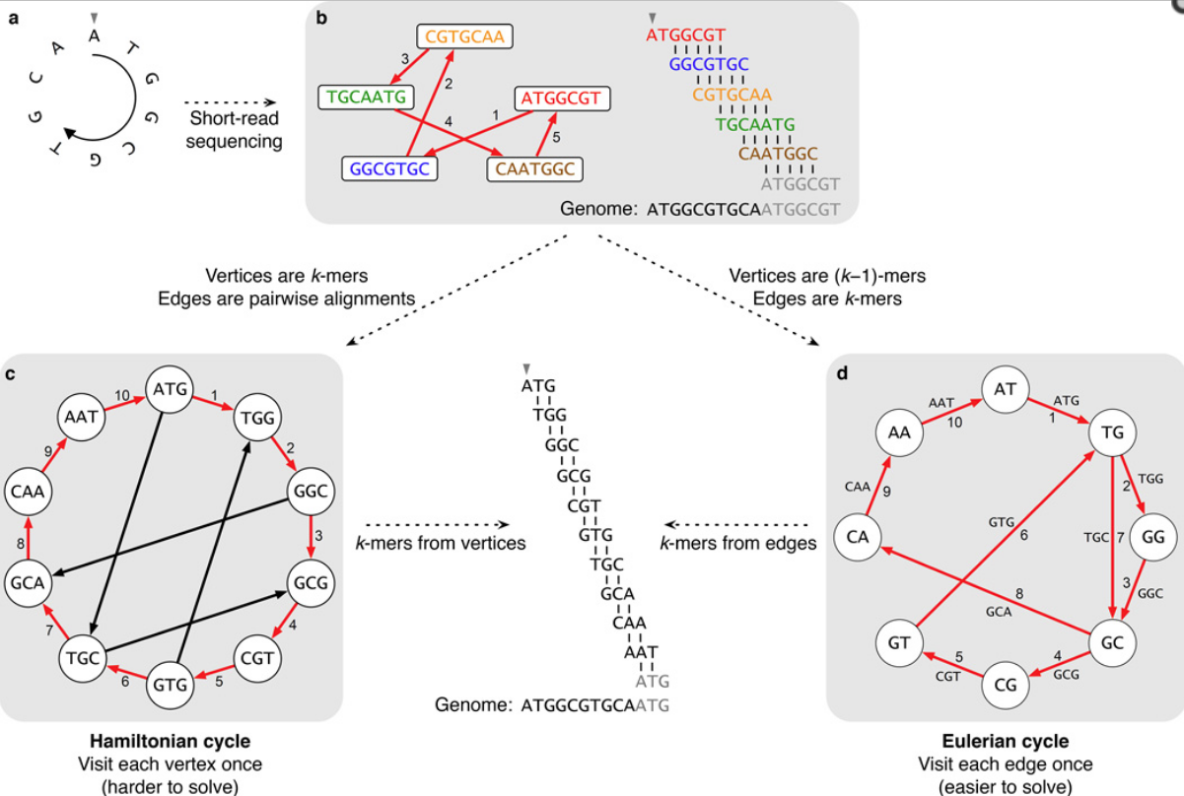
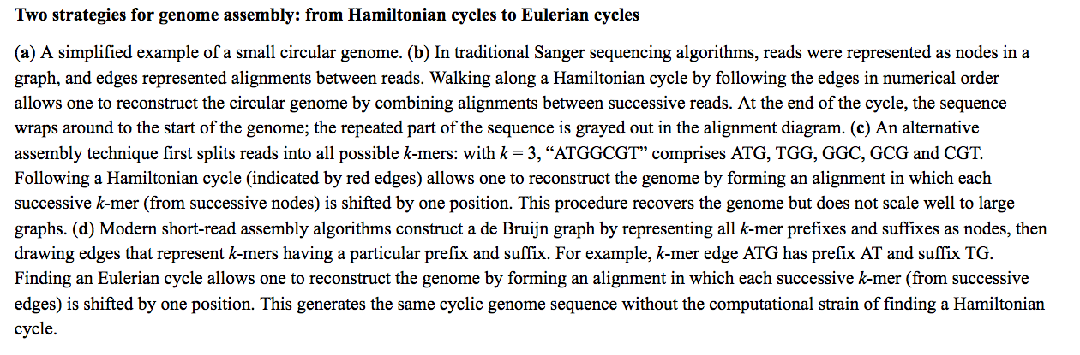

Slide 36
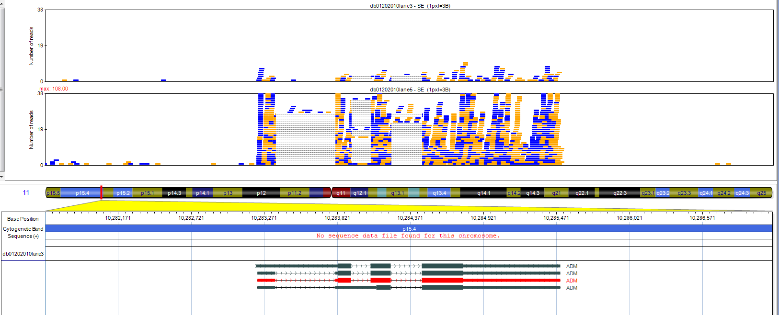
Differential expression (DE)
Condition 1
Condition 2
Best methods to discover DE are coupled with sophisticated approaches to normalization
E.g. DESeq, EdgeR, Cufflinks
Ignoring very low expressing genes is recommended: RPKM<1
Notes:
This is a basic example of a gene with is differentially expressed when comparing condition 1 and 2.
The known gene is shown below, whereas the reads mapping results in the two conditions are shown on the top
The gene is more-expressed in condition 2 since it has more reads mapped
Read-count data have a statistical distribution very different than microarray estimates, and need to be normalised using appropriate methods.
Specific methods as DESeq are also need to call differential expression
Moreover, it is highly recommended to filter out signals that can be very close to background noise.
For instance, over one half of the 200 thousands Ensembl transcripts can be expressed in a sample but only a small proportion of highly expressed RNAs will account for the most of expression whereas many transcript will be covered by only a few reads each

Slide 37
Count-based gene expression quantification
Longer transcripts have higher counts → Length bias, an intra-sample bias
Different experiments have different yields → inter-samples bias.
Normalization is required:
Reads Per Kilobase of exonic sequence per Million mapped reads
(Mortazavi et al Nature methods 2008)
Non uniform coverage in different exons
Reads sharing among transcripts
Multiple mapping problem
    Overlapping genes
Notes:
Gene expression level can be quantified using read-count data. The basic idea is that the more a gene is expressed the more numerous will be the reads sequenced from gene transcripts and then mapped to gene exons.
The longer the transcripts the higher the probability of having reads from them
Since different samples will generate different numbers of total sequences, both intra sample and inter-sample normalization is required
A simple normalisation is obtained by calculating the number of reads per kilobase of exonic sequence per million mapped reads, the RPKM measure which is a proxy of gene expression estimated by RNA-seq data.
There are many issues complicating gene or transcript expression level estimation

Slide 38
Differential expression
What genes/transcripts are differentially expressed in various test conditions?
  The first step is proper normalization of the data
  In general, RNA-Seq data do not follow a normal (Poisson) distribution, but follow a negative binomial distribution –> need of a statistical program that makes the correct assumptions
  EdgeR, DESeq, other R/Bioconductor packages for DE detection

Slide 39

Gene fusion events
Relevant for cancer pathogenesis, and as diagnostic and therapeutic targets (e.g. imatinib)
Mitelman DB 2015
Chromosome Aberrations and Gene Fusions in Cancer
Cases = 65,388
Gene fusions = 2,327
Specific fusions in thyroid tumorigenesis
The genome can be highly rearranged in tumours
Only a fraction of rearrangements might alter transcription
PTC
RET/PTC1
FTC/FVPTC
PAX8-PPARG
RET/PTC3
Notes:
Gene fusion events, due to breackage and re-joining of two different chromosomes or to rearrangements within a chromosome are relevant for cancer pathogenesis and threatment
Besides the BCR/ABL1 fusion in CML, many different gene fusion events are known in haematologic malignancies and in solid tumours.
Nevertheless cancer cell genome can be not higly rearranged
BCR/ABL1 fusion in CML chronic myelogenous leukemia t(9;22) proliferation independent by cytokines
RET/PTC → PTC
PAX8-PPARG in altri istotipi follicular architecture-follicular thyroid carcinoma (FTC) and follicular variant of papillary thyroid carcinoma (FVPTC),
RET receptor tyrosine kinases
PAX8 Transcription factor for the thyroid-specific expression of the genes exclusively expressed in the
thyroid cell type, maintaining the functional differentiation of such cells
tumori maligni in cui uno dei tre enzimi bloccati da imatinib (ABL, KIT, PDGFR) è coinvolto nell'origine del tumore.
Azione inibendo enzimi ad attività tirosin-chinasica

Slide 40
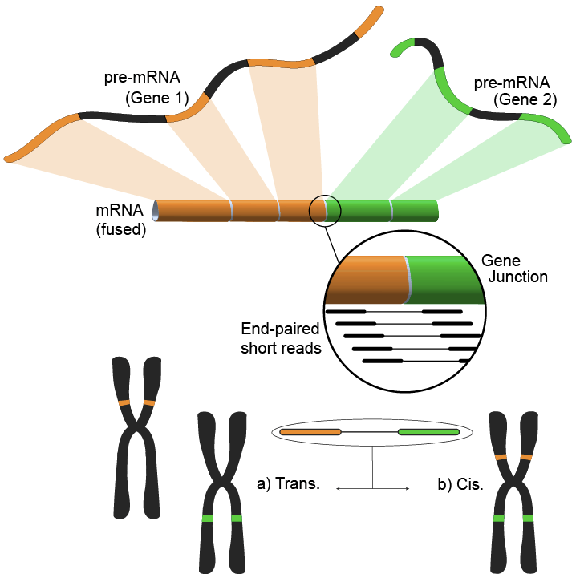
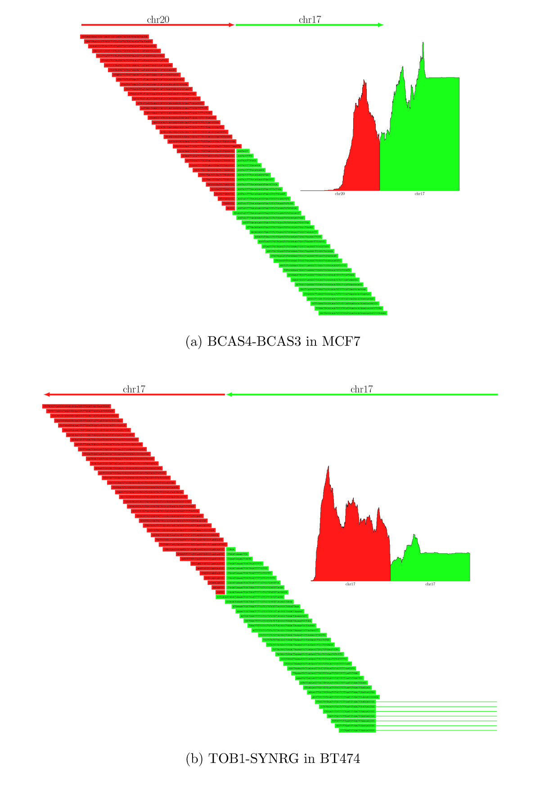

RNA-seq can identify expressed fusion transcripts likely to be functional or causal of disease
Identification of gene fusion events bejond annotated exons, in new genes, is also possible E.g. TopHat fusion, deFuse
Normally splice aligners require reads mapping in the same chromosome, with a fixed maximal distance
Notes:
RNA-seq can identify expressed fusion transcripts likely to be functional or causal of disease
Identification of gene fusion events bejond annotated exons, in new genes, is also possible
As I showed before read-to genome mapping normaly requires that read fragments map within a relatively small region of a single chromosome
The identification of fusion teanscripts relies on specific methods

Slide 41
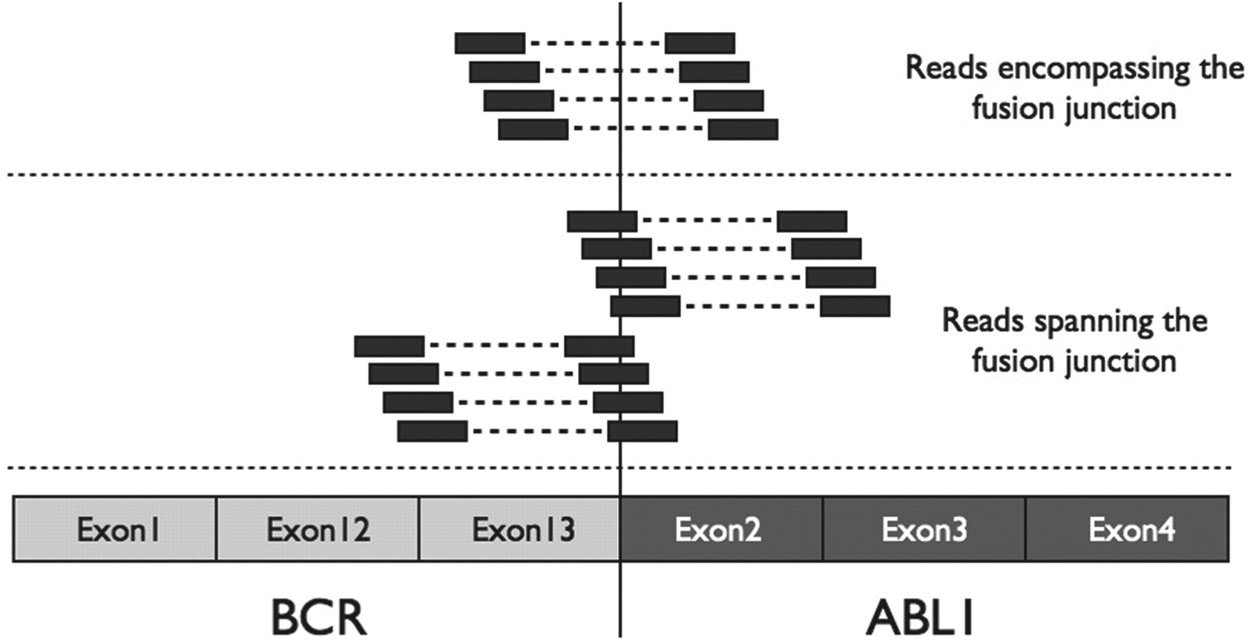
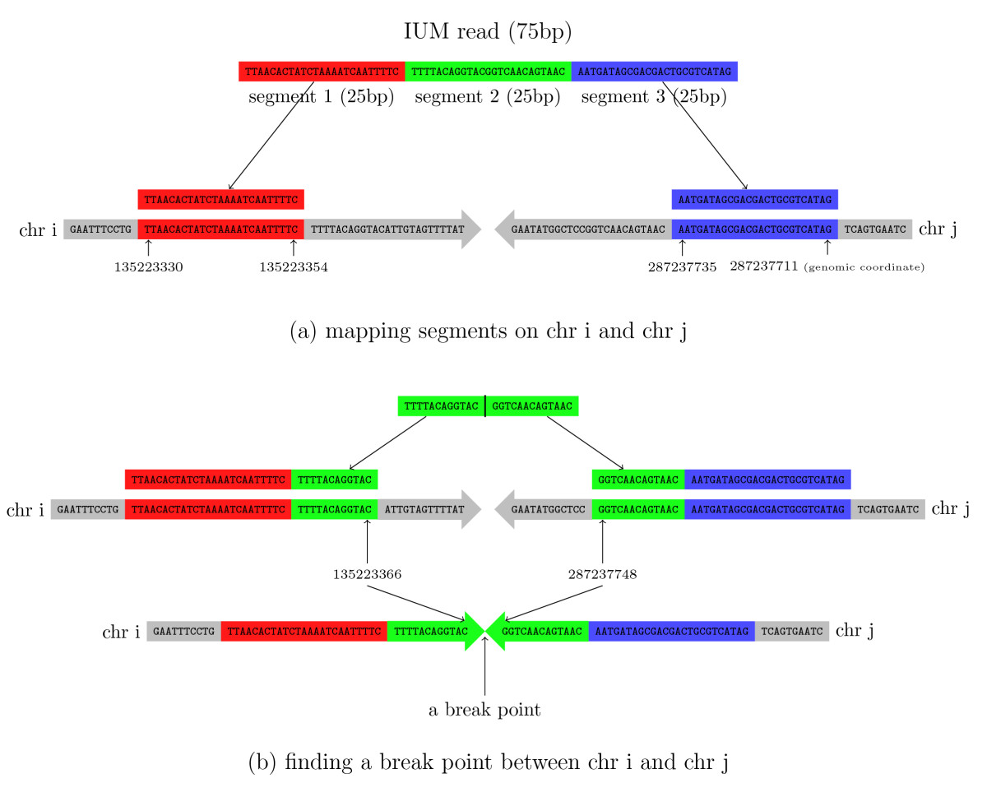
The detection of fusion events relies on unmapped reads
Reads encompassing the fusion junction
Identify gene fusion candidates
Reads spanning the fusion junction
Define the exact boundary sequence
Abate F et al. Bioinformatics 2012
Read to genome mapping
IUM reads are splitted into fragments
Fragments are mapped separately
Two terminal fragments map to different chromosomes
The unmapped central fragment is used to find the precise fusion point
Initially Unmapped Reads (IUM)
Kim & Salzberg Genome Biol 2011
Notes:
The group of reads not mapped by canonical methods are the starting point for fusion trasncripts detection and charachterization
Reads encompassing the fusion junction allow to indentify involved genes
Whereas the reads spanning the junction define the exact boundary
Fusion transcripts detection methods rely basically to splitting into fragments the group of unmapped reads. If two terminal fragments of a given read map to different chromosome (or to far regions) the central par is used to define the boundary
With these methods the problem is the specificity, since they are based on mapping of very short fragments
False positives are reduced by
Considering alignment quality
Considering both supporting and conflicting reads
Evaluating multiple mapping reads
Anchoring to a known gene at least one side of a fusion
Requiring uniform coverage of a window centered in a fusion point

Slide 42
Small RNA-seq enables the discovery and profiling of microRNAs and other small RNAs
Biosample
RNA preparation
Size selection (< 40 nt)
deep sequencing (25 nt)
Illumina, SOLiD, IonTorrent
unmappable reads
map reads to genome
Bowtie, SHRiMP
Filter reads mapping to repetitive DNA
repeat sequences
Known miRNAs quantification
New miRNA*s
New moRNAs
Known miRNA precursors
miR&moRe
New miRNAs
miRNA precursor prediction
miRDeep2
Notes:
RNAs come in a wide range of sizes
RNA-seq of small RNAs gounds on size selection during library preparations Then, specifically tailored analyses allows obtaining short reds mapping to the genome or to known miRNA precursors to attain miRNA identification, quantification and characterisation but also to discover new small RNAs

Slide 43
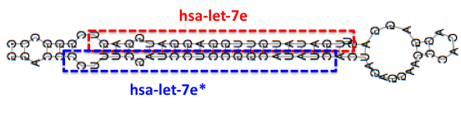
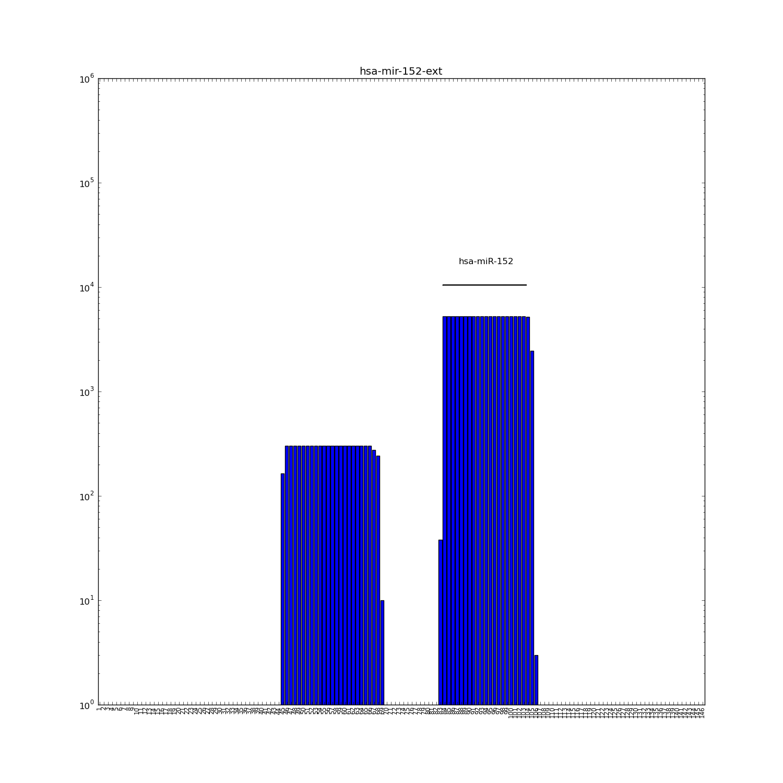

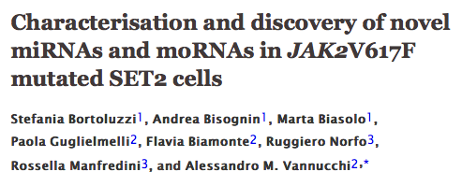
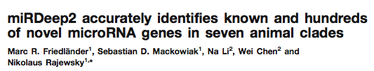

Small RNA-seq: main results
Discovery of hundreds of new miRs -> 2042 matures in miRBase v.19
Importance of miR*
Discovery of miRNA sequence variability (isomiRs)
Evidences of non-canonical miRNA biogenesis
Sister miRNA pair (miR/miR*)
Reads to hairpin locus alignment
Known miRNA
Expression quantification
New miRNA* discovered
and quantified
Expression (log₁₀ of read count
nt of hairpin locus
I-BFM
2013
Notes:
Small RNA-seq intruced a revolution in the microRNA field with hudreds of new miRNAs discovered in last years.
Part of new miRNAs uncovered were expressed from the so called passenger strand of a knwon hairpiun and now we knwow that both sister miRNAs are importnat and can be concurrently expressed

Slide 44
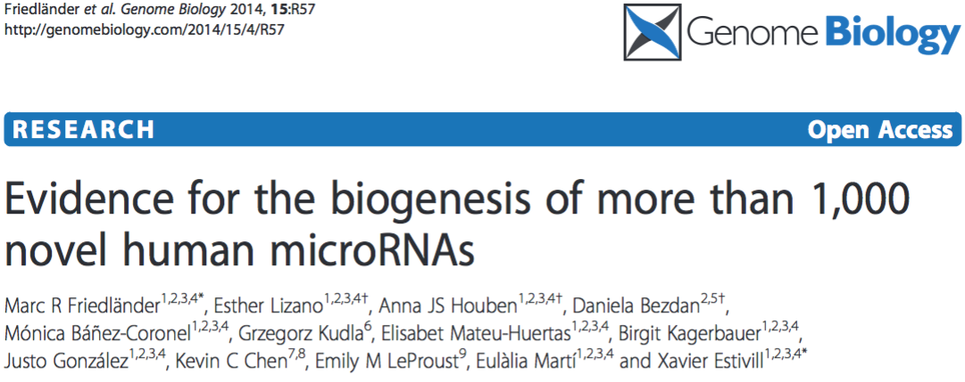
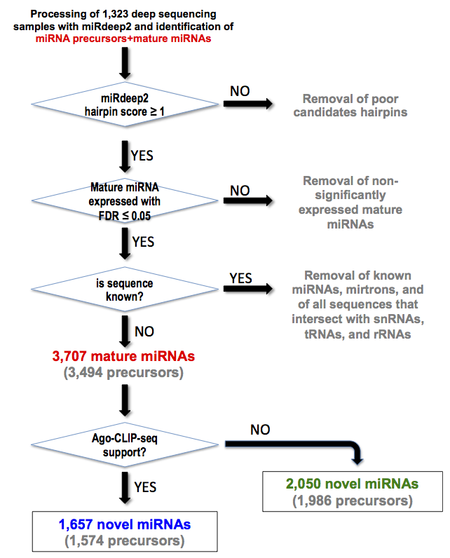
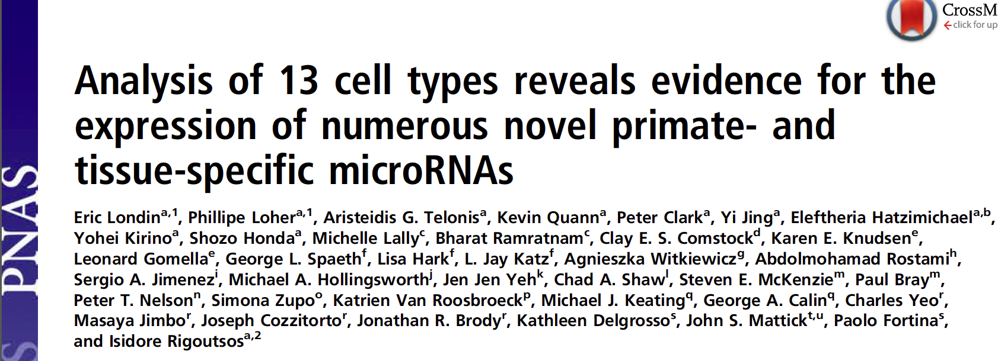
A large-scale small RNA-seq study recently doubled the miRNA repertoire
Support of novel miRNAs by a Dicer KO experiment
Other validations

Slide 45
Thousands new miRNAs validated
Many are seed-paralogues of known mirbase miRNAs
Many are specific to the Hominidae family of Primates
Weakly expressed
Expressed with tissue-, development-, differentiation-specific patterns
      2013 2015
      ≈2000 ≈4000
NUMBER OF MIRNAS
Notes:
New miRNA validated
New miRNA tissue- and development-specificMany new miRNAs are expressed in a tissue-specific manner
Many are seed-paralogues of known mirbase miRNAs
Many are specific to the Hominidae family of Primates

Slide 46
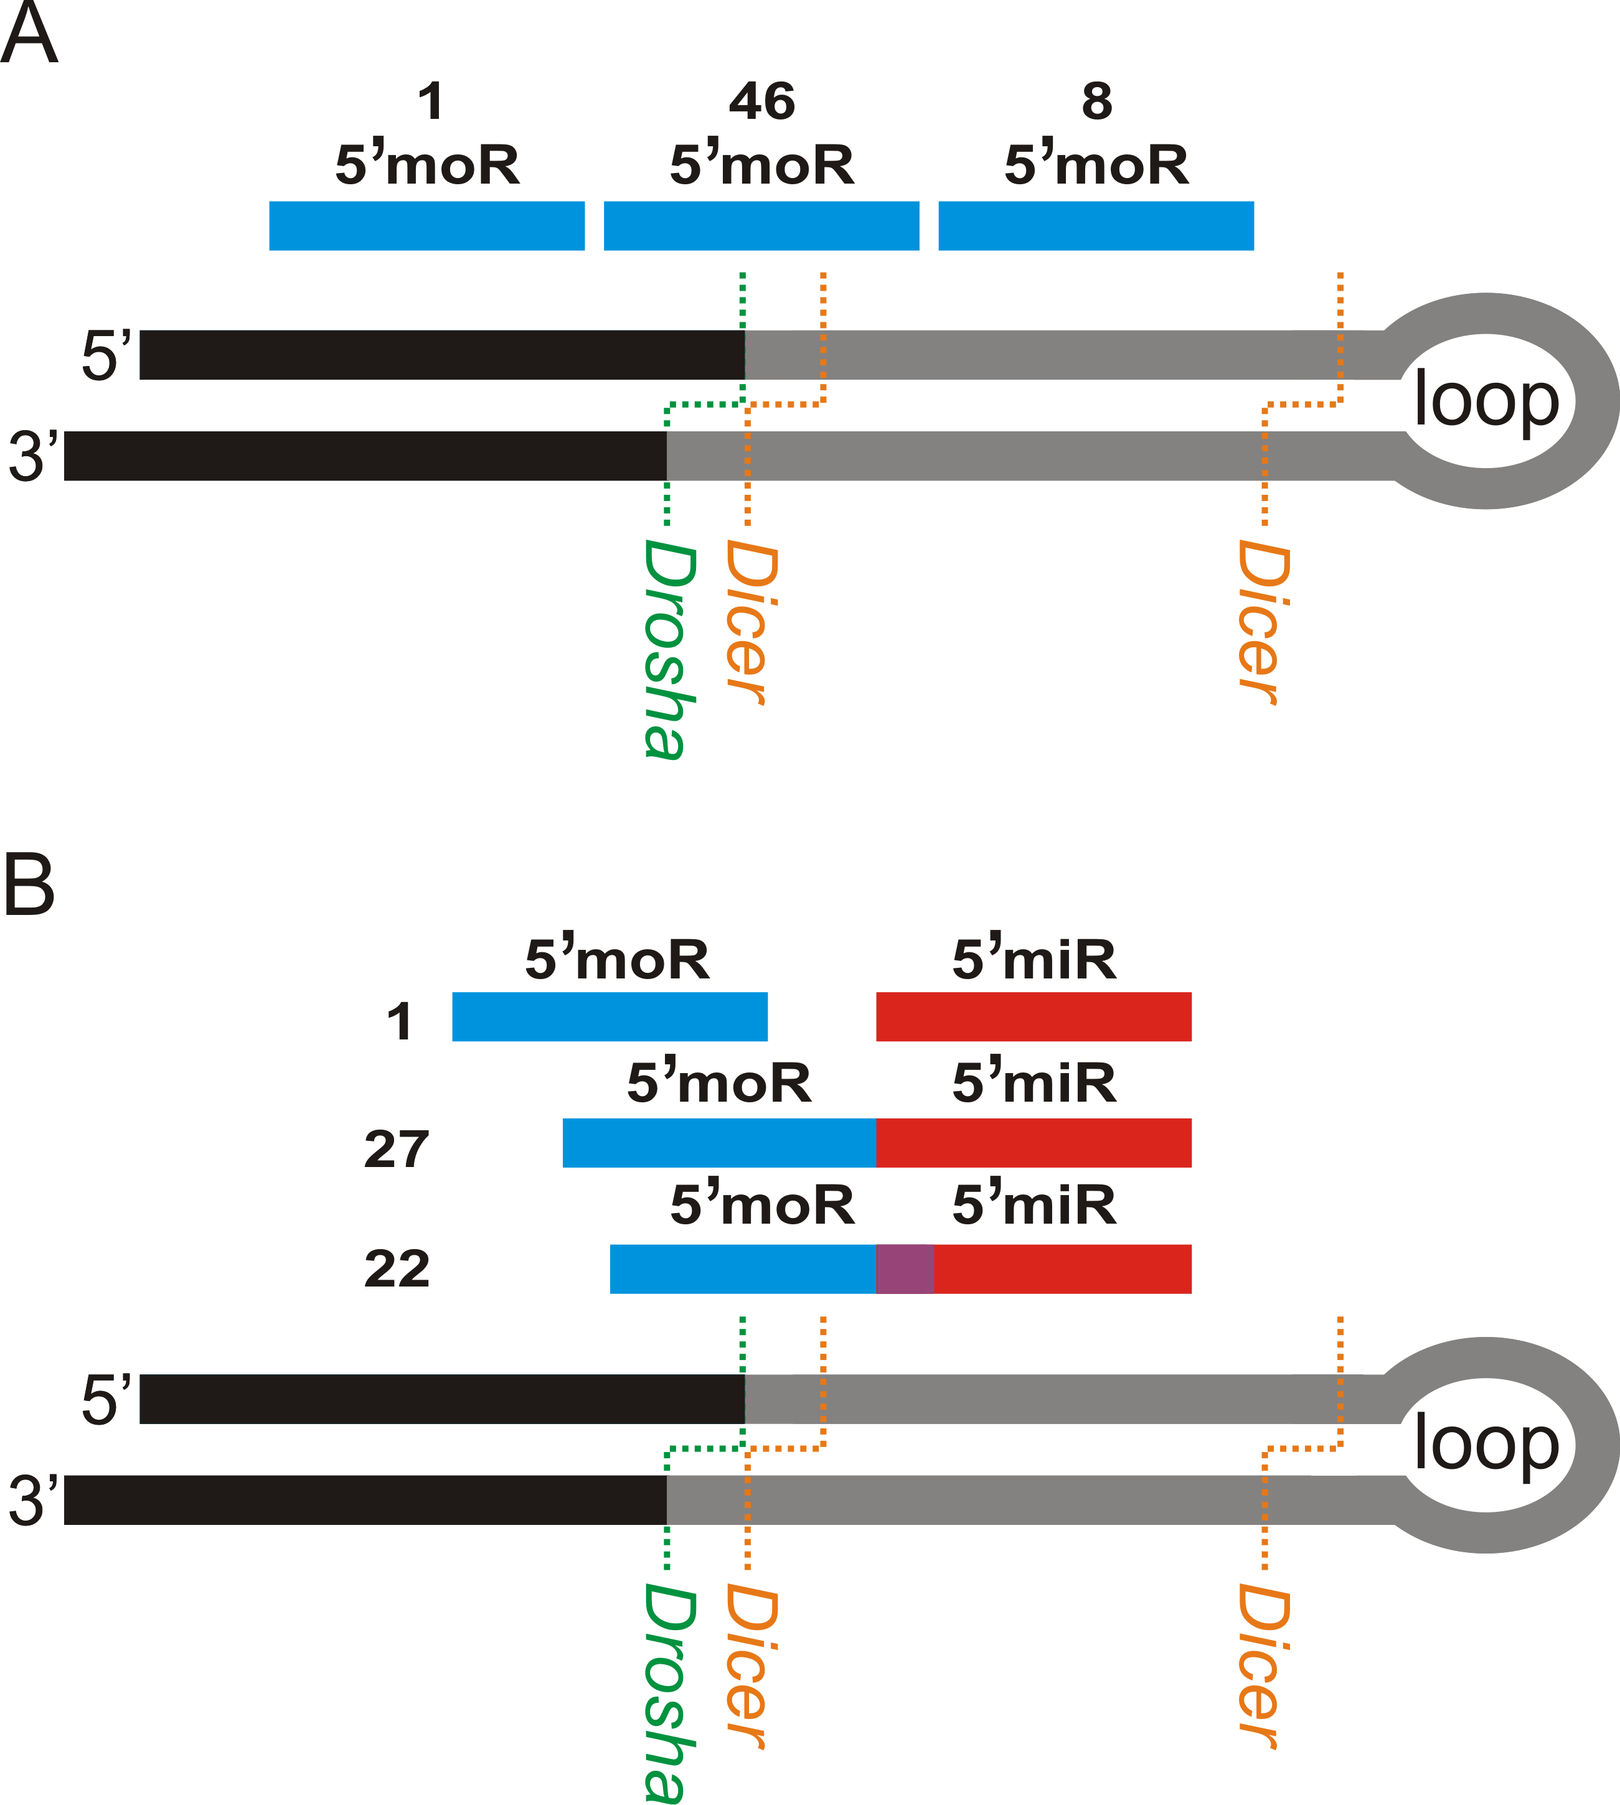
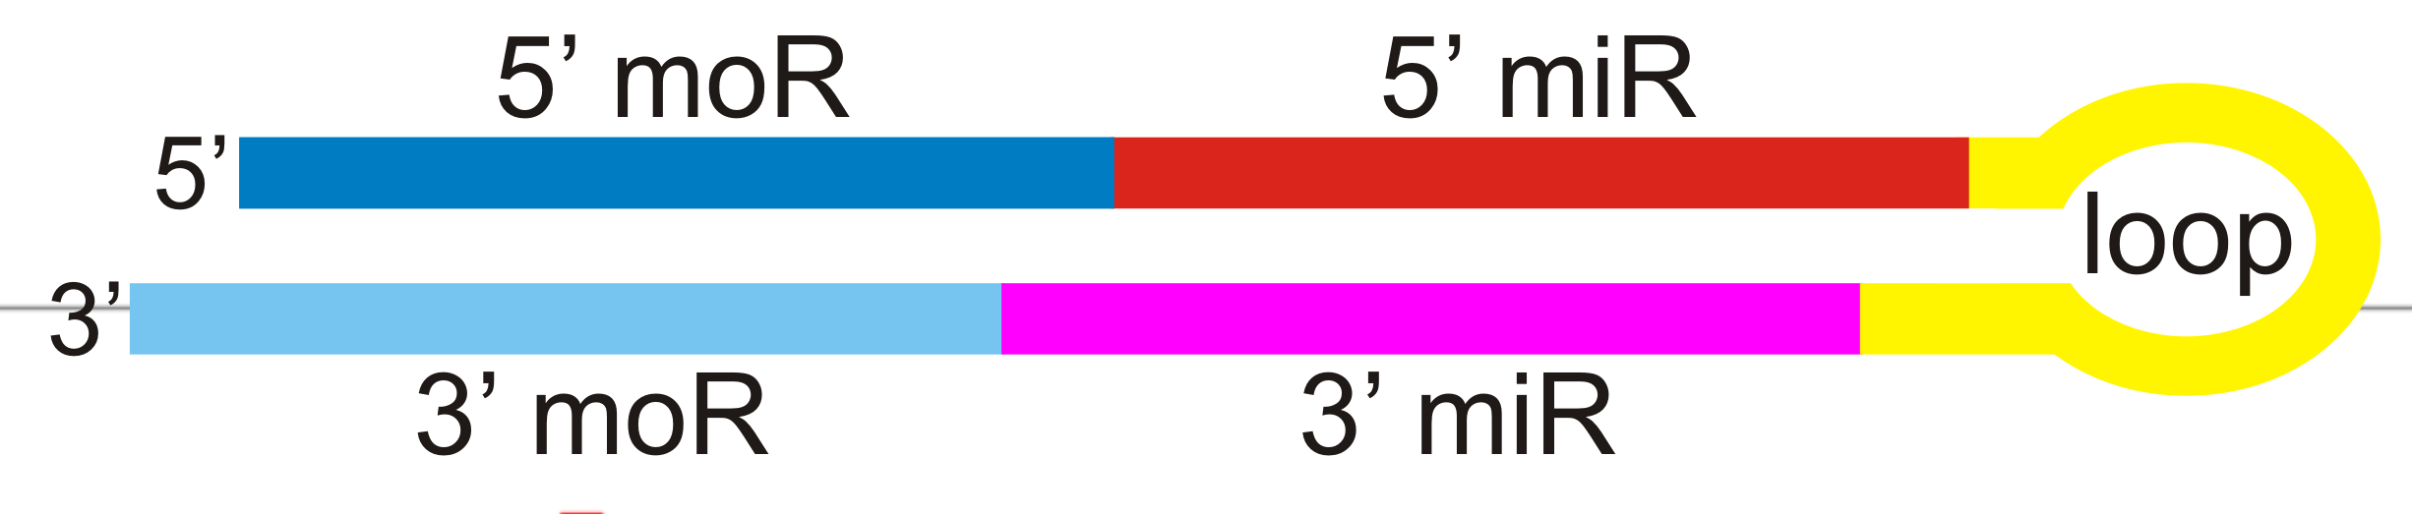
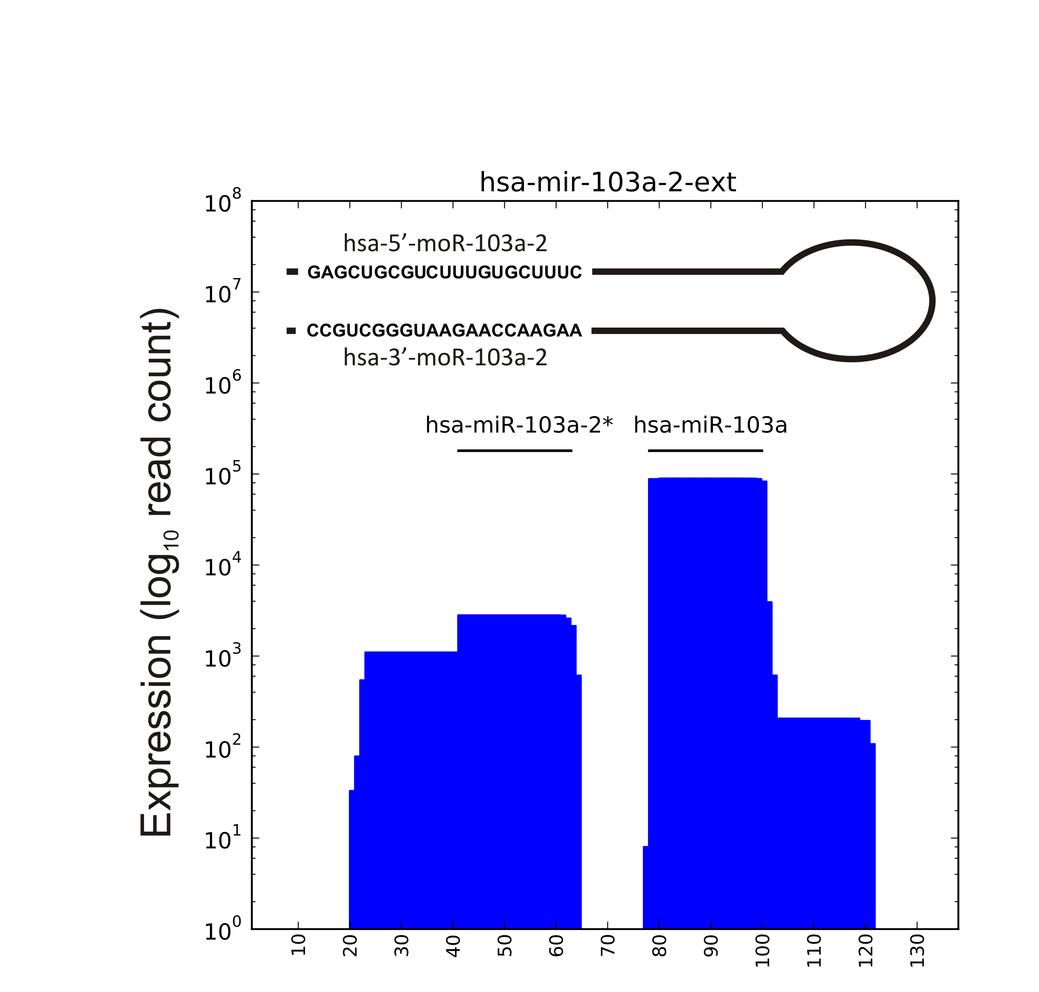
moRNA (miRNA-offset RNA) discovery
~20 nt long RNAs derived from tends of pre-miRNAs
Novel type of miRNA-related small RNAs, discovered by RNA-seq in the ascidian Ciona intestinalis, then found in human cells, in solid tumours and in herpes viruses infected cells.
Some are enriched in the nuclear fraction of RNAs, function unknown
One locus -> 4 products!
miRNA
miRNA
moRNA
moRNA
Notes:
Using small RNA-seq miRNA like RNAs calle moRNAs (after miRNA-offset RNA) expressed from one or both ends of precursors were also discovered
moRNAs are weaky expressed products with a poorly characherized function, but we see today that up to four disticnt smallRNAs can be produced from the same precursor

Slide 47
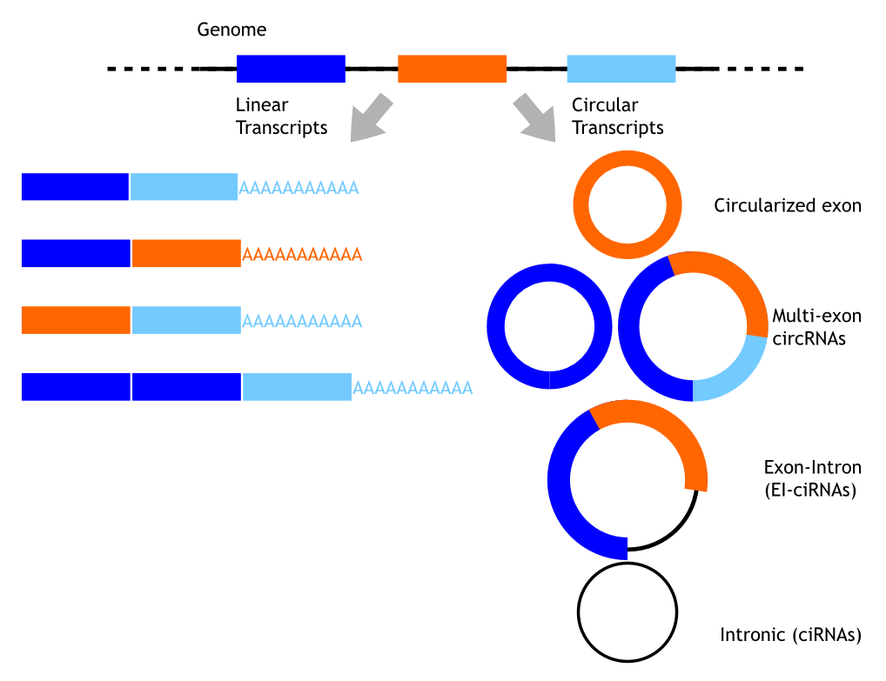
circular RNAs
Covalently closed RNA molecules deriving from backsplicing
Relaunched recently by RNA-seq projects
Thousands in human cells discovered by RNA-seq
Bonizzato et al., 2016.

Slide 48
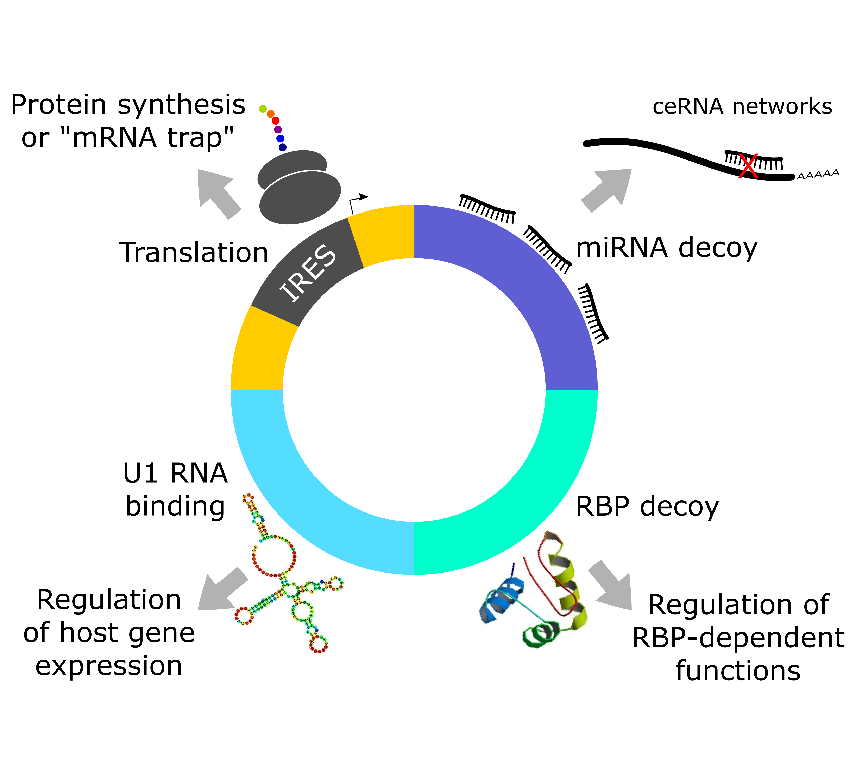
CircRNAs play important functions and have distinctive features
Evolutionarily conserved
Ubiquitary and highly expressed
Tissue and developmental stage specificity
Highly
stable
Detectable in body fluids
Disease cancer markers
Competitors of mRNA splicing
Bonizzato et al., 2016.

Slide 49
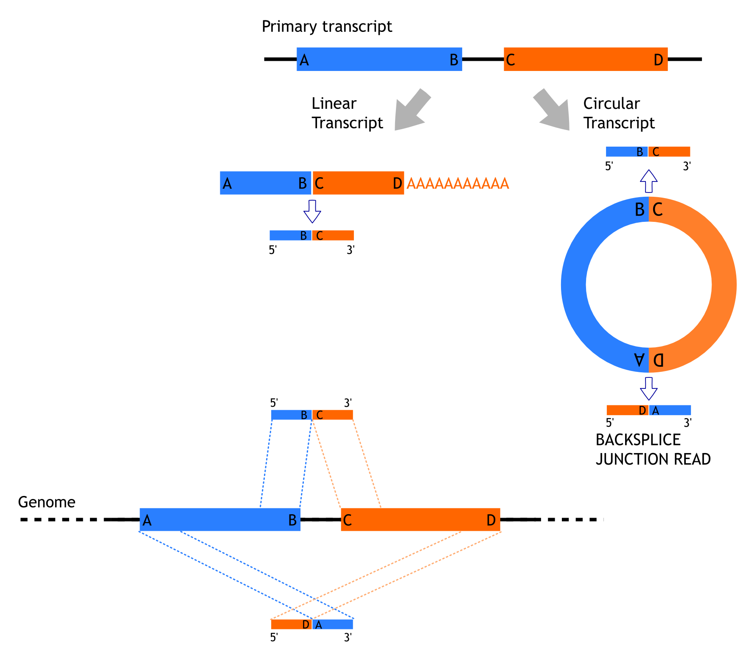
CHIASTIC MAPPING
on the genome of the reads derived from the backsplice junction
Co-linear mapping
Chiastic mapping
Bonizzato et al., 2016.

Slide 50
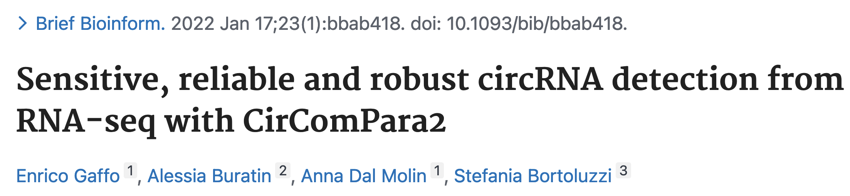
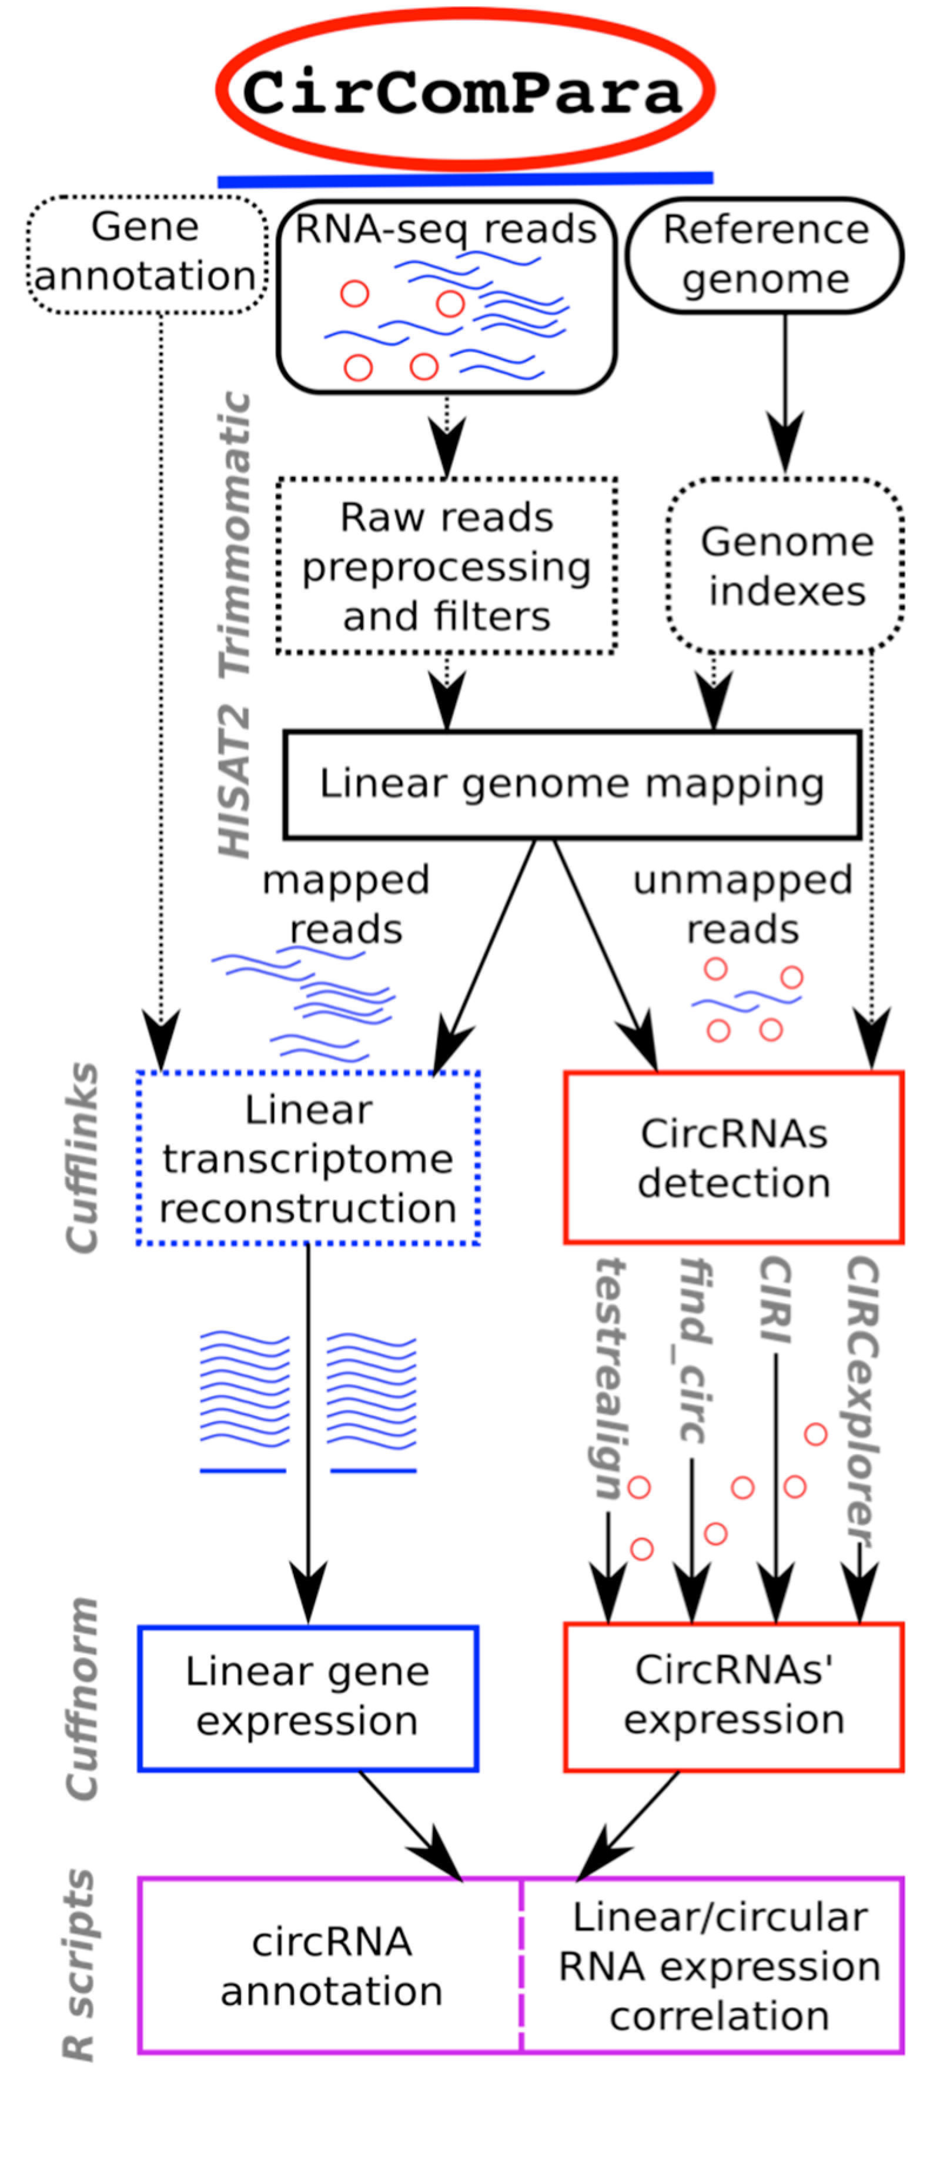
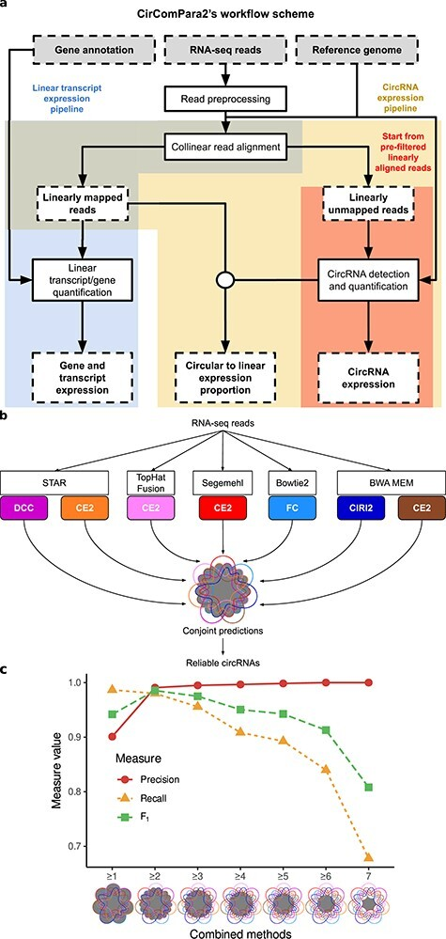

Slide 51
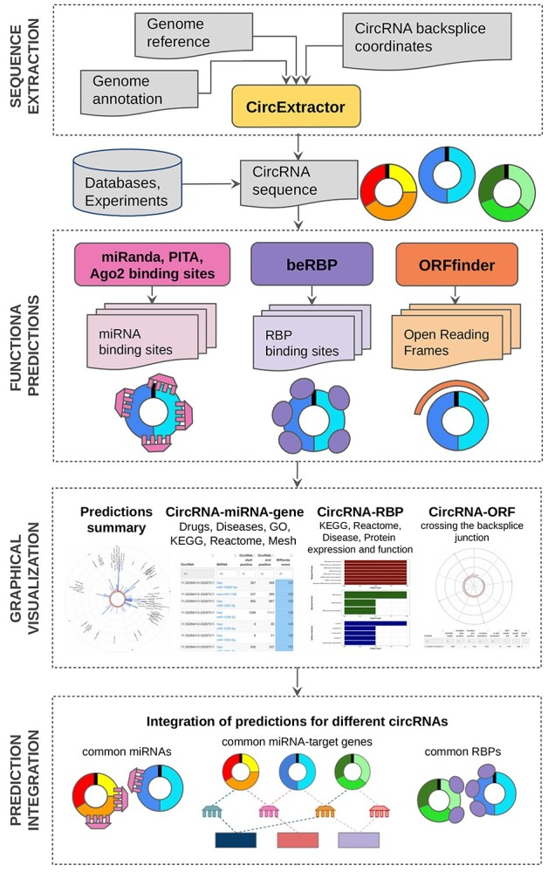
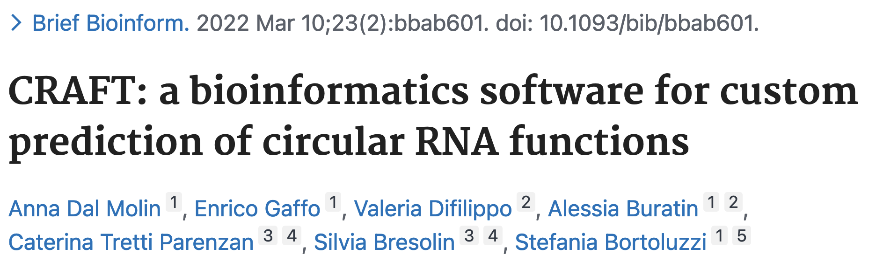

Slide 52
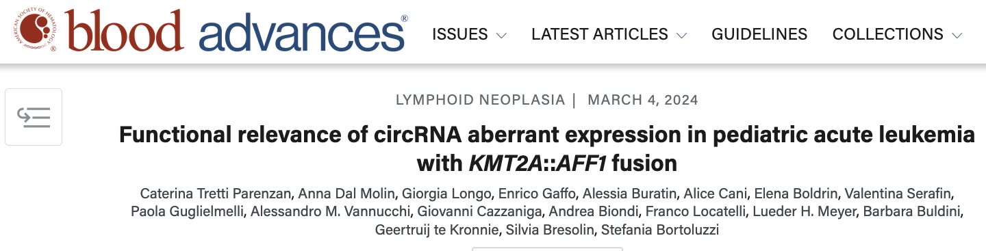
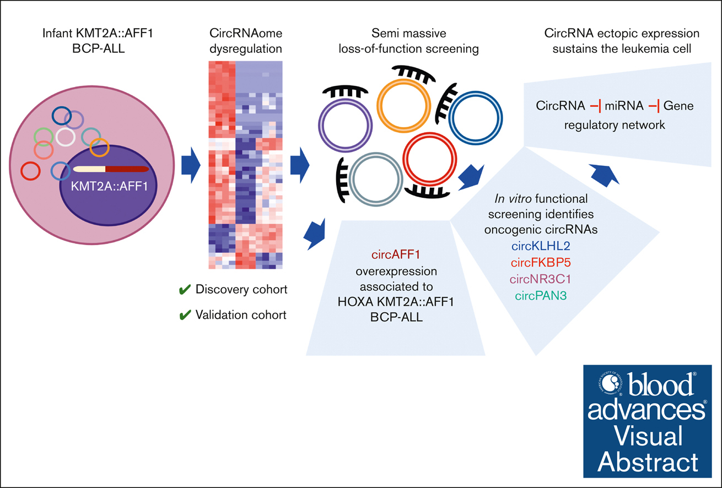

Slide 53




