Slide 1
A.A. 2025-2026
Master degree in Evolutionary Biology
School of Science
University of Padova
MOLECULAR METHODS and BIOINFORMATICS
Prof. STEFANIA BORTOLUZZI

Slide 2
GENOME SEQUENCING
AND RESEQUENCING

Slide 3
Outline
Genome sequencing
Genomes resources
NGS and applications

Slide 4
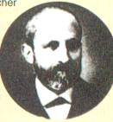
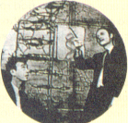
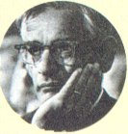
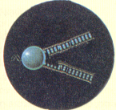
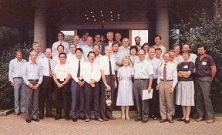
Modern Biology and Genome Projects
1869
1953
1968
1983
1988
Watson e Crick scoprono la struttura del DNA
(Nobel per la medicina 1962)
Viene fondata la HUGO, comincia il Progetto Genoma
Mullis inventa la tecnica PCR per analizzare sequenze di DNA
(Nobel per la chimica 1993)
Miescher isola la nucleina, il DNA allora sconosciuto
Khorana e altri 12 ricercatori producono il primo gene sintetico (Nobel per la medicina, 1968)

Slide 5
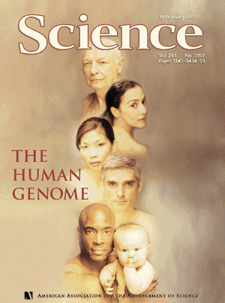
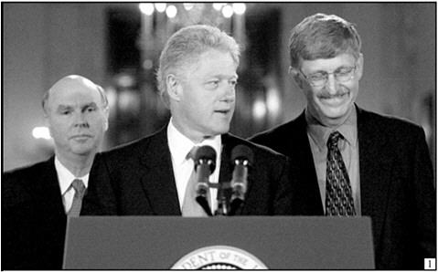

…up to the Human Genome
1999 (December) The complete sequence of chromosome 22 published in Nature.
2000 (May) The complete sequence of chromosome 21 published in Nature.
2000 (June) Francis Collins and Craig Venter jointly announce that they have completed the "draft" of the Human genome.
2001 The complete draft of the human genome (working draft) is published in Nature (public consortium) and in Science (Celera).
Celera Genomics – C. Venter
Consorzio internazionale
2000-2001

Slide 6
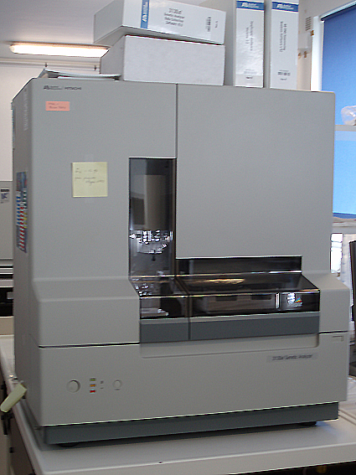
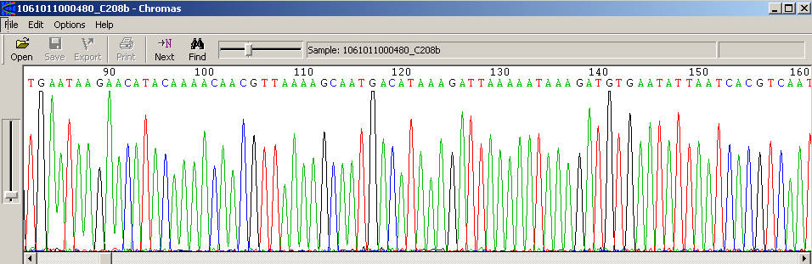
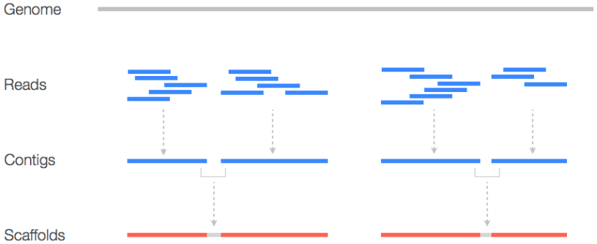
Shotgun sequencing strategy
Creating a RANDOM library of DNA fragments
Sequencing of a SUFFICIENTLY HIGH number of randomly selected fragments
Assembly of the CONTIGS and SCAFFOLDS

Slide 7
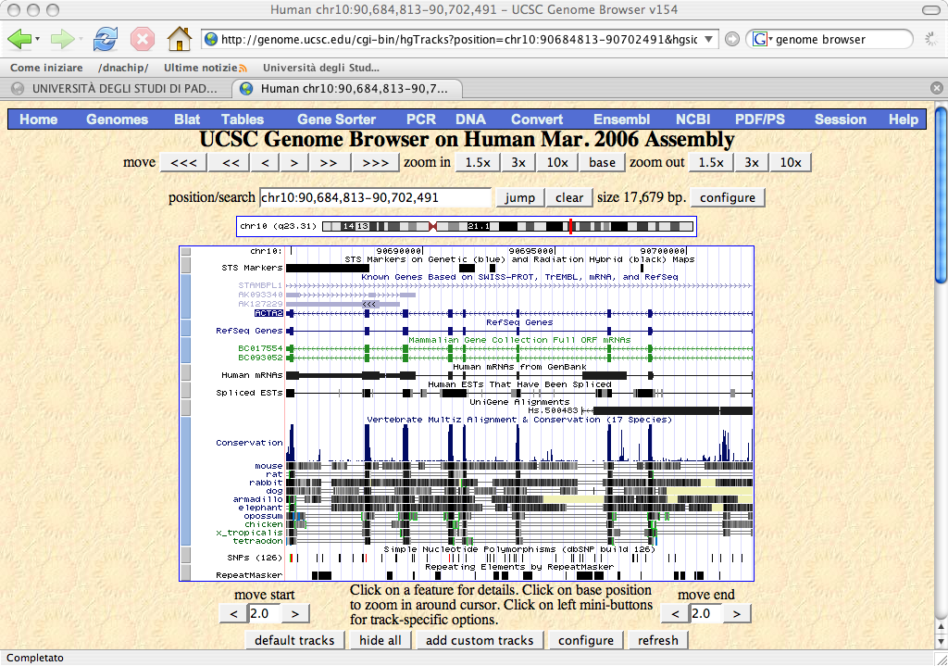
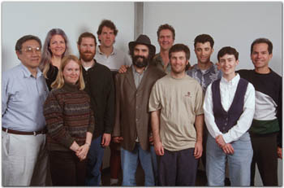
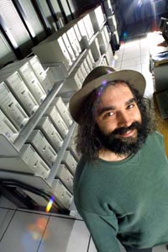
The Human Genome Superman: Jim Kent
“I used 100 800 MhZ Pentium processors with 256 Mb RAM each, running Linux, the gcc compiler, the vim editor, a whiteboard, and occasional ice packs for the wrists” Jim Kent

Slide 8
La sequenza primaria del genoma non è sufficiente…
Annotazione del genoma
E’ necessario riportare sull’assembly le informazioni e i dati sperimentali già ottenuti.
Riconciliare e integrare l’assembly con le mappe fisiche, genetiche e citogenetiche
Gli STS sono mappati sulla sequenza usando e-PCR
La corrispondenza con la mappa citogenetica utilizzando FISH sistematica di BAC.
L’annotazione dei geni è attuata con metodi leggermente diversi dai 3 “genome browser”
  L’NCBI allinea mRNA di RefSeq, mRNA di GenBank utilizzando MegaBlast.
  Ensembl allinea tutte le proteine umane note di SP/Trembl utilizzando un suo algoritmo
  UCSC allinea mRNA di Refseq e GenBank e dalle ultime release SP/Trembl con BLAT

Slide 9
Annotazione dei geni
ab initio, in base a “sensori”, funzioni che tentano di dedurre la presenza di una caratteristica genica in base a motivi o proprietà statistiche del DNA.
  Sensori per TSS (G+C)
  Sensori per siti splicing (AG-GT)
  Sensori che misurano la composizione in basi di esoni putativi
L’output dei vari sensori è combinato per generare un “modello genico”
metodi basati sulla similarità: l’allineamento di una regione genomica con un cDNA o un EST sono una buona evidenza.
Lo splicing alternativo complica l’interpretazione degli allineamenti tra DNA genomico, cDNA e ESTs
I dati di similarità sono incompleti: trascritti poco espressi o espressi transientemente sono assenti…
I programmi come Grail/Exp, Genie EST, GenomeScan combinano predizioni ab inizio con dati di similarità ottenendo risultati migliori

Slide 10
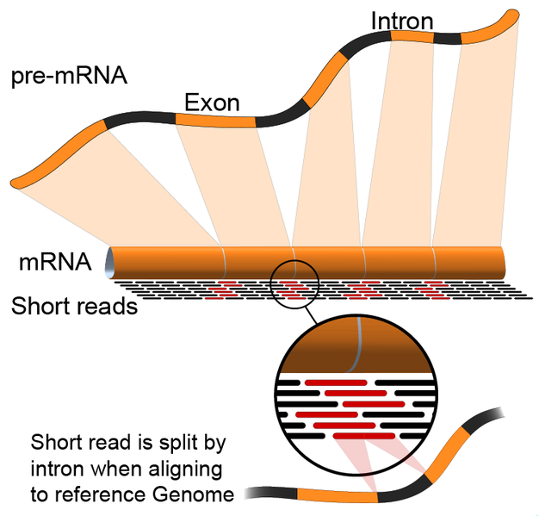

Slide 11
What next?
Post Genomic era
  Comparative Genomics
  Functional Genomics
  Structural Genomics

Slide 12
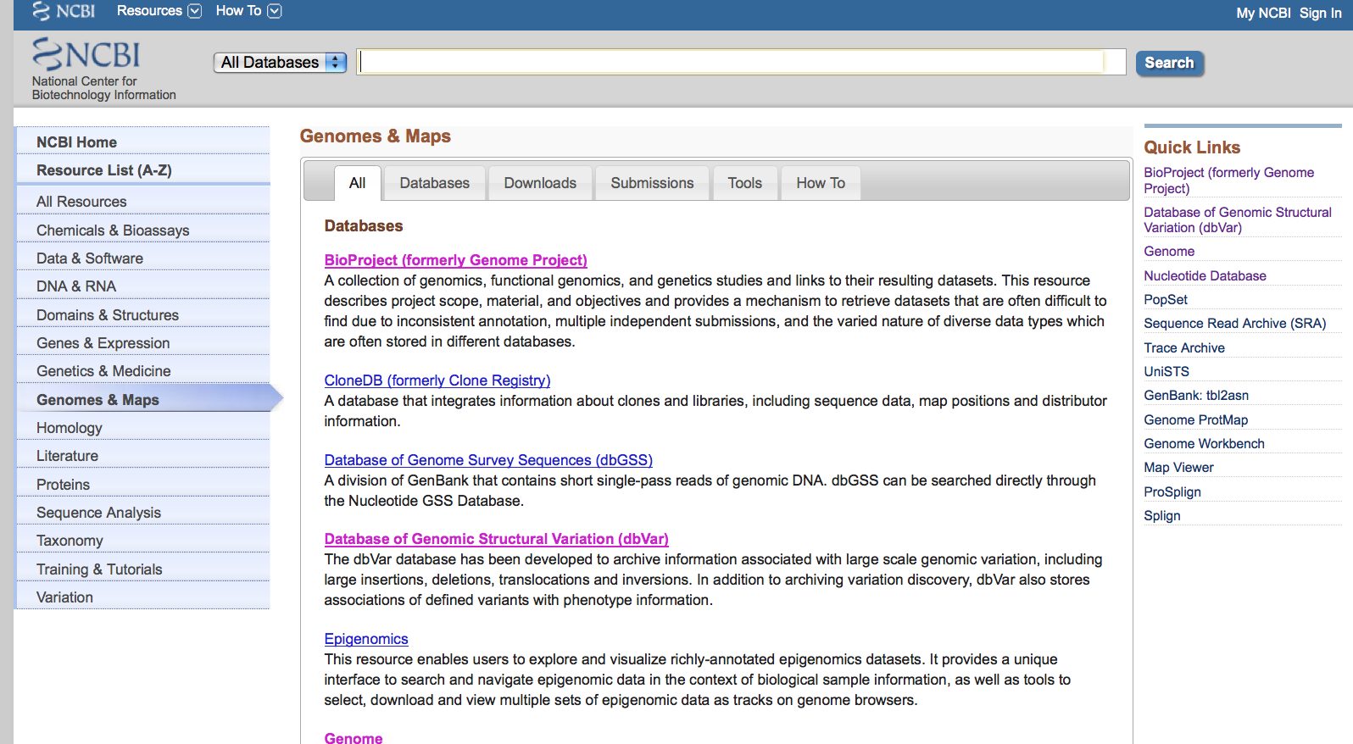
Viral Genomes

Slide 13
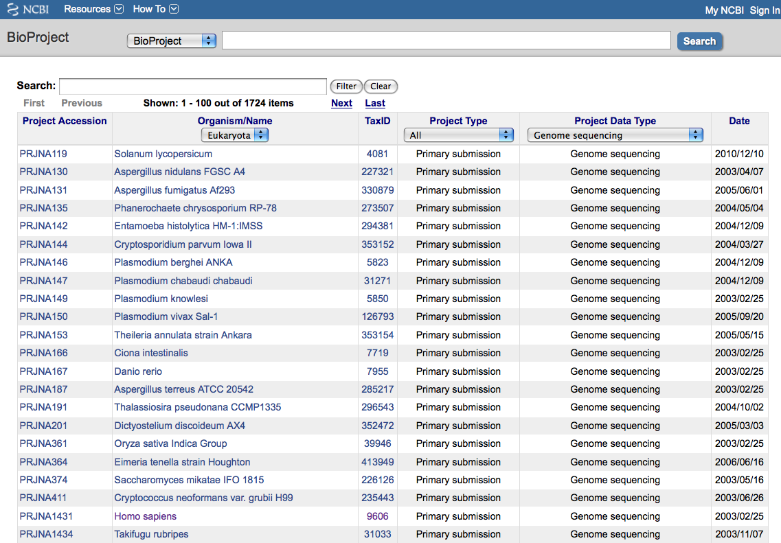
Viral Genomes

Slide 14
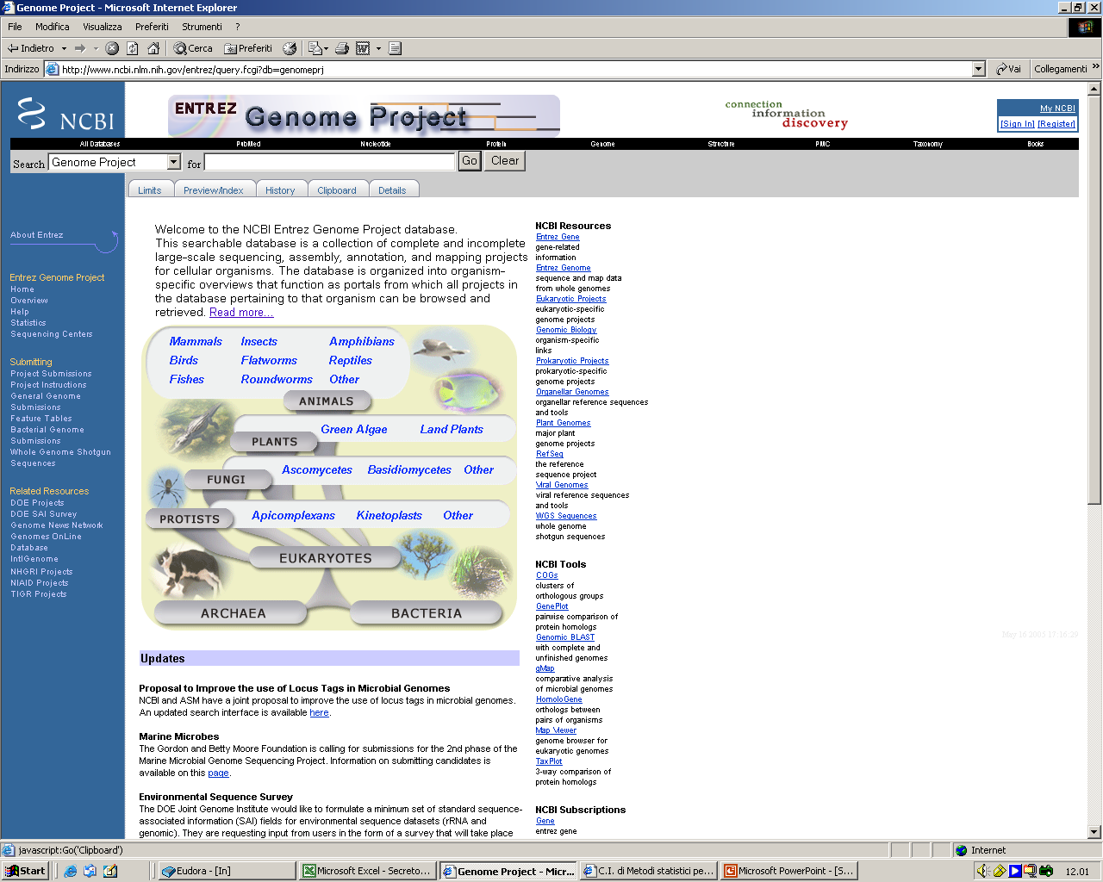
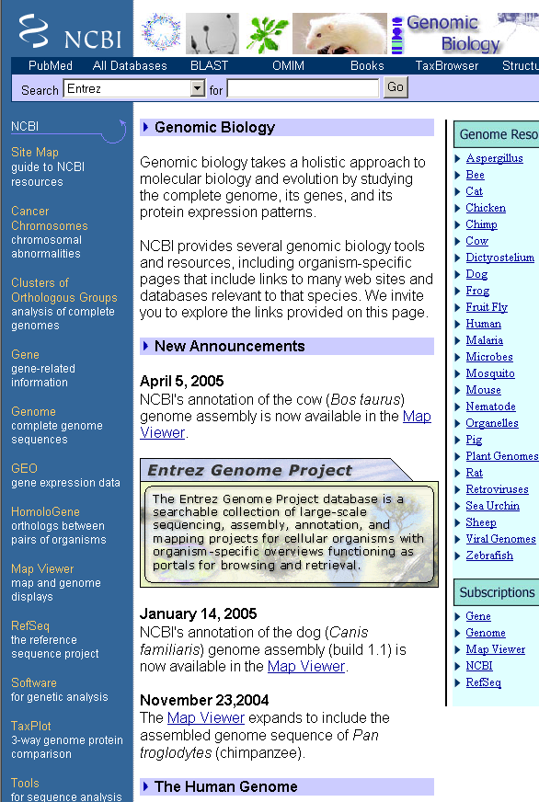
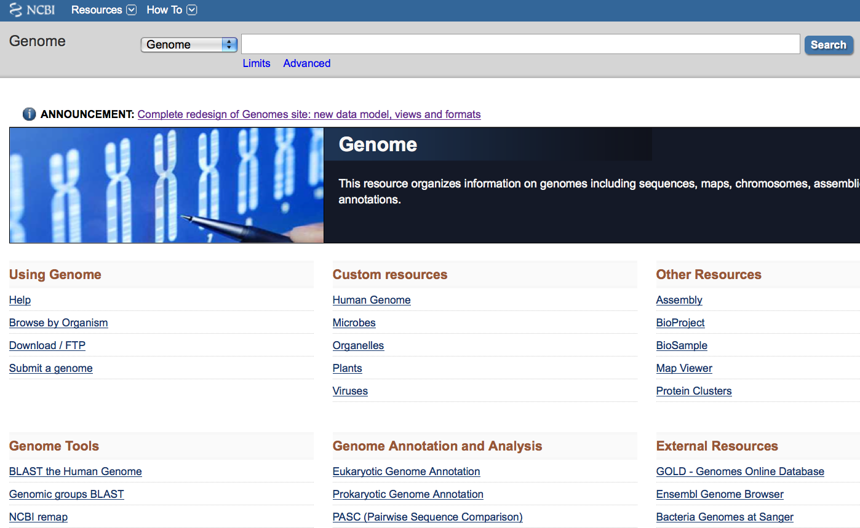
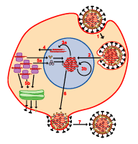
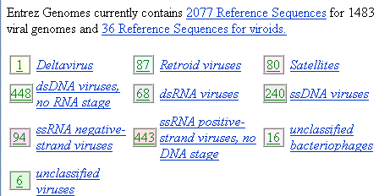
Viral Genomes

Slide 15
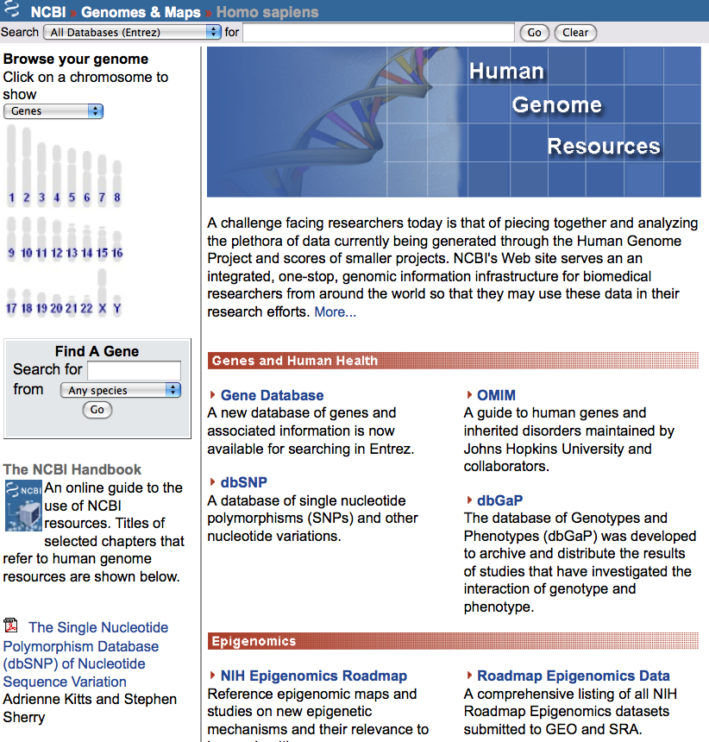
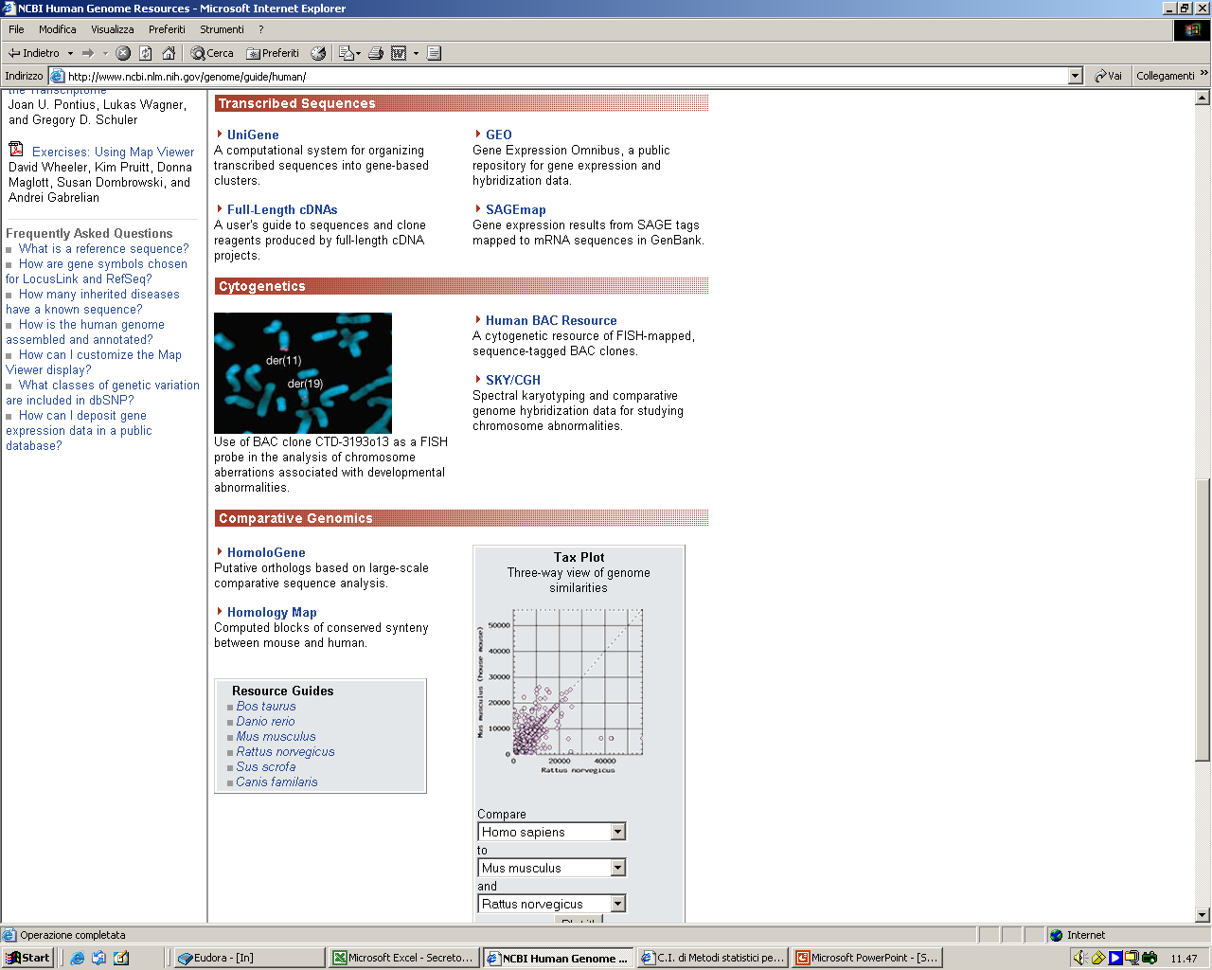
Viral Genomes

Slide 16
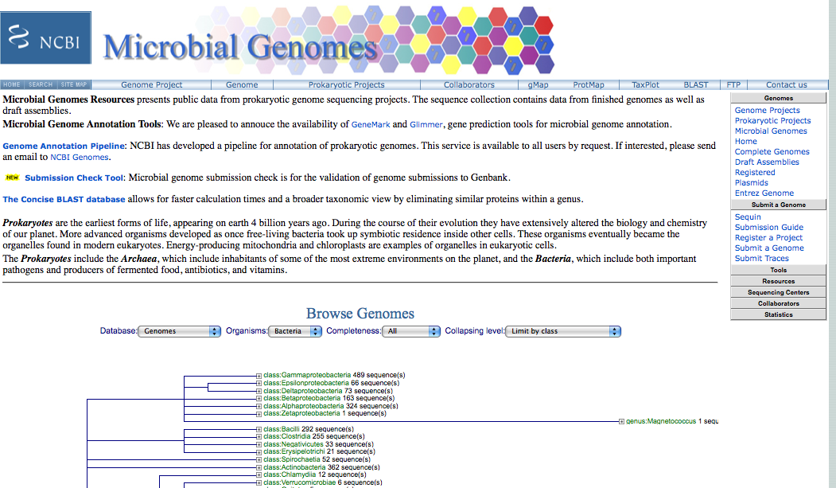
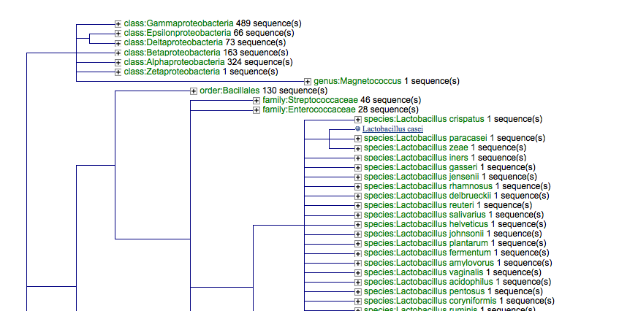
Viral Genomes

Slide 17
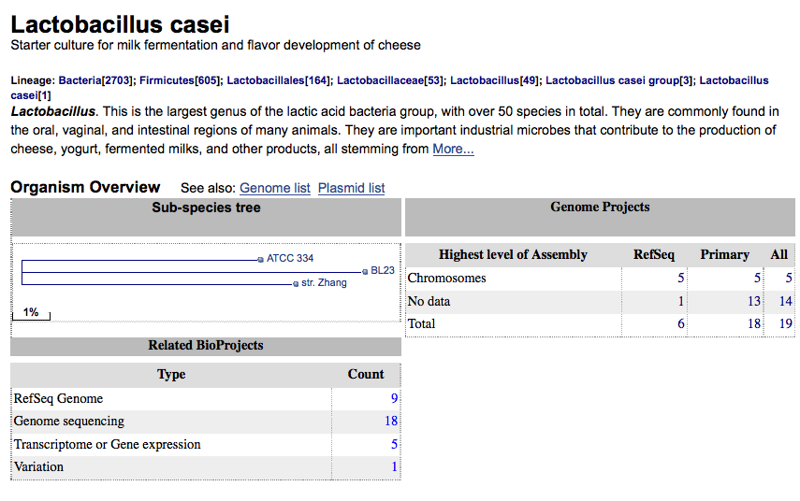
Viral Genoes

Slide 18
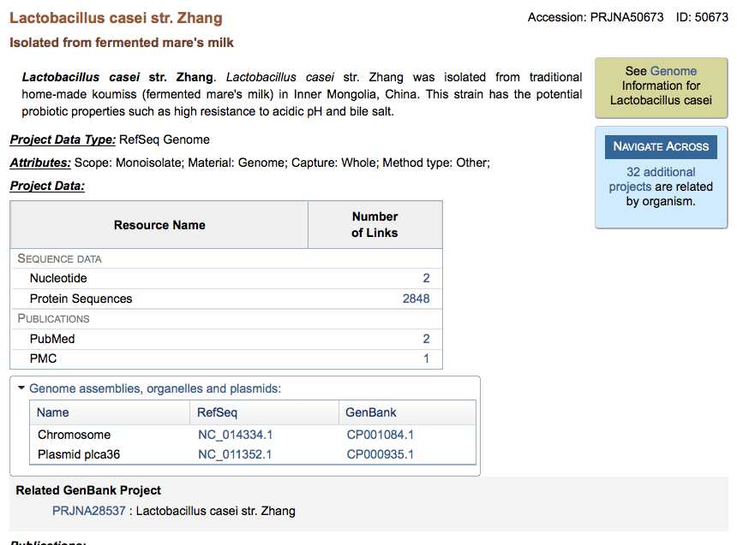
Viral Genoes

Slide 19
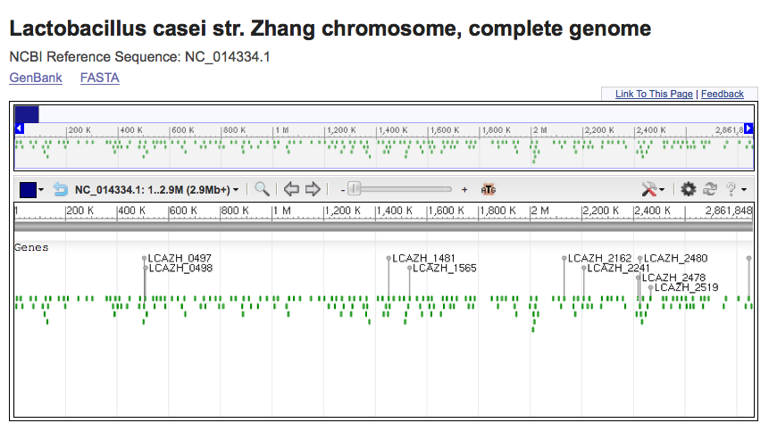
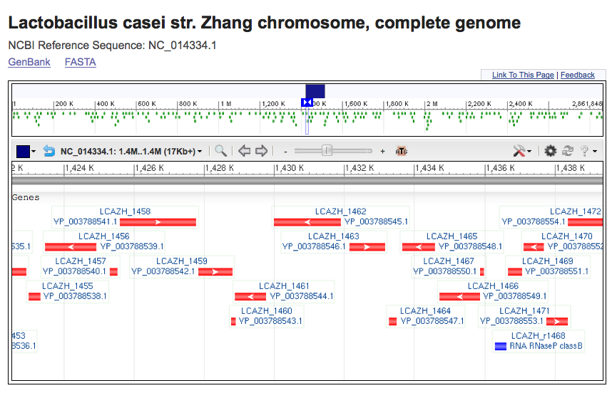
Viral Genoes

Slide 20
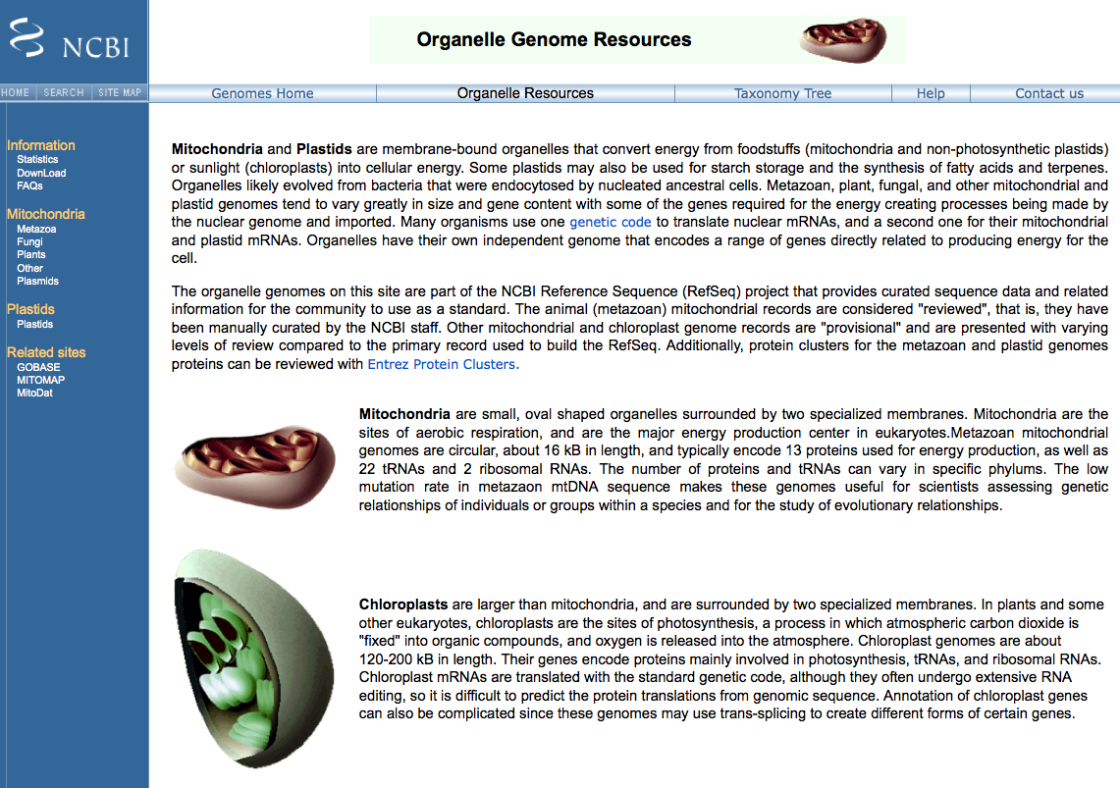
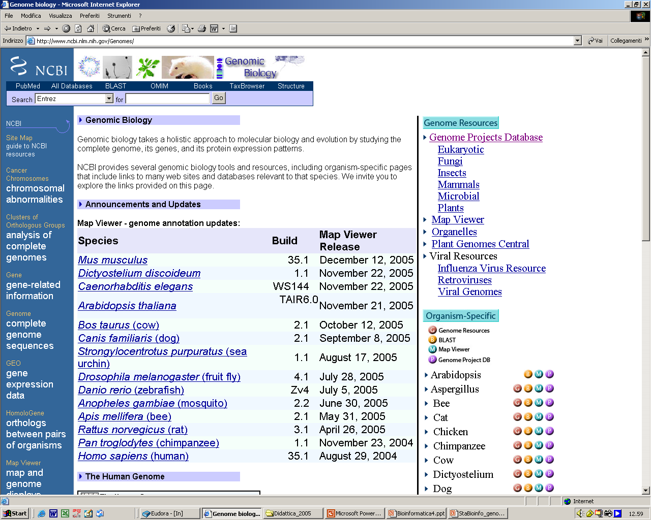
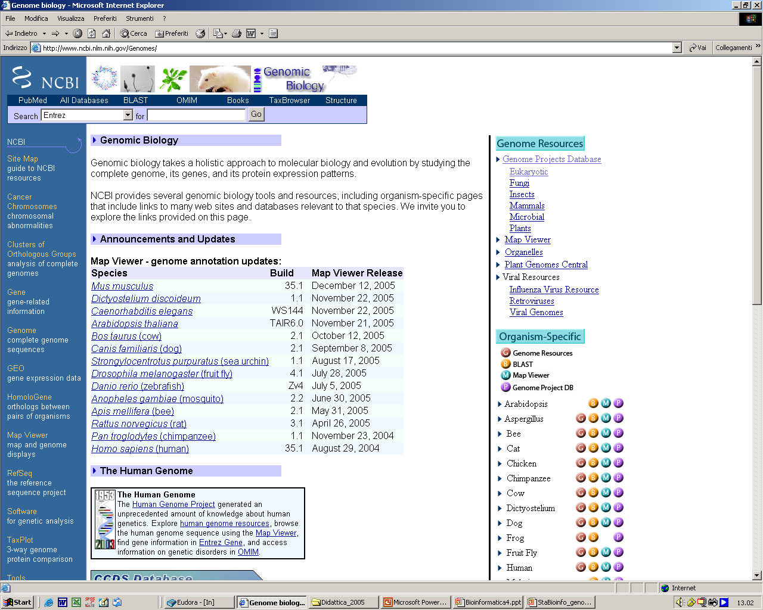

Slide 21
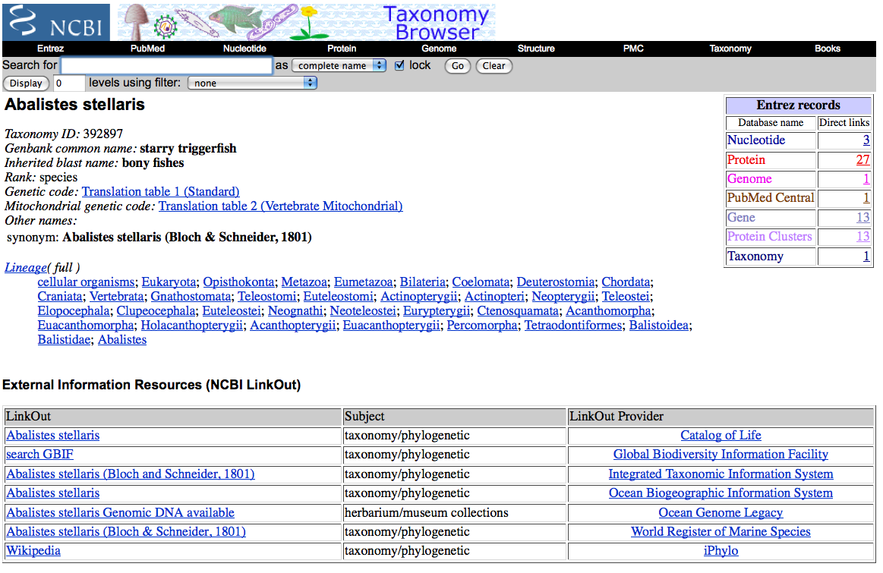
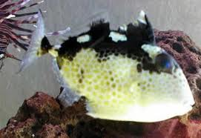

Slide 22
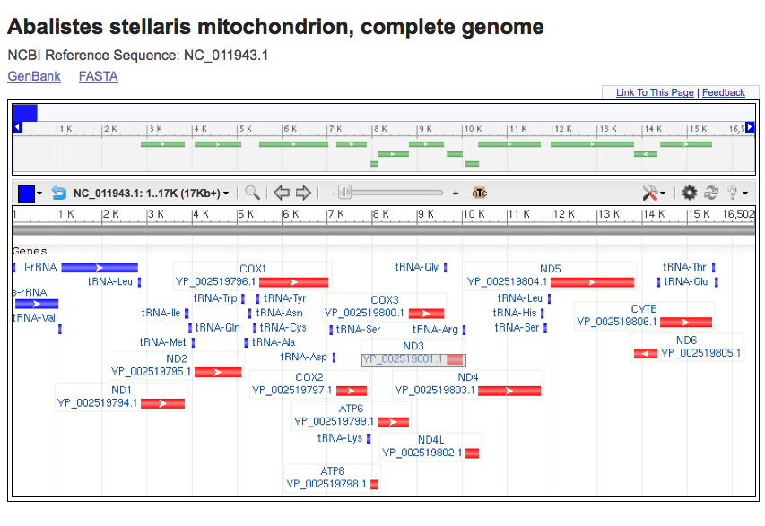
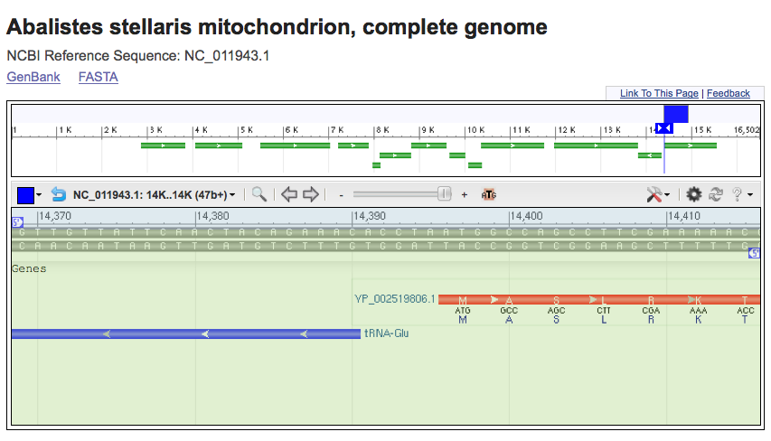

Slide 23
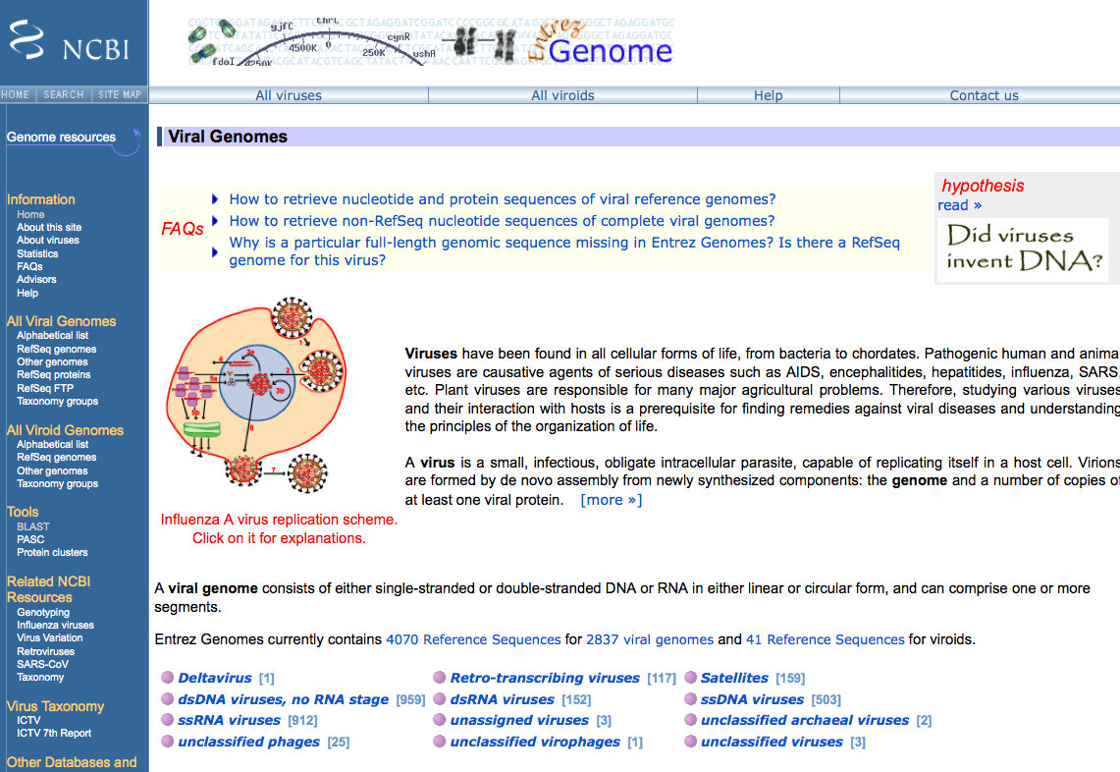

Slide 24
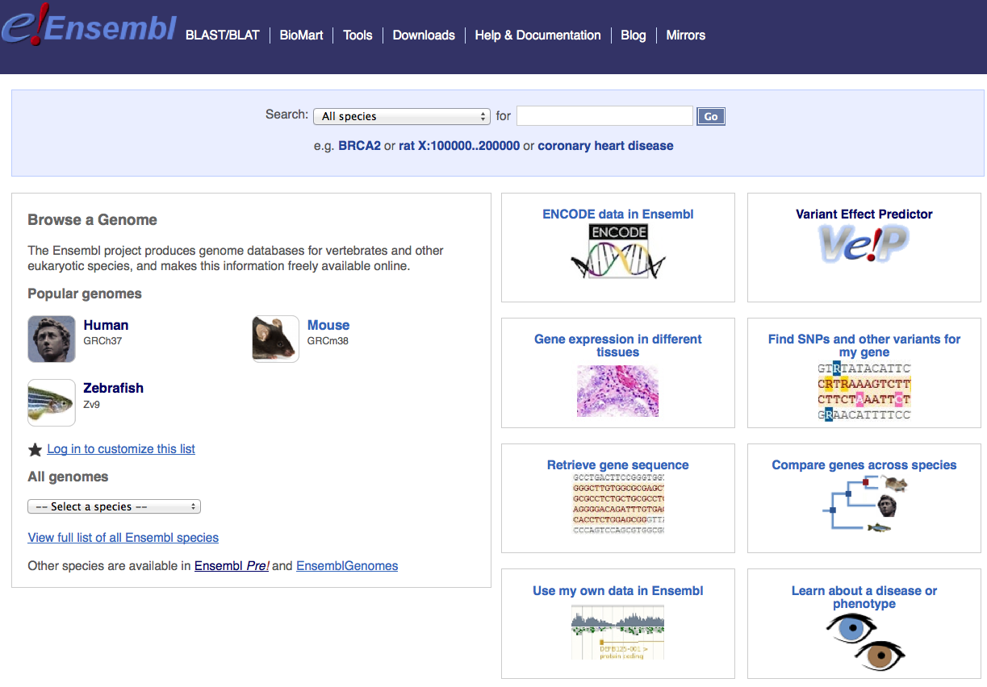
Ensembl Genome Browser

Slide 25
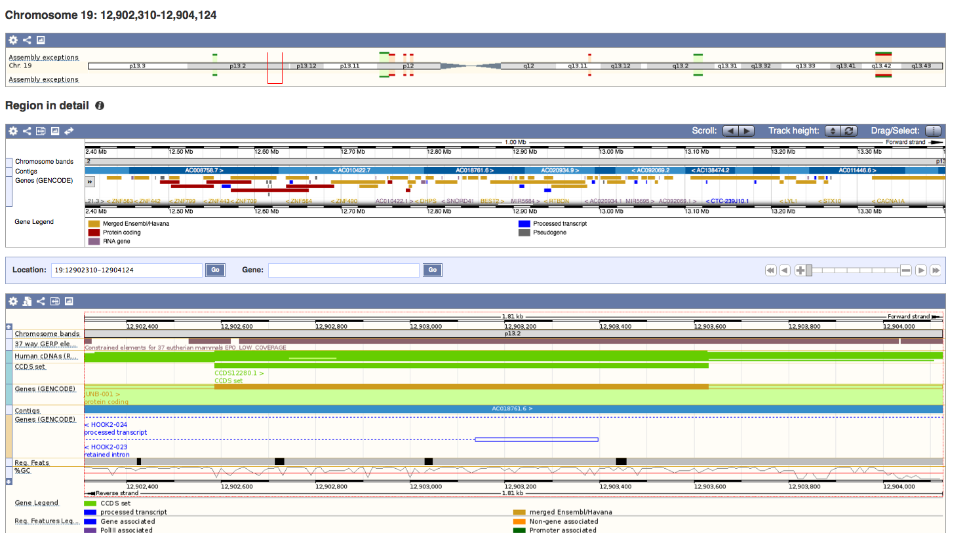
Ensembl Genome Browser

Slide 26
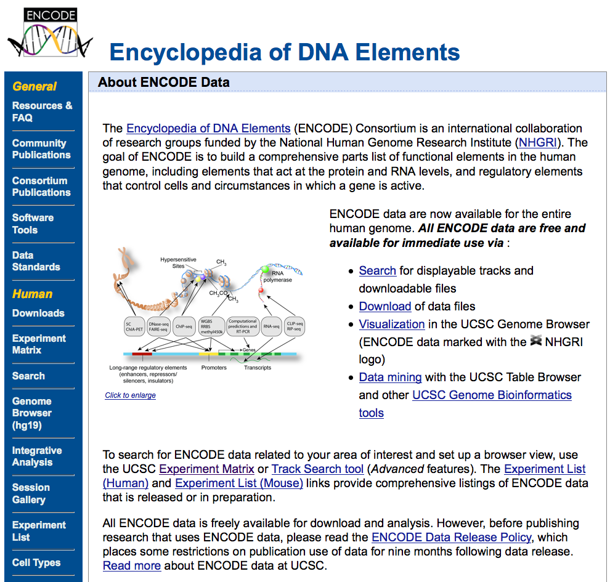
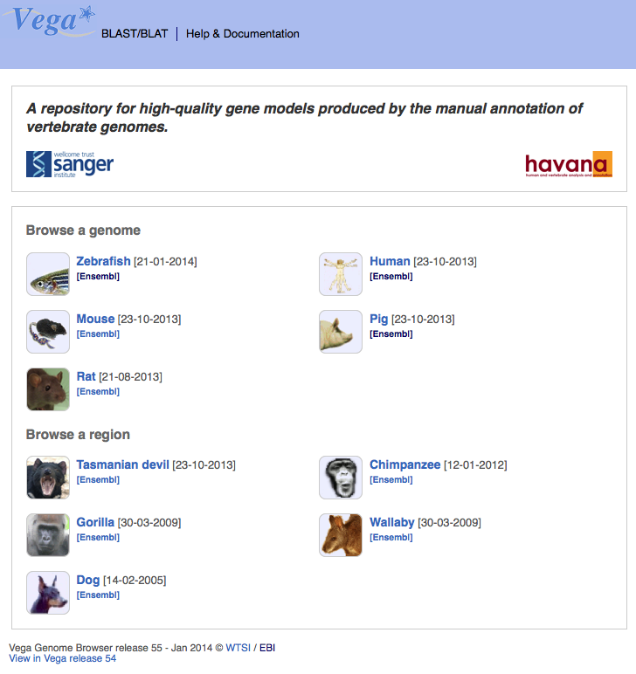
VEGA AND ENCODE:
detailed annotation of genomes
Experimental projects for a greater functional characterization of DNA elements (ENCODE) or in any case provide for an additional phase of manual curation of data relating to genes and transcripts (VEGA).

Slide 27
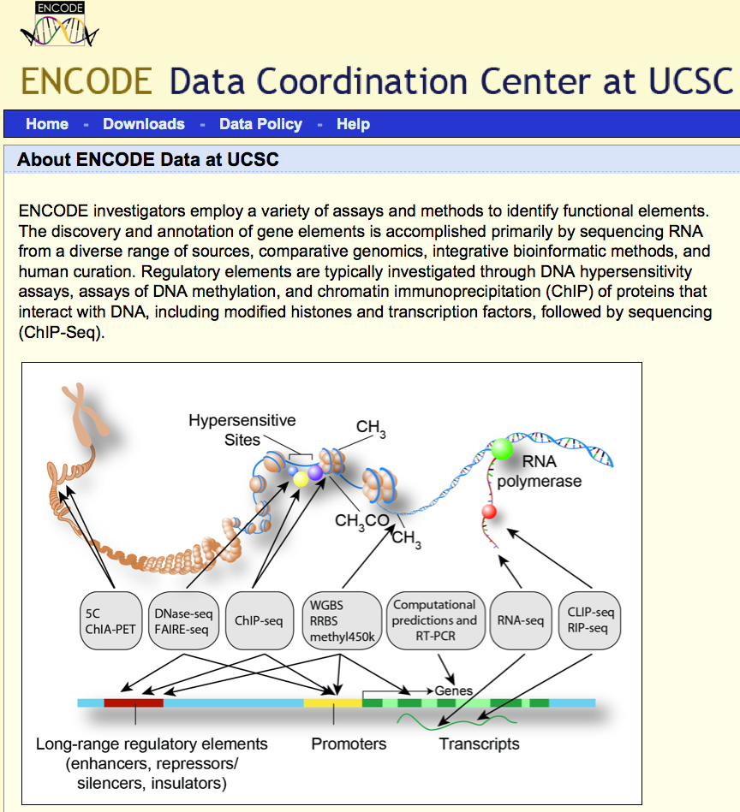
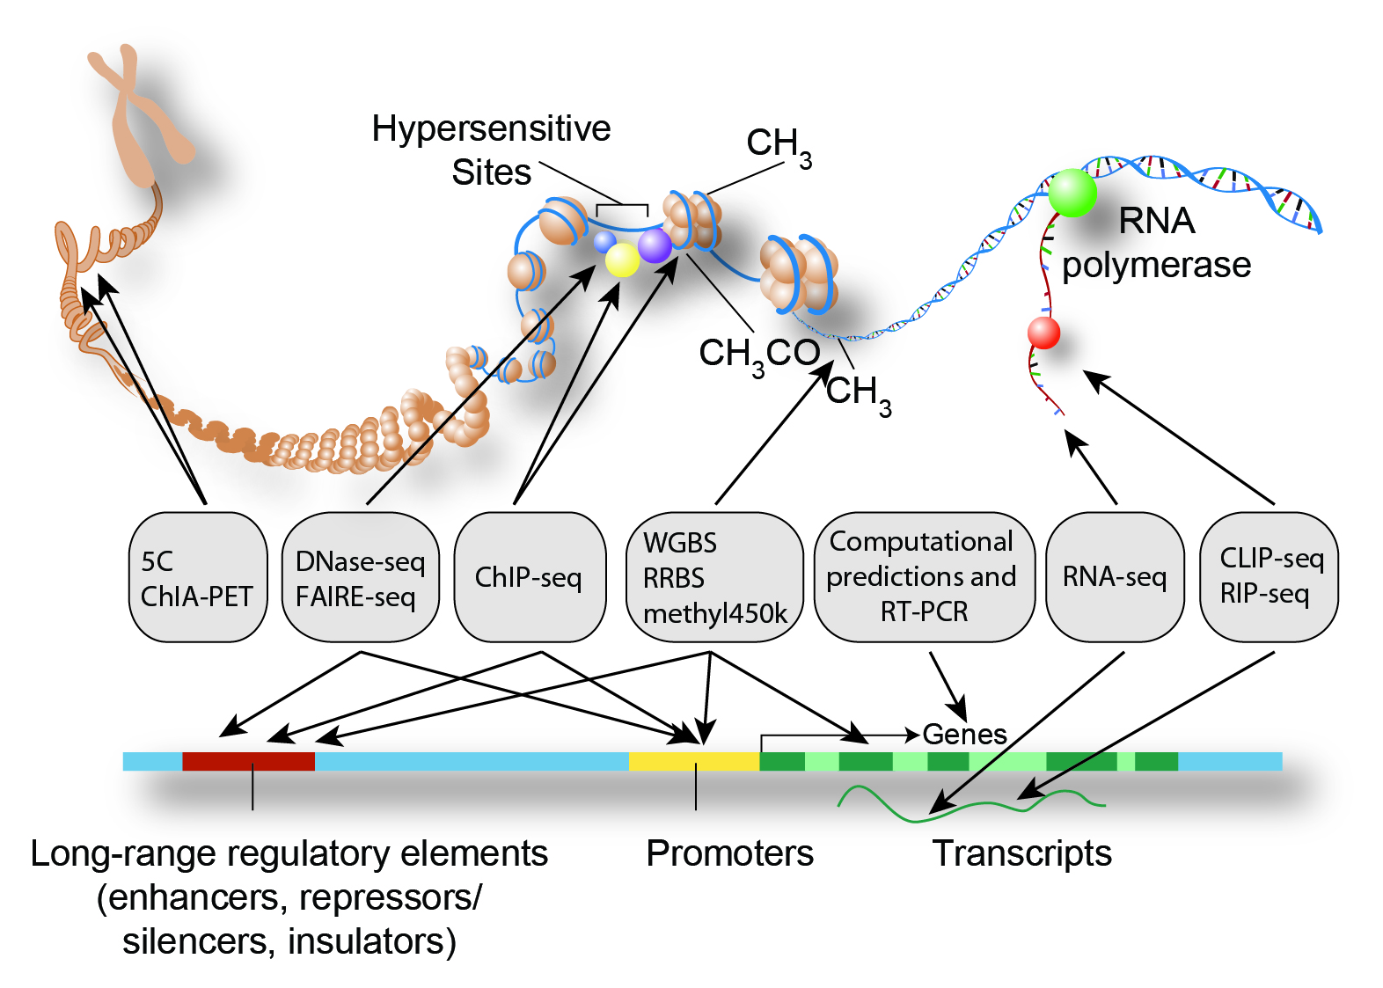
ENCyclopedia of DNA Elements
Consortium of
International researchers
Notes:
Following the major sequencing of the human genome, a new project was launched to take a closer look at the elements that comprise the genome sequence features. --> This international research consortium, sponsored by the National Human Genome Research Institute (or NHGRI), is called ENCODE: ENCyclopedia Of DNA Elements. -->
UCSC has been designated as the Data Coordination Center (DCC)—a repository for submission and retrieval of ENCODE Consortium data. -->
Next we’ll briefly describe some background and framework for the ENCODE project. -->

Slide 28
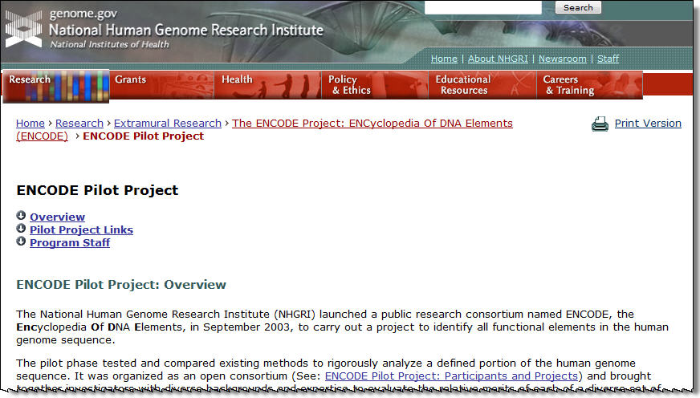
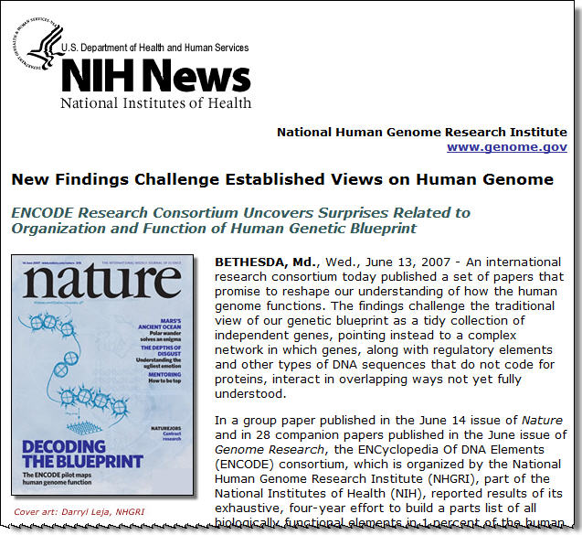
ENCODE Background
Pilot phase, or phase I
Selected regions of the genome: 1%, 30 MB
Notes:
Rather than providing exhaustive understanding of human genomics, the completion of the human genome project made it apparent that merely having the nucleotide sequence of the genome wouldn’t provide complete knowledge of the genome organization and function. --> The ENCODE project was devised to catalog all of the functional elements in the human genome, and to rigorously examine them to gain a better understanding of their roles in the cell. --> This began with a pilot project, and information about the pilot phase can be obtained at the URL shown.
To accomplish this, data has been generated using cutting-edge technologies. This data is at the forefront of our genomic knowledge, moving beyond the mere transcription of known genes into more in-depth questions on chromatin remodeling, transcription factor binding, transcription of non-coding RNA genes, and more.
The first phase of the ENCODE project was referred to as the “pilot” phase. --> In the pilot phase, selected regions of the genome were chosen for detailed examination. --> Approximately 30 megabases, representing 1% of the genome, was defined as the target. --> Half of the regions included well-studied gene-rich or known feature-rich areas with substantial similarity in other species. --> Half were randomly selected—so the features would be less well-known or understood.

Slide 29
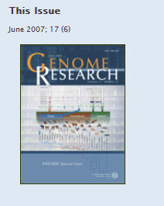
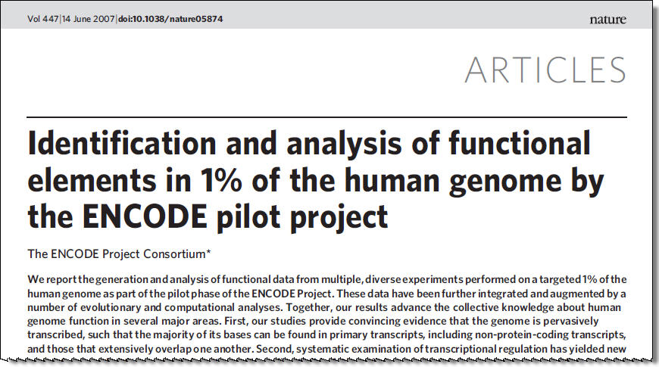
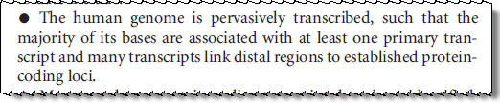
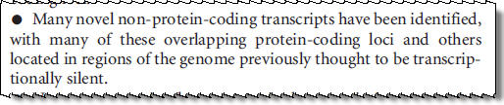
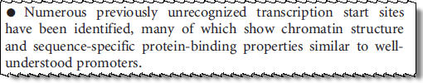


ENCODE Discoveries
“Marker” papers: Nature and issue of Genome Research
Changes to our conceptual framework for the genome
Notes:
The ENCODE pilot phase was completed in 2007. --> The results were published—as a whole project overview “marker” paper in Nature, and as individual papers by research teams that describe their specific data focus in a special issue of Genome Research. Scores of important insights were generated and are highlighted in the Nature paper. --> These include:
There is abundant transcription beyond the known protein-coding genes: both intragenic and intergenic transcription, including both non-coding RNA and transcribed pseudogenes. --> This had been observed before, but the ENCODE pilot phase conclusively demonstrated this.
At the same time, known protein-coding genes revealed unexpected complexity: distal untranslated region (UTR) exons as many as 200 kilobases away, overlapping or interleaved loci, antisense transcription. This has all really challenged the conventional definition of a "gene".
Patterns of histone modification and DNase sensitivity reveal "domains" of packed or accessible chromatin, and these accessibility patterns correlate well with rates of transcription, DNA replication, and regulatory protein factors binding to the DNA. --> This underscores the regulatory importance of epigenetic factors.
These items, and many more which can be explored in great detail in the individual papers by the research teams, resulted in changes to our conceptual framework for understanding the organization and functional aspects of the genome. -->

Slide 30





ENCODE Production Phase Focus
chromatin
transcriptome/
genes
promoters/
regulatory sites
DNase sites
ENCODE is now genome-wide
Specific cell types and new technologies being applied
Project focus topics selected, then supplemented
Notes:
The genome-wide production phase of the ENCODE project is proceeding now. -->
A key feature of the production phase is that several cell types have been selected to form the main data collection efforts. --> All project teams will use these same cells in their work for consistency. --> The cell types are organized into tiers: 1, 2, and 3 to prioritize the experimental investigations. --> This will enable better coordination of the studies and interpretation of the results. --> It might also be something for researchers to consider for their own experiments, as there will be a great deal of supporting data for these cell types that might be informative. --> The cell types are publicly available from a variety of providers. --> More can be learned about them from the ENCODE project site or the UCSC portal.
Several areas of focus have been funded. --> These include chromatin organization and DNase hypersensitive sites. --> Detailed studies of gene structures, and the transcriptome as a whole, are underway. --> Exploration of regulatory elements, including transcription factor binding sites, is ongoing. --> These topics will help us to understand much more about genomic mechanisms.
In October 2009, a number of new ENCODE groups were funded as part of the NIH American Recovery and Reinvestment Act grants. --> These newer groups will expand the scope of ENCODE research to the mouse genome, and will provide new assays (such as proteo-genomics and epitope-tagging protein binding) to supplement results produced during the first two years of the project. -->
We’ll provide you with the information on how to identify and use ENCODE project data that comes from additional methods as we proceed.

Slide 31


Slide 32


Slide 33





ENCODE Data Types
Mapping data
Genes
Expression
Regulation
Variation
ENCODE Tracks identified with icon
Notes:
As we described in the last section, various types of data are now being submitted to the UCSC ENCODE DCC from numerous different providers. --> Here we will provide an overview of these data types as they are organized in the UCSC Genome Browser “track groups” area, and mention some key features. These are the data types present at the time we created this tutorial—more ENCODE data is flowing in regularly, and you may find more as you examine the site.
ENCODE data is identified in the tracks area by the ENCODE NHGRI helix icon, a few examples of which are indicated on the slide. Most participating research groups have provided several tracks for any data set, and generally only selected data from each research group is displayed by default. Track details can be accessed by clicking any of the hyperlinked track names on the web page. This will open a window providing details of all the available tracks and data features available to view. This report will also provide the full details of any data type, including a description and associated references.
ENCODE data can be found in the Mapping and Sequencing Tracks group, Genes and Gene Predictions group, Expression, Regulation, and Variation at this time. --> Next we will briefly discuss each of these data types.

Slide 34




ChIP-seq Data for TFBS
TP53
cell types + antibodies
stronger signals
Yale TFBS
Sample display near TP53 in “dense” visibility mode
Chip-seq graphic adapted from: wikipedia.org/wiki/ChIP-on-chip
Notes:
As an example of a specific ENCODE data set, we will now specifically examine the Yale TFBS set of data. The data will be described briefly, and then we will look at the available display features. --> The principles of access, usage, and display that we cover will be true for all of the new ENCODE data.
The new techniques and data types being submitted may require new graphical displays or controls than other data. --> And each project will have different aspects. --> We will use this first data set as an example. This data is ChIP-seq data for identifying Transcription Factor Binding Sites. We are focusing on an area around the start of the TP53 gene for this sample. If the Yale TFBS data in the “Regulation” tracks is displayed in “dense” mode, it will appear as shown on this slide. -->
Here the underlying premise for identifying transcription factor binding sites with the ChIP-seq methods is shown graphically. --> Cells for the ENCODE project are grown. --> Cross-linking agents bind transcription factors to genomic DNA. --> The DNA is fragmented. The proteins of interest (or POI) bound with DNA fragments can be captured by different antibodies—for example, an antibody for the c-FOS factor or one for the Pol2 protein. --> Then immunoprecipitation pulls out the complexes. --> The DNA sequences can then be isolated and high-throughput sequencing technologies can be used to identify the specific sequence. -->
The sequences can then be mapped to the genomic reference sequence and indicated on the browser. --> Shown is a segment near the beginning of the TP53 gene. --> It looks as if there are positive signals from this technique, near the beginning of this gene, in certain cell types, and with certain antibodies to that transcription factor. That suggests that the transcription factor may bind in some conditions to this region. -->
To understand more about the display and ways to view and understand the data, one can refer to the description page. --> The hyperlink above the menu for Yale TFBS links to that page, and will be examined next.

Slide 35



Slide 36






Expression Data: RNA Localization
http://en.wikipedia.org/wiki/MRNA
RNAs molecules, location in various cell types and fractions
Notes:
A number of interesting data tracks are available in the Expression group. --> A variety of techniques are being used to locate and characterize the messenger RNA molecules in the ENCODE cell types. -->
Some projects are looking at the subcellular localization of mRNAs. --> The diagram on the left illustrates some of the regions where one might expect to find mRNA molecules in various stages of their lifespan. --> Researchers can take the cells and fractionate them, and then determine which pieces of the mRNAs are found. --> For example, the nuclear fraction may have different characteristics than mRNAs out in the cytoplasm. -->
One can choose to display the different cell types and the different fractions on the track details pages. --> Shown here is a simple example of a region of the TPTE gene, and the composition of the mRNAs observed. The pattern is different in the cytosol and in the nucleus.
[Image from: http://en.wikipedia.org/wiki/MRNA; gene sample is TPTE gene region on chromosome chr21:9,911,130-10,020,902]

Slide 37








Expression Data: Presence of RNA or Exons
http://en.wikipedia.org/wiki/MRNA
RNAs of various types
Special look for long mRNAs and exons
Notes:
In addition to the subcellular localization, various groups are looking to identify new mRNAs or confirm the presence of known mRNAs. Using different technologies and strategies—some with extra effort to obtain longer mRNAs which are technically challenging—data providers will offer an extensive look at mature mRNAs and their corresponding exons. -->
As always, one can examine the track details to learn more about the technology and the data involved.

Slide 38






Regulation Data
Image from NIH
Regulation data
Structure: modifications, open vs. closed chromatin
Notes:
A major focus of the ENCODE project is to investigate regulatory components and features of the genome. --> A wide range of tools and methods are being used to investigate this.
Some projects have the goal of looking at structural aspects of the genome organization. --> For example, the position and modification of histones can provide clues about which regions of the genome are accessible or inaccessible. --> DNA fragments can be chemically bound to histones and then isolated and the corresponding DNA can be sequenced to determine the location. --> Leads on promoters, enhancers, silencers, and various other types of functional elements may be gleaned from this type of data.
Commonly the data will show strong signal regions in summary form, and the more dispersed pattern from the signal data.
Again, the data description page provides additional details on the methods and displays.
[sample region: chr21:9,939,013-9,949,270]
[Image credit http://www.genome.gov/Images/press_photos/highres/20150-300.jpg]

Slide 39





Regulation Data II
TATA bound to DNA
Transcription factor binding sites, TFBS
RNA binding proteins
Notes:
The binding of proteins to possible regulatory elements is also a key focus of the ENCODE work. --> A number of projects are studying the binding of proteins to either genomic DNA, or to mRNA, to learn more about various aspects of regulation. We will provide an example of that type of data in an upcoming tutorial section, when we describe the Yale TFBS project. -->
Several additional strategies to examine transcription factor binding sites (or TFBS) are underway. --> Other work is looking at other features of possible promoter regions—such as bi-directional promoters between two genes. --> Negative regulatory elements, another interesting and important aspect of regulation, are also being pursued. -->
RNA binding proteins may provide further clues to regulation of gene expression. -->
[Sample region: chr21:29,281,340-29,292,754]
[Image credit: http://en.wikipedia.org/wiki/File:TATA-binding_protein.png]

Slide 40



Variation Data
Copy Number Variation (CNV) Data
Notes:
Understanding variation is also crucial to complete interpretations of genomics data. --> Copy number variation, or CNVs, had been elusive before we had a reference genome sequence and the appropriate technologies for their detection. But researchers have recently become more aware of these structural variations of the genome that can impact the functions of cells. -->
Some CNVs appear to be present in humans without a detectable impact on health status. --> Others may be important in disease. --> In the framework of the ENCODE project, it is important to know in the cell lines under examination if they have extra or missing copies of genomic segments. -->
Copy number variations may include amplification or duplication of a segment. It may mean deletion of a piece of the genomic region with respect to the reference genome. --> These types of variation are present in this data set. --> Pairs of chromosomes may include alteration on one, or both of the members of a pair, and therefore the deletions may be scored as heterozygous or homozygous deletions.
Such data can be investigated using the Common Cell CNV track data. --> The example shows a region on the X chromosome, with observable patterns indicating the presence and absence of segments on one or both chromosomes, and amplifications in some cases. Normal segments are also indicated. If a gene of interest is in a region with variation, this could be crucial information about these cells.
With the strategies we have described in this tutorial for locating and using the ENCODE data types researchers will have the skills to access and visualize any new data types that come along. --> The ENCODE icon and details pages can be examined for further guidance.
[sample image: chrX:45,908,749-80,283,771, front menu on pack, both details page views set to pack]

Slide 41


Manual Sanger sequencing based “chain termination”, radioactive labelling and gel electrophoresis
2 days of work: reading and entering the data done by hand, approximately 300 bases!

Slide 42


Automated Sanger sequencing
Hood & Hunkapiller released the 1st semi-automated sequencer based on Sanger’s method (1986).
Both chemistry and data-gathering were improved:
As the labeled fragments migrated through the gel, a laser beam stimulated the fluorescent labels, causing them to glow.
The light they emitted was picked up by a lens and photomultiplier, and transmitted as digital information directly into a computer.
Radioactive labels replaced by fluorescent dyes specifically color-coding each of the 4 ddNTPs (4 dyes / 1 lane strategy).
Integration of laser and computer technology eliminated the tedious process of information-gathering by hand at the end of the process.
30 years of constant improvement resulted into an automated 96-capillary instrument with state-of-the art performances (ABI 3730xl):
96 sequences/2 h run; ≤1000 bp/rxn → ≤ 1Mbp/day
Cost: $1/Q₂₀ Kb (based on averaged 800 bp reads)

Slide 43
Sequencing of the human genome
Public Consortium
Many years of hard work
More than 20.000 BAC clones
Each containing about 100Kb fragment
Together provided a tiling path through each human chromosome
Amplification in bacterial culture
Isolation, select pieces about 2-3 kb
Subcloned into plasmid vectors, amplification, isolation
Recreate contigs
Refinement, gap closure, sequence quality improvement
(less 1 error/ 40.000 bases)
BAC based approaches toward WGS

Slide 44
“Next Generation” Sequencing
1. In 2004, 454 Life Sciences (now part of Roche Diagnostics) commercialized the ﬁrst next-generation sequencing instrument
2. The parallel nature of this technology allows simultaneous measurement of more than 200 000 DNA sequences totaling 20 40 million base pairs
3. In December 2006, 454 Life Sciences introduced the second-generation instrument, Genome Sequencer FLX (GS FLX)
→ 100 million base pairs and an average read length of more than 240 bases
6. Through April 2008, more than 200 peer-reviewed articles have been published, demonstrating the utility of 454 Sequencing in a broad range of research applications

Slide 45
“Next Generation” High-throughput Sequencing methods
Sequencing process parallelization
Sequencing by synthesis (or by ligation)
Thousands of millions of reads are
produced simultaneously
Pyrosequencing: Roche's (454) GS FLX Genome Analyzer
Sequencing by synthesis: Illumina's sequencers
Sequencing by ligation: Applied Biosystem's SOLiD system
Semiconductor sequencing: Ion Torrent

Slide 46






Sequencing technology evolution
NGS
Next Generation Sequencing, High-throughput, Ultramassive
ABI/Solid
Illumina/Solexa
LifeTechnologies’ IonTorrent
Roche/454
Sanger
Read length (nt)
1000 100 50
THROUGHPUT
Mb Gb
1 700 1 30 (short time) 60 600
THROUGHPUT
Illumina/Solexa
ABI/Solid
LifeTechnologies’ IonTorrent
Roche/454
Sanger
Notes:
Different sequencing technologies are available, producing reads of different length and with very different throughput
High-throughput sequencing technologies, also called Next Generation Sequencing techniques allowed the massive parallel sequencing of many short DNA molecules in a single experiment
In last years this field experienced a continuous and rapid increase of sequencing output and a corresponding dramatic decrease of the cost of sequencing per base
With Sanger Sequencing we are able to obtain sequences of up to one thousands bases, whereas most deep sequencing technologies produce reads around 100 bp long, with Roche technology reaching around 500 bp of good sequence
Regarding the throughput, the range is from less than one Gigabase with Roche to from 30 to 600 gigabases with most massive technologies, that actually differ also for sequencing time

Slide 47

Roche 454 pyrosequencing technology

Slide 48
Emulsion PCR
Templates
Primer coated beads

Slide 49

Roche 454 pyrosequencing technology
The pyrosequencing method is based on detecting the activity of DNA polymerase (a DNA synthesizing enzyme) with another chemoluminescent enzyme.
Essentially, the method allows sequencing a single strand of DNA by synthesizing the complementary strand along it, one base pair at a time, and detecting which base was actually added at each step.
          The template DNA is immobile. Solutions of A, C, G, and T nucleotides are sequentially added and removed from the reaction.
          Light is produced only when the nucleotide solution complements the first unpaired base of the template. The sequence of bases which produce chemioluminescent signals allows the determination of the sequence of the template.
The base incorporation releases pyrophosphate (PPi).
ATP sulfurylase converts PPi to ATP in the presence of adenosine 5’ phosphosulfate. This ATP acts as a substrate for the luciferase-mediated conversion of luciferin to oxyluciferin that generates visible light in amounts that are proportional to the amount of ATP. The light produced in the luciferase-catalyzed reaction is detected by a camera and analyzed in a program.
Unincorporated nucleotides and ATP are degraded by the apyrase, and the reaction can restart with another nucleotide.
Notes:
The pyrosequencing method is based on detecting the activity of DNA polymerase (a DNA synthesizing enzyme) with another chemoluminescent enzyme. Essentially, the method allows sequencing a single strand of DNA by synthesizing the complementary strand along it, one base pair at a time, and detecting which base was actually added at each step. The template DNA is immobile, and solutions of A, C, G, and T nucleotides are sequentially added and removed from the reaction. Light is produced only when the nucleotide solution complements the first unpaired base of the template. The sequence of solutions which produce chemioluminescent signals allows the determination of the sequence of the template.
This incorporation releases pyrophosphate (PPi).
ATP sulfurylase converts PPi to ATP in the presence of adenosine 5´ phosphosulfate. This ATP acts as a substrate for the luciferase-mediated conversion of luciferin to oxyluciferin that generates visible light in amounts that are proportional to the amount of ATP. The light produced in the luciferase-catalyzed reaction is detected by a camera and analyzed in a program.
Unincorporated nucleotides and ATP are degraded by the apyrase, and the reaction can restart with another nucleotide

Slide 50





Illumina Sequencing Workflow
1
Library Preparation
Fragment DNA
Repair ends
Add A overhang
Ligate adapters
Purify
2
Cluster Generation
Hybridize to flow cell
Extend hybridized template
Perform bridge amplification
Prepare flow cell for sequencing
Sequencing
3
Perform sequencing
Generate base calls
Data Analysis
4
Images
Intensities
Reads
Alignments

Slide 51



The Illumina/Solexa platform
Tons of reads !!
Modified nucleotides with fluorescent tag and a reversible terminator
Bridge amplification
Notes:
Vediamo ora un esempio di tecnologia di NGS: la piattaforma Illumina.
Le fasi per ottenere le sequenze sono qui rappresentate:
Dai campioni viene estratto il materiale che subisce una fase di amplificazione per la preparazione di una libreria, ad esempio l’RNA messaggero viene isolato, trasformato in cDNA e frammentato. Alle estremità dei frammenti vengono applicati (legati) degli adattatori che servono a “fissare” i frammenti alla piastra (flow cell). In seguito i frammenti subiscono un’ulteriore fase di amplificazione, che per la piattaforma illumina si chiama bridge amplification . Questa fase è quella che determina il limite alla lunghezza dei frammenti sequenziabili. La bridge amplification genera dei cluster di frammenti omogenei sulla piastra. Il passo successivo è quello dell’effettivo sequenziamento dei frammenti: vengono ripetuti ciclicamente l’aggiunta di nucleotidi marcati con un’etichetta fluorescente (che impedisce impedisce la sintesi di ulteriori nucleotidi) che estendono i filamenti, con una DNA polimerasi, un nucleotide ad ogni ciclo. Dopo l’aggiunta di ogni nucleotide viene emesso un laser sulla flow cell che genera dei puntini luminosi per ogni cluster, di colore diverso a seconda di quale nucleotide che è stato aggiunto; l’immagine della flow cell viene analizzata e per ogni coordinata viene memorizzato il nucleotide nella sequenza e alla fine del ciclo viene lavato via l’adattatore fluorescente (così si può attaccare un nuovo nucleotide al ciclo successivo). Per frammenti di 100 basi vengono eseguiti 100 cicli. In questo modo otteniamo le reads, cioè le sequenze, dei filamenti presenti nella flow cell.
fluorescent tag and a reversible terminator
Sequencingtechnology:
Library preparation
Machine (ex: HiSeq2000)
Bridge amplification
Sequencing by synthesis
Paired end reads

Slide 52

Illumina Solexa

Slide 53










Illumina Sequencing Technology Workflow
3’
5’
DNA
(0.1-5.0 μg)
A
T
C
G
C
T
T
G
A
G
C
C
A
G
A
T
G
C
A
A
T
C
G
C
C
C
G
Single molecule array
A
T
C
G
A
5’
A
Library Preparation
Cluster Growth
Sequencing
1
2
3
4
5
6
7
8
9
T G T A C G A T …
Image Acquisition
Base Calling

Slide 54
The Illumina/Solexa platform
Some numbers:
  Reads length: 35-150bp
  Many clusters per flow cell: MiSeq---15 Million reads → HiSeq X: 3 Billion reads
  Time per run: 2 to 11 days
  Platform specific sequencing error:
    base miscalling ~1%
  Cost: 5-150$ per 1 Billion bases
Notes:
Con l’illumina HiSeq2000 in 11 giorni si possono sequenziare 2 flow cells da 3 miliardi di clusters di frammenti lunghi fino a 100 paia di basi, per un totale di (2x3x10e9x10e2) 600miliardi di basi sequenziate.
Da notare è il livello d’errore caratteristico di questa tecnologia che è circa dell’un per cento, cioè ogni cento nucleotidi letti abbiamo un errore di lettura

Slide 55



Slide 56
454 vs Illumina
 | 454 | Illumina
Cost per 1 billion bases | 10,000$ | 10$
Reads per run | 1.000.000 (24h) | Up to 3 billions (1/2 weeks)
Error pattern | Homopolymers | Substitutions errors (more in correspondence to specific profiles)
Applications | De novo assembly, metagenomics | WGS, WES, RNA-seq, small RNA-seq
Notes:
$2400

Slide 57

The third generation: REAL TIME LONG READS
DNA (OR RNA) SEQUENCING
OXFORD NANOPORE SEQUENCING
A. DNA library preparation. Adaptors are added to the target DNA and a motor protein binds and delivers the DNA to a nanopore on the flow cell. Each nanopore is embedded in a electro-resistant membrane and is associated to an electrode connected to a channel in a sensor chip.
B. Motor protein unwinds the dsDNA and pushes it through the nanopore.
C. Fluctuations in current as the DNA is pushed through the nanopore are recorded and analyzed.

Slide 58


Slide 59

MinION
https://nanoporetech.com/platform/technology

Slide 60



Slide 61



Slide 62




Slide 63



Further reading
Notes:
$2400

Slide 64
Formats: FASTA
>unique_sequence_ID My sequence is pretty cool
ATTCATTAAAGCAGTTTATTGGCTTAATGTACATCAGTGAAATCATAAATGCTAAAAA
Deceptively simple format (e.g. there is no standard)
However in general:
  Header line, starts with ‘>’
  followed directly by an ID
  … and an optional description (separated by a space)
Files can be fairly large (whole genomes)
Any residue type (DNA, RNA, protein), but simple alphabet

Slide 65

NGS output
Millions of sequences (Large file of several Gbytes)
Output formats:
  FASTQ ≈ FASTA + quality score
    Quality score = goodness of base call (higher is better)
FASTQ file example:
Read 1
Read 2
Read 3
Read 4
1) ‘@’ header (sequence identifier/description)
2) Raw sequence (in letters)
…
3) ‘+’ sequence identifier (again) – opt.
4) Quality score per nucleotide, charachter encoded
May be ‘raw’ data (straight from sequencing) or processed (trimmed)
Variations: Sanger, Illumina, Solexa (Sanger is most common)
Notes:
Tutte queste reads sequenziate sono memorizzate in formato digitale in uno o più files di testo che possono raggiungere dimensioni dell’ordine di grandezza di GigaBytes.
Ci sono dei formati che possiamo definire standard per la rappresentazione, sono il formato FASTA che immagino sia noto a tutti, con cui si può riportare la sequenza grezza dei nucleotidi e un identificativo per ogni sequenza.
Un altro formato è il tipo FASTQ:
Tale formato si può vedere come fosse un’estensione del formato FASTA, in cui viene riportata anche l’affidabilità della lettura effettuata per ogni singola base. La ‘Q’ di FASTQ sta infatti per ‘Quality’ e la qualità non è altro che una misura della probabilità che il sequenziatore abbia commesso un errore nella lettura di una base. Valori alti corrispondono ad alta qualità, alta affidabilità.
Vediamo qui un esempio di come è strutturato un file FASTQ:
È sostanzialmente un file di testo in cui ogni read è rappresentata in quattro linee. La prima linea deve cominciare sempre con un carattere chiocciola (‘at’) a cui segue un identificatore, il nome, della sequenza e opzionalmente una descrizione;
La seconda linea riporta la sequenza dei nucleotidi, A,C,G,T in lettere, come nel formato FASTA;
La terza linea deve cominciare con il carattere ‘più’, seguito opzionalmente dall’identificatore della read;
Nella quarta linea sono riportate le qualità delle basi, un carattere per ogni base, nello stesso ordine e in corrispondenza della sequenza della seconda linea. Per risparmiare spazio i numeri delle qualità sono codificati con dei caratteri ASCII, in modo da avere un singolo carattere di qualità per ogni base.
Quello che si ottiene alla fine sono M di seqeunze
che occupano spazio su disco fisso
Codificate secondo i formati FASTA che conosciamo
e FASTQ che è formato da…
‘@’ sequenceidentifier
rawnucleotidessequence
‘+’ sequenceidentifieragain (optional)
qualityscores (encoded)

Slide 66

Phred Quality Score
Each base call is associated with a quality score (Q)
where P is the probability that a base call is erroneous
Phred Quality Score | Prob. Of Incorrect Base Call | Base Call Accuracy
10 | 1 in 10 | 90%
20 | 1 in 100 | 99%
30 | 1 in 1000 | 99.9%
Charachter encoded score
the charachter whose ASCII code is Q+33
? = 63 in ASCII code (= Q 30)
(Sanger Institute standard)

Slide 67

Phred Quality Score
Charachter encoded score
the charachter whose ASCII code is Q+33
? = 63 in ASCII code (= Q 30)
(Sanger Institute standard)

Slide 68
Challenges from NGS
We have
We need
Tons of raw data
Short reads data
High error rates
Different aims of sequencing problem (experiment design)
CPU time to process one run
CPU time for analysis
Algorithms
Predictive methods
Storage
High performance computing
Notes:
Le difficoltà che riscontriamo con il sequenziamento di seconda generazione sono il dover maneggiare grandissime quantità di dati. Questi dati hanno la forma di brevi sequenze nucleotidiche, su cui non abbiamo altra informazione se non la sequenza stessa. Le sequenze inoltre non sono totalmente affidabili poiché il tasso di errore nel processo di sequenziamento è alto. E un’ulteriore difficoltà è data dal fatto che a diversi scopi corrispondono diversi tipi di disegno dell’esperimento di sequenziamento, che può far variare sia la quantità di dati, sia la lunghezza delle reads, sia il tipo stesso di materiale sequenziato e i campioni da cui è ricavato. Per far fronte a tali problematiche abbiamo quindi bisogno di spazio su dischi rigidi per immagazinare i dati, sia di partenza che delle varie fasi di analisi; c’è bisogno di dedicare risorse di calcolo sia per il processamento preliminare dei dati di ogni esperimento che per l’analisi. Tali risorse di calcolo devono avere alte prestazioni e possibilmente essere parallelizzate per ottenere risultati in tempi ragionevoli. E ancora c’è la necessità di algoritmi efficienti e metodi predittivi per ricavare la maggior quantità possibile di informazione contenuta nei dati e indirizarci.

Slide 69
NGS applications
Genome sequencing
De novo
Whole genome
Whole exome
Targeted/Amplicon
Resequencing
Alternative splicing analysis
SNPs/variants detection
Expression quantification
Vs. reference genome
Vs. unknown genome (de novo)
Transcriptome (RNA-seq)
Gene discovery
Assembly + annotation
Assembly + annotation
Notes:
Una volta ottenuti i dati possiamo cominciare a pensare per quali applicazioni li possiamo usare.
In questo schema ne ho riportato alcune:
Se abbiamo sequenziato materiale genomico possiamo averlo fatto per ricavare informazioni su un genoma che ancora non conosciamo, per esempio se lo vogliamo sequenziare e ricostruire per la prima volta. Oppure possiamo risequenziare un genoma già noto per ricavare ulteriori informazioni: in questo caso potremmo risequenziare l’intero genoma o risequenziare solo le parti corrispondenti agli esoni, oppure risequenziare solo determinate regioni di interesse.
Nel caso dell’RNA-seq viene sequenziato il trascrittoma di un organismo o tessuto. I dati di trascrittoma possono riferirsi sia ad un genoma non ancora conosciuto, sia ad un genoma di riferimento. Con un genoma di riferimento, come ad esempio quello di maiale, ma in verità anche nel caso di un genoma non ancora noto, e con i dati NGS alcune analisi interessanti che possiamo effettuare sono la quantificazione dell’espressione, dei geni e dei trascritti, l’individuazione di variazioni e snips, analisi di splicing alternativo e si possono anche scoprire nuovi geni.
Cosa si può effettivamente indagare con i dati NGS?...
Quantificazione dell’espressione genica e più in generale dei trascritti di un tessuto
Le variazioni e gli snps
Ed in più c’è la possibilità di poter scoprire nuove regioni …
Genomesequencing
De novo
Resequencing
ALL Wholegenome
EXONS WholeExome
REGIONS targeted/amplicon
Transcriptome
Vs. unknowngenome
Vs. referencegenome
Expressionquantification
SNPs detection
Gene idscovery
Alternative splicing

Slide 70

Sequencing DEPTH AND COVERAGE
  DEPTH = number of bases sequenced
  Often the number of reads sequenced of fixed lengt: e.g. 120 million reads (100 bp long) per sample
  COVERAGE is a factor that estimates the depth of sequencing for genomes
    How many times do the total sequenced nucleotides “cover” the genome
    Average coverage on all genome positions (e.g. 20x)

Slide 71
  READS ALIGNMENT
millions of very short reads, rather than a few long
ones, must be mapped to the genome
dominant cause for mismatches is read errors, not
substitutions
base-call quality information (“phred scores”) are more important
only small gaps are expected (indel)
Many tools for short-read alignment to reference seq.:
Bowtie, BWA, SSAHA2, Soap, RMAP, SHRiMP, ZOOM, NovoAlign, Mosaik, Slider
Several efficient methods use the burrows-wheeler transform (BWT):
Bowtie (Langmead et al., Univ. of Maryland)
BWA (Li et al., Sanger Institute) very fast, good accuracy
STAR, ultrafast universal RNA-seq aligner (Dobin et al. 2013)

Slide 72
Sequence Alignment/Map – SAM format
A common standard format for alignment output
Containing info on alignment and metadata
HEADER (metadata as source of the reads, reference genome,
Aligner, …)
ALIGNMENT SECTION (a table describing the alignment)
SAMtools to
• convert between SAM and BAM
SAM: a human-readable text file
BAM: a binary version of a SAM file, for fast processing
• sort and merge SAM files
• Index SAM and FASTA files for fast access
• view alignments (“tview”)
• produce a “pile-up”, i.e., a file showing local coverage
• mismatches and consensus calls
• indels

Slide 73


