Slide 1
A.A. 2024-2025
Master degree in Evolutionary Biology
School of Science
University of Padova
MOLECULAR METHODS and BIOINFORMATICS
Prof. STEFANIA BORTOLUZZI

Slide 2
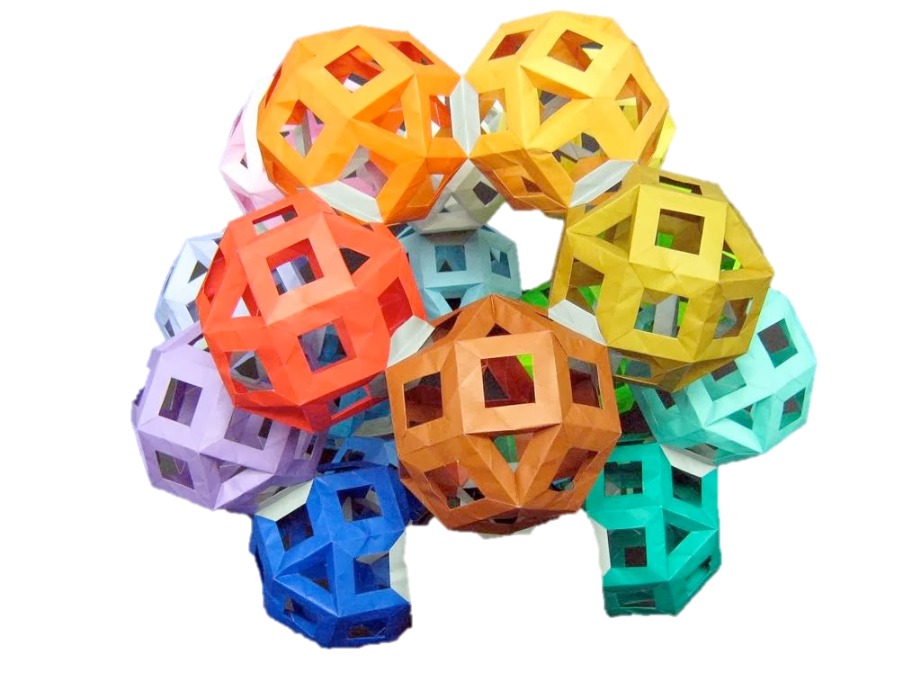
PREDICTION OF BIOMOLECULAR STRUCTURES
Protein folding
RNA folding

Slide 3
Molecular alphabet
NUCLEIC ACIDS AND PROTEINS ARE LINEAR POLYMERS → BIOSEQUENCES
DNA and RNA are linear polymers of nucleotides, specialized in the storage, transmission and use of genetic information
Proteins are polymers of amino acids, which perform functions thanks to their SHAPE in 3D space
Nucleic acids can take specific shapes in 3D space
  DNA double helix, G quadruplex, etc.
  RNAs, like proteins, can perform different activities (e.g. catalysis) thanks to 3D structures and given their ability to pair with other nucleic acids

Slide 4
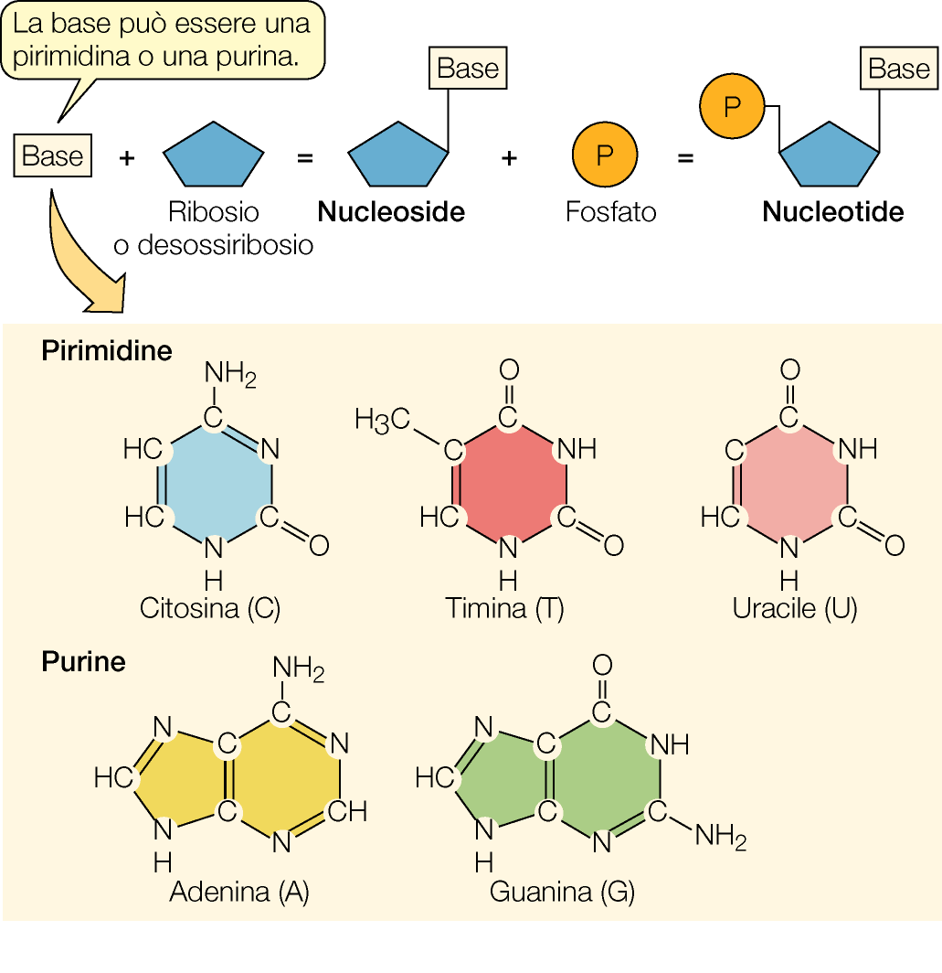
MACROMOLECULES: NUCLEIC ACIDS
NUCLEOTIDES
Nucleotide:
PENTOSE SUGAR (with 5 carbon atoms) which can be RIBOSE (in RNA) or DEOXYRIBOSE (in DNA)
NITROGENOUS BASE (C, T, U, A or G)
a phosphate group

Slide 5
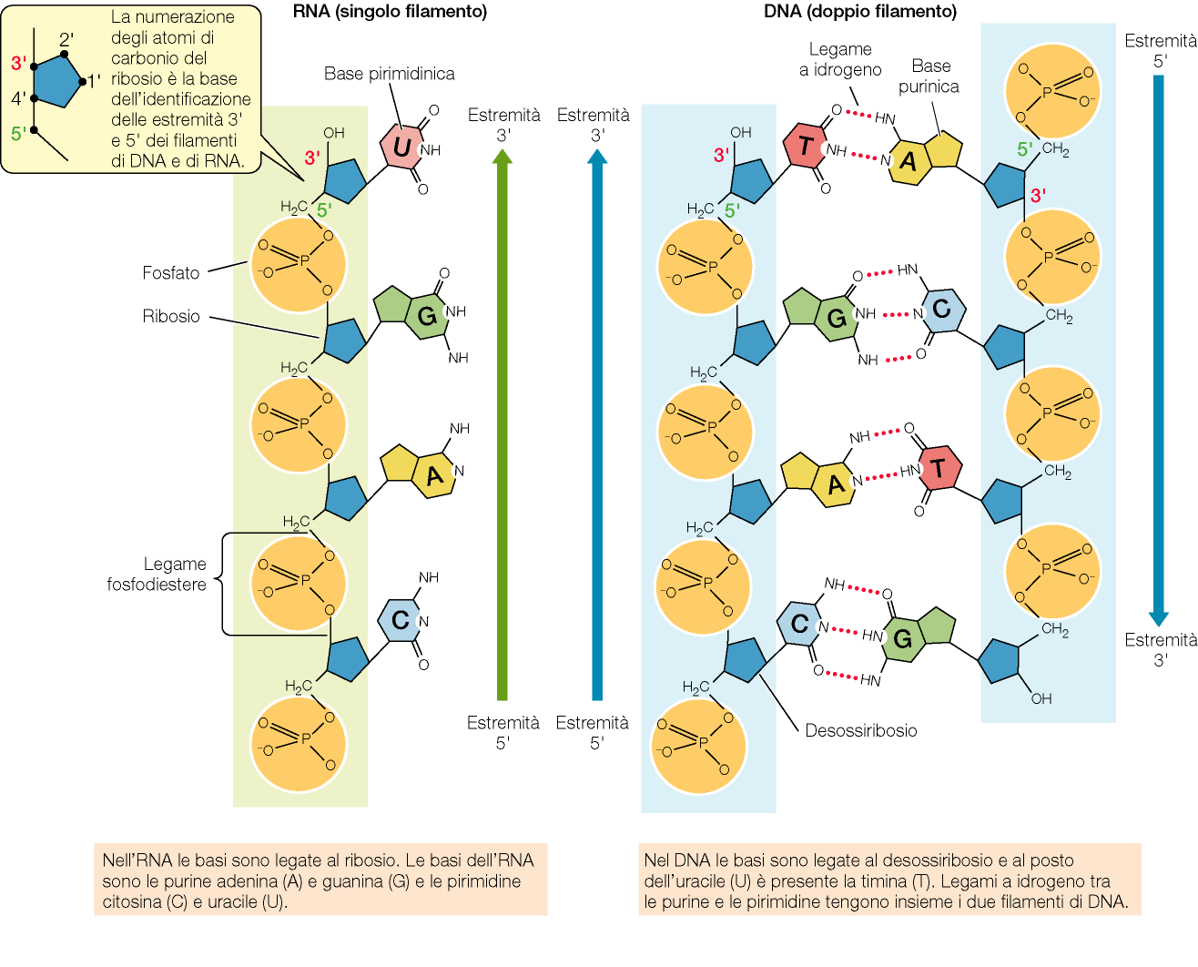
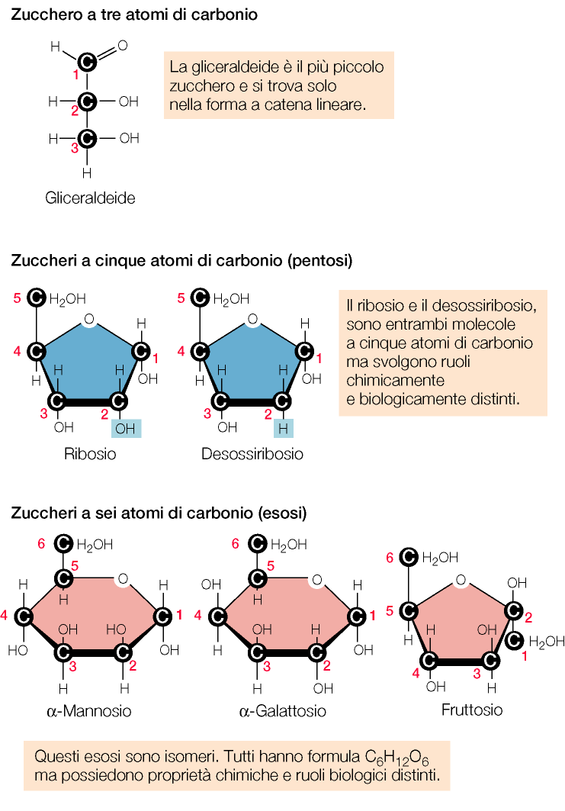
MACROMOLECULES: NUCLEIC ACIDS
RNA
DNA

Slide 6
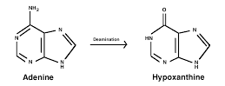
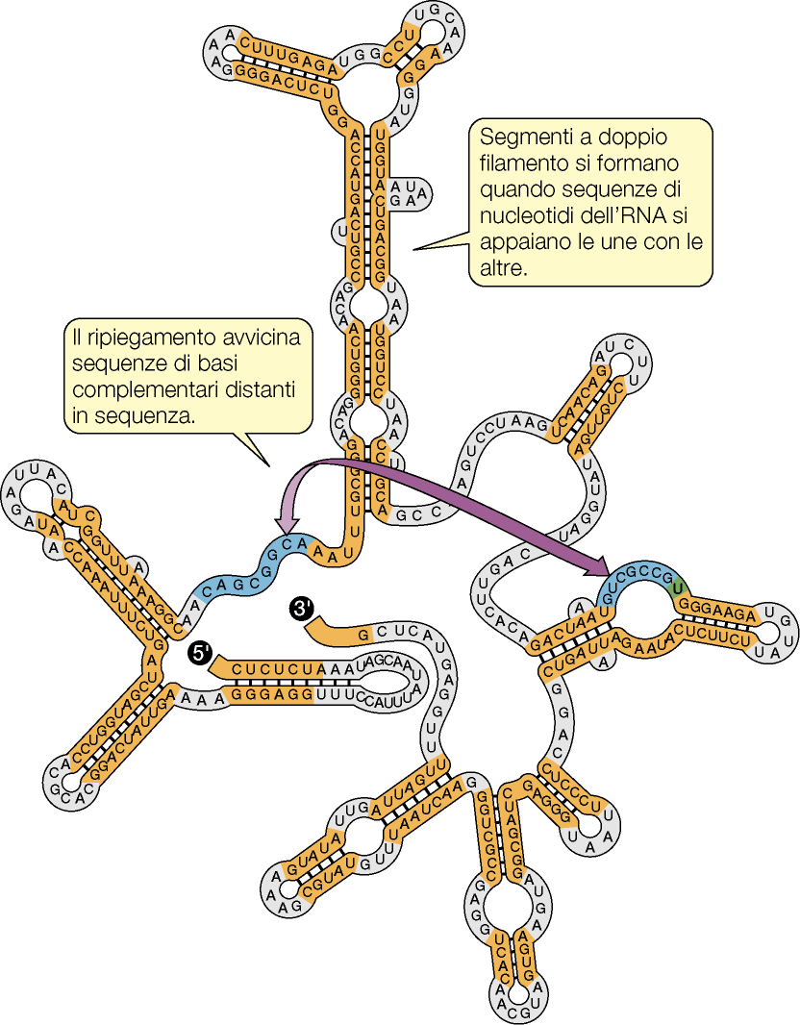
In RNA the pentose sugar is ribose and instead of Thymine there is Uracil (U)
RNA molecules can fold thanks to the pairing of complementary bases and take on specific shapes in 3D space
Wobble base pairs (G-U, I-U, I-A, I-C)
Stem-loop, bulges, tetraloops, pseudoknots
The main function of RNA is informational, and lies in the transfer of information from DNA to protein
RNAs with catalytic function and with many other non-coding molecular functions (lncRNAs, miRNAs, circRNAs)
RNA

Slide 7
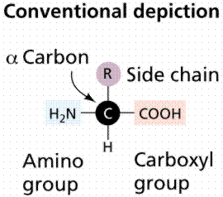
PROTEINS
About 500 known aa
22 proteinogenics all α-AA
20 AA encoded by the genetic code
2 "non-canonical" (pyrrolisin and selenocystine)
Of the 20, 9 "essential" for humans
AMINO ACIDS
Compounds with multiple functional groups bound to one C atom (Cα)
amino group
carboxyl group
H
“Side Chain”
Different side chains are found in the molecules of the different amino acids, with different composition, chemical properties and steric bulk

Slide 8
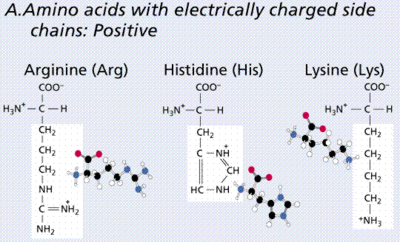
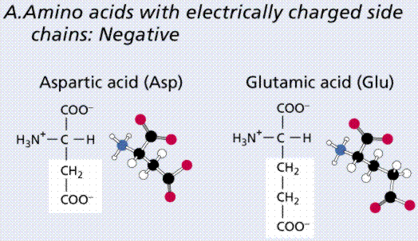
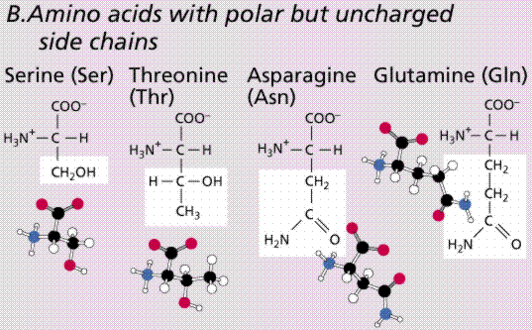
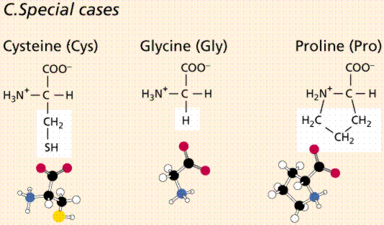
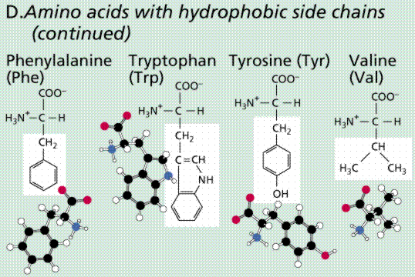
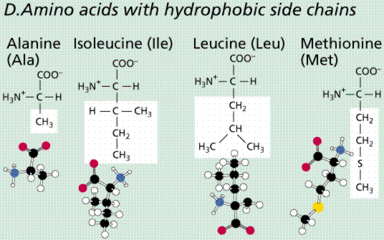
PROTEINS: 20 AMINO ACIDS proteinogenics

Slide 9
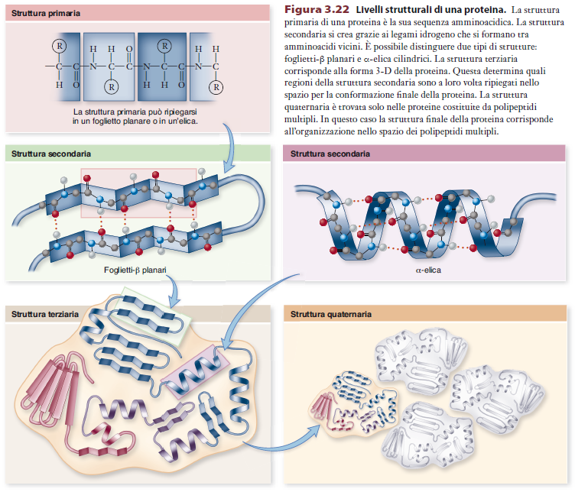
PRIMARY STRUCTURE
Protein
structure
levels
SECONDARY STRUCTURE
SECONDARY STRUCTURE
TERTIARY STRUCTURE
QUATERNARY STRUCTURE

Slide 10
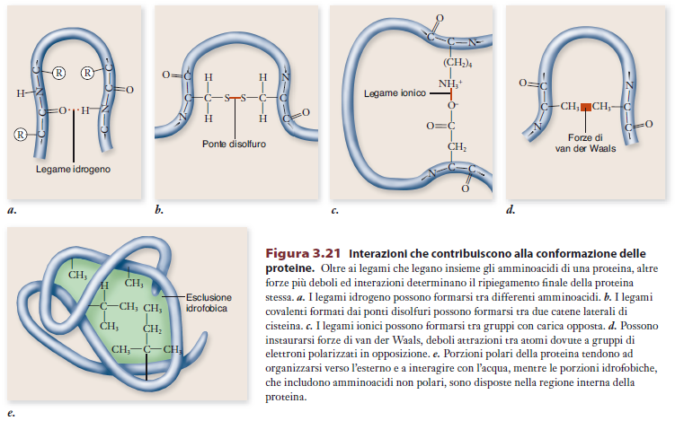
Ionic bonding: interaction between opposite charges, i.e. between charged side chains.
Van der Waals forces: due to interactions between molecules with asymmetric charge distribution (dipoles), weak forces, at short ranges.
Hydrophobic interactions: The hydrophobia of some aa causes the chains to fold so as to exclude water in regions occupied only by non-polar chains.
Hydrogen bonding: they determine secondary structures, but also tertiary ones.
Disulfide bridges: covalent bonds between cysteine side chains. Important for Tertiary Structure.
Notes:
Interazione tra dipoli permanenti Coinvolto H legato a elemento elettronegativo che attrae elettroni di valenza
WdW inerazionindeboli dovte a distribuzioni disomogenees di carica

Slide 11
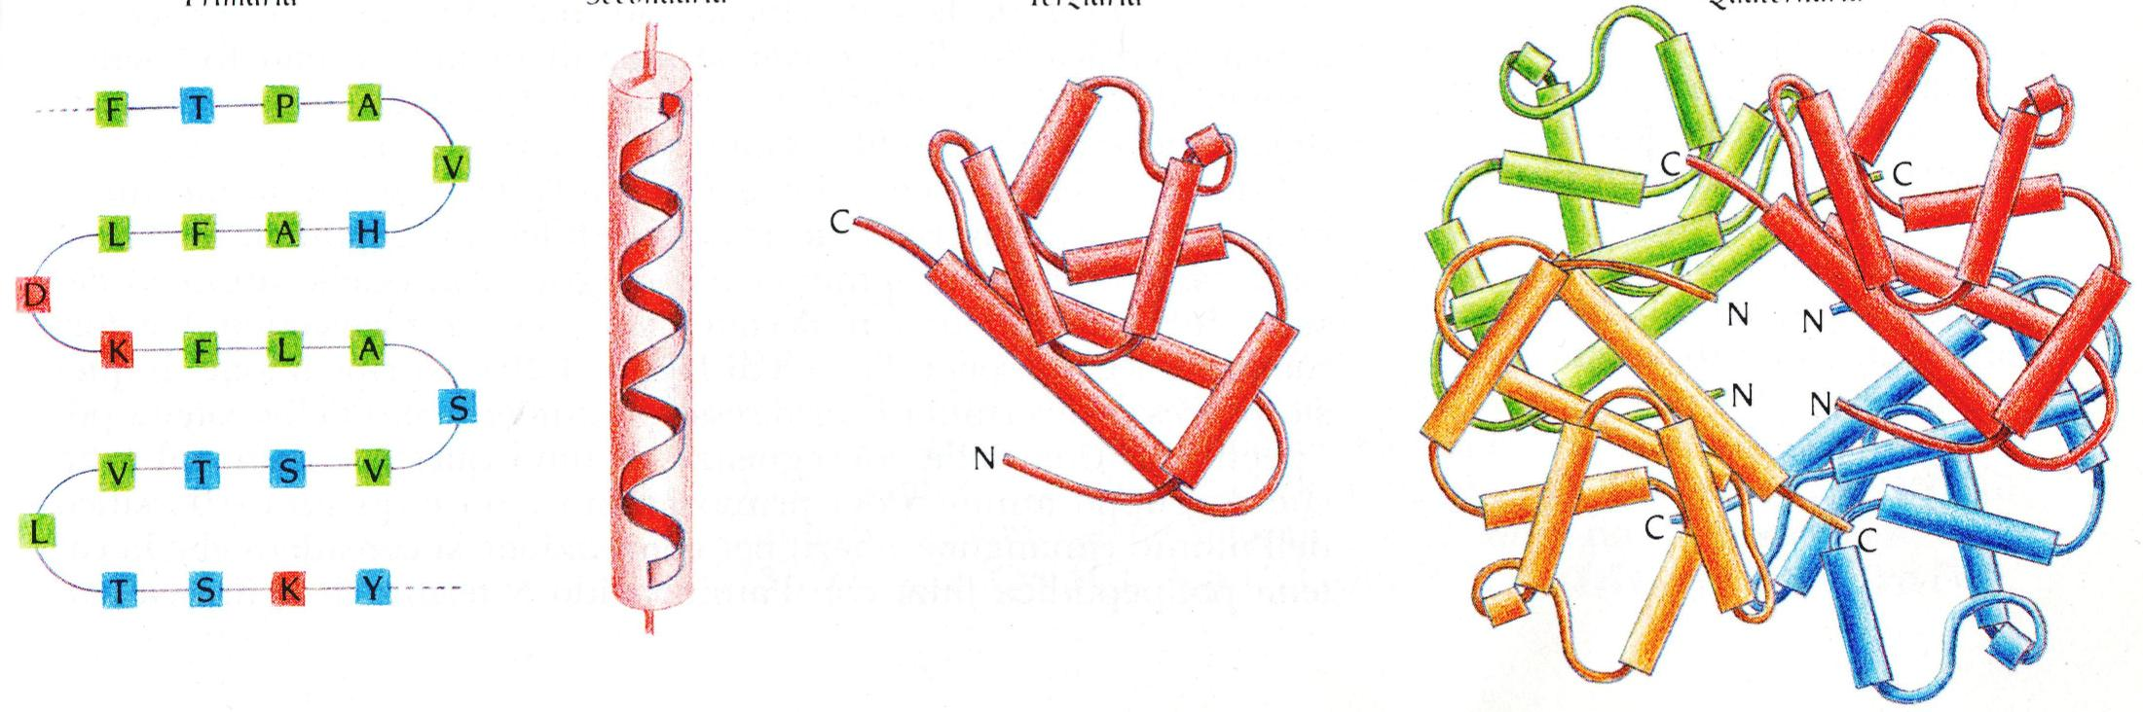
COVALENT
BONDS
NON-COVALENT
SHORT RANGE
BONDS
NON-COVALENT
LONG RANGE BONDS
+
DISULFIDE BRIDGES
Primary
Secondary
Tertiary
Quaternary

Slide 12
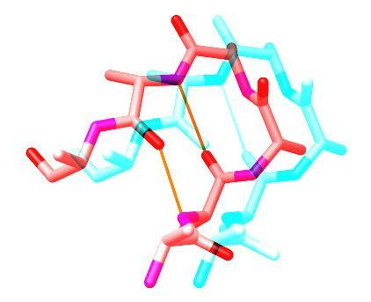
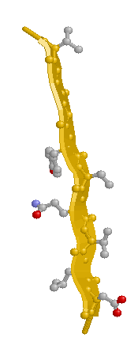
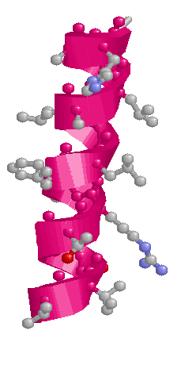
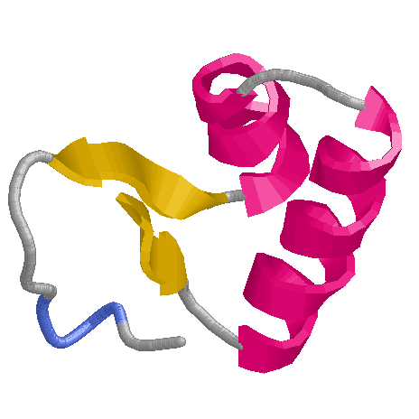
The secondary structural elements of proteins
β−Turn
β sheet
α -Helix
N
C

Slide 13
Why is it interesting to know the structure of a macromolecule?

Slide 14
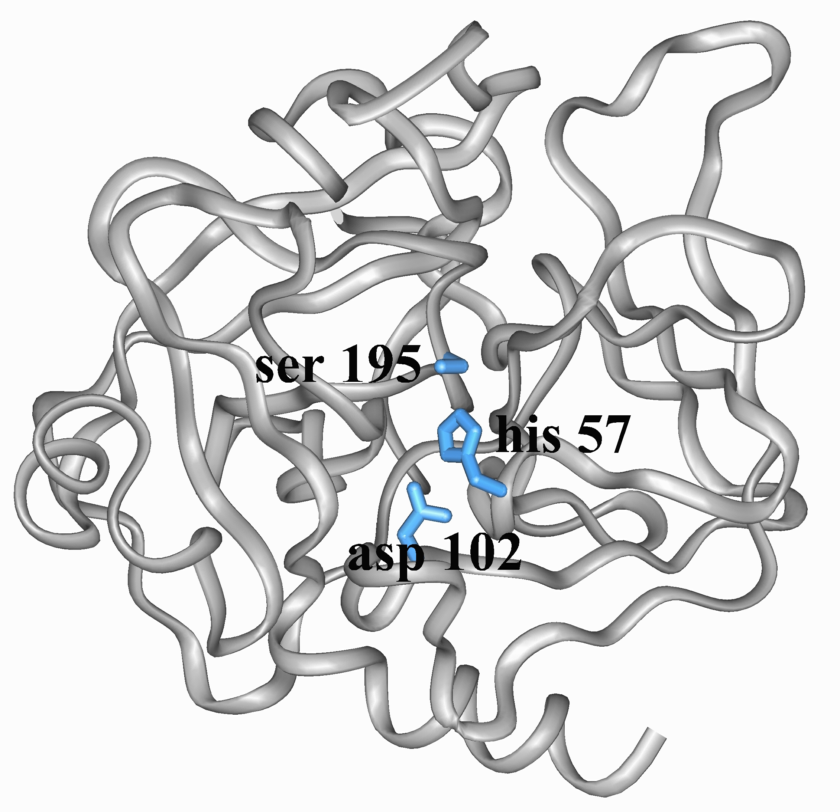
3D structure of chymotrypsin
The residues of the catalytic triad are not contiguous in the protein sequence
The contiguity of the residues in
structure determines the function
Notes:
in molti casi è vero che solo l’analisi della struttura tridimensionale di una macromolecola può aiutarci a comprendere in quale modo e per quale motivo una determinata sequenza (avvolta in una specifica struttura) possa svolgere una ben precisa funzione

Slide 15
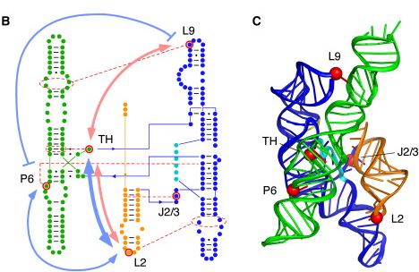
Structure of the Ribozime Group I
(Azoarcus sp.)
Mutations that alter interactions that are key for folding and function
Tertiary structure
The catalytic properties (self-excision and cutting of nucleotide substrates) depend on the structure
Notes:
Many noncoding RNAs fold into unique 3D structures, which allow them to catalyze biochemical reactions or act as regulators of gene expression. Recent genomic sequence analyses indicate that noncoding RNAs with complex structures are widespread in nature (Weinberg et al., 2009 and Westhof, 2010) and may encode a greater variety of biochemical functions than currently known.
Group I introns are catalytic RNAs (ribozymes) that do not require the spliceosome for their removal from primary transcripts. Instead, these ribozymes fold into catalytically active structures that undergo two successive transphosphorylation reactions, facilitating their own excision and the ligation of the two flanking exons

Slide 16
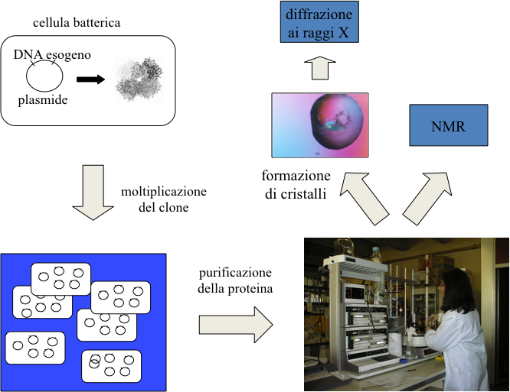
How can the structure of a protein be studied?
Classical experimental methods for solving the 3D structure:
X-ray crystallography
Magnetic and nuclear resonance (NMR) spectroscopy
Cloning in bacteria
X-ray diffraction
NMR
Clone expansion
Crystals
Protein purification

Slide 17
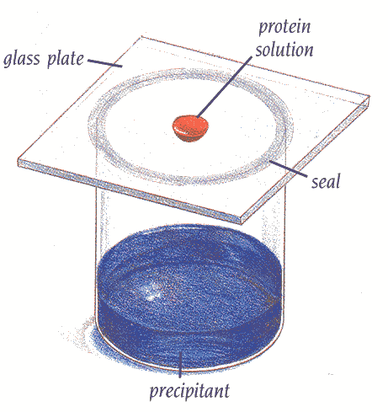
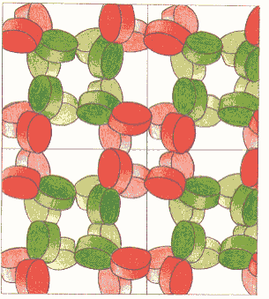
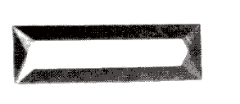
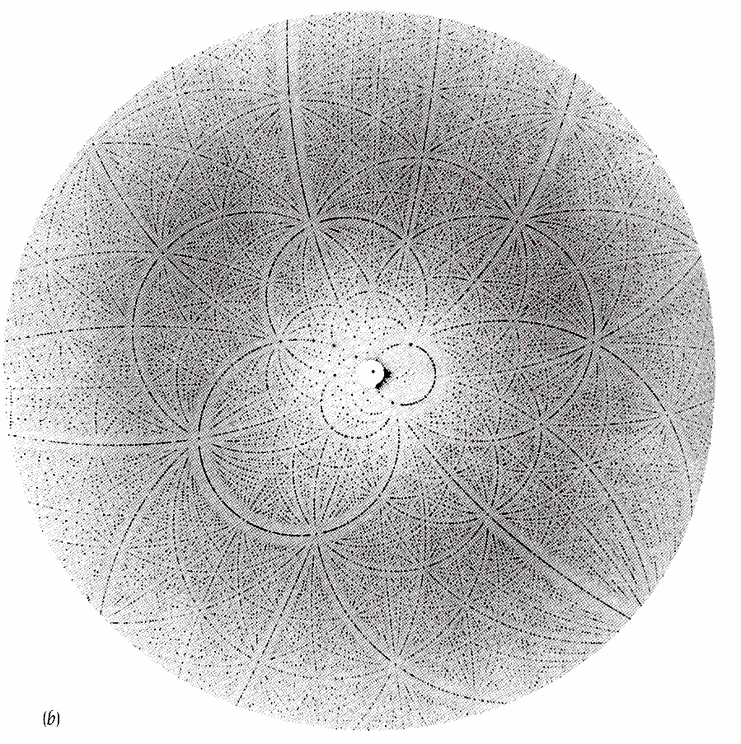
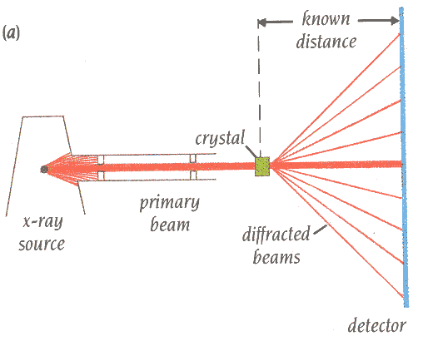
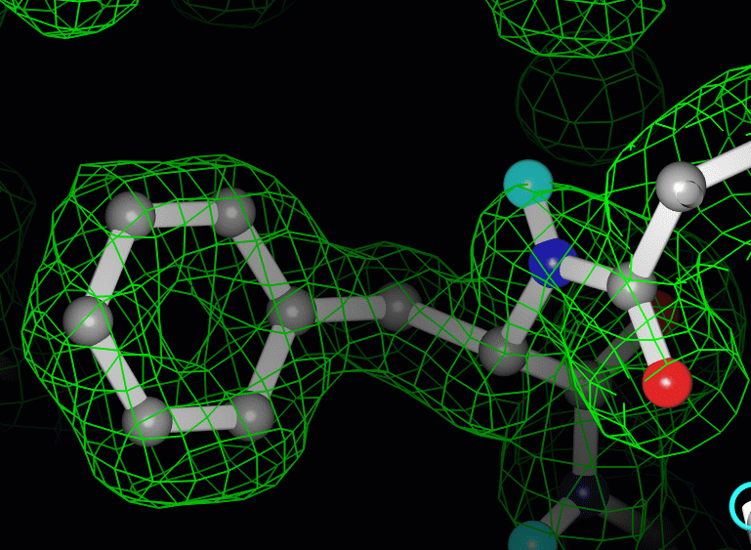
X-Ray Crystallography
~0.5mm
Protein crystal
X-Ray diffraction
Electron Density Maps
two-dimensional images taken at different orientations

Slide 18
Uniprot/Swissprot Release 2014_08 of 03-Sep-14 of contains 546,238 sequence entries
PDB As of Tuesday Sep 16, 2014 at 5 PM PDT there are 103,354 Structures (lower number of unique structures)
600000
Sequence structure gap
500000
400000
300000
200000
100000
0
Sequenze
Comparative Models
Strutture

Slide 19
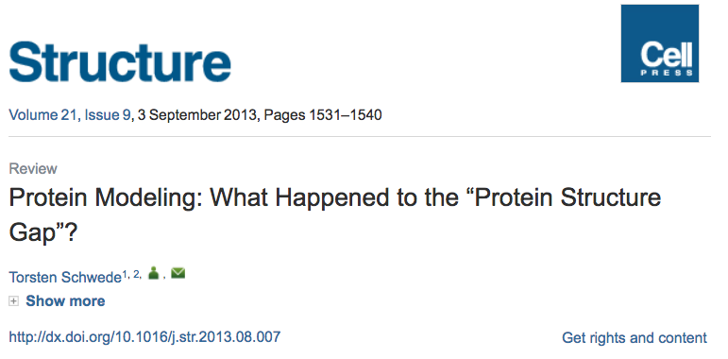

Slide 20
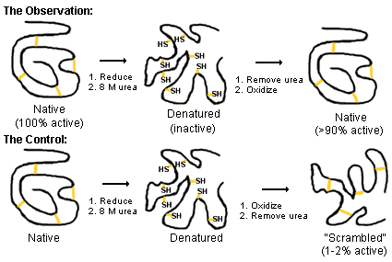
Anfinsen's Experiment (1973) - The primary sequence of a protein determines its structure: an experimental test
  β-mercaptoethanol – breaks disulfide bonds
  Urea or guanidine hydrochloride – denaturant, also heat or pH
RNAse A
The information contained in the sequence is sufficient to determine the folding and function of the protein → Thermodynamic hypothesis: the native structure of a protein corresponds to the thermodynamically most stable overall structure

Slide 21
Levinthal’s paradox
Consider a 100 residues protein.
If each residue can take only 3 positions, there are 3¹⁰⁰ = 5 × 10⁴⁷ possible conformations.
If it takes 10⁻¹³s to convert from 1 structure to another, exhaustive search would take 1.6 × 10²⁷ years!
But, proteins fold in millisecond even not in microsecond times
→ Folding must proceed by progressive stabilization of intermediates
  Molten globules (MG) – most secondary structure formed, but much less compact than “native” conformation
  U ↔ MG ↔ N

Slide 22
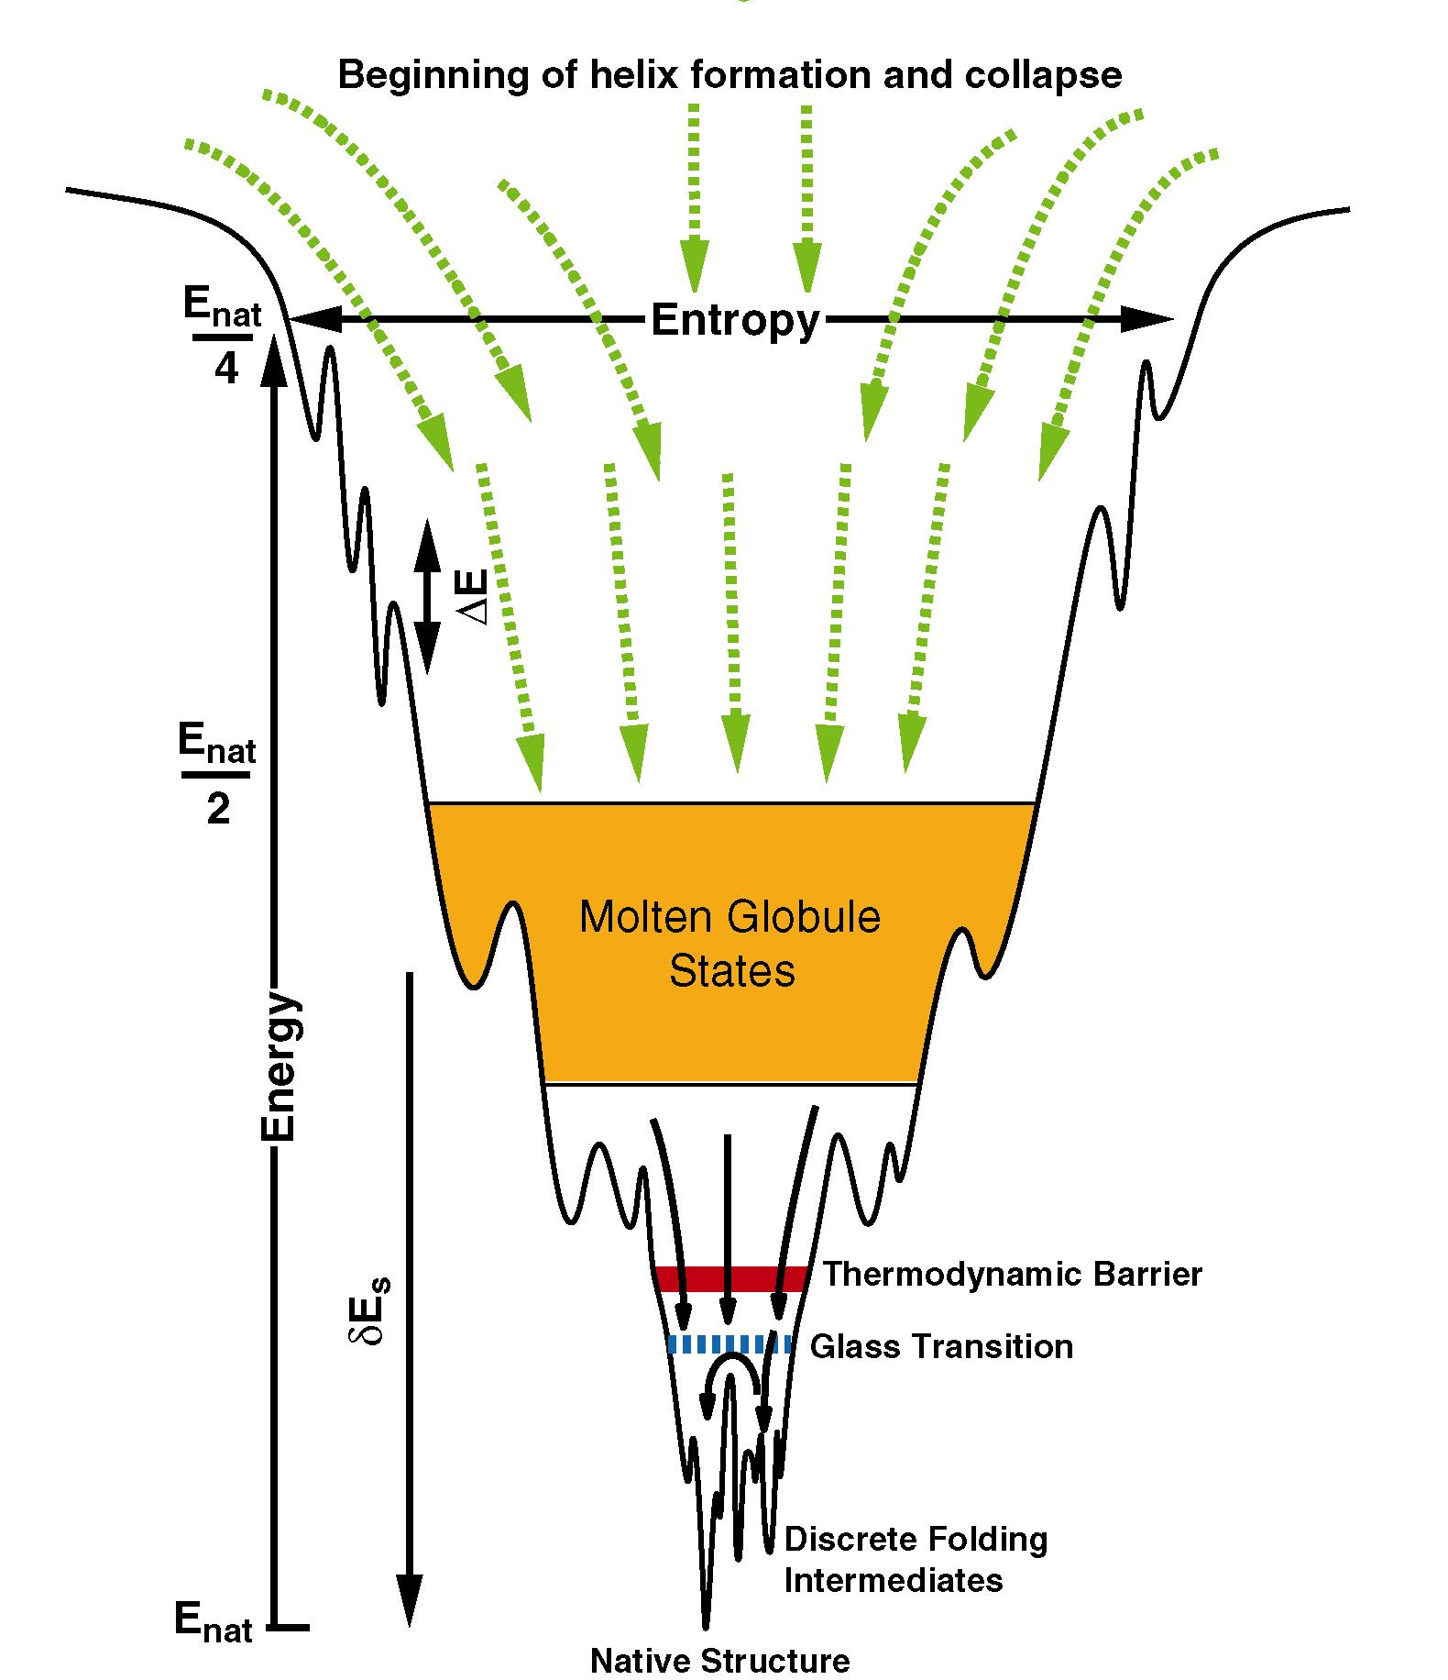
Anfinsen thermodynamic hypothesis
The information encoded in the amino acid sequence of a protein completely determines its native structure
The native state is the absolute minimum of the free energy of the protein

Slide 23
Structure Method
experimental computational
Primary
Secondary
Tertiary
Quaternary
Circular
dichroism
Secondary structure prediction methods
Homology Modelling
Fold Recognition
Folding ab-initio
X-ray crystallography
NMR

Slide 24
Secondary structure
prediction

Slide 25
The secondary structural elements of proteins
β−Turn
β sheet
α -Helix
N
C

Slide 26
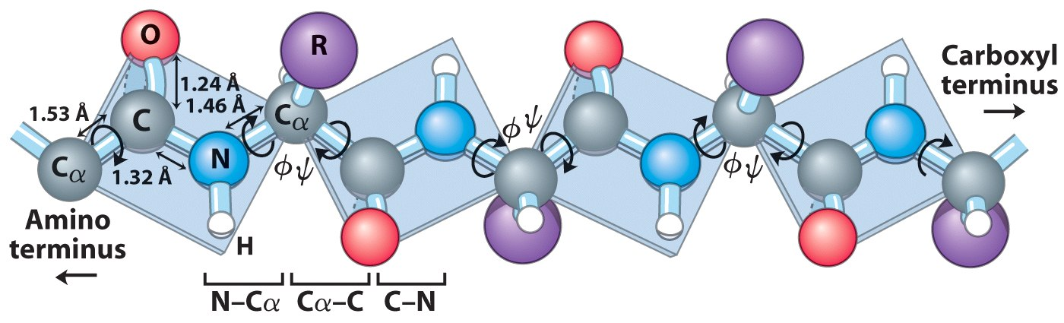
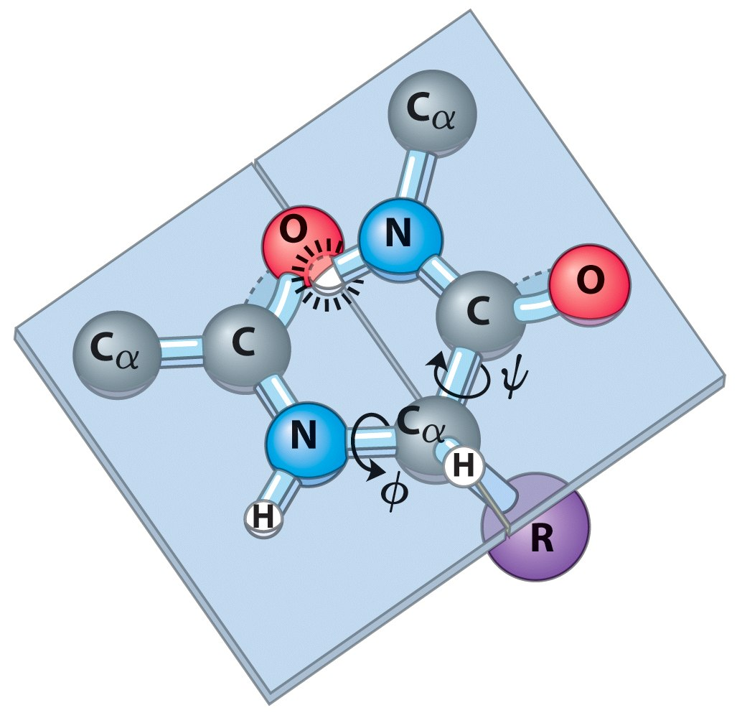
The peptide bond is rigid and planar
The backbone conformation is defined by two dihedral angles of the amino acid residues:
Φ (phi) N-C_{α} bond (hetero) Ψ (psi) C_{α}-C bond (same)
e ψ are 180 when the polypeptide is in the (forbidden) conformation where the peptide groups are on the same plane

Slide 27
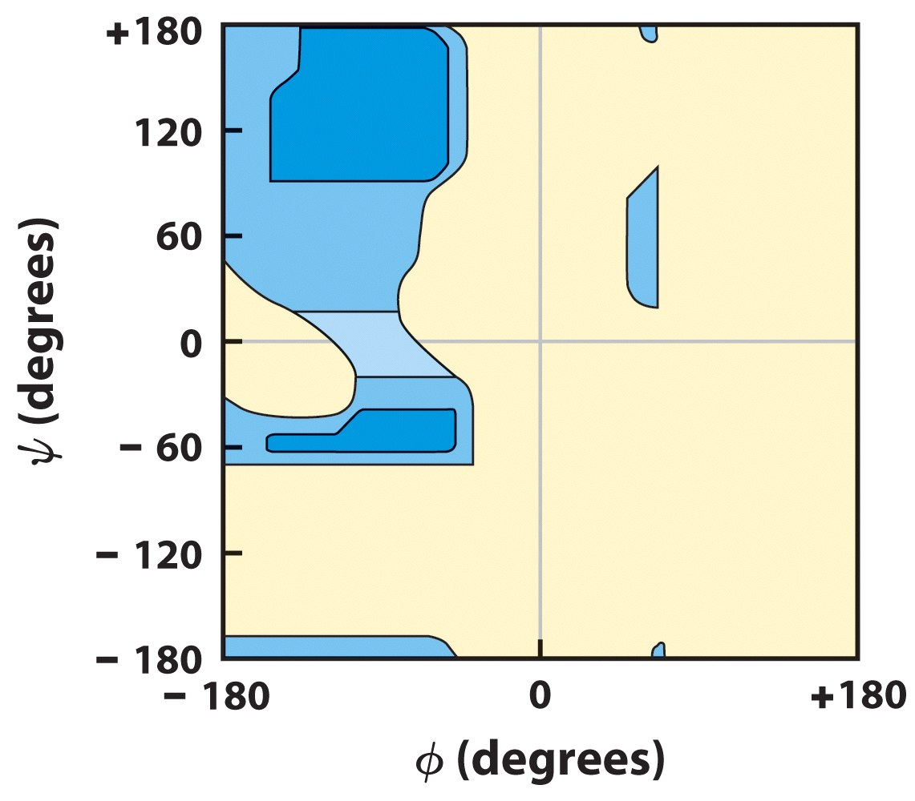
Ramachandran plot (L-Ala)
allowed conformations in blue
Beta
Negative Φ and Ψ positive (e.g.-150 e 120)
Alpha
Φ e Ψ both negative
(e.g.-60 e -60)
Steric collision
Typical for all non-glycines

Slide 28
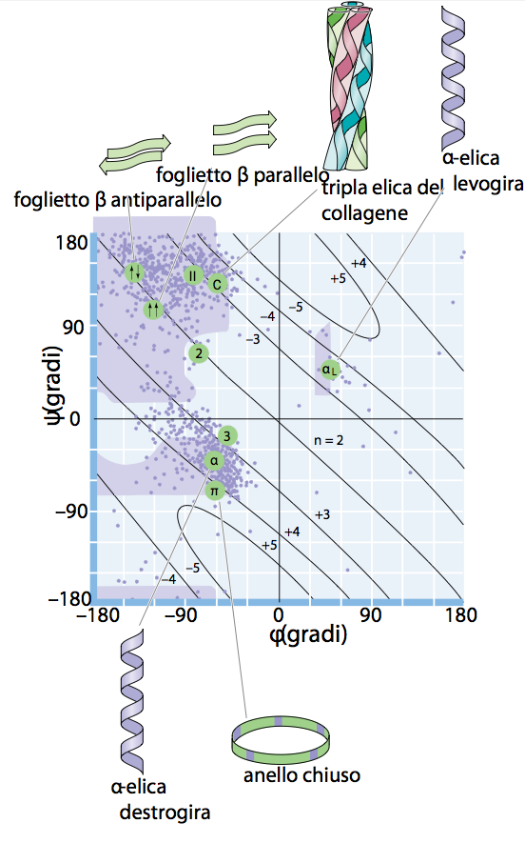
'Populated' conformations of torsion angles and sparsely populated 'forbidden' zones

Slide 29
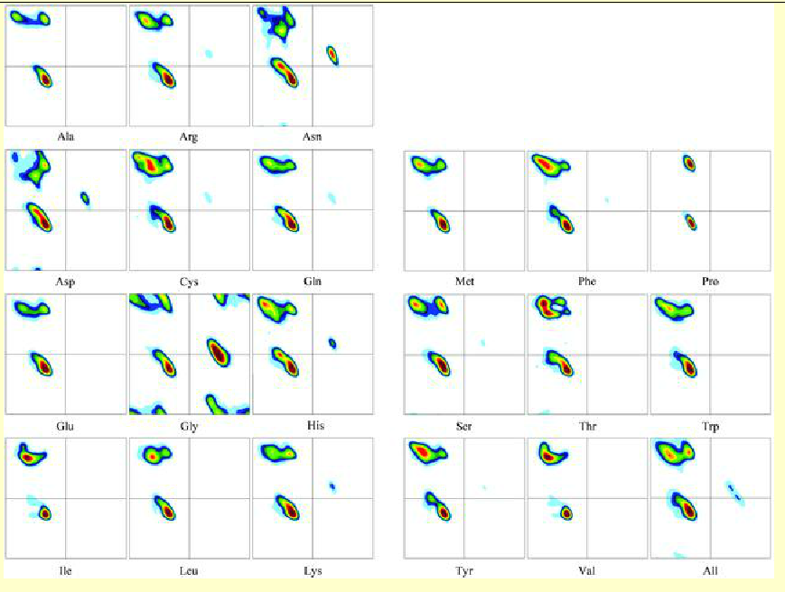
Ramachandran plots for each of the 20 amino acids
(All includes all 20 amino acids)
Most amino acids have two distinct maxima in the [beta]-sheet region (upper left quadrant).
Asp and Asn have the most complicated plots after Gly. This reflects their role in terminating [alpha]-helices and [beta]-sheets.
The two amino acids with highest preference for [beta]-sheets, Ile and Val, have very similar Ramachandran plots.
The plots of the three large hydrophobic amino acids Phe, Tyr and Trp look alike.

Slide 30
Accuracy of secondary structure predictions
If:
N = predicted residues
M_{i =} correct predictions
Q₃=100/N Σ_{i=α,β,loop}M_{i}
Q₃ → Percentage of residues correctly predicted

Slide 31
Assumptions
The sequence determines the secondary structure
The side chains of the aa determine the structure of the chain region of which they are part

Slide 32
Chou-Fasman method (1974)
Consider the single residue
Method based on the statistical analysis of the residue composition of known secondary structures (present in PDB)
Some residues are more often associated with certain structures(α-helices, β-sheets, coils)
Examples: Glu α-helix
Val β-strand

Slide 33
Chou-Fasman method (1974)
Each AA is assigned:
Conformational parameters
P(a), P(b) e P(t) Based on the observed frequencies of the different AAs in known secondary structures
Bending Parameters
f(i), f(i+1), f(i+2), f(i+3)
Based on how often the AA is in first, second, and third position on a hairpin turn
Name P(a) P(b) P(turn) f(i) f(i+1) f(i+2) f(i+3)
Alanine 142 83 66 0.06 0.076 0.035 0.058
Arginine 98 93 95 0.070 0.106 0.099 0.085
...

Slide 34
Chou-Fasman method (1974)
Name P(a) P(b) P(turn) f(i) f(i+1) f(i+2) f(i+3)
Alanine 142 83 66 0.06 0.076 0.035 0.058
Arginine 98 93 95 0.070 0.106 0.099 0.085
Aspartic Acid 101 54 146 0.147 0.110 0.179 0.081
Asparagine 67 89 156 0.161 0.083 0.191 0.091
Cysteine 70 119 119 0.149 0.050 0.117 0.128
Glutamic Acid 151 037 74 0.056 0.060 0.077 0.064
Glutamine 111 110 98 0.074 0.098 0.037 0.098
Glycine 57 75 156 0.102 0.085 0.190 0.152
Histidine 100 87 95 0.140 0.047 0.093 0.054
Isoleucine 108 160 47 0.043 0.034 0.013 0.056
Leucine 121 130 59 0.061 0.025 0.036 0.070
Lysine 114 74 101 0.055 0.115 0.072 0.095
Methionine 145 105 60 0.068 0.082 0.014 0.055
Phenylalanine 113 138 60 0.059 0.041 0.065 0.065
Proline 57 55 152 0.102 0.301 0.034 0.068
Serine 77 75 143 0.120 0.139 0.125 0.106
Threonine 83 119 96 0.086 0.108 0.065 0.079
Tryptophan 108 137 96 0.077 0.013 0.064 0.167
Tyrosine 69 147 114 0.082 0.065 0.114 0.125
Valine 106 170 50 0.062 0.048 0.028 0.053

Slide 35
The algorithm then defines the regions that are part of α-helices, β sheets, and β bends as follows:
α helix
Search for regions of 4-6 contiguous AAs withP(a)>100
Try to extend them in both directions until it encounters 4 residuals with average P(a)<100
If the extended region ΣP(a)>ΣP(b) e l>5 → α-helix
β sheets
Identify β sheets in a similar way average P(b)>100 e ΣP(b)>ΣP(a)
3. Resolves overlaps α/β
4. Β turns
At the end β turns are detected
P(t)i=f(i)+f(i+1)+f(i+2)+f(i+3) is calculated
If P(t)i>0.000075 and the average value (from i to i+3) of P(t) >100 and ΣP(a)<ΣP(t)>ΣP(b)
This method considers only the single aa,
does not use conditional P
Q₃ approximately 50%

Slide 36
The GOR method
(Garnier-Osguthorpe-Robson, 1978)
Consider a sequence segment
Like C-F, GOR it is based on the statistical analysis of the residual composition of the known secondary structures present in PDB.
Bayesian inference:
  Based on P_{ij} values of Chou-Fasman
  But also of the E sulla conditional probability of a AA participating to a structure (Alpha, Beta o Loop), conditioned to the contribution of its neighbors.
  It uses a window of 17 (8-1-8) residues to determine the probability of the central residue to be part of a specific secondary structure (sliding window approach)
Notes:
.[12] The GOR method takes into account not only the probability of each amino acid having a particular secondary structure, but also the conditional probability of the amino acid assuming each structure given the contributions of its neighbors (it does not assume that the neighbors have that same structure)

Slide 37
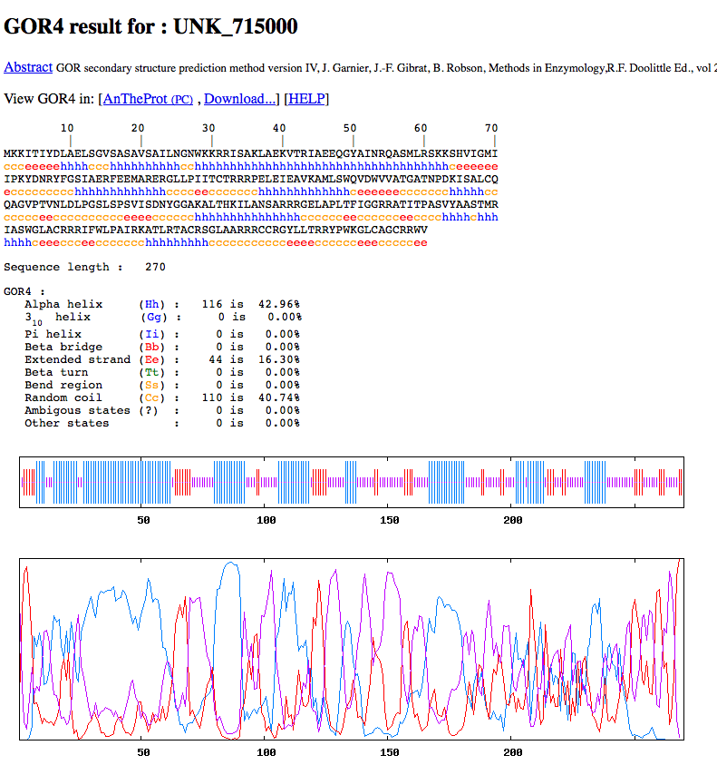
Il metodo GOR
Q₃ <60%

Slide 38
Predictive methods based only on the local context have limited accuracy
Role long-range bonds especially in β sheets
NEURAL NETWORK
(NN)-BASED METHODS
Ground on multiple alignment analysis
Evolution provides us with information on which AAs are key to the maintenance of a certain secondary structure

Slide 39

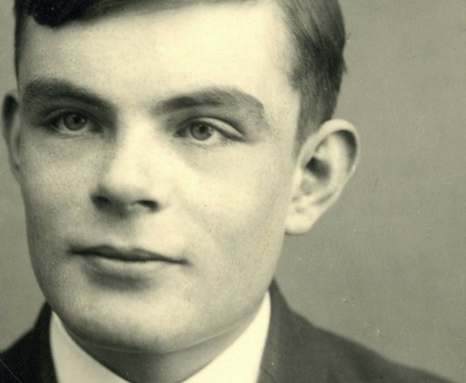
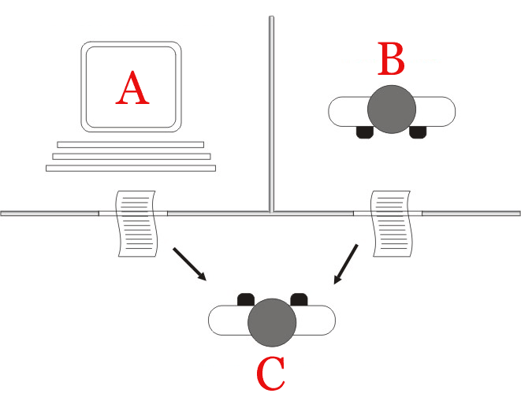
Is AI just an imitation of the human mind?
1950, Alan Turing “Computing Machinery and Intelligence”
‘‘I propose to consider the question,
‘Can machines think?’ ’’
What is intelligence?
Turing defines a specific task to do
Can a computer text and answer to questions in a way that a human interrogator could not tell it apart, through written conversation, from a human being?
Turing test
Judge
Notes:
But an important precursor in the field has been Alan Turing, the british matematician who you problably knwow for his work in the british team at
Bletchley Park that decoded the Enigma code used by nazis to encode military messages
He is also sadly known for a terrible persecution operated by the british governement for his homosexualirty and that likely brought him to commit suicide.
Anyhow, after the war, Turing contributed to the development of one of th first programmable calculators and dedicated his studies to the first concepts of artificial intelligence. In the paper “Computing Machinery and Intelligence”, he opens with the words “I propose to consider the question, 'Can machines think?'" Because "thinking" is difficult to define, Turing chooses to "replace the question by another, which is closely related to it and is expressed in relatively unambiguous words."[
Turing describes the new form of the problem in terms of a three-person game called the "imitation game",
Turing test: whether a machine can aswer as a human cheating another human

Slide 40
Is AI just an imitation of the human mind?
AI founder, John McCarthy:
"Artificial intelligence is not, by definition, simulation of human intelligence"
The intelligent agent paradigm defines the concept of “intelligent behavior” in general, without reference to human beings.
Intelligent agent = a system with a goal-directed behavior
Notes:
We started to introduce AI in relation to the human mind, welll.. there are parallels, but this wiew il limited.
Also, since early times, the Turing test has been criticized for being chauvinistic, too antropocentric in other words
So this will lead us to the question if AI is just an imitation of the human mind. Also the founder of

Slide 41
Artificial
Intelligence
Machine Learning
Neural
networks
Deep
learning
Complexity
Notes:
The AI field is big, it comprises many methods, including more simple Machine learning methods.
A further and more recent development is represented by Neural networks.
More complex and powerful NN are called Deep learning
The white dot stands to say that the AI field is in rapid evolution and new methods and approaches are proposed every day

Slide 42
ARTIFICIAL NEURAL NETWORKS (NN)
Neural networks (NN) are programs that can learn, in an attempt to simulate the behavior of the human brain.
NNs are trained using a suitable set of data called a training set (e.g. a set of sequences of known structure that fold into α-helix, β sheets and other non-α non-β elements)
Once well trained, NNs can then make predictions (e.g. distinguishing α-helix from β− sheets and otehr elements)

Slide 43
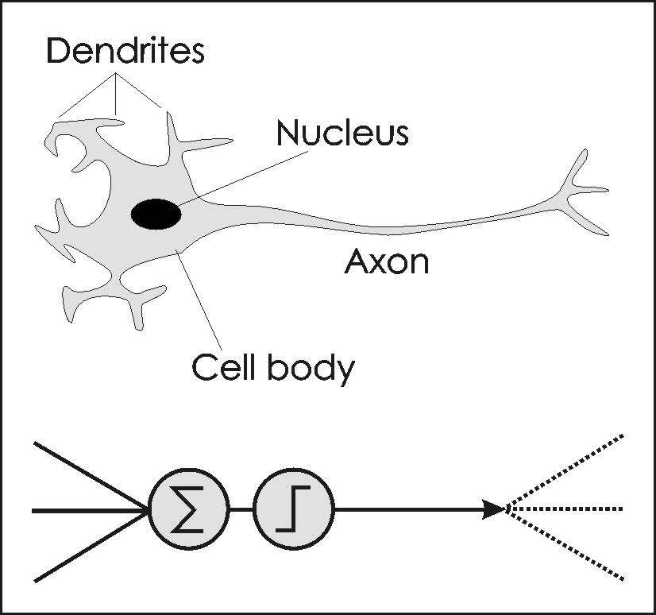
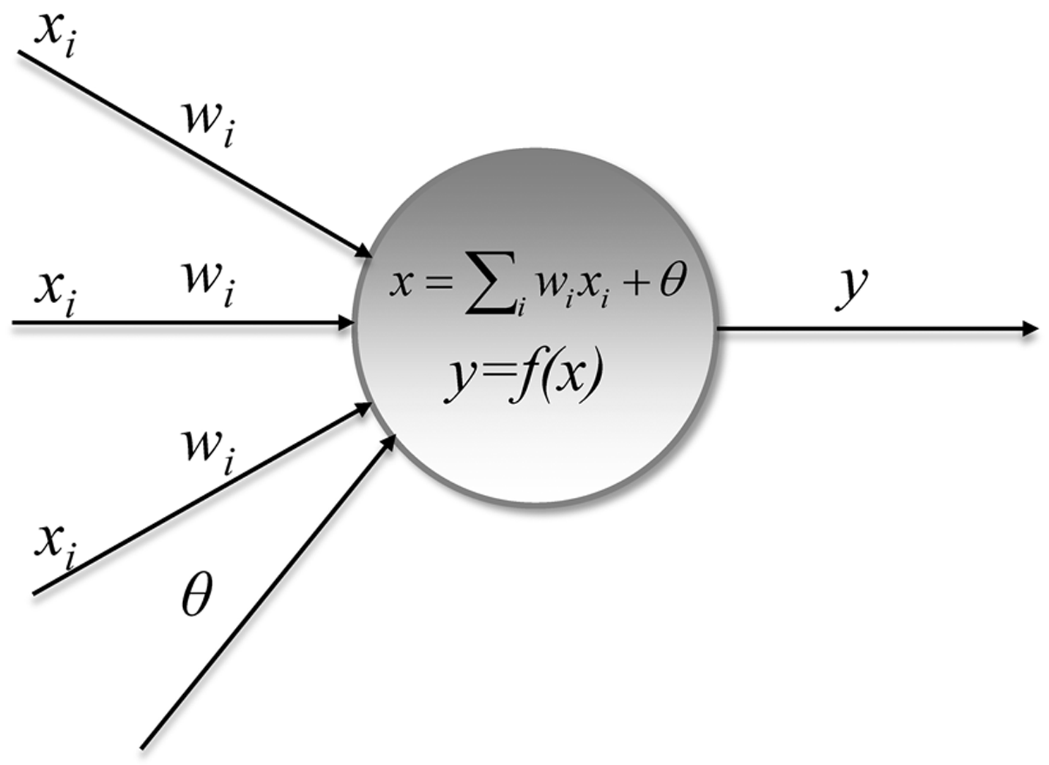
NNs are sets of equations (neurons) linked together (synapses)
Each neuron receives and integrates inputs (x_{i})
The state of activation of the neuron and therefore its output (y) is then determined
Weights (biases, w_{i}) associated with the neuron are values that modify the output of the neuron

Slide 44
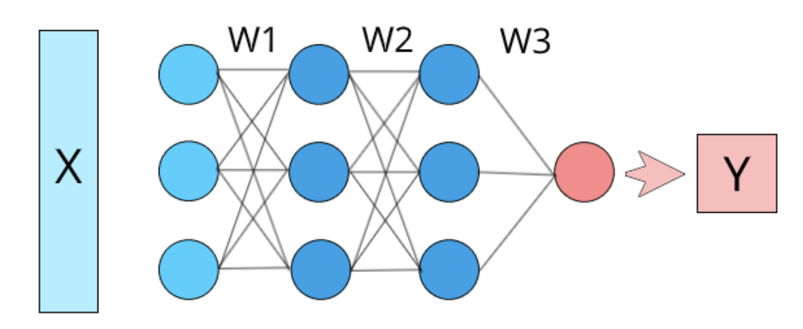
The first equations describe the object under analysis
(input layer)
The final equation provides the classification (or other data)
(output)
Hidden layers
in between
The concatenation between equations is represented in an architecture (relations, weights, etc.)
The architecture is modified in the training phase in order to optimize the NN and maximize the predictive capacity
→ The architecture represents the knowledge acquired
Generalization

Slide 45
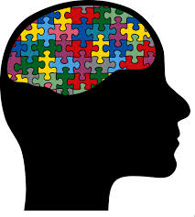

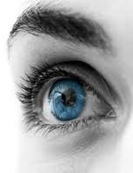
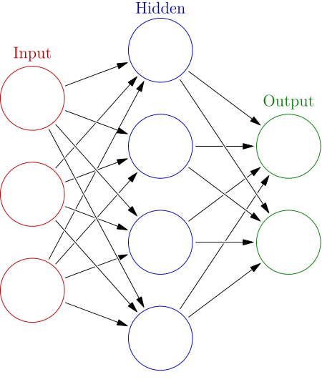
NEURAL NETWORKS (NN)
Obviously, it's a Tree!
It is a Tree, with a certain probability

Slide 46


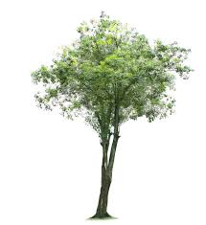

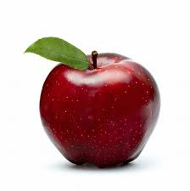


Machine Learning: Neural Networks
Training
Prediction
Known set
New Item
Tree
General Rules
learned
Non Tree
Prediction
Mapping is known
Tree P=98% | Not a tree P=2%

Slide 47
Machine Learning: Neural Networks
Training
Prediction
Set from the database
New sequence
General Rules
learned
Backpropagation
During supervised training the architecture is modified taking into account the known mapping, until it is optimized to minimize the classification error
Mapping
α helix
β sheet
β turn
Prediction
α helix | β sheet | β turn
probabilities
Notes:
Funzione di costo

Slide 48
Testing and validating a NN
Protein set
Testing
(or prediction)
set
Training
(or learning)
set
Training set: A set of known mapping datasets (f.i. non-homologous proteins with known structure)
Test set: A disjointed set to use as a performance test
    Do the rules work?
        Are they general enough?
          Overtraining?

Slide 49
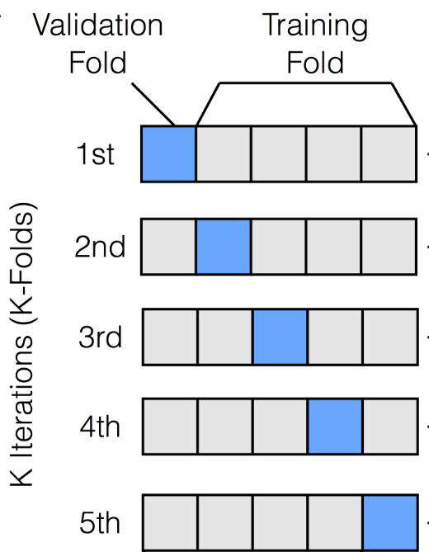
K-FOLD CROSS VALIDATION
all n observations are used for both training and validation
each observation is used for validation exactly once and is used in training k-1 times
If K=n Leave One Out CV
Average
performance
measure
Notes:
An efficient way to proceed is the well-known K-fold cross validation scheme
this is a statistical technique in which we split the data into K folds (usually 5 to 10 parts)
and in K different iterations each fold is used in turn as validation folds, while the remaing are used for the training
The main advantages are that
all n observations are used for both training and validation
each observation is used for validation exactly once
we obtain a measure of performance averaged over K iterations, that is expected to be more stable
The variance of the resulting estimate is reduced as k increases.
There are many variations of this procedure
f.i. is K equals n the numver of observations, it is called Leave One Out cross validation. This presets the advantage of liiting the overestimation of the MSE compared to using a single test set. stable measure over n-1 calculations but expensive
can be very computational intensive with large datasets.
An issue interfering with K-fold cross validation can arise when the class of interest (red dots) is very rare, as frequently occurring in real world, f.i. with rare diseases
LOO CV It tends not to overestimate the test MSE compared to using a single test set. stable measure over n-1 calculations but expensive

Slide 50
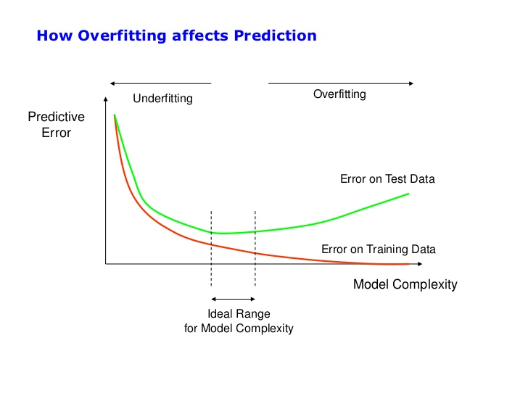

VALIDATION and TESTING
Notes:
The testing data shown in green are observations that were not used, we can say, never seen by the model before
If the model has a good performance at the validation, and also passes this test, we can use it
Otherwise, if the error sensibly increases when the model is applied to the test data, this can indicate overfitting.

Slide 51
In the context of the prediction of the secondary structure of polypeptides: The input window
The properties of the residue R depends on local interactions (window W) and non-local interactions (context C)
Context C
Window W
Residue R
Neural Network
O_{α}
O_{not α}

Slide 52

La finestra di input
Not a single sequence
but a multiple alignment is used as input for the neural network
→ Increased accuracy

Slide 53


Multiple alignment encoded in a profile used as input for the neural network
PHD
Multiple levels of NN resolve inconsistencies
Final jury produces "averaged" values with an estimate of reliability (Reliability Index, RI)
Giuria

Slide 54
Methods for secondary structure prediction
AGADIR to predict the helical content of peptides
http://agadir.crg.es/
PSIPRED uses a system of two neural networks
Alignment construction using PSI-BLAST
http://bioinf.cs.ucl.ac.uk/psipred/
PREDATOR is based on recognition of potentially hydrogen-bonded residues in a single amino acid sequence
https://npsa-prabi.ibcp.fr/cgi-bin/npsa_automat.pl?page=/NPSA/npsa_predator.html
JPRED4
https://www.compbio.dundee.ac.uk/jpred/
Makes a consensus of various methods
Q₃ >80%

Slide 55
PSIpred Output
Conf: Confidence (0=low, 9=high)
Pred: Predicted secondary structure (H=helix, E=strand, C=coil)
AA: Target sequence
Conf: 988766667637889999877999871289878877049963202468899999997887
Pred: CCCCCCCCCCHHHHHHHHHHHHHHHHHCCCCCCHHHCCCCCHHHCHHHHHHHHHHHHHHH
AA: MQRSPLEKASVVSKLFFSWTRPILRKGYRQRLELSDIYQIPSVDSADNLSEKLEREWDRE
10 20 30 40 50 60
Conf: 742888731467888768899999999999999987557888998875227887303678
Pred: HHCCCCCCHHHHHHHHHHHHHHHHHHHHHHHHHHHHHHHHHHHHHHHHHCCCCCCCHHHH
AA: LASKKNPKLINALRRCFFWRFMFYGIFLYLGEVTKAVQPLLLGRIIASYDPDNKEERSIA
70 80 90 100 110 120
Confidence level
Predicted structure

Slide 56
Methods for protein fold prediction
(tertiary structure and function)

Slide 57
Based on
theoretical
principles
Long calculation times
A b inizio
Homology or
Comparative
modelling
Knowledge
based
Methods
They are based on the available structural and sequence information, whether or not they use evolutionary information.
Threading/Fold recognition
Good results, high speed

Slide 58
ab inizio
NO alignment
NO known structure
AB INIZIO OR DE NOVO
Given a protein sequence, calculate its structure
The calculation is based on the estimation of the energy relative to the position of each atom in space and its chemical-physical relationship with the other atoms and with the solvent
The global minimum of the energy function defines the most likely 3D structure
Approach:
Construct an empirical merit function that describes the forces of interaction
Explore the conformational space to maximize merit function

Slide 59

H-P model (Lau and Dill, 1989)
Based on the idea that hydrophobic interactions are the main force driving folding
First defined on the 2D-square lattice it is applicable and used in various lattices and even in off-lattice models.
In the easiest form it is a backbone model (i.e. one monomer per amino acid) but also side chain models are possible.
The model only represents two groups of amino acids
  Alphabet = {H, P}
  H = Hydrophobic P =Polar
Notes:
31

Slide 60

To determine the energy of a protein structure only hydrophobic contacts are considered by counting the number of H-H monomer interactions, excluding consecutive ones along the chain.
Two monomers interact if they occupy neighboring positions in the lattice, adding an energy gain of -1.
A sample protein conformation in the 2D HP model.
H P
            The protein sequence is HPHPPHHPHPPHPHHPPHPH
            The dotted lines represents the H-H contacts underlying the energy calculation.
            The “energy” of this conformation is -9, which is optimal for the given sequence.
model only hydrophobic interactions
Notes:
31

Slide 61

HPPHPH
The model only represents two groups of amino acids
Model only backbone (C-α) positions
Model only hydrophobic interactions

Slide 62
Off-lattice models
More details on the position of the side chains
+ More realistic energy and optimization functions
Hydrophobic interactions
Hydrogen bonds
Electrostatic interactions
…
Notes:
31

Slide 63
Homology (or Comparative) Modelling
Homology
or Comparative modelling
The sequence evolves faster than the structure (Chothia & Lesk, 1986)
Limited number of folds observed in nature (1,000?)
In general, the greater the sequence identity between two proteins, the greater the similarity between their structures
The quality of the model depends on the similarity between the sequences of the two proteins

Slide 64

Homology (or Comparative) Modelling
Homology
or Comparative modelling
RMSD (root-mean-square deviation) = average distance between the atoms (usually the backbone atoms) of superimposed proteins
RMSD between atoms in the backbone chain
% of identical residues
If the identity between two protein sequences is greater
than 30%, it can be assumed that their structures are similar

Slide 65

Chicken lysozyme
Alpha-lactalbumin
of baboon
37% of sequence
identity
1 KQFTKCELSQ NLYD--IDGY GRIALPELIC TMFHTSGYDT QAIVENDE-S TEYGLFQISN ALWCKSSQSP QSRNICDITC DKFLDDDITD DIMCAKKILD
1 KVFGRCELAA AMKRHGLDNY RGYSLGNWVC AAKFESNFNT QATNRNTDGS TDYGILQINS RWWCNDGRTP GSRNLCNIPC SALLSSDITA SVNCAKKIVS
* * .***. . .* * .* . .* . * ..* ** * . * *.**..**.. **. ...* ***.*.* * .* *** . *****.
98 IK-GIDYWIA HKALCT-EKL EQWL--CEK-
101 DGNGMNAWVA WRNRCKGTDV QAWIRGCRL
*.. *.* . * . . *. *

Slide 66

Comparison of 3D structures
Just as to compare sequences it is necessary to align them, to obtain a comparison of 3D structures it is necessary to superimpose them as rigid bodies by choosing a rule of correspondence between pairs of atoms or residues in the two structures.
The first difficulty consists in the fact that the two proteins very often do not have the same number of residues.

Slide 67
Comparison of 3D structures
Generally the insertions and deletions accumulate in the loops that can simply be excluded from the superposition.
For the superimposition, the chains of alpha carbons belonging to the elements of secondary structure can be used.
3D comparison methods use sequence alignment to decide the residue matching rule of the compared proteins that underlies the structural superposition.

Slide 68
Distance between 3D structures
A structural alignment can be evaluated based on:
root mean square deviation RMSD
But also on the number of atoms that have been coupled in the superposition
and the similarity of overlapping residues.

Slide 69


The RMSD of a three-dimensional superposition is a measure of the average distance between the atoms of all pairs that participated in structural alignment.
The lower the RMSD, the better the calculated structural alignment will be.
With the same RMSD, the structural alignment made with a larger number of coupled atoms will be considered better.

Slide 70
Big or small distance?
→ RMSD 0.5-1 Å = identical or very close
Statistical significance of a structural alignment
z-score = Distance, in standard deviations, between the observed alignment RMSD and the mean RMSD for random pairs of the same length, with the same or fewer gaps.
→ Z-scores less than 2 are considered to lack statistical significance.

Slide 71

Bacterial cell division protein FtsZ aligned by Dali server with mammalian tubulin Sequence identity in the structurally aligned regions is about 13%.
RMSD for this Dali alignment is 3.2 Å (300 aa)
The non-aligned segments are white in the query (FtsZ) and thin in the target (tubulin).

Slide 72

Homology (or Comparative) Modeling

Slide 73

Homology (or Comparative) Modeling

Slide 74
HOMOLOGY MODELLING by steps
SEARCH FOR STRUCTURAL TEMPLATES
  Blast-Fasta-PSI-BLAST
  Against sequences with known structure (PDB)

Slide 75
HOMOLOGY MODELLING by steps
2. SELECT STRUCTURAL TEMPLATES
Higher identity/similarity
Structure resolution
Experimental conditions and possible ligands
Functional knowledge

Slide 76
HOMOLOGY MODELLING by steps
3. ALIGNMENT BETWEEN TARGET SEQUENCE (QUERY) AND STRUCTURAL TEMPLATES
Assign structural equivalences
Critical phase
Profile-to-Profile Alignment
Matching AA with important functions
Matching the substructure (secondary str.) between template and query
Refining alignment based on the information obtained

Slide 77


HOMOLOGY MODELLING by steps
3. MODEL CONSTRUCTION
The template structure is used to build the model following the alignment.
The 3D coordinates of structurally preserved residues can be copied directly.
Variable regions of the structure (usually loops) cannot be copied.
flexible
conserved

Slide 78

HOMOLOGY MODELLING by steps
3. MODEL CONSTRUCTION
Rigid body assembly based on
structurally conserved zones (SCRs)
that are used as scaffolds
Applying spatial constraints
Conditional probability of observing a certain structural feature (e.g., a distance between C_{alpha}) in the model given the observation in the template
SCR
Variable
Notes:
SCR gruppi di residui la cui RMSD risulta bassa dopo sovrapposizione degli stampi

Slide 79

HOMOLOGY MODELLING by steps
4. FINISHING
THE MODEL
Raw model
Loop modeling
Side chain placement
Refinement

Slide 80

HOMOLOGY MODELLING by steps
4. FINISHING THE MODEL
Loop modeling
Loops are important but often correspond to poorly preserved regions
INDELS
We look for a fold that connects the N-terminal fragment (pre-loop) with the C-terminal fragment (post-loop) through k residues
Two strategies:
Modeling ab initio based on structural mechanics
Transplantation from known structures

Slide 81

HOMOLOGY MODELLING by steps
4. FINISHING THE MODEL: Side chains
Tyr
Applying template coordinates to the target sequence the type, size, and position of the side chains can change
The location of the side chains can affect important regions (e.g., active site)
Where possible, it is best to maintain the conformations of the side chains of the template.
ROTRAMER LIBRARIES: Contain the possible conformers of the side chains (conformational preferences; intrinsic and main-chain dependent)
ENERGY OPTIMIZATION: Removal of spherical interference phenomena (CLASH)
Prefered rotamers of this tyrosin (colored sticks) the real side-chain (cyan) fits in one of them.
Rotamers are usually defined as low energy side-chain conformations → mode among observed in structures

Slide 82

HOMOLOGY MODELLING by steps
5. MODEL QUALITY CONTROL
The model is a hypothesis, you need:
Stereochemical quality evaluation:
Bond lengths and angles
Torsional angles
Flatness aromatic rings
Chirality C
Stability:
Pair potentials (aa-aa interactions)
Solvation potentials (aa-solvent)
Pair potentials
Notes:
numero di solvatazione, cioè il numero di molecole di solvente che costituiscono la sfera di solvatazione primaria

Slide 83

HOMOLOGY MODELLING by steps
5. MODEL QUALITY CONTROL
Deviations from ideal geometry of side chains
Deviations from planarity of the peptide bonds
Deviations from C-alpha geometry
Secondary structure, accessibility
Are angles in populated regions of Ramachandran plots?
Other geometrical factors evaluation
Notes:
numero di solvatazione, cioè il numero di molecole di solvente che costituiscono la sfera di solvatazione primaria

Slide 84
obiettivi intermedi e meno ambiziosi
Threading/Fold recognition
The different known folds are a limited number (about 1300). In fact, 90% new structures placed in PDBs similar to known folds.
Non-evolutionarily related proteins also adopt similar folds (structural analogy)
Threading:
Given a protein sequence and a set of possible three-dimensional folds, is it possible to identify the fold most similar to the one really assumed by the sequence?
Notes:
Legge da’ p di distribuzione molecole tra stati in base T e E
Se conosco frequenza stimo P e ricavo E

Slide 85

obiettivi intermedi e meno ambiziosi
Threading
1) Fold collection
Sequence of interest
2) Alignment
Boltzmann's Law
Energy functions
3) Energy
4) Statistical evaluation
Then you build the model based on the selected mold
Notes:
Legge da’ p di distribuzione molecole tra stati in base T e E
Se conosco frequenza stimo P e ricavo E

Slide 86
obiettivi intermedi e meno ambiziosi
Homology modelling | Threading/Fold-recognition
Identify homologues first | Try all possible structures
Determine the optimal alignment | Try all possible structural alignments
Optimize a model | Evaluate many models that are inaccurate in detail

Slide 87
Predizione della struttura terziaria - diagramma di flusso
Summary
Comparison with protein sequence databases
Yes
no
Sequence alignment with proteins
of known structure?
no
Secondary structure prediction
Yes
Modeling by homology
using protein coordinates
of the known structure
Motif searches,
fold recognition, ab initio
Assesment

Slide 88
An example: Phyre
protein homology/analogy
recognition engine

Slide 89
Phyre2
ARDLVIPMIYCGHGY
Homologous sequences
User sequence
Search the 10 million known sequences for homologues using PSI-Blast.

Slide 90
Phyre2
HMM
ARDLVIPMIYCGHGY
User sequence
PSI-Blast
Hidden Markov model
Capture the mutational propensities at each position in the protein
An evolutionary fingerprint

Slide 91



Phyre2
~ 65,000 known 3D structures

Slide 92
Phyre2
~ 65,000 known 3D structures

Slide 93
Phyre2
Extract sequence
HAPTLVRDC…….
~ 65,000 known 3D structures

Slide 94
Phyre2
Extract sequence
HAPTLVRDC…….
~ 65,000 known 3D structures
PSI-Blast

Slide 95
Phyre2
Extract sequence
HAPTLVRDC…….
~ 65,000 known 3D structures
PSI-Blast
HMM
Hidden Markov model
for sequence of KNOWN structure

Slide 96
Phyre2
HMM
HMM
HMM
~ 65,000 known 3D structures
~ 65,000 hidden Markov models

Slide 97
Phyre2
Hidden Markov Model Database of
KNOWN
STRUCTURES
~ 65,000 known 3D structures

Slide 98
Phyre2
Query Sequence
ARDLVIPMIYCGHGY
HMM
PSI-Blast
Hidden Markov model
Capture the mutational propensities at each position in the protein
An evolutionary fingerprint
Of the query

Slide 99
Phyre2
HMM
ARDLVIPMIYCGHGY
PSI-Blast
Hidden Markov Model DB of KNOWN
STRUCTURES
HMM-HMM
matching
Query Sequence
Alignments of user query sequence to known structures ranked by confidence.
ARDL--VIPMIYCGHGY
AFDLCDLIPV--CGMAY
Sequence of known structure

Slide 100
Phyre2
HMM
ARDLVIPMIYCGHGY
PSI-Blast
Hidden Markov Model DB of KNOWN
STRUCTURES
HMM-HMM
matching
Query Sequence
ARDL--VIPMIYCGHGY
3D-Model
AFDLCDLIPV--CGMAY
Sequence of known structure

Slide 101
Phyre2
HMM
ARDLVIPMIYCGHGY
PSI-Blast
Hidden Markov Model DB of KNOWN
STRUCTURES
Very powerful –
able to reliably detect extremely
remote homology
HMM-HMM
matching
Routinely creates accurate models even
when sequence identity is <15%
ARDL--VIPMIYCGHGY
3D-Model
AFDLCDLIPV--CGMAY
Sequence of known structure

Slide 102
Phyre2
Three independent secondary structure prediction programs are used in Phyre: Psi-Pred, SSPro and JNet.
Consensus created
Disopred prediction of disordered structures
The profile and secondary structure is then scanned against the fold library using a profile–profile alignment algorithm
Top 10 scoring alignments are used to build the 3D model of the query
The model is refined using:
  Loop library and loop reconstruction
  side chain placement according to rotamer library

Slide 103

Phyre2
Consider domains separately

Slide 104


Slide 105


Slide 106



Slide 107


Slide 108


Slide 109




Slide 110

https://deepmind.com/blog/article/alphafold-a-solution-to-a-50-year-old-grand-challenge-in-biology
July of 2021: AlphaFold available
Approach based on AI deepmind.com/AlphaFold
Global Distance Test (GDT) 0-100, the percentage of aa within a threshold distance from the correct position.
A GDT of 90 is competitive with results obtained from experimental methods.
AlphaFold predictions have an average RMSD=1.6 Angstroms, which is comparable to the width of an atom.

Slide 111
Approach
An overview of the main neural network model architecture. The model operates over evolutionarily related protein sequences as well as amino acid residue pairs iteratively passing information between both representations to generate a structure.
Evolutionarily related sequences, multiple sequence alignment (MSA)
Correlated evolution of aa pairs → close in the structure → contact map → distance map in Alphafold
Very efficient NN: attention-based neural network system

Slide 112

Accuracy
→ On July 28, 2022, the team uploaded to the database the structures of around 200 million proteins from 1 million species, covering nearly every known protein on the planet
Many important applications!

