Slide 1
A.A. 2025-2026
Master degree in Evolutionary Biology
School of Science
University of Padova
MOLECULAR METHODS and BIOINFORMATICS
Prof. STEFANIA BORTOLUZZI

Slide 2
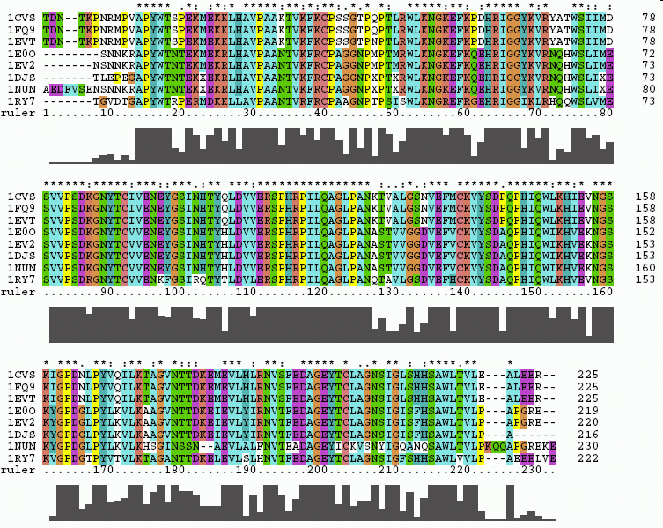
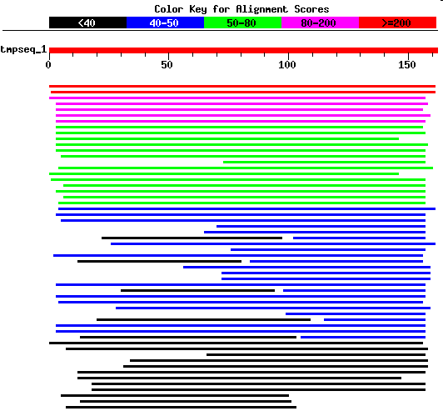
WORKING WITH BIOSEQUENCES
Alignments and similarity search

Slide 3
WORKING WITH BIOSEQUENCES
Alignments and similarity search
Similarity search
BLAST

Slide 4
HOMOLOGY AND HOMOPLASY
Homology Similarity due to derivation from same common ancestor
Homoplasy Similarity due to convergence, similar selective pressure on two evolutionary lines can lead to similar characters
ORTHOLOGY AND PARALOGY
HOMOLOGY
COMMON ANCESTOR
ORTOLOGY PARALOGY
SPECIATION GENE DUPLICATION
Relationships between genes in a family (paralogy)
or between different organisms (orthology)
(simplified definition)

Slide 5
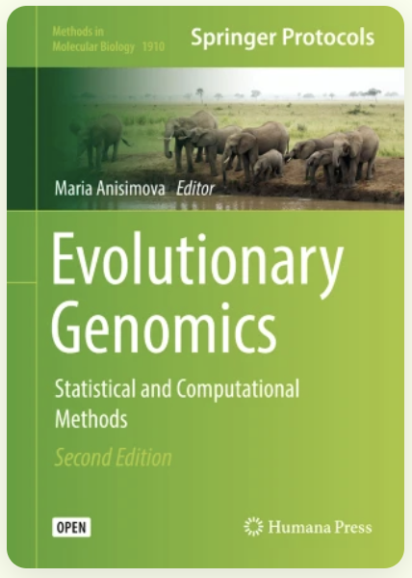
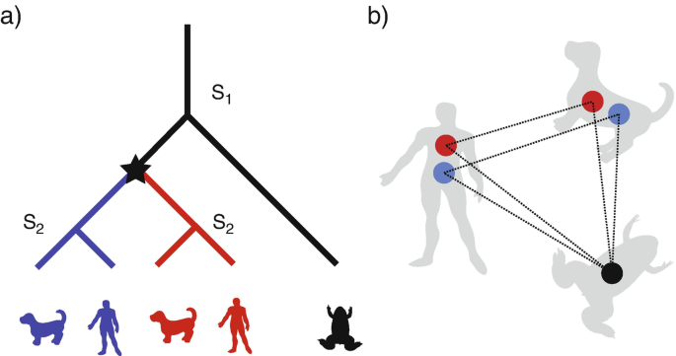
Evolutionary scenario of a gene family with two speciation events (S₁ and S₂) and one gene duplication event (star)
The type of events define all pairs of orthologs and paralogs
Orthology graph
Genes are vertices
Orthology relationships are edges

Slide 6
Evolutionary scenario of a gene family with two speciation events (S₁ and S₂) and one gene duplication event (star)
The type of events define all pairs of orthologs and paralogs:
The frog gene is orthologous to all other genes (they coalesce at S₁).
The red and blue genes are:
  orthologs between themselves (they coalesce at S₂)
  but paralogs between each other (they coalesce at star).
Orthology graph
Genes are vertices
Orthology relationships are edges
The frog gene forms one-to-many orthology with both the human and dog genes, because it is orthologous to more than one sequence in each of these organisms
Orthologous generally have similar function, paralogous may diverge

Slide 7
Evolutionary scenario of a gene family with two speciation events (S₁ and S₂) and one gene duplication event (star)
The type of events define all pairs of orthologs and paralogs :
The frog gene is orthologous to all other genes (they coalesce at S₁).
The red and blue genes are:
  orthologs between themselves (they coalesce at S₂)
  but paralogs between each other (they coalesce at star).
Orthology graph
Genes are vertices
Orthology relationships are edges
The frog gene forms one-to-many orthology with both the human and dog genes, because it is orthologous to more than one sequence in each of these organisms
Orthologous generally have similar function, paralogous may diverge more

Slide 8
Evolutionary scenario of a gene family with two speciation events (S₁ and S₂) and one gene duplication event (star)
Gene loss makes things more complex
Orthology graph

Slide 9
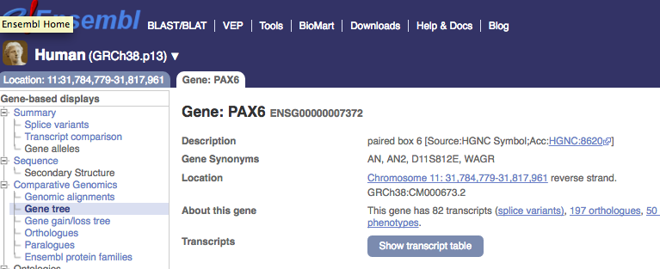
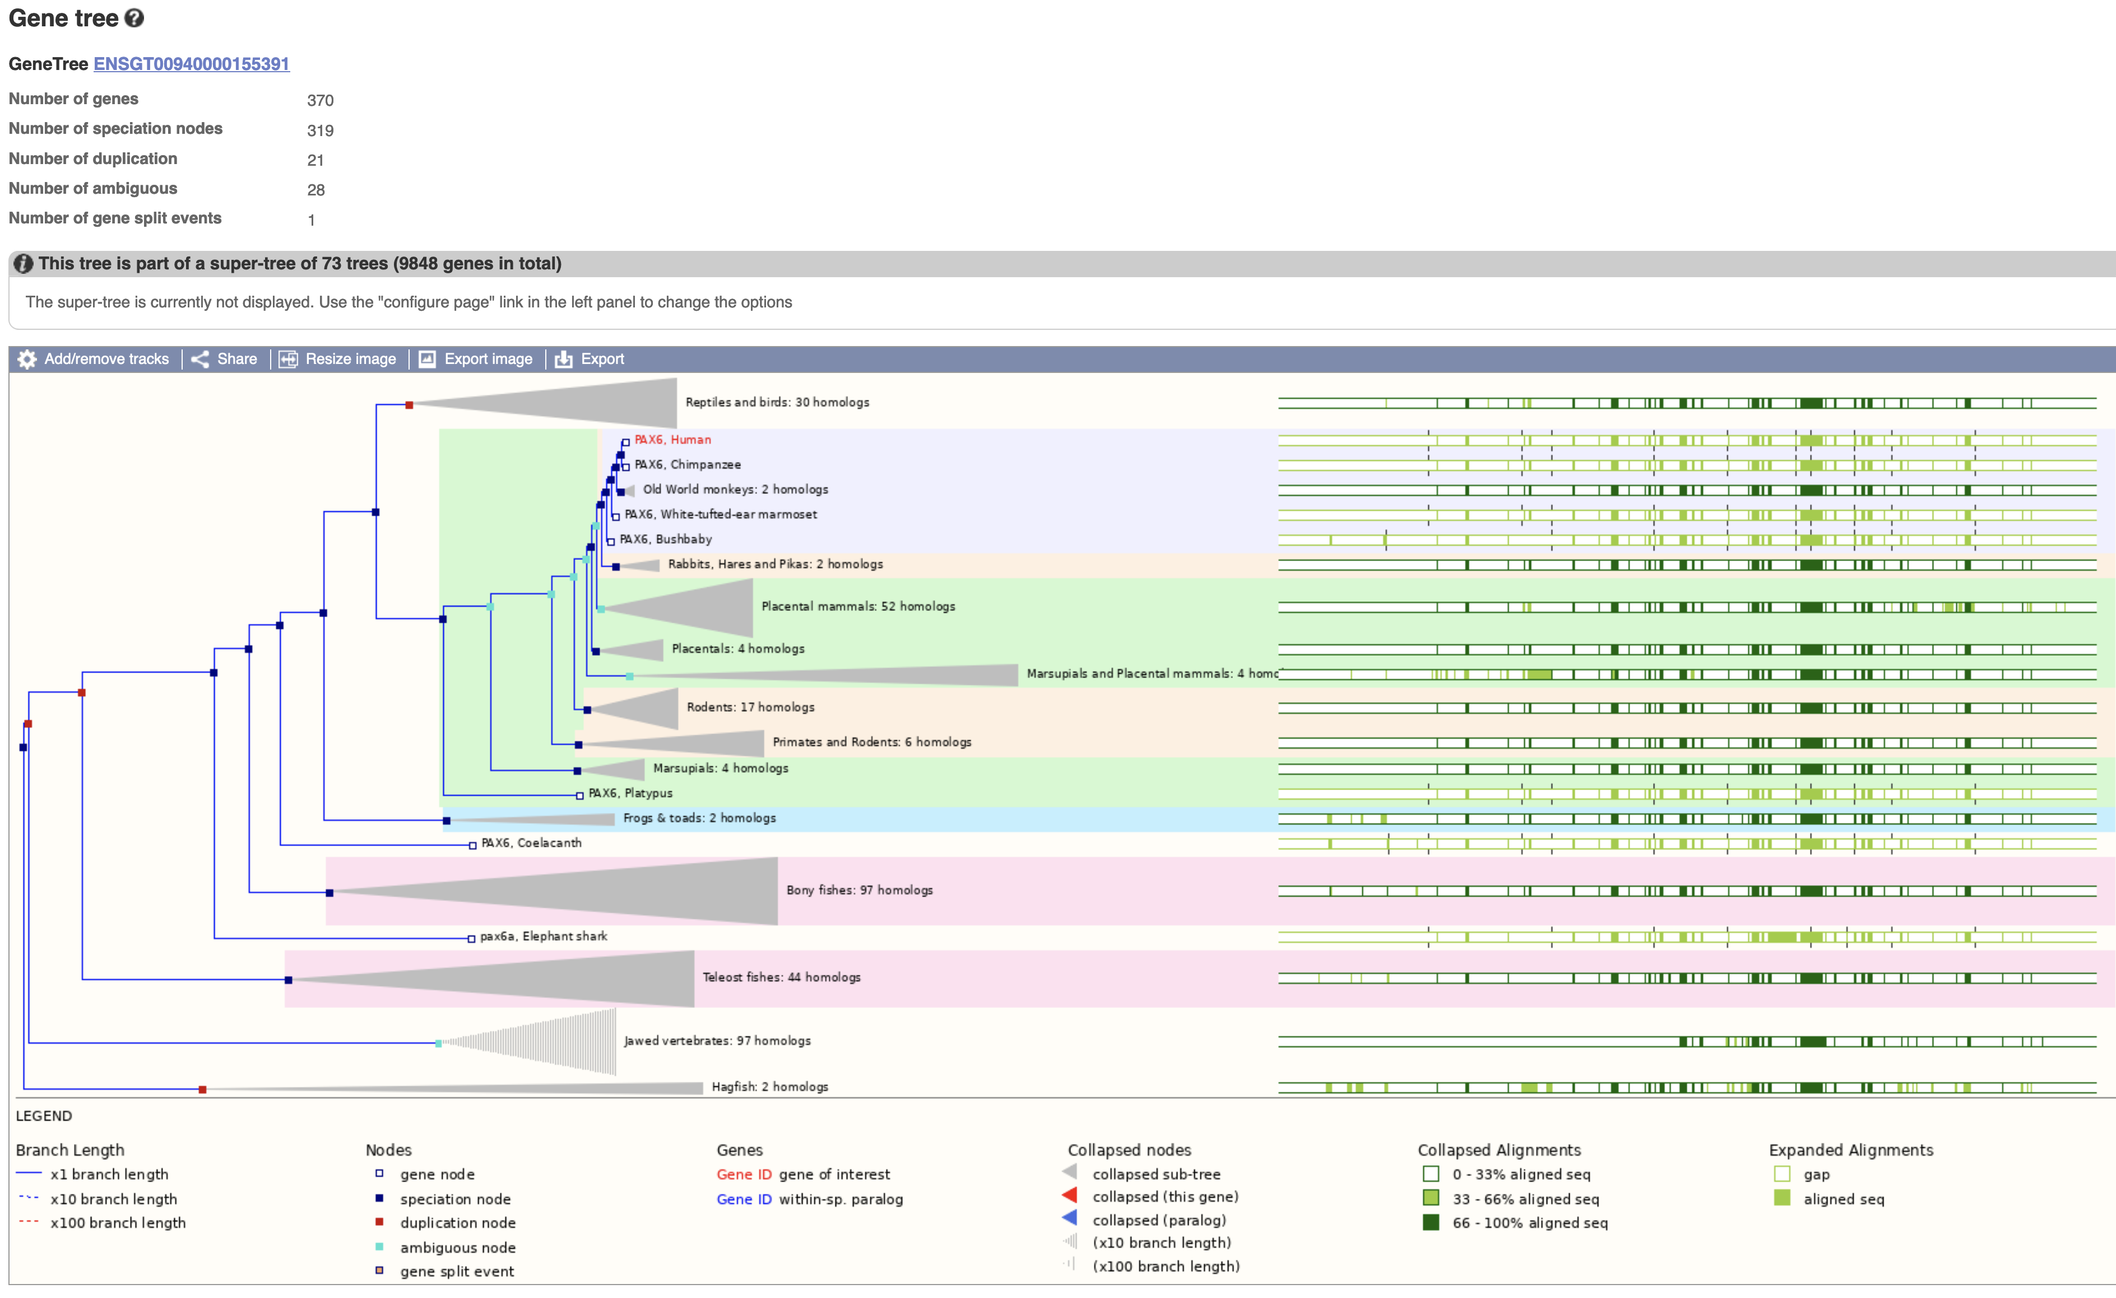
Ensembl Compara

Slide 10
SIMILARITY SEARCH
SIMILARITY ←?→ HOMOLOGY
HOMOLOGY properties of characters (sequences) due to their derivation from a common ancestral sequence
  Homology is a qualitative property, it cannot be measured
SIMILARITY "degree" of similarity between 2 sequences
→ Similarity is a quantitative property, it can be measured
The observed similarity between two sequences MAY indicate that they are homologous, i.e. evolutionarily related
The similarity between sequences is observed, whereas the homology between sequences can only be hypothesized on the basis of the similarity observed
Percentage of similarity! Similarity search!
Percentage of homology
Homology search

Slide 11
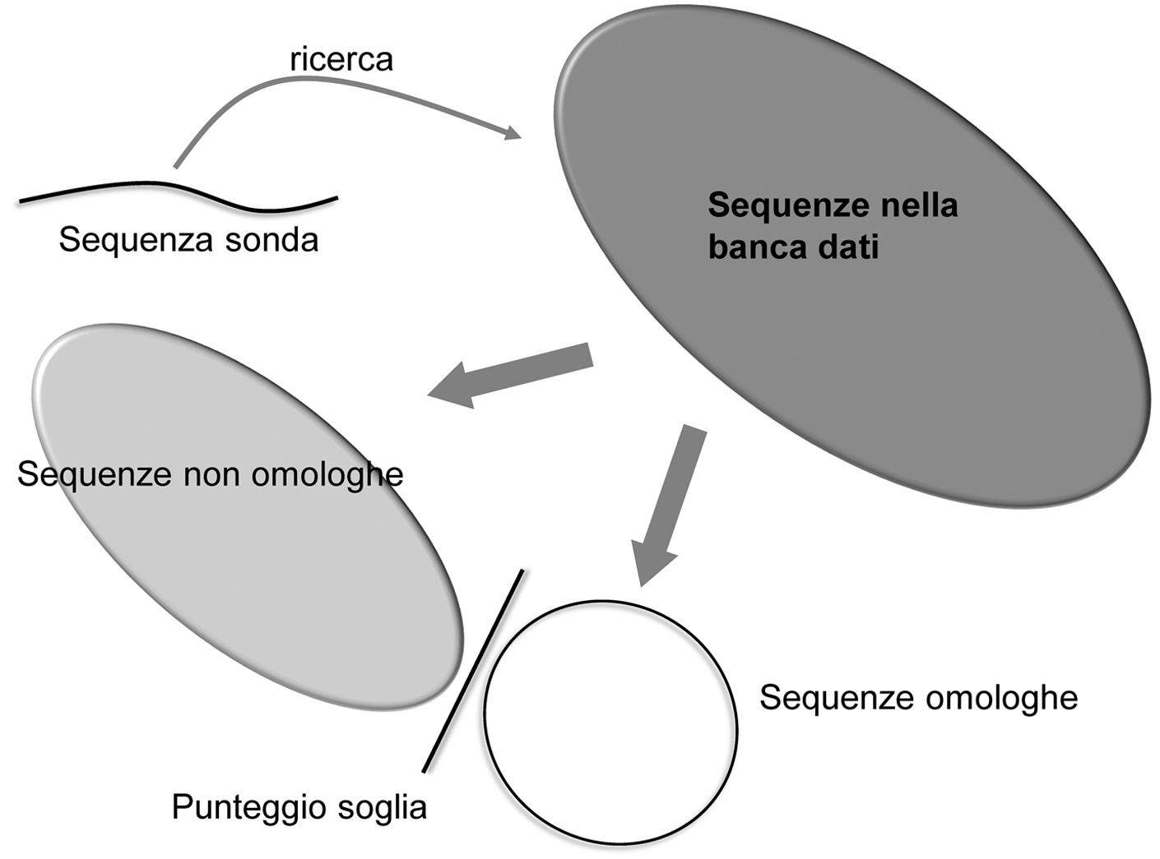
SIMILARITY SEARCH - Ideal situation
search
Sequence database
Sequence of interest
Non homologous sequences
Homologous sequences
Threshold score

Slide 12
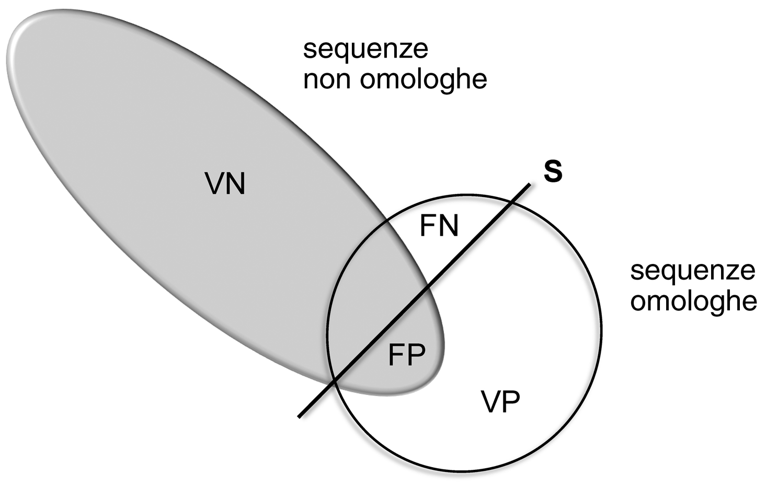
SIMILARITY SEARCH - Real situation
Non homologous sequences
TN
Homologous sequences
TP
Notes:
Un test sarà tanto più sensibile quanto più bassa risulterà la quota dei falsi negativi
Un test sarà tanto più specifco quanto più bassa risulterà la quota dei falsi positivi
Se FN e FP tendono a 0 sia Se sia Sp tendono a 1

Slide 13
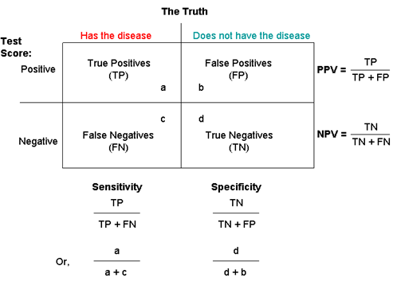
Confusion matrix of a test and performance measures
Homologous | Non-homologous
Sensitivity
S_{e} = TP / (TP+FN) is the ability to correctly classify positives, true positives found on all actually positives
→ A test with a smaller FN share will be the more sensitive
Specificity
S_{p} = TN / (TN+FP) defines the probability of classifying as negative an actually negative case
A test with a smaller FP share will be more specific
If both FN and FP tend to 0, both S_{e} and S_{p} tend to 1
Balance between Se and Sp searched! F₁ score: harmonic mean of S_{e} and S_{p}
Notes:
Un test sarà tanto più sensibile quanto più bassa risulterà la quota dei falsi negativi
Un test sarà tanto più specifco quanto più bassa risulterà la quota dei falsi positivi
Se FN e FP tendono a 0 sia Se sia Sp tendono a 1

Slide 14
Exact algorithms→ carry out exhaustive searches and explore the entire space of possible alignments (dynamic programming)
These are order n² algorithms:
  N&W Time complexity: O(mn), where m and n are the lengths of the sequences (to align two sequences each 1000 residues long, they make 1000x1000 = a million comparisons: too slow!!!)
Exponential growth of database size
The use of exact algorithms for similarity searches is not feasible
.

Slide 15
Database size
Repetitive searches
Slowness of "exact" algorithms
Quick but approximate alignment systems development
Heuristic methods for alignment
Development of programs (such as FASTA and BLAST) capable of quickly performing similarity searches, thanks to heuristic solutions based on assumptions that are not certain, but extremely probable.
In practice, the search is made faster at the expense of the certainty of having really found the best solution
.

Slide 16
BLAST
Basic Local Alignment Search Tool
(Altschul, 1990)
BLAST's heuristic algorithm is:
Cut the sequences into words
Speed things by focusing only on word pairs (query sequence/database) with a good score, under the assumption that related sequences must share at least one similar short subsequence
These word pairs are the starting point to attempt a local alignment
Given a QUERY SEQUENCE and a SEQUENCE DATABASE,
BLAST searches the database for "words" of at least "W" length with a similarity score of at least "T" once aligned with the "query" sequence (SEED align.).
The selected "words" are extended, if possible, until they reach a score higher than "S" or an "E-value" below the specified limit (HSP, High Scoring Pairs)

Slide 17
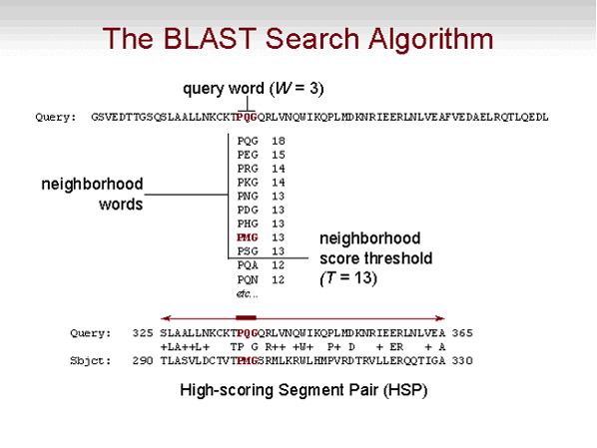
If two sequences have an identical or nearly identical word in common, they may be related
HSP = A pair of segments of the two sequences that, aligned without indel, show a score that cannot be increased by extending the local alignment
→ If two sequences have an HSP, they are likely related

Slide 18
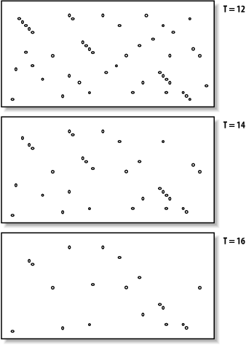
1- Seeding
DNA sequences
W = 7
Protein sequences
W = 2-3

Slide 19
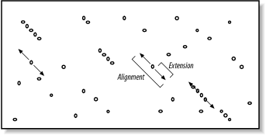
2 - Extension
The next step involves extending the seeds
Extension occurs in both directions
Blast has a mechanism to decide when to stop the extension (Evaluation)

Slide 20
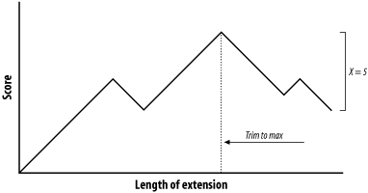
3 - Evaluation
The quick brown fox jumps over the lazy dog
||| ||| ||||| | | ||
The quiet brown cat purrs when she sees him
The quick brown fox jump
||| ||| ||||| |
The quiet brown cat purr
123 45654 56789 876 5654
000 00012 10000 123 4345 drop off score cut-off=5
Score ->
drop off score ->
Extension to the right >>>>
Let’s score
+1 for matches
–1 for mismatches
We calculate the drop off score starting from the maximum reached previously
When the drop off score reaches 5, the extension stops.

Slide 21
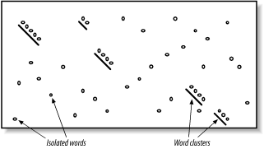
Two-hits algorithm → Gapped BLAST
The Word-hits tend to cluster along diagonals
The two-hits algorithm requires that the word-hits are within a defined distance

Slide 22
Significance of an alignment
Aligned sequences
ATTGCCCACGTTCGCGATCG
Observation
Score = S
ATAGGGCACTTT-GCGATGA
** * *** ** *****
Alternative hypotheses
HOMOLOGY?
CHANCE?

Slide 23
Significance of an alignment
To understand what is the probability of achieving a certain alignment by chance, model based on random sequences is needed.
Long alignments tend to have higher scores even if the aligned segments are not very similar.
Notes:
Just as the sum of a large number of independent identically distributed (i.i.d) random variables tends to a normal distribution, the maximum of a large number of i.i.d. random variables tends to an extreme value distribution. In studying optimal local sequence alignments, we are essentially dealing with the latter case

Slide 24
The result of a similarity search is a list of the best alignments between the query sequence and the sequences "extracted" from the database.
The SIGNIFICANCE of each alignment is expressed as:
- P value: probability of obtaining an alignment with a score equal to or better than that observed by chance
It is calculated by relating the observed score (S) to the expected distribution of HSP when comparing random sequences of the same length and composition as those considered
The closer the P value is to 0, the more significant it is (2x10-245 is better than 0.001 !!)
- E value: (Expectation value) Expected number of matches with score equal to or better than those observed
The lower, the better

Slide 25
Significance of an alignment
For sequences of length m and n, long enough, the HSP scores (S) are not normally distributed, their distributon depends instead from the two parameters K e λ
according to the equation (Gumbel's or extreme value distribution)
P(score>=S)=1-exp(-Kmn e^{-λS})
E-value for the score S E = mn * Pval(S) = Kmn e^{-λS}
As m and n ("search space") increase, the value E increases linearly
The dependence of E on S is exponential
K e λ are constant and depend on the score matrix used and the gap penalties applied
Karlin and Altschul, 1990
Notes:
Just as the sum of a large number of independent identically distributed (i.i.d) random variables tends to a normal distribution, the maximum of a large number of i.i.d. random variables tends to an extreme value distribution. In studying optimal local sequence alignments, we are essentially dealing with the latter case

Slide 26
Significance of an alignment
BIT SCORE = a log-scaled version of a score
BIT SCORE S’ = (λS-lnK)/ln2
"Normalized" score independent of the search space.
Allows the comparison of different search results (with different substitution matrices and databases)
The bit score indicates the size of the database in which the current match could be found just by chance
Es. BIT SCORE = 30
It would take 2³⁰ random alignments to find a better score.
Each time the score increases by one point, the number of alignments increases by a factor of 2
Karlin and Altschul, 1990
Notes:
The bit score (S) is determined by the following formula: S = (λ × S − lnK)/ ln2 where λ is the Gumble distribution constant, S is the raw alignment score, and K is a constant associated with the scoring matrix used. Clearly, the bit score (S) is linearly related to the raw alignment score (S). Thus, the higher the bit score, the more highly significant the match is. The bit score provides a constant statistical indicator for searching different databases of different sizes or for searching the same database at different times as the database enlarges.

Slide 27
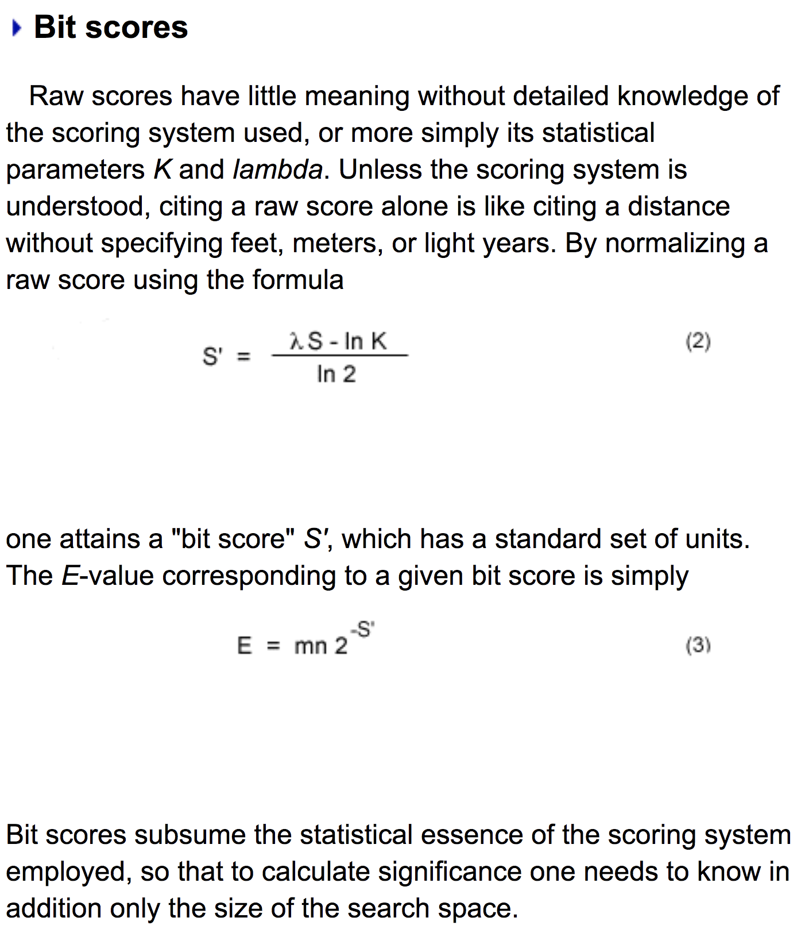
From:
NCBI “The Statistics of Sequence Similarity Scores”
https://www.ncbi.nlm.nih.gov/BLAST/tutorial/Altschul-1.html

Slide 28
Significance of an alignment
Alignment
(Blosum62, gap=-11)
Seq1
Seq2
V D C C Y
Seq1 V D C - C Y
Seq2 V E C L C Y
Score 4 2 9-11 9 7
Score = 20
V E C L C Y
Sequences
Randomized sequences
Alignment
(Blosum62, gap=-11)
Score = 9
Seq1
Seq2
C D V Y C
Seq1
Seq2
C D V Y - C
Repeat (e.g. 10,000 times)
saving all scores
C V Y L E C
C V E Y L C
Score 9 -3 -2 7 -11 9
Random score distribution
Frequency
Alignment score (20)
Score

Slide 29
How to use BLAST
OPZIONI
Query sequences nucleotides
protein
(FASTA format, GenBank Accession numbers o GI numbers)
Database Nucleotide seq. DB
Protein seq. DB
Type of BLAST Standard BLAST (blastn)
Standard protein BLAST (blastp)
translated blast (blastx, tblastn, tblastx)
MEGABLAST
PSI-BLAST
PHI-BLAST
…
Blast selection table
https://www.ncbi.nlm.nih.gov/blast/BLAST_guide.pdf

Slide 30
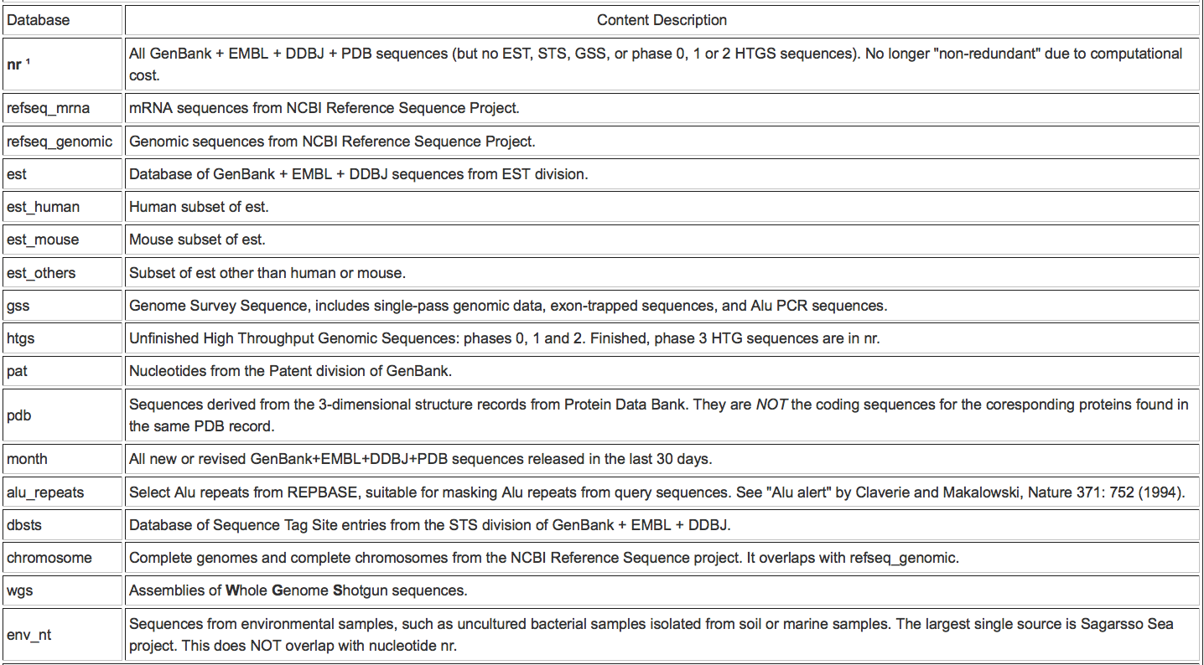
How to use BLAST - Nucleotide seq. DBs

Slide 31
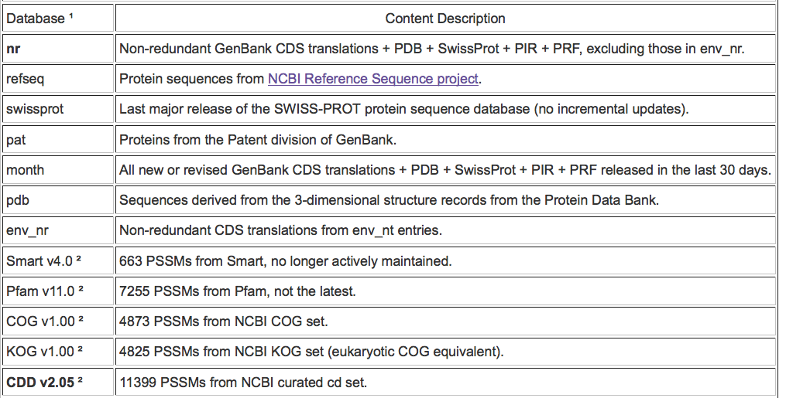
How to use BLAST - Protein seq. DBs

Slide 32
How to use BLAST
PROGRAMS
Blastn Nucleotide query - Nucleotide db
Blastp Protein query - Protein db
Translating BLAST Through the conceptual translation of the query sequence or databases, compares a nucleotide sequence with protein databases or vice versa.
Translated query - Protein db blastx
Protein query - Translated db tblastn
Translated query - Translated db tblastx

Slide 33
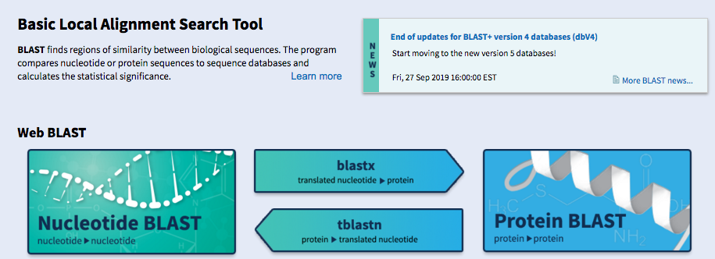
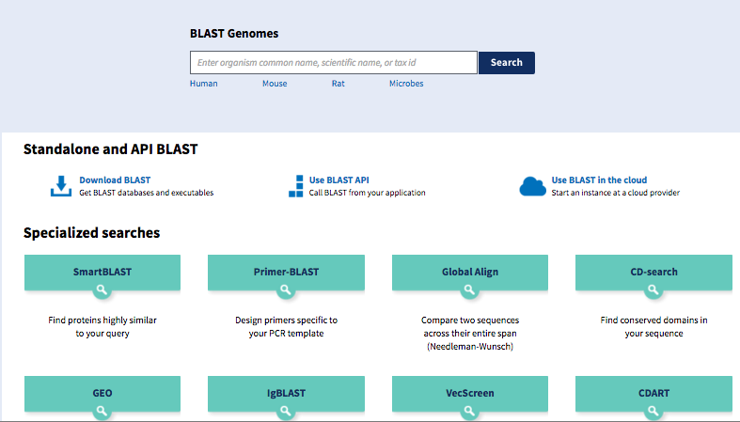
WWW BLAST
http://blast.ncbi.nlm.nih.gov

Slide 34
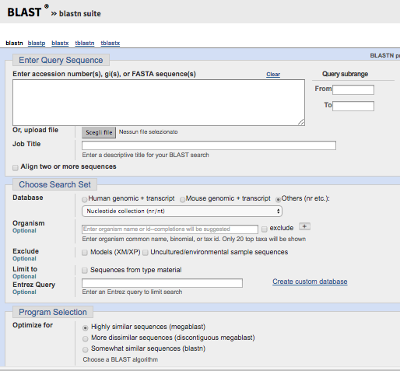

Slide 35
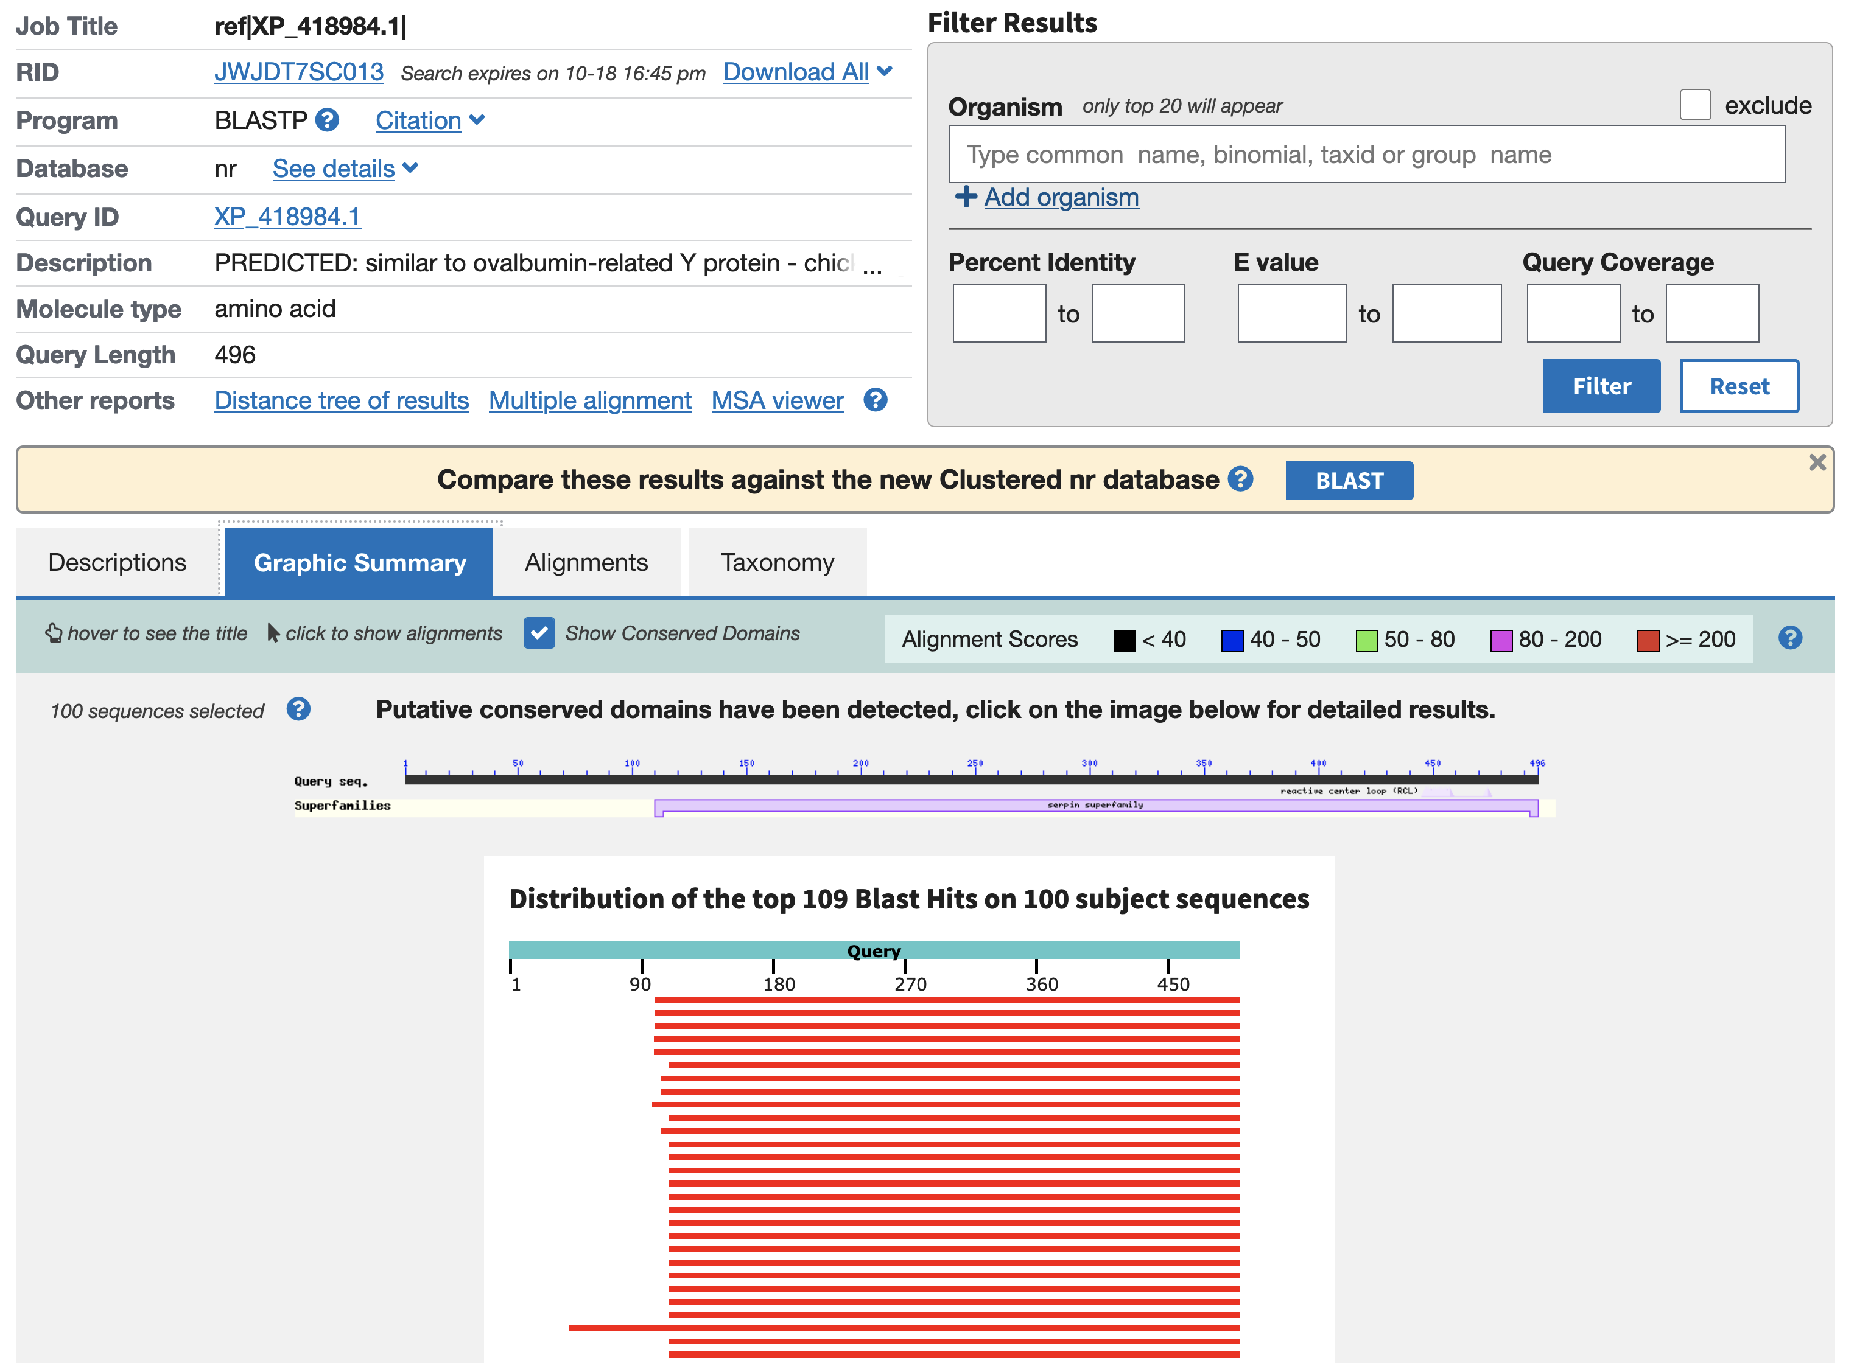
WWW Blast: Results

Slide 36
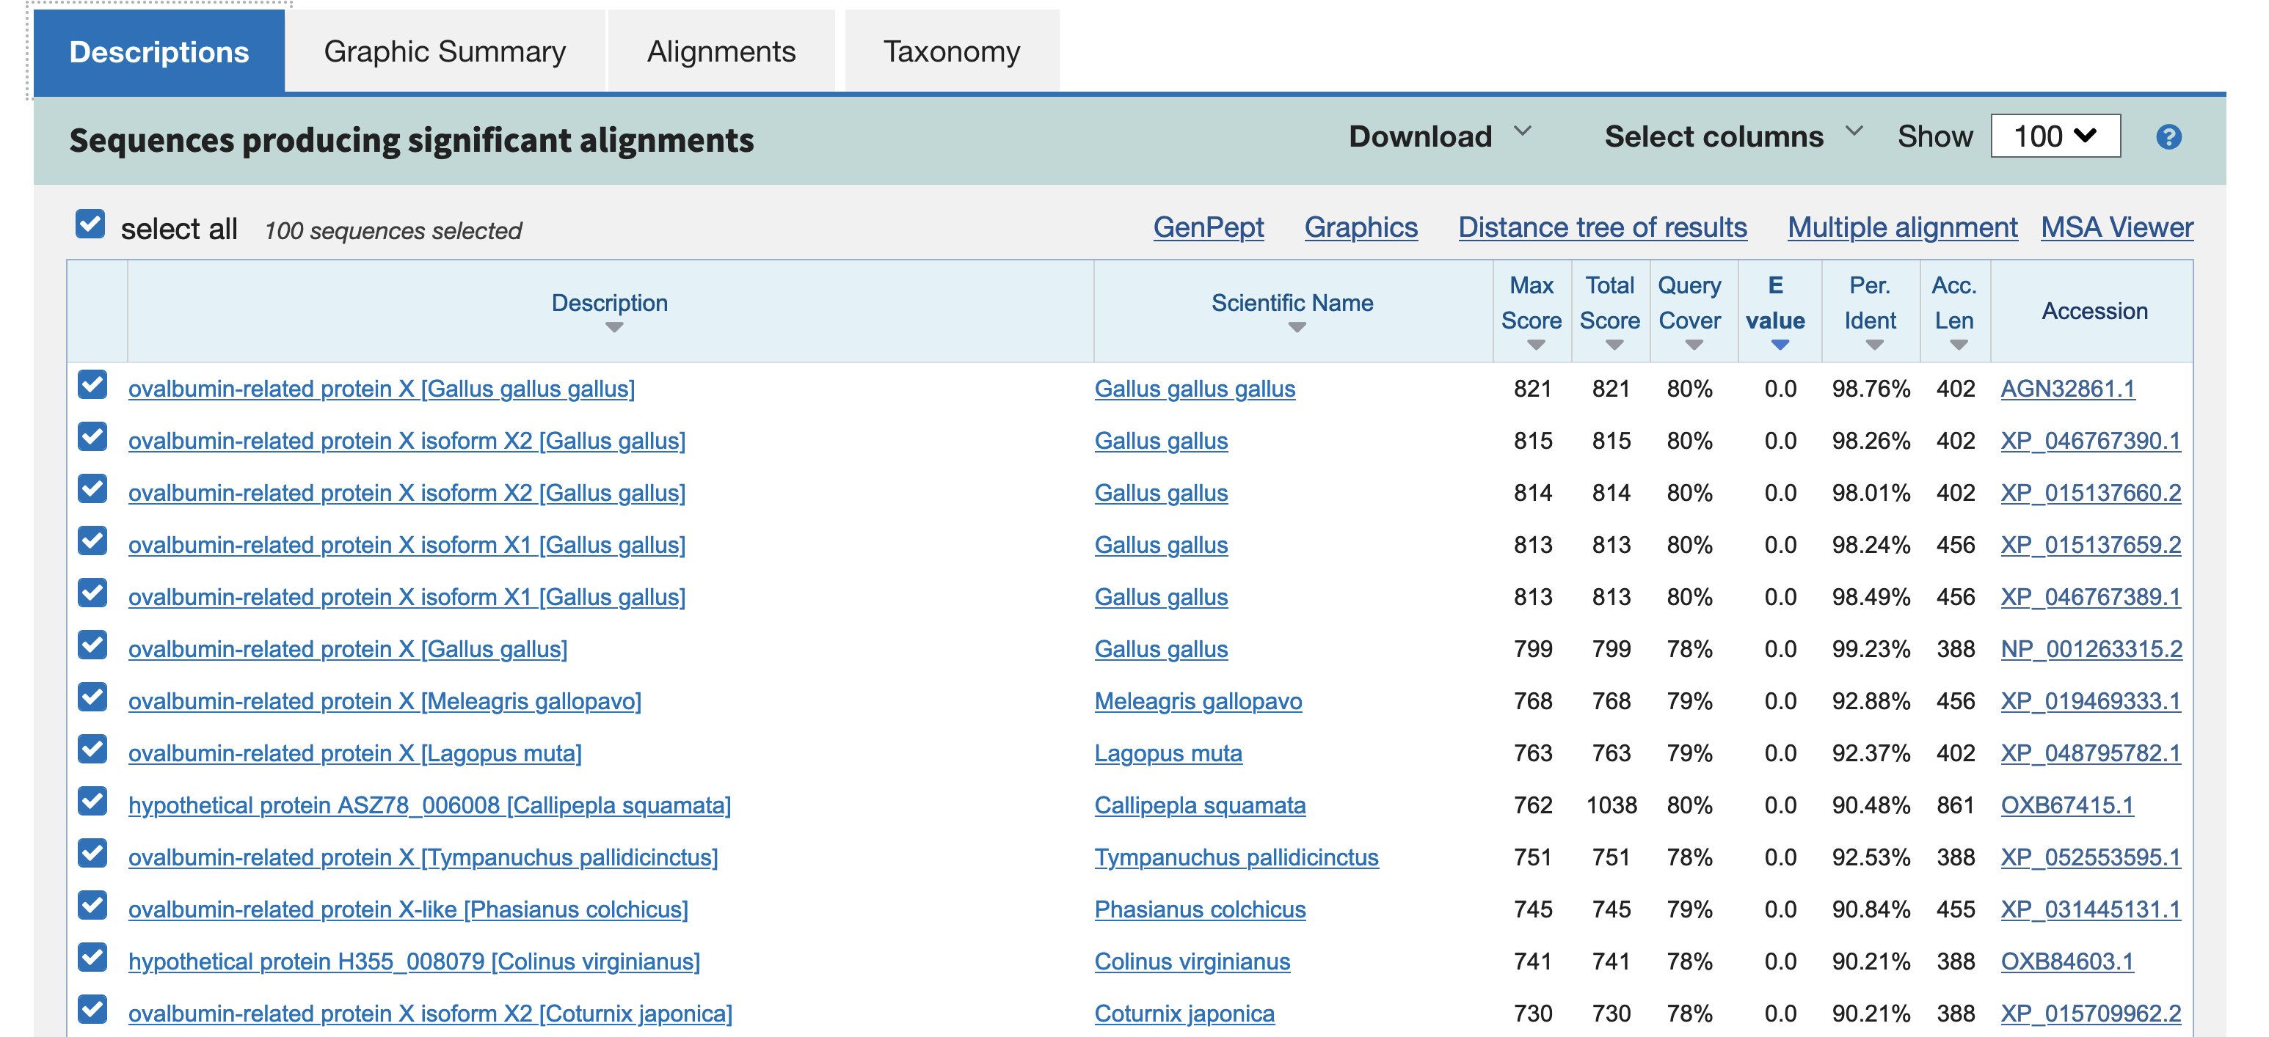
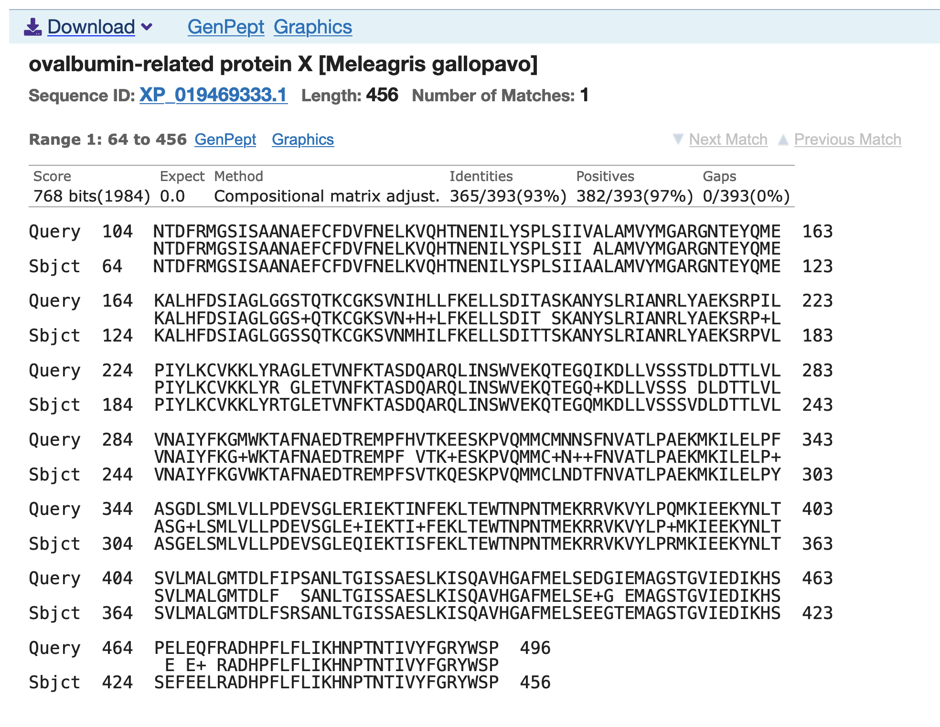

Slide 37
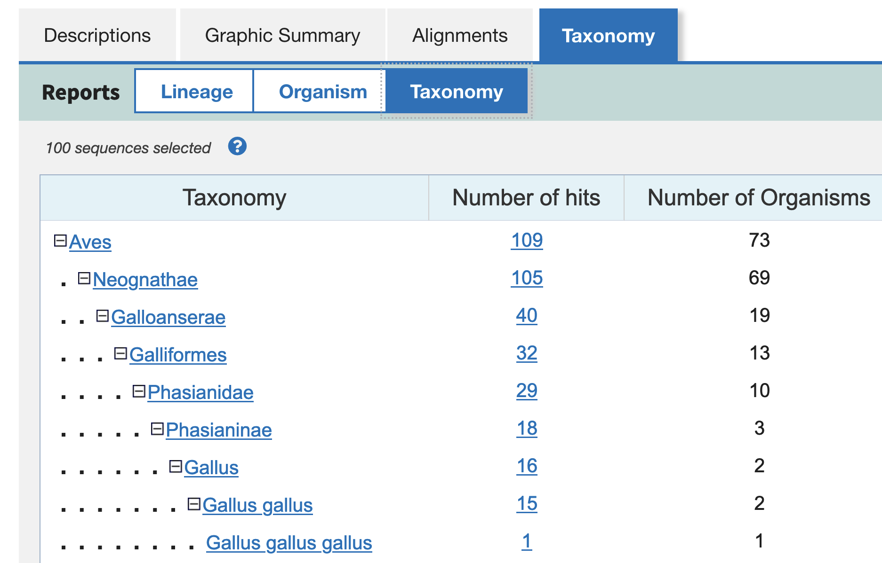

Slide 38
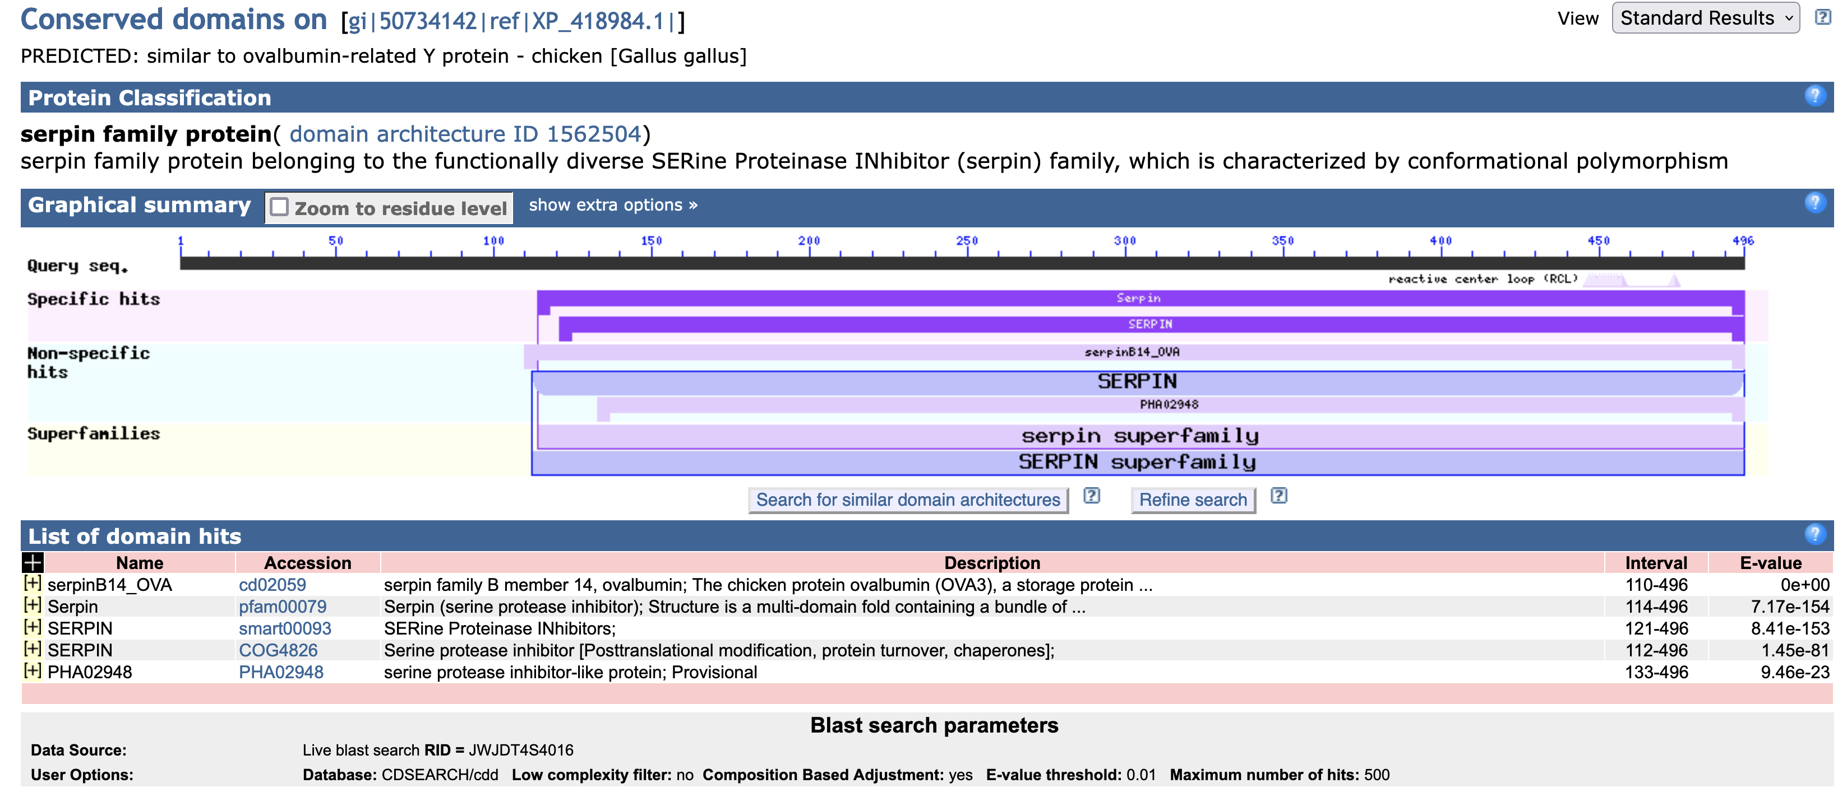
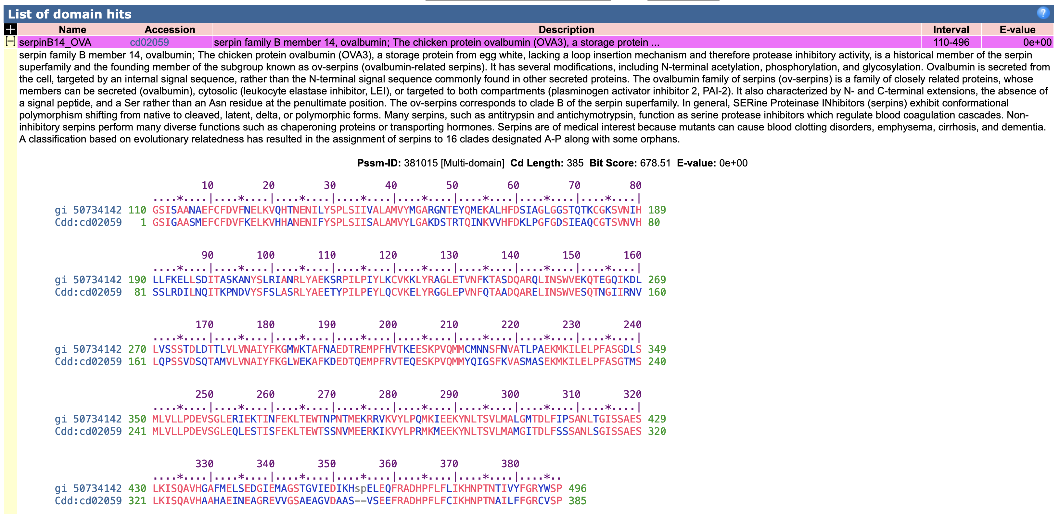

Slide 39
MEGABLAST
It uses a fast and optimized greedy algorithm to compare sequences that differ little (large word size, optimised drop-off, not affine gapping parameters * ...)
Aim → identification
Search for short nearly exact matches
blastn with parameters chosen in order to optimize the search for almost exact and short matches.
These are often found by chance, so it uses high E-value (less stringent), small word size (7) and filtering
Aim → Primer search
* E.g. GOP=0
Notes:
An affine gap penalty encourages the extension of gaps rather than the introduction of new gaps.
Non affine = permissive for gap opening

Slide 40
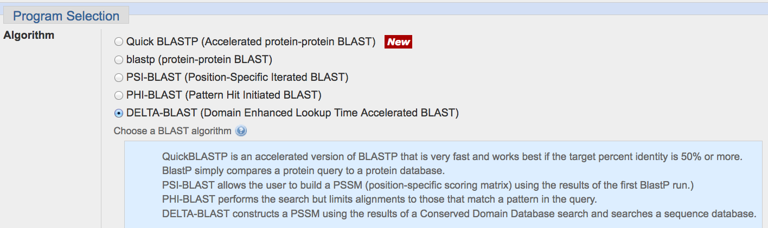
Protein BLAST options
Notes:
Popular sequence alignment algorithms, such as BLAST [1] or FASTA [2], use substitution score matrices to measure similarity between two amino acid or nucleotide sequences. In a 20 × 20 protein substitution matrix, each element s_{ij} is a score derived from the probability that, in homologous sequences, amino acids i and j descend from a common ancestor. Sequence similarity searches generally perform better at detecting distantly related homologs when they use either matrices specialized for particular protein classes [3-11], or position-specific score matrices (PSSMs)

Slide 41
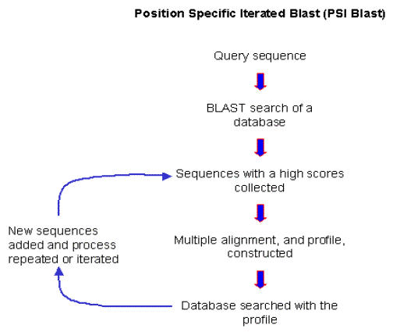
PSI-BLAST position-specific iterated blast
Find members of a protein family or build a custom position-specific score matrix (PSSM)

Slide 42
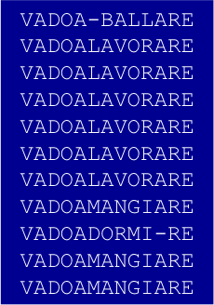
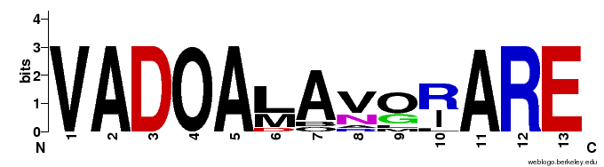
Multiple alignment
SEQUENCE LOGO
V 11/11
R 6/11
I 4/11
L 1/11

Slide 43
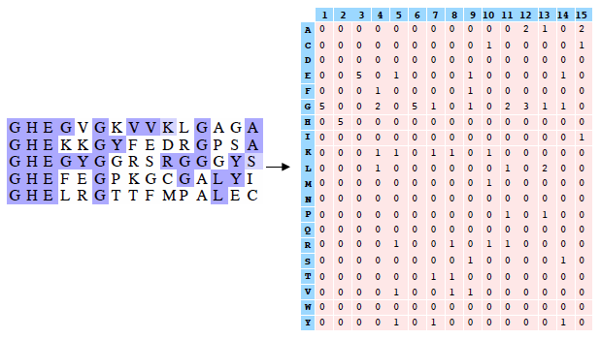
Position-specific Score Matrix (PSSM)
A PSSM is constructed from a multiple sequence alignment (MSA) of related proteins
A PSSM associated with a sequence of length l is an l × 20 matrix,
where element s_{ij} is derived from the probability that related sequences have amino acid j at PSSM position i
It models the amino acid substitutions particular to a specific protein family and sequence position
Multiple alignment
position-specific score matrix

Slide 44
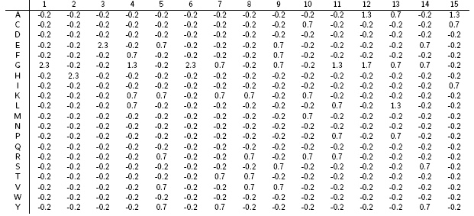
Position-specific Score Matrix (PSSM)
Multiple alignment
position-specific score matrix
Using pseudocounts to avoid excessive specificity of the PSSM

Slide 45
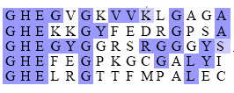
Can be aligned?

Slide 46
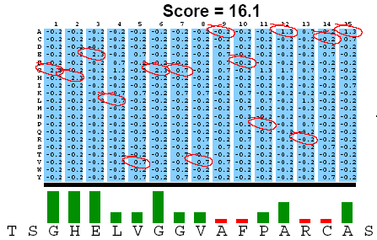
I compare the new sequence with the profile

Slide 47
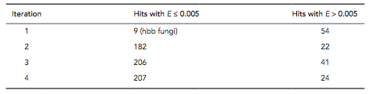
Example query:
Standard BLASTP search would produce about 9 hits with low expect values.
PSI-BLAST search produces >200 hits after 3 or 4 iterations.
PSI Blast finds distantly related protein
It increases the sensitivity of a database search by detecting homologous matches with relatively low sequence identity

Slide 48
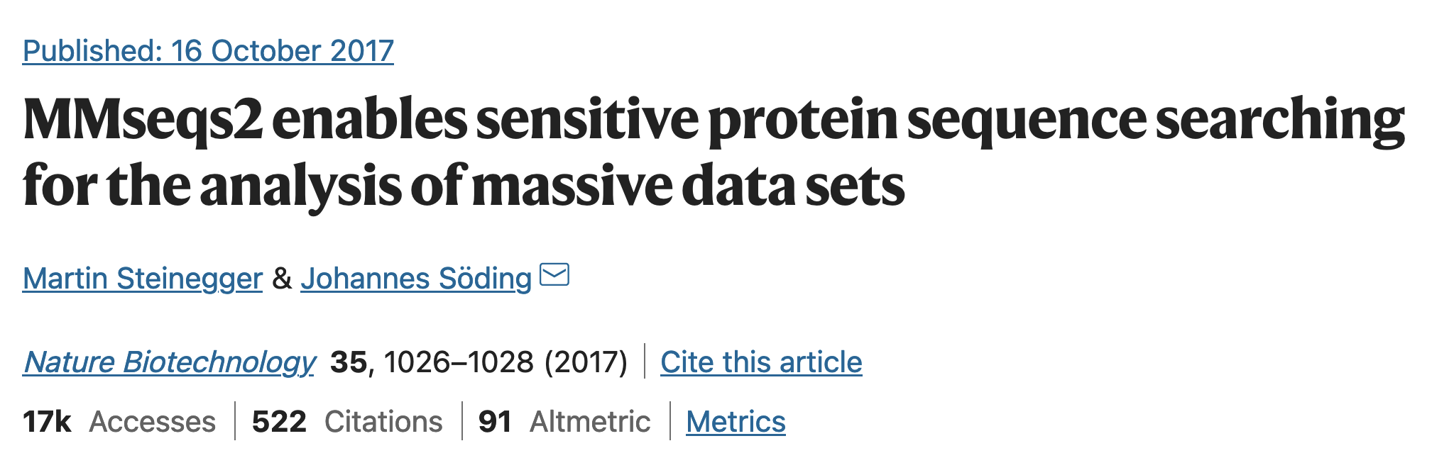
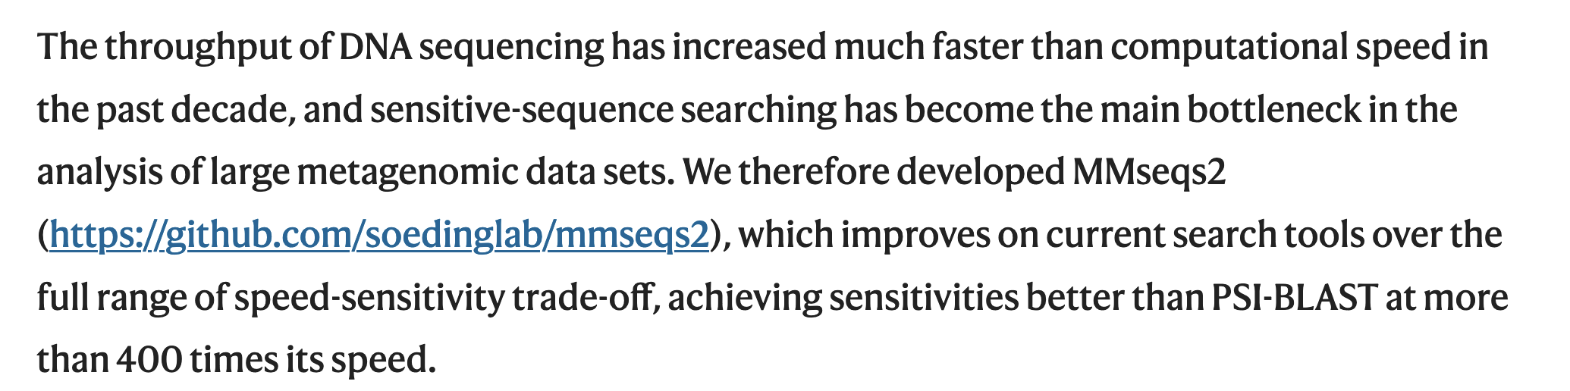
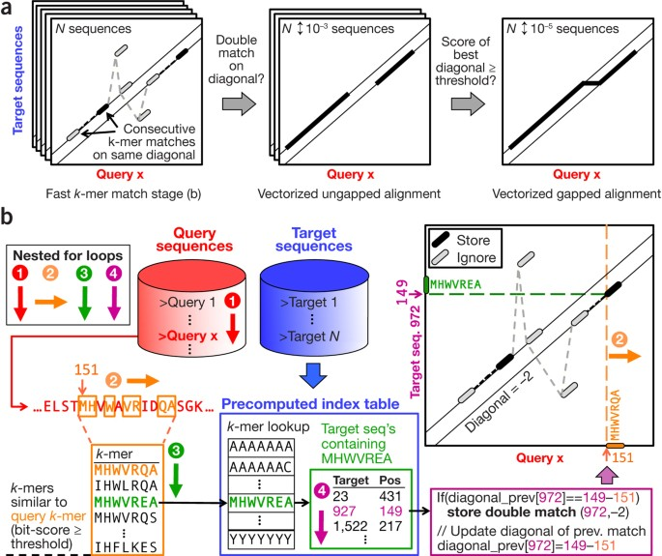

Slide 49
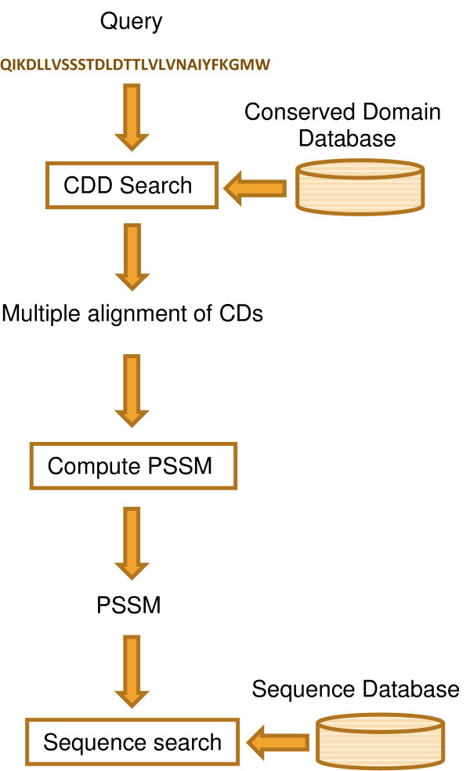
DELTA-BLAST (Domain Enhanced Lookup Time Accelerated BLAST)
PSI-BLAST creates multiple alignments and position-specific scoring matrices (PSSMs).
DELTA-BLAST searches a query against a library of pre-computed PSSMs.
DELTA-BLAST, for its PSSMs, employs a subset of NCBI’s Conserved Domain Database (CDD; curated domain models that are refined using protein 3D structures, or models constructed from clusters of related sequences with unknown structure)
DELTA-BLAST searches CDD with the supplied query, uses aligned domains to compute a PSSM and searches a sequence database with this PSSM.
Most queries do match a PSSM; if not the search proceeds in a PSI-BLAST-like manner
Notes:
Popular sequence alignment algorithms, such as BLAST [1] or FASTA [2], use substitution score matrices to measure similarity between two amino acid or nucleotide sequences. In a 20 × 20 protein substitution matrix, each element s_{ij} is a score derived from the probability that, in homologous sequences, amino acids i and j descend from a common ancestor. Sequence similarity searches generally perform better at detecting distantly related homologs when they use either matrices specialized for particular protein classes [3-11], or position-specific score matrices (PSSMs)

Slide 50
PHI-BLAST (Pattern Hit Initiated Blast)
Find proteins similar to the query around a given pattern
PHI-blast enforces the presence of a motif in addition to the usual PSI-blast criteria
It uses regular expression
W-x(9,11)-[VFY]-[FYW]-x(6,7)-[GSTNE]-[GSTQCR]-[FYW]
This means a W followed by 9 to 11 of anything, followed by one of the residues V, F, or Y, etc.

