Slide 1
A.A. 2025-2026 Master degree in Evolutionary Biology School of Science University of Padova MOLECULAR METHODS and BIOINFORMATICS Prof. STEFANIA BORTOLUZZI

Slide 2
DATABASES
Classifications of DBs
Biosequence DBs
Structural data DBs

Slide 3
How can we classify databases?
Primary Databases index data derived experimentally, f.i.
nucleotide sequences
three dimensional structures
Secondary Databases are derived from the analysis, treatment or integration of primary data
F.i. DBs of :
alignments
secondary structure predictions
hydrophobicity plots
domains
Or knowledgebases

Slide 4
How can we classify databases?
Technical design
Flat-files
Relational database (SQL)
Exchange/publication technologies (FTP, HTML, CORBA, XML,...)

Slide 5
How can we classify databases?
Availability
Publicly available, no restrictions
Available, but with copyright
Accessible, but not downloadable
Academic, but not freely available
Proprietary, commercial; possibly free for academics

Slide 6
Primary Databases - Biosequences
Collections of individual records, each containing an annotated stretch of DNA or RNA.
Each record is also called ENTRY, and is uniquely identified by a code (ACCESSION NUMBER)
EMBL nucleotide database (1980), now maintained by
EMBL = European Molecular Biology Laboratory (Heidelberg, DE)
EBI = European Bioinformatics Institute (Hinxton, UK)
GenBank = NIH, at NCBI (1982)
NIH = National Institutes of Health (USA)
NCBI = National Center for Biotechnology Information, Bethesda, Maryland (USA)
DDBJ = DNA DataBase of Japan (1986)

Slide 7
DATA EXCHANGE: International Collaboration of DNA Sequence Databases (1988) establishes a common format for the daily exchange of sequences.
DIRECT SUBMISSION → Most of the sequences end up in one of the three databases because the author (the laboratory where this sequence was obtained) sends it directly.
The sequence is then inserted and the corresponding record remains the property of only that database, the only one with the right to modify it.
The database that receives the sequence then sends it to the other two.
ANNOTATION → « Annotators» extract the sequences from scientific journals and transfer them to the database.
→→→ Redundancy

Slide 8
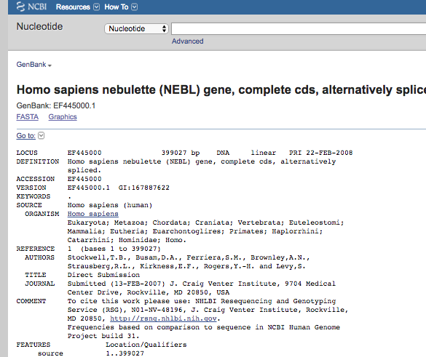
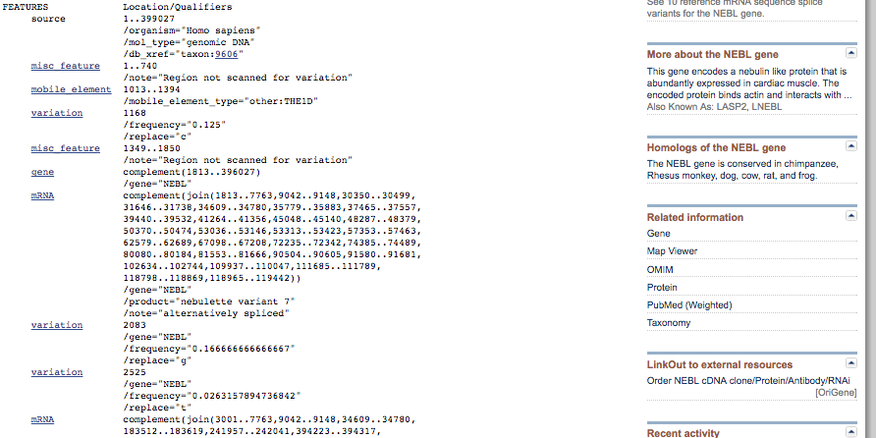

Slide 9
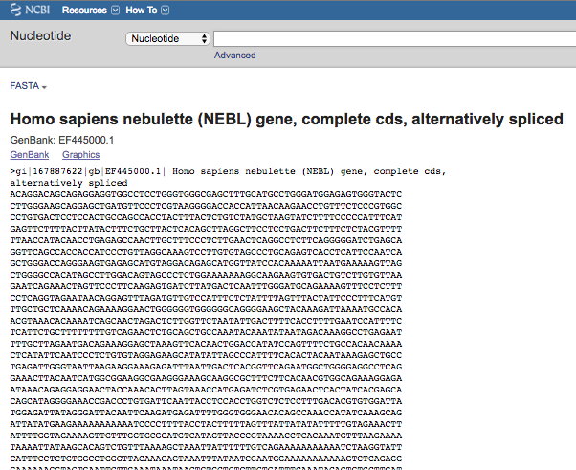

Slide 10
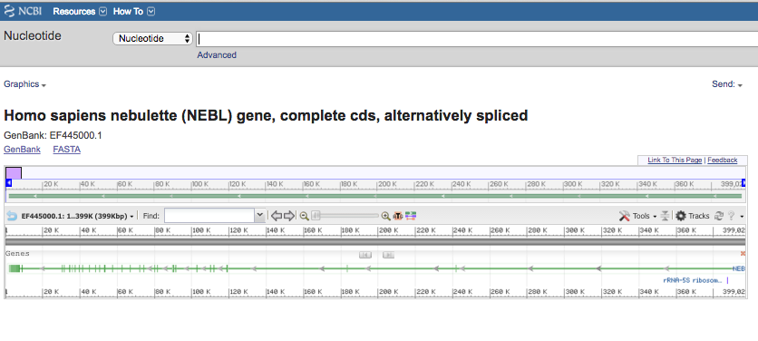

Slide 11
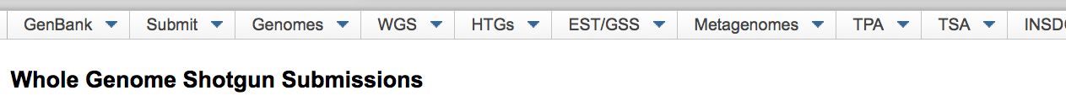
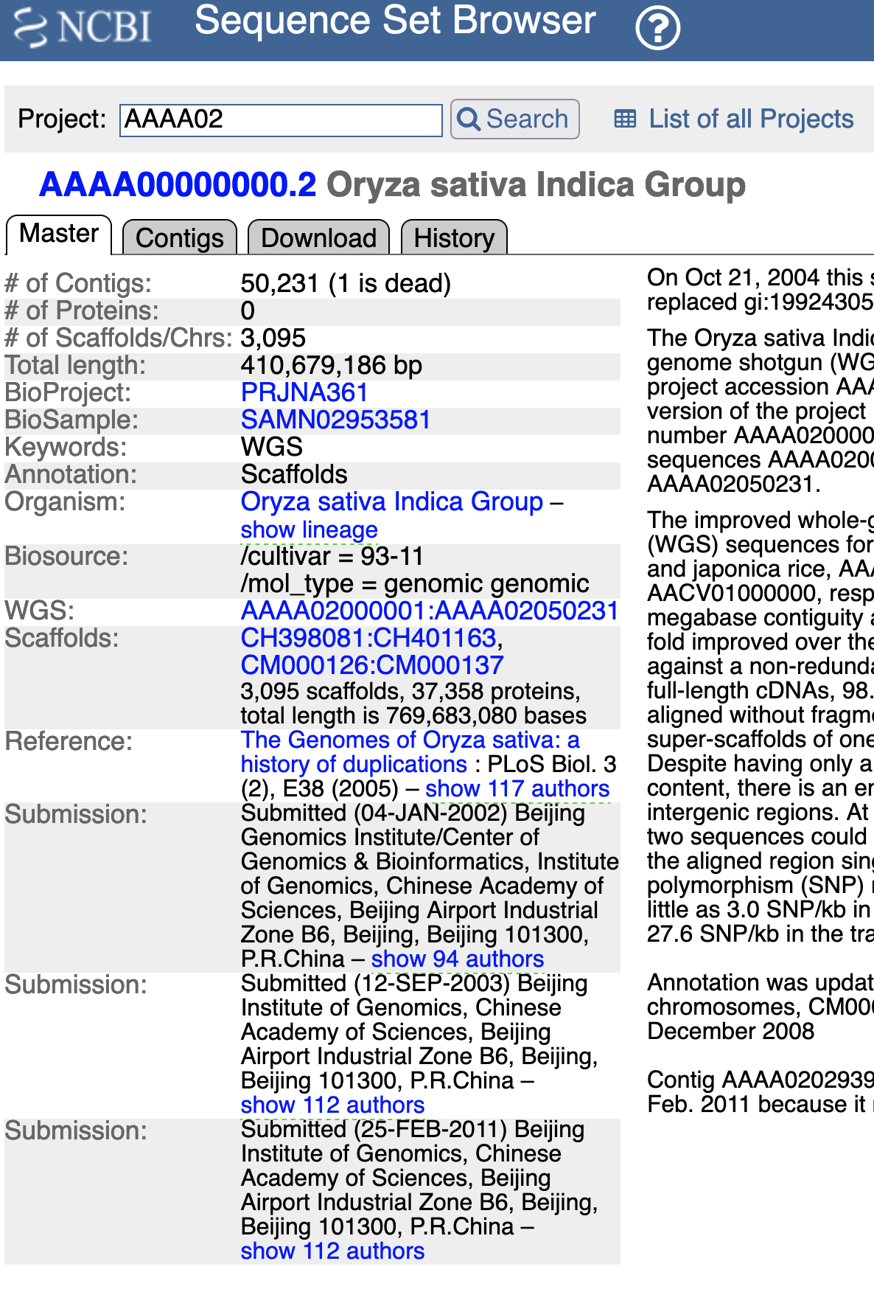
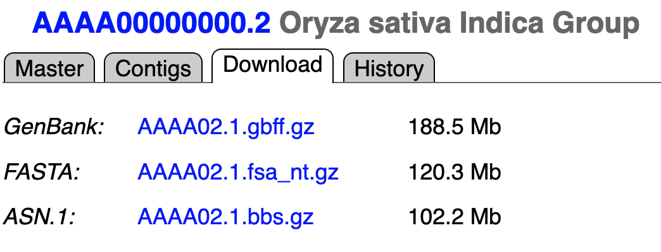
A bit of history ...
2002 → founded WGS (Whole Genome Shotgun)
What is WGS?
WGS projects are genome assemblies of incomplete genomes or incomplete chromosomes of prokaryotes or eukaryotes that are generally being sequenced by a whole genome shotgun strategy.
WGS projects may be annotated, but annotation is not required.
NCBI has a Prokaryotic Genomes Annotation Pipeline that may be requested at the time the genome files are submitted to GenBank. This pipeline generates a submission-ready annotated file that is posted back to the submitter for review and which the submitter could edit prior to data release.

Slide 12
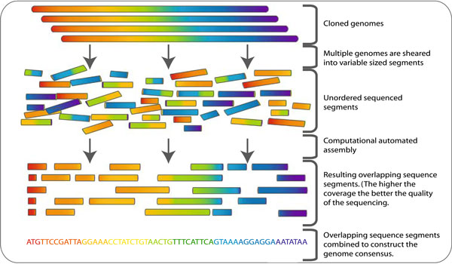
What is Whole Genome Shotgun sequencing?

Slide 13
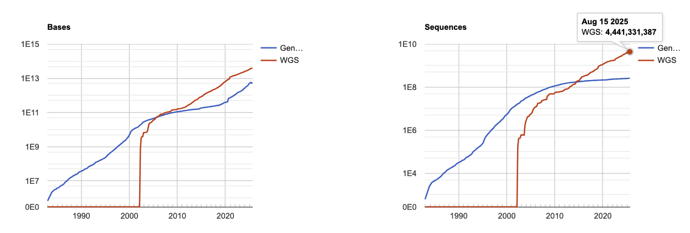
NUCLEOTIDE SEQUENCE DATABASE – GenBank
GENBANK AND WGS STATISTICS
GenBank WGS
Bases Sequences Bases Sequences
1, Dec 1982 680,338 606
…
…
268, Aug 2025
5.7E+12 2.6E+08 4.0E+13 4.4E+09
260 TB
6 TB
Notes:
peta P 10¹⁵ 1000000000000000 Quadrillion tera T 10¹² 1000000000000 Trillion 1960 giga G 10⁹ 1000000000 Billion mega M 10⁶ 1000000 Million

Slide 14
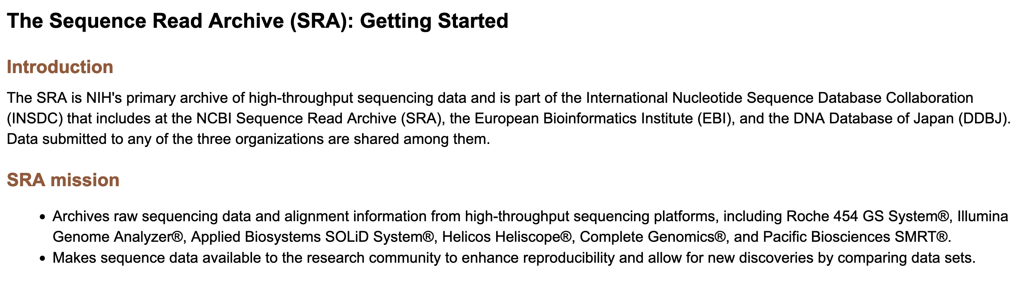
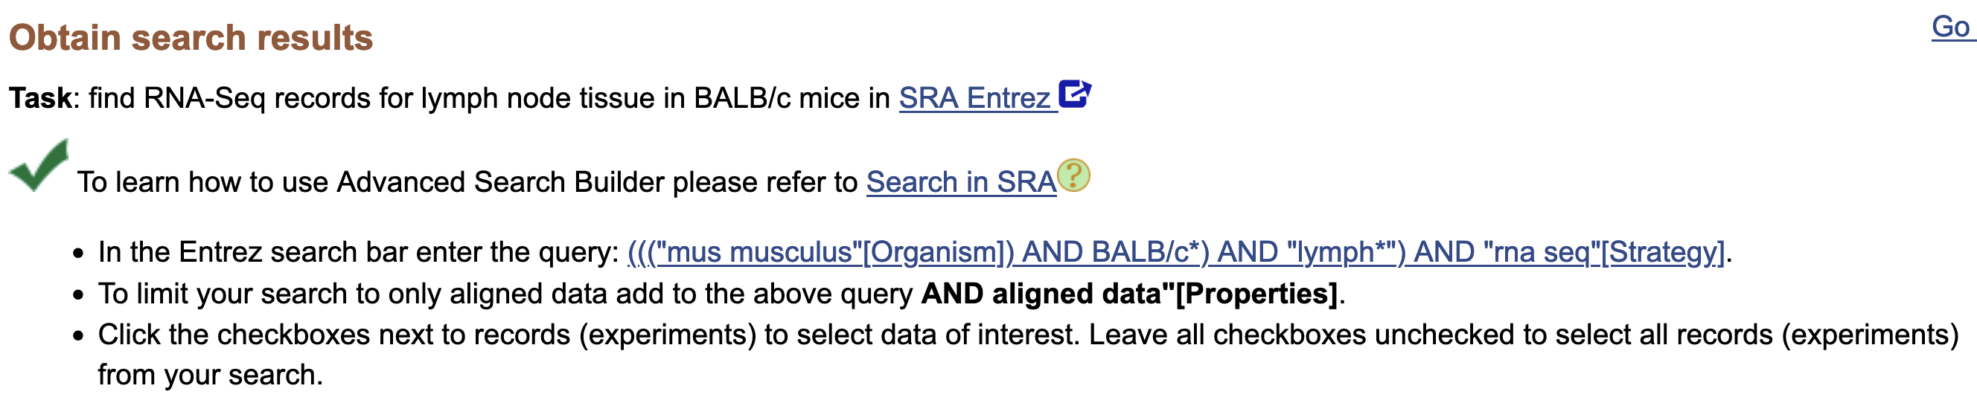
Sequences from High throughput sequencing platforms go to SRA

Slide 15
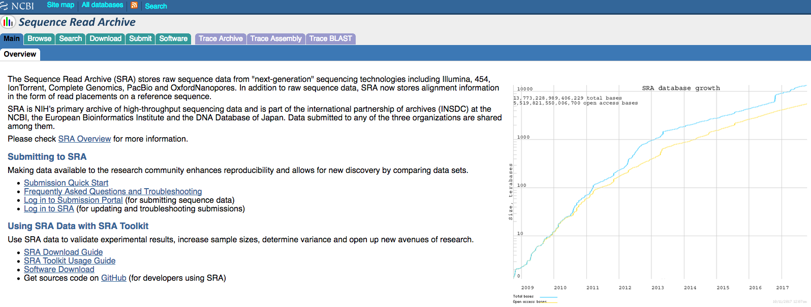
The Sequence Read Archive (SRA) stores raw sequence data from "next-generation" sequencing technologies
Illumina, 454, IonTorrent, Complete Genomics, PacBio and Oxford Nanopore.
In addition to raw sequence data, SRA now stores read alignment to a reference sequence.
International partnership of archives (INSDC) at the NCBI, the EBI and the DDBJ.

Slide 16
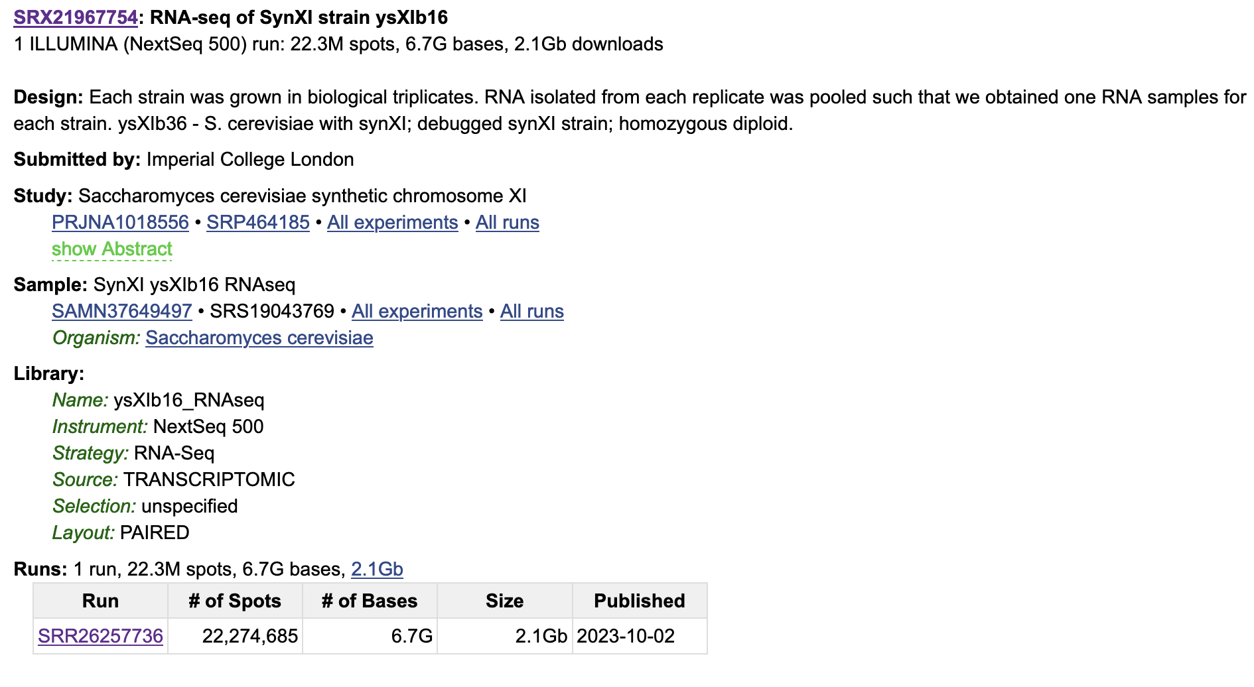
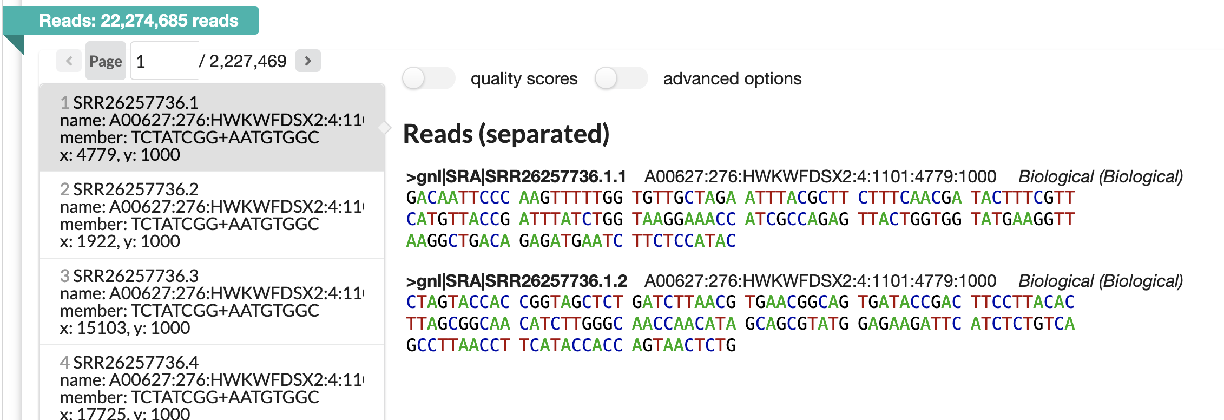
SRA entry example

Slide 17
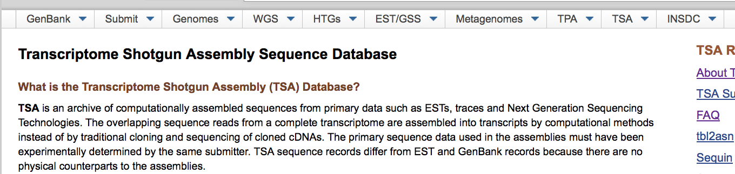
TSA

Slide 18
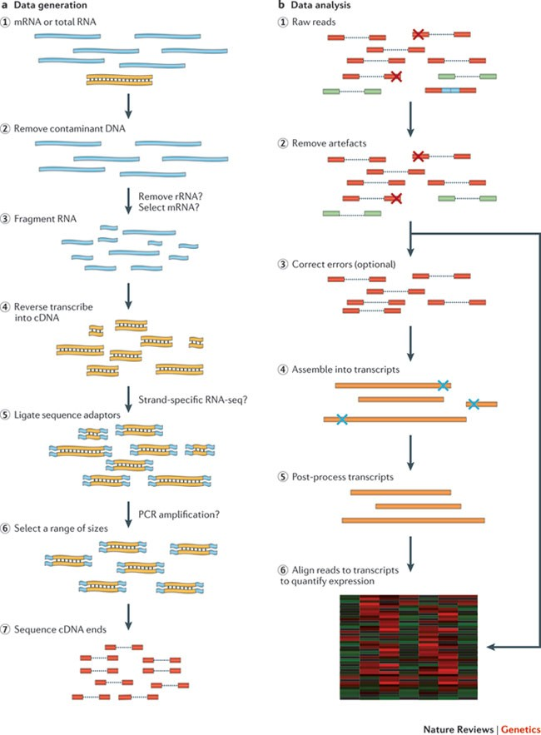
What is Transcriptome Assembly?

Slide 19
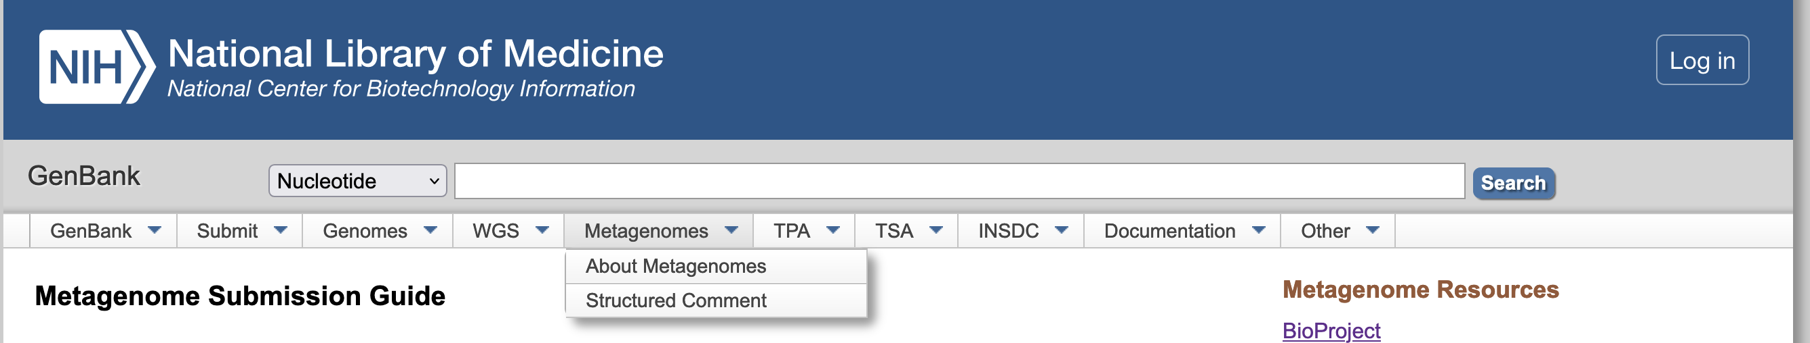
Metagenome
Microorganisms comprise the majority of the planet's biological diversity. However, many of these cannot be cultured by standard techniques.
Culture-independent methods are essential for understanding the genetic diversity, population structure, and ecological roles of these uncultured microorganisms.
Metagenomics is the culture-independent genomic analysis of a community of microorganisms.
It provides a community-wide assessment of metabolic function, and a way to identify new organisms and isolate complete genomes environmental samples.
Metagenome projects may include raw sequence reads collected from an ecological or organismal source (submitted to the Sequence Read Archive), assembled contigs and/or scaffolds derived from the raw sequence data, including partial genomes from taxonomically defined organisms (submitted as a WGS project).

Slide 20
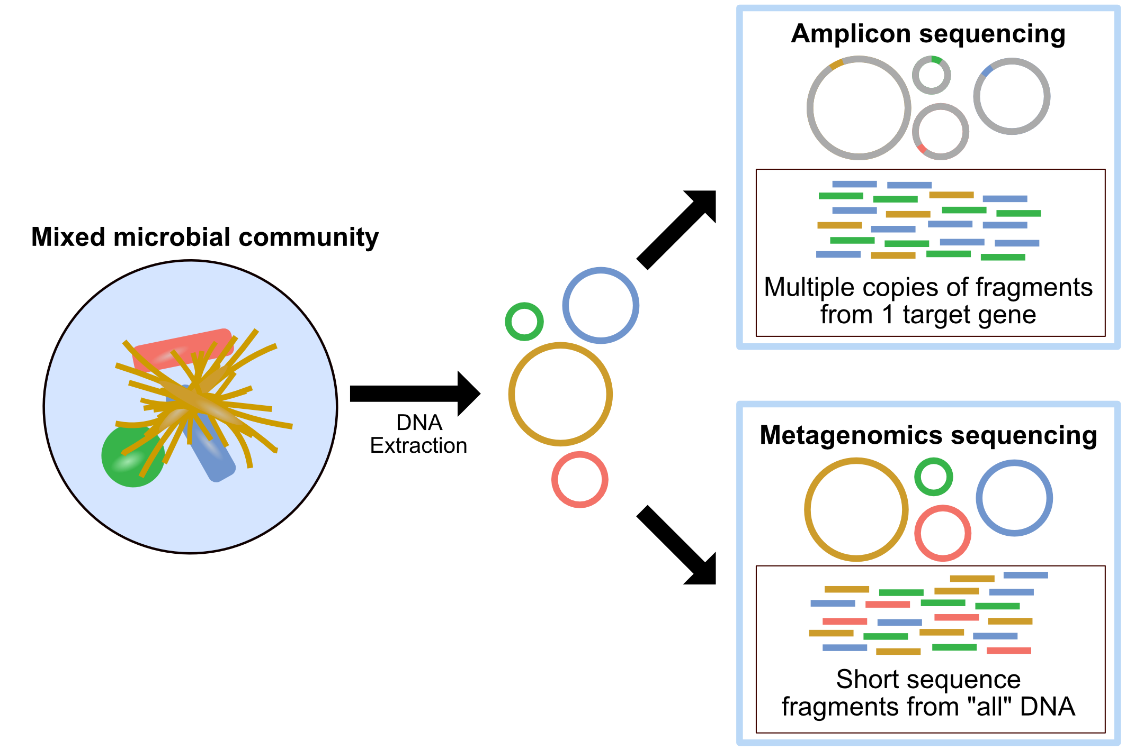
Metagenomics
vs
Amplicon seq.

Slide 21
Primary Databases - Biosequences
PROTEIN SEQUENCE DATABASE
SWISS-PROT
Database of annotated, "scarcely" redundant and cross-referenced protein sequences,
including:
SWISS-PROT
TrEMBL, supplement to SWISS-PROT with computer-annotated sequences, as a translation of all coding sequences present at the EMBL
TrEMBL sections:
SP-TrEMBL, go in SWISSPROT, with AC.
REM-TrEMBL, remaining (immunoglobulins, synthetic proteins, ...), no AC.
Today part of Universal Protein Knowledgebase (UniProt)

Slide 22
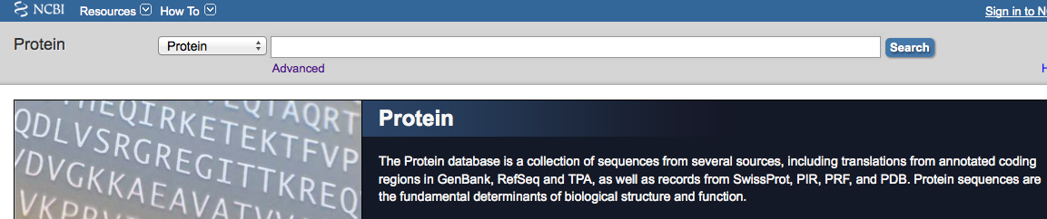
LOCUS AIL58882 140 aa linear BCT 29-AUG-2014
DEFINITION crystallin [Staphylococcus aureus].
ACCESSION AIL58882
VERSION AIL58882.1 GI:675303284
DBLINK BioProject: PRJNA240091
DBSOURCE accession CP007499.1
KEYWORDS .
SOURCE Staphylococcus aureus
ORGANISM Staphylococcus aureus
Bacteria; Firmicutes; Bacilli; Bacillales; Staphylococcus.
REFERENCE 1 (residues 1 to 140)
AUTHORS Benson,M.A., Ohneck,E.A., Ryan,C., Alonzo,F. III, Smith,H.,
Narechania,A., Kolokotronis,S.O., Satola,S.W., Uhlemann,A.C.,
Sebra,R., Deikus,G., Shopsin,B., Planet,P.J. and Torres,V.J.
TITLE Evolution of hypervirulence by a MRSA clone through acquisition of
a transposable element
JOURNAL Mol. Microbiol. 93 (4), 664-681 (2014)
PUBMED 24962815
REFERENCE 2 (residues 1 to 140)
AUTHORS Planet,P.J., Narechania,A., Shopsin,B. and Torres,V.
TITLE Direct Submission
JOURNAL Submitted (18-MAR-2014) Pediatrics, Columbia University, 650 West
168th St, New York, NY 10032, USA
COMMENT Annotation was added by the NCBI Prokaryotic Genome Annotation
Pipeline (released 2013). Information about the Pipeline can be
found here: http://www.ncbi.nlm.nih.gov/genome/annotation_prok/
##Genome-Annotation-Data-START##
Annotation Provider :: NCBI
Annotation Date :: 03/20/2014 14:06:33
Annotation Pipeline :: NCBI Prokaryotic Genome Annotation
Pipeline
Annotation Method :: Best-placed reference protein set;
GeneMarkS+
Annotation Software revision :: 2.4 (rev. 429283)
Features Annotated :: Gene; CDS; rRNA; tRNA; ncRNA;
repeat_region
Genes :: 2,836
CDS :: 2,729
Pseudo Genes :: 29
rRNAs :: 19 ( 5S, 16S, 23S )
tRNAs :: 59
ncRNA :: 0
Frameshifted Genes :: 23
##Genome-Annotation-Data-END##
FEATURES
…
FEATURES Location/Qualifiers
source 1..140
/organism="Staphylococcus aureus"
/strain="2395 USA500"
/db_xref="taxon:1280"
Protein 1..140
/product="crystallin"
Region 1..137
/region_name="IbpA"
/note="Molecular chaperone (small heat shock protein)
[Posttranslational modification, protein turnover,
chaperones]; COG0071"
/db_xref="CDD:223149"
Region 36..124
/region_name="alpha-crystallin-Hsps_p23-like"
/note="alpha-crystallin domain (ACD) found in
alpha-crystallin-type small heat shock proteins, and a
similar domain found in p23 (a cochaperone for Hsp90) and
in other p23-like proteins; cl00175"
/db_xref="CDD:260235"
CDS 1..140
/locus_tag="CH51_12820"
/coded_by="CP007499.1:2592248..2592670"
/inference="EXISTENCE: similar to AA
sequence:RefSeq:WP_001010521.1"
/note="Derived by automated computational analysis using
gene prediction method: Protein Homology."
/transl_table=11
ORIGIN
1 mnfnqfenqn ffngnpsdtf kdlgkqvfny fstpsfvtni yetdelyyle aelagvnked
61 isidfnnntl tiqatrsaky kseqlilder nfeslmrqfd feavdkqhit asfengllti
121 tlpkikpsne ttsstsipis
//

Slide 23
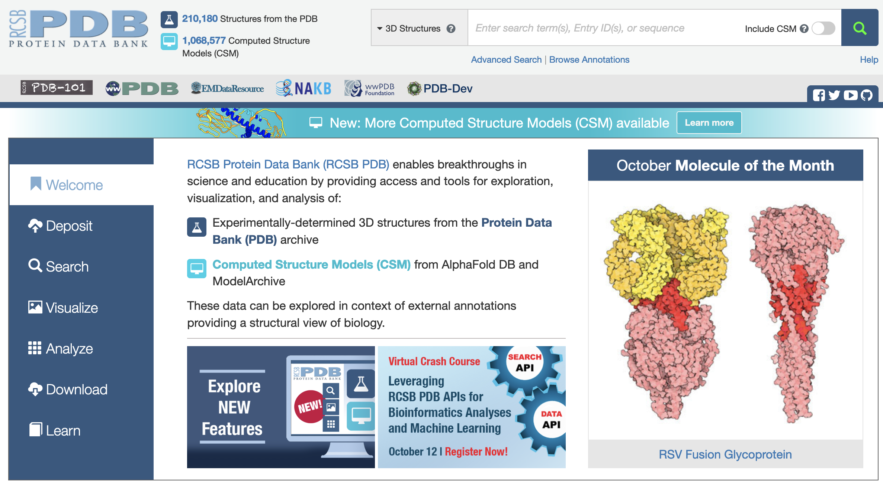

Slide 24

PRIMARY DATABASES
Database of 3-D structures of proteins and nucleic acids Data obtained experimentally and submitted directly by researchers Founded in 1971
Notes:
NMR Nuclear Magtnetic Resonance, Neutron Scattering, Electon Microscopy

Slide 25
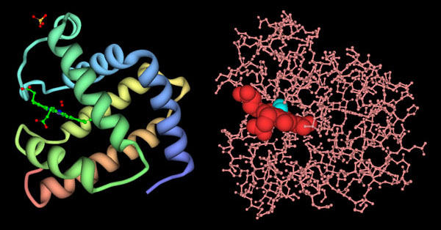
Myoglobin structure ribbon vs atom positions

Slide 26
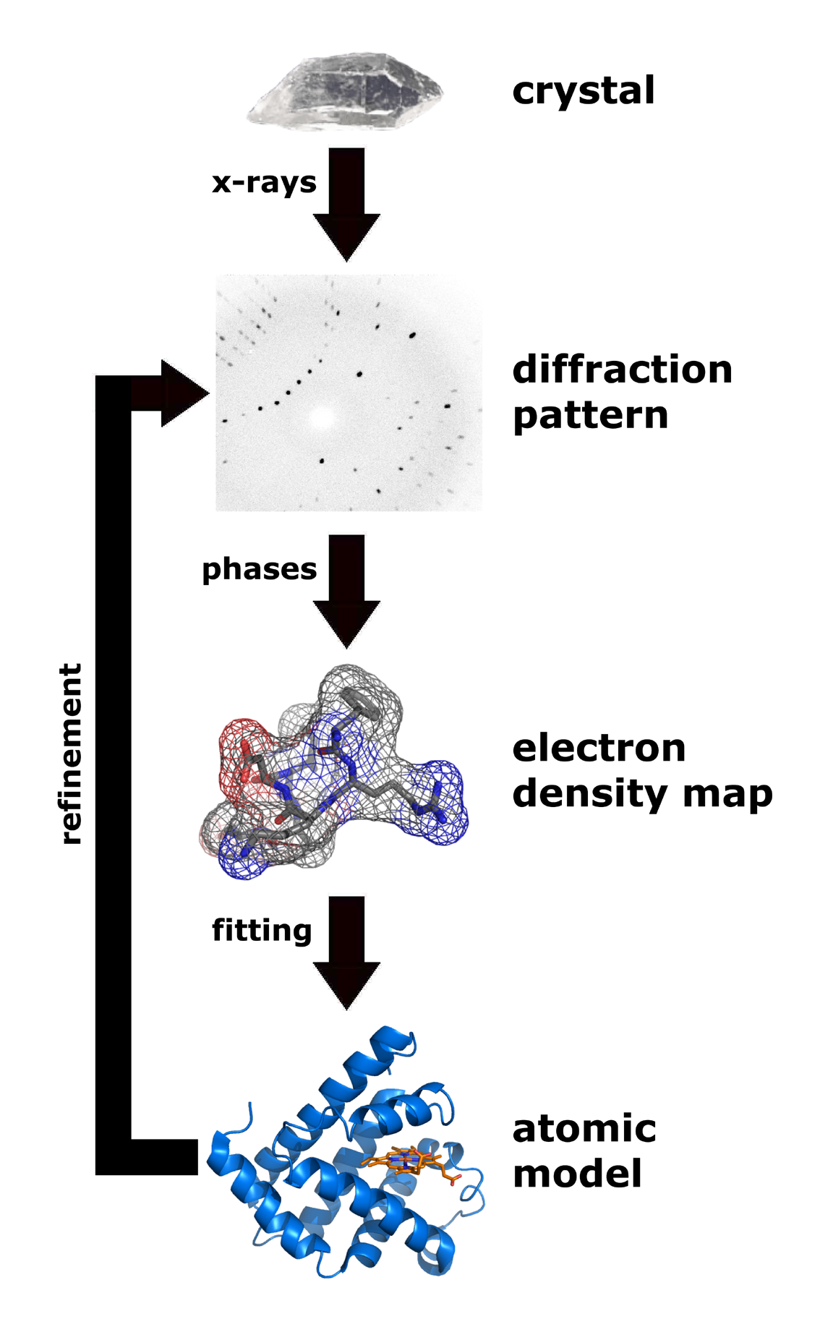
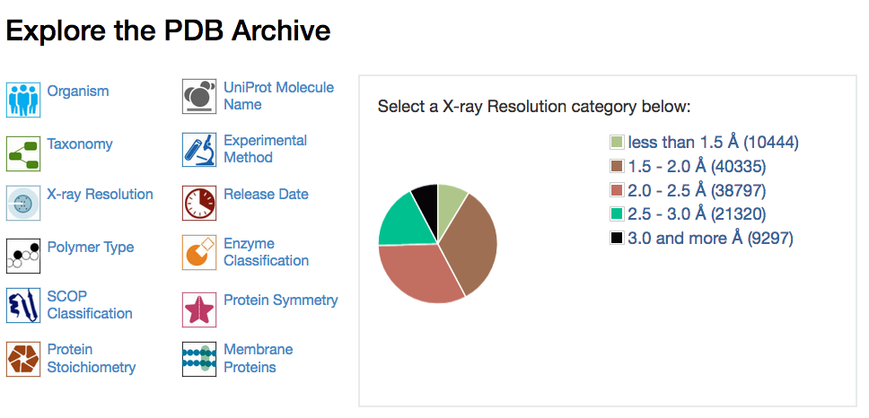
X-RAYS
crystallography
median resolution 2.05 Å
PDB stores in separate sections:
Experimental structural data
Structural data associated to models
Notes:
Protein purified and grown into a crystal, which is exposed to X-rays whose diffraction depends on the crystal structure, a detector records a diffractino pattern and then the software-based electron density map is calcculated and an anotmic model is built up, advantages high resolution, limitations reside in the difficulty to ontain a crystal

Slide 27
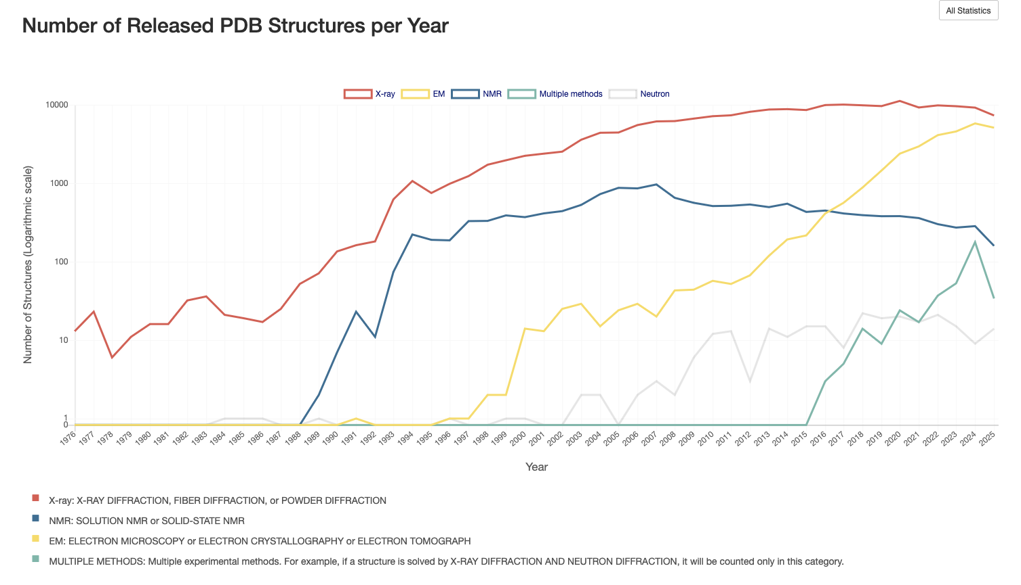

Slide 28
PDB files
The most common format for storage and exchange of atomic coordinates for biological molecules is PDB file format
PDB file format is a text (ASCII) format, with an extensive header that can be read and interpreted either by programs or by people
Next slide: PDB file format

Slide 29
name
HEADER TRANSCRIPTION REGULATION 25-AUG-94 1RPO 1RPO 2
COMPND ROP (COLE1 REPRESSOR OF PRIMER) MUTANT WITH ALA INSERTED ON 1RPO 3
COMPND 2 EITHER SIDE OF ASP 31 (INS (A-D31-A)) 1RPO 4
SOURCE (ESCHERICHIA COLI) 1RPO 5
AUTHOR M.VLASSI,M.KOKKINIDIS 1RPO 6
REVDAT 2 15-MAY-95 1RPOA 1 REMARK 1RPOA 1
REVDAT 1 14-FEB-95 1RPO 0 1RPO 7
JRNL AUTH M.VLASSI,C.STEIF,P.WEBER,D.TSERNOGLOU,K.WILSON, 1RPO 8
JRNL AUTH 2 H.J.HINZ,M.KOKKINIDIS 1RPO 9
JRNL TITL RESTORED HEPTAD PATTERN CONTINUITY DOES NOT 1RPO 10
JRNL TITL 2 ALTER THE FOLDING OF A 4-ALPHA-HELICAL BUNDLE 1RPO 11
JRNL REF NAT.STRUCT.BIOL. V. 1 706 1994 1RPO 12
JRNL REFN ASTM NSBIEW US ISSN 1072-8368 2024 1RPO 13
REMARK 1 1RPO 14
REMARK 1 REFERENCE 1 1RPO 15
REMARK 1 AUTH M.KOKKINIDIS,M.VLASSI,Y.PAPANIKOLAOU,D.KOTSIFAKI, 1RPO 16
REMARK 1 AUTH 2 A.KINGSWELL,D.TSERNOGLOU,H.J.HINZ 1RPO 17
REMARK 1 TITL CORRELATION BETWEEN PROTEIN STABILITY AND CRYSTAL 1RPO 18
REMARK 1 TITL 2 PROPERTIES OF DESIGNED ROP VARIANTS 1RPO 19
REMARK 1 REF PROTEINS.STRUCT.,FUNCT., V. 16 214 1993 1RPOA 2
REMARK 1 REF 2 GENET. 1RPOA 3
REMARK 1 REFN ASTM PSFGEY US ISSN 0887-3585 0867 1RPO 22
REMARK 2 1RPO 29
REMARK 2 RESOLUTION. 1.4 ANGSTROMS. 1RPO 30
REMARK 1RPO 94
REMARK 999 SEQUENCE NUMBER IS ALSO THAT FROM PDB ENTRY 1RPO 95
SEQRES 1 65 MET THR LYS GLN GLU LYS THR ALA LEU ASN MET ALA ARG 1RPO 96
SEQRES 2 65 PHE ILE ARG SER GLN THR LEU THR LEU LEU GLU LYS LEU 1RPO 97
SEQRES 3 65 ASN GLU LEU ALA ASP ALA ALA ASP GLU GLN ALA ASP ILE 1RPO 98
SEQRES 4 65 CYS GLU SER LEU HIS ASP HIS ALA ASP GLU LEU TYR ARG 1RPO 99
SEQRES 5 65 SER CYS LEU ALA ARG PHE GLY ASP ASP GLY GLU ASN LEU 1RPO 100
ATOM 1 N MET 1 1.132 3.053 2.801 1.00 25.53 1RPO 115
ATOM 2 CA MET 1 2.398 3.546 2.283 1.00 27.85 1RPO 116
ATOM 3 C MET 1 3.091 2.466 1.442 1.00 21.34 1RPO 117
ATOM 4 O MET 1 2.642 1.298 1.451 1.00 19.29 1RPO 118
ATOM 5 CB MET 1 3.281 3.936 3.463 1.00 23.96 1RPO 119
ATOM 6 CG MET 1 3.718 2.760 4.291 1.00 27.52 1RPO 120
ATOM 7 SD MET 1 4.491 3.371 5.797 1.00 26.29 1RPO 121
ATOM 7 SD MET 1 4.491 3.371 5.797 1.00 26.29 1RPO 121
ATOM 8 CE MET 1 3.039 3.650 6.762 1.00 25.19 1RPO 122
ATOM 9 N THR 2 4.142 2.833 0.689 1.00 13.20 1RPO 123
ATOM 10 CA THR 2 4.851 1.806 -0.025 1.00 12.76 1RPO 124
ATOM 11 C THR 2 5.719 1.011 0.950 1.00 14.35 1RPO 125
compound
organism
author
references
resolution
sequence
residue 1
residue 2
Atom number
Atom type
Residue type
x
y
z
Residue number

Slide 30
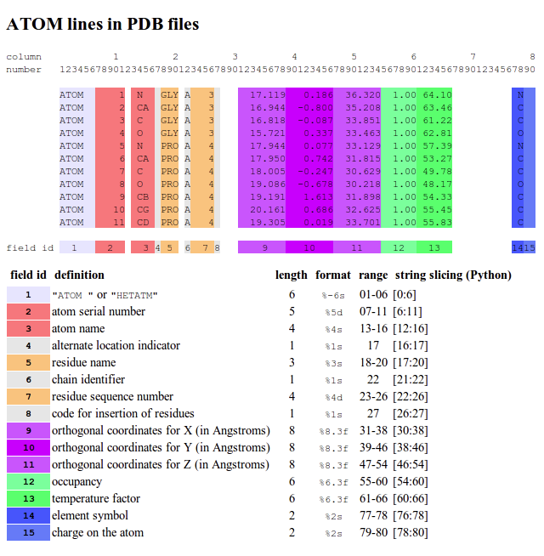
Occupancy: the fraction of unit cells that contain the atom in this particular location, usually 1.00, or all of them (can be used to represent alternative conformations of side chains);
Temperature factor: an indication of uncertainty in this atom's position due to disorder or thermal vibrations (can be used by graphics programs to represent the relative mobility of different parts of a protein)

Slide 31
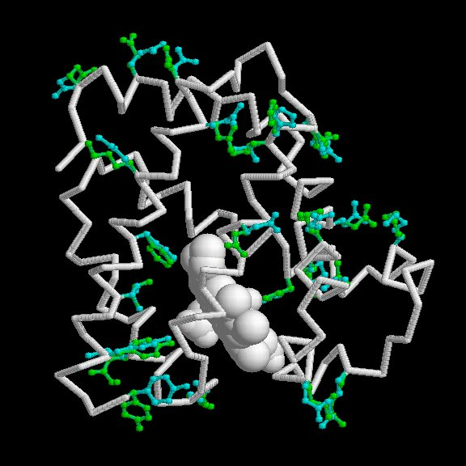
Occupancy
Alternative conformations: myoglobin aa with two conf.

Slide 32
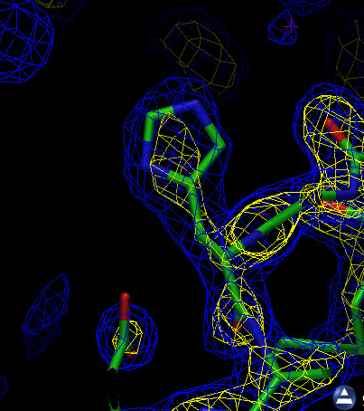
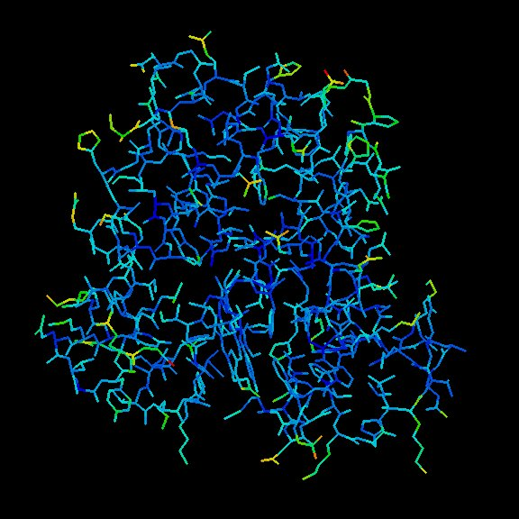
Temperature factor
Electron density depends on vibrations
Atoms colored by the temperature factors

Slide 33
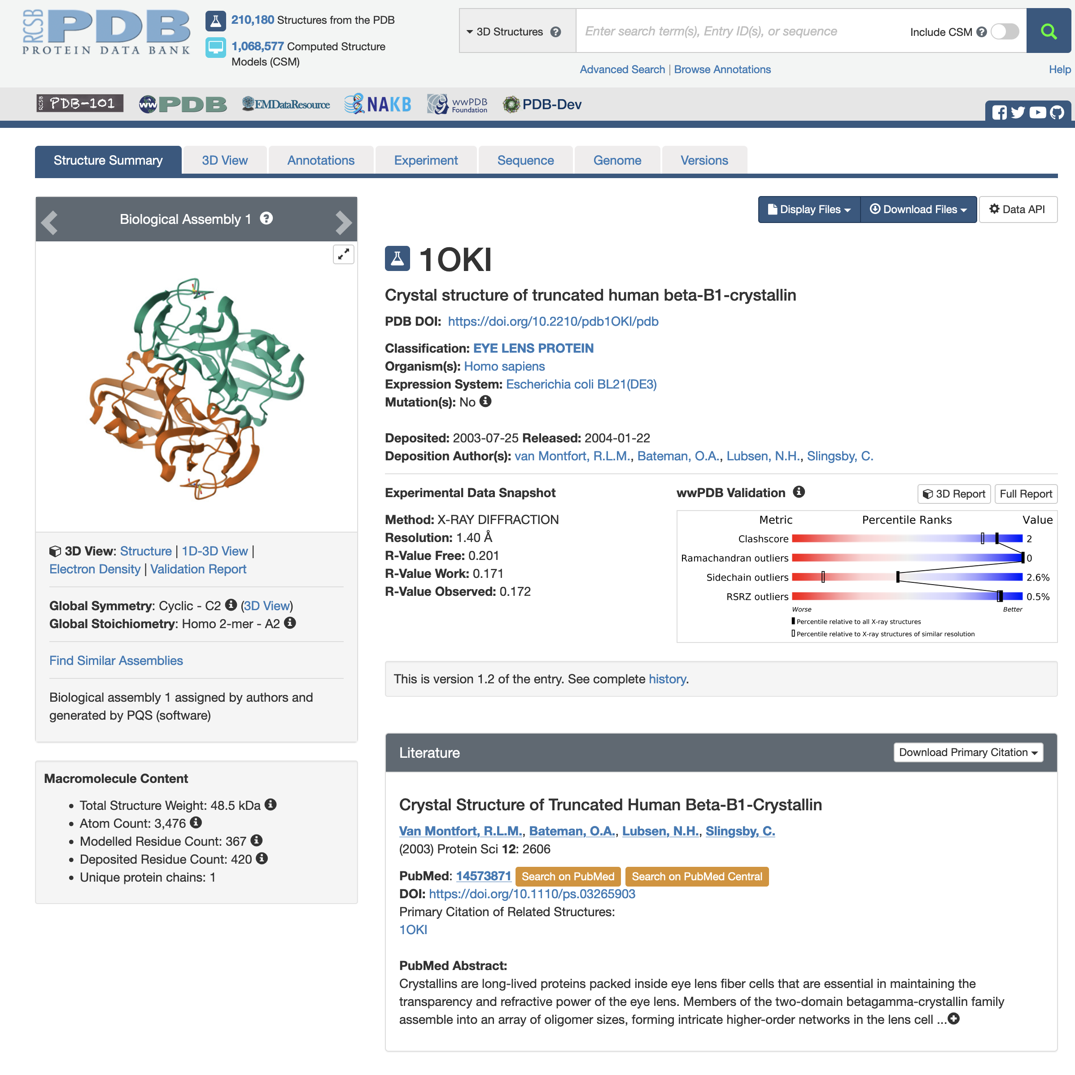

Slide 34
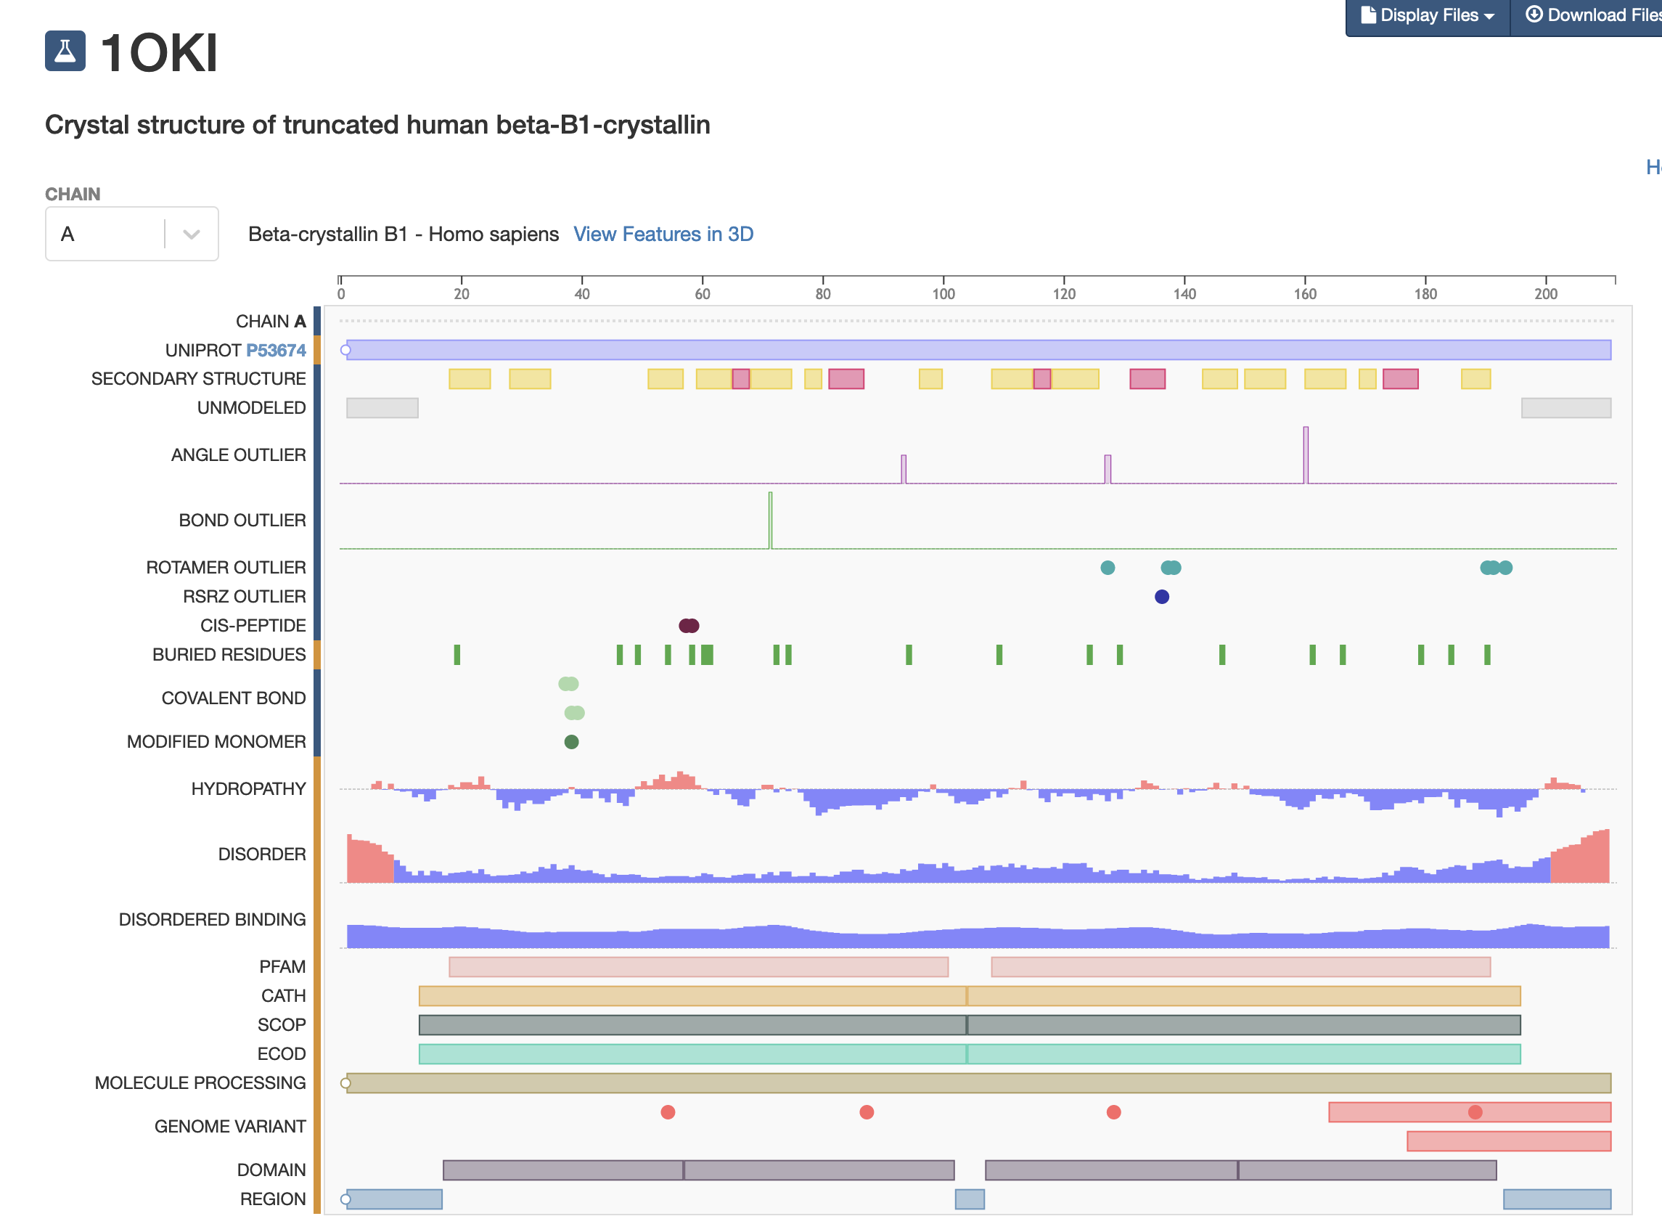
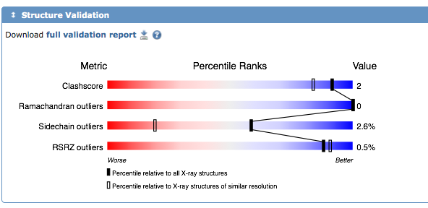
SEQUENCE
STRUCTURE VALIDATION

Slide 35
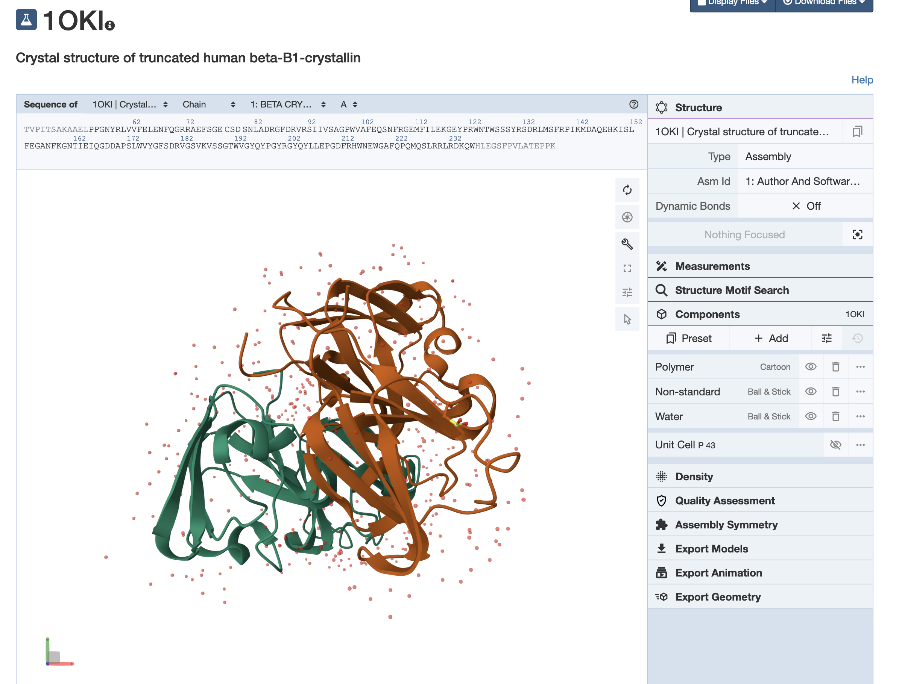
Interactive view
Subunits view

Slide 36
SECONDARY DATABASES

Slide 37
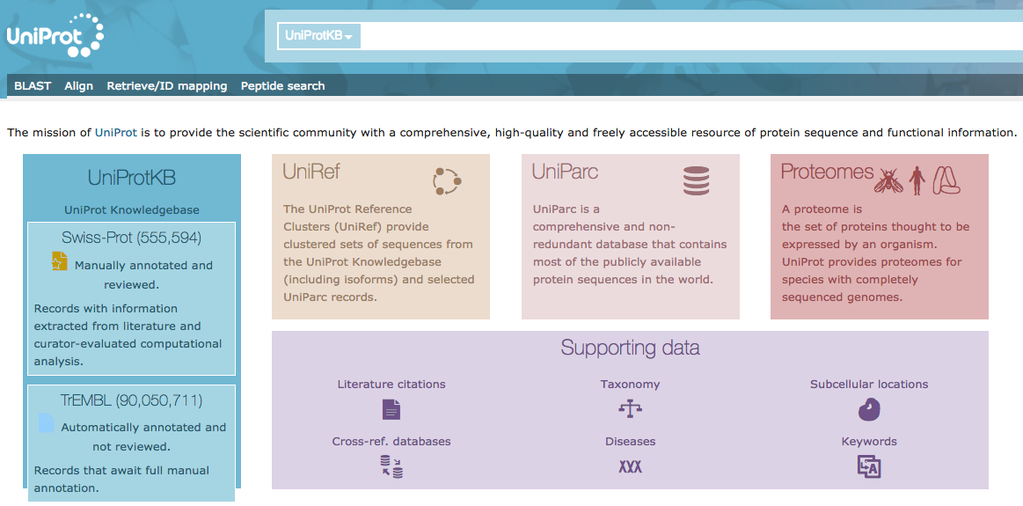
SECONDARY DATABASES
UniProt (Universal Protein Resource)
The largest catalog of protein information. It contains information on the sequence and function of proteins and is obtained from the set of information contained in Swiss-Prot, TrEMBL and PIR.

Slide 38
UniProt http://www.uniprot.org/uniprot/
UniProtKB/Swiss-Prot
manually annotated records, information from literature
UniProtKB/TrEMBL
Records made by computational analysis, pending complete annotation
UniProt Knowledgebase is the central access point for extensive curated protein information, including function, classification, and cross-reference.

Slide 39
What is UniProt useful for?
Very useful to find protein sequence and functional information
Useful for evolutionary studies
We can find out:
Properties of proteins including the biological processes they are involved in
Post-translational modification
Variants observed intra species
Interactions with other molecules
Location in cells and organisms

Slide 40
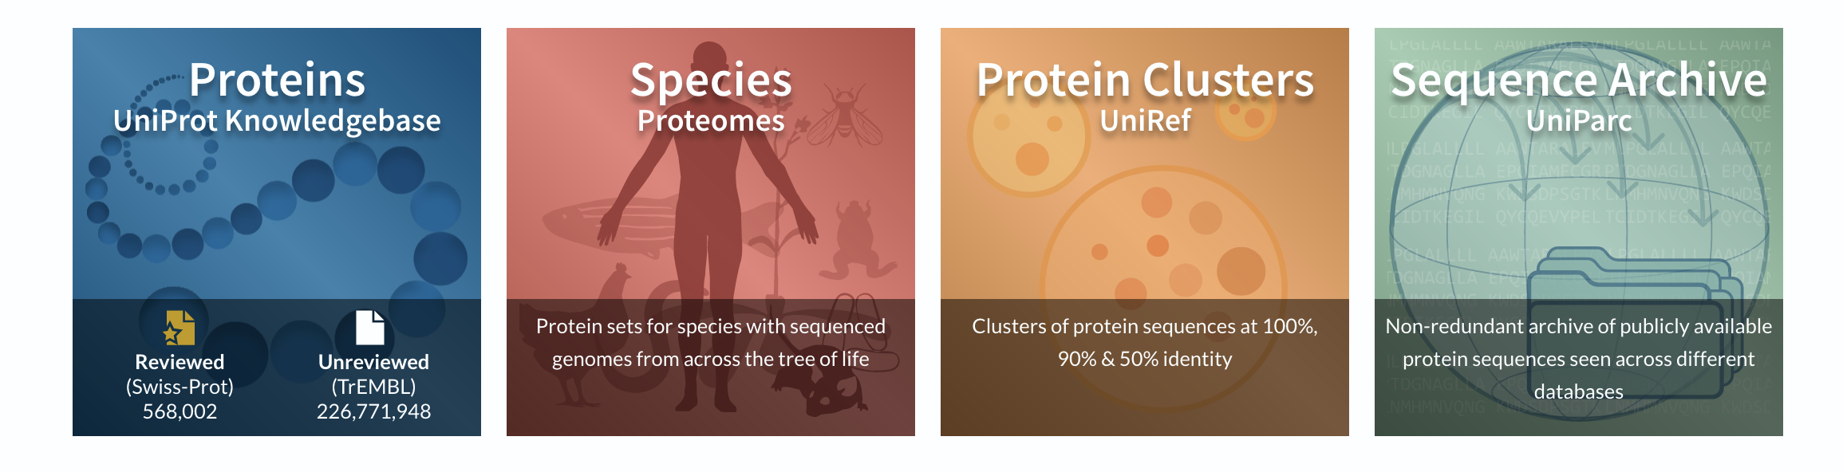
UniProt Non-redundant Reference (UniRef) databases combine closely related sequences into a single record to speed searches.
UniProt Archive (UniParc) is a comprehensive repository, reflecting the history of all protein sequences.
The sequences and information in UniProt is accessible via text search, BLAST similarity search, and FTP.

Slide 41
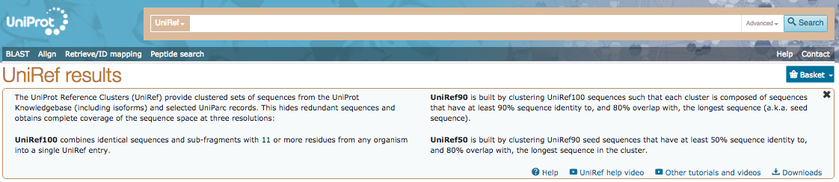

Slide 42
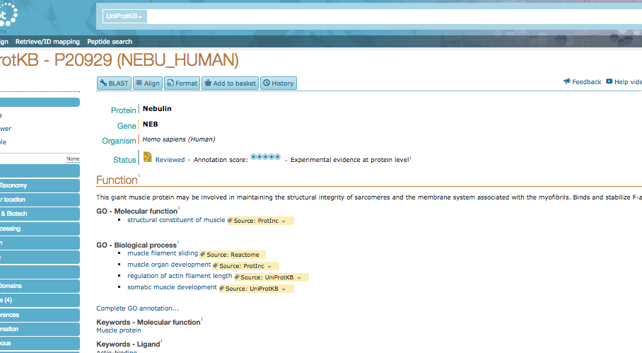

Slide 43
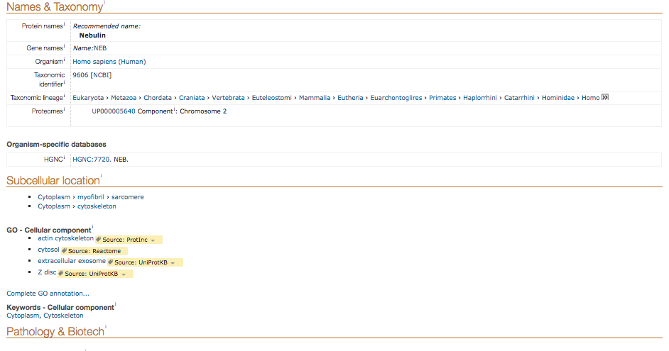

Slide 44
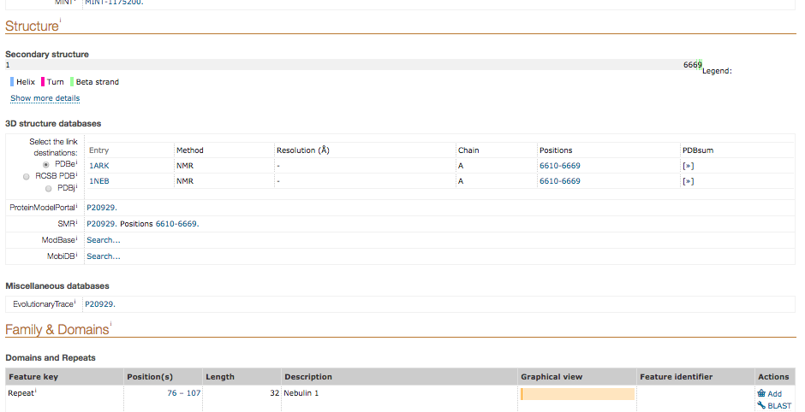

Slide 45
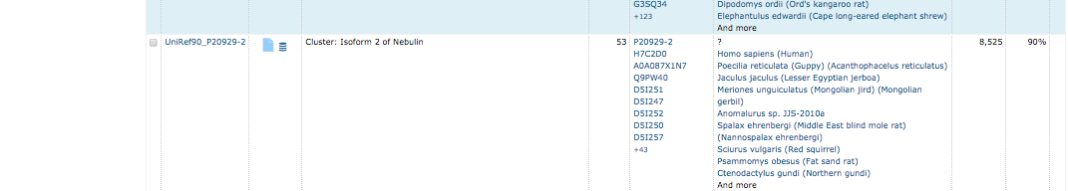
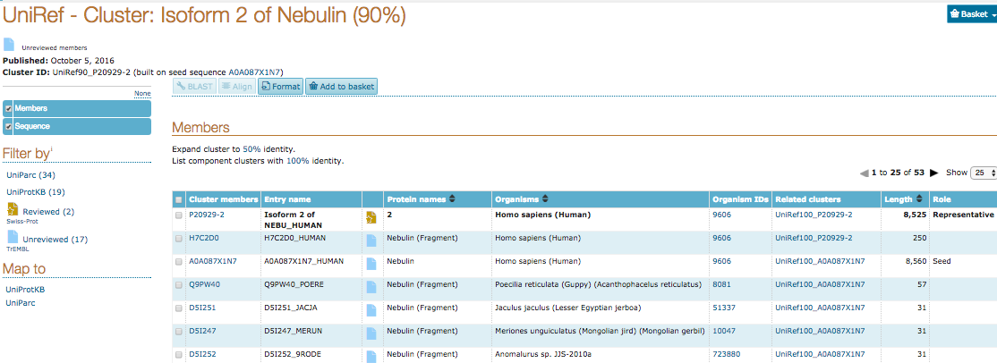

Slide 46

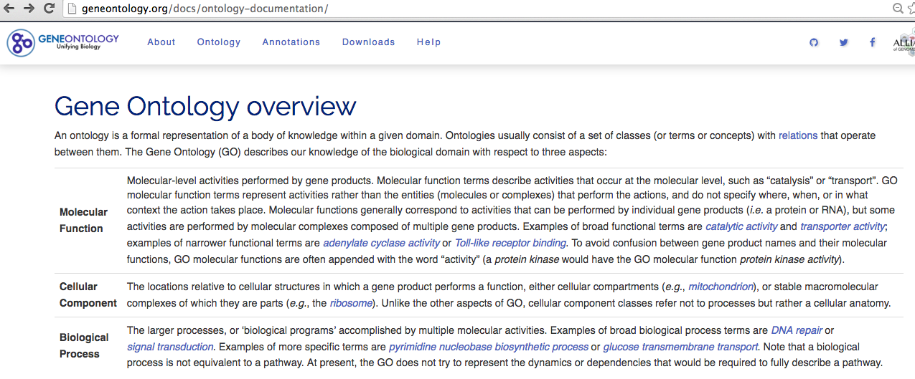
How functional data are encoded?

Slide 47
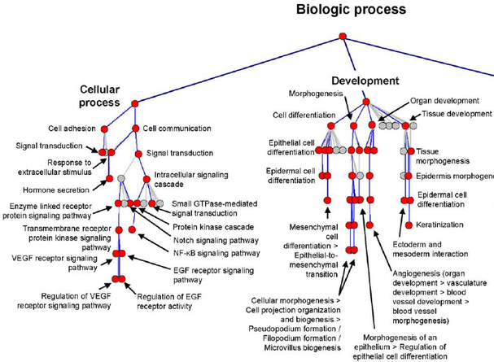
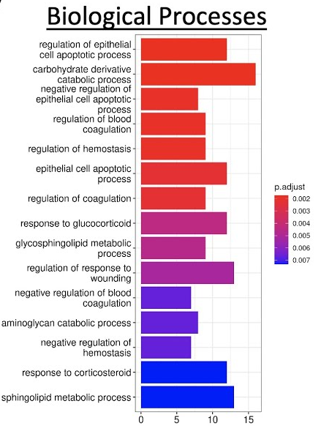
Gene list
Statistical analysis of enriched GO terms
Enrichment score

Slide 48
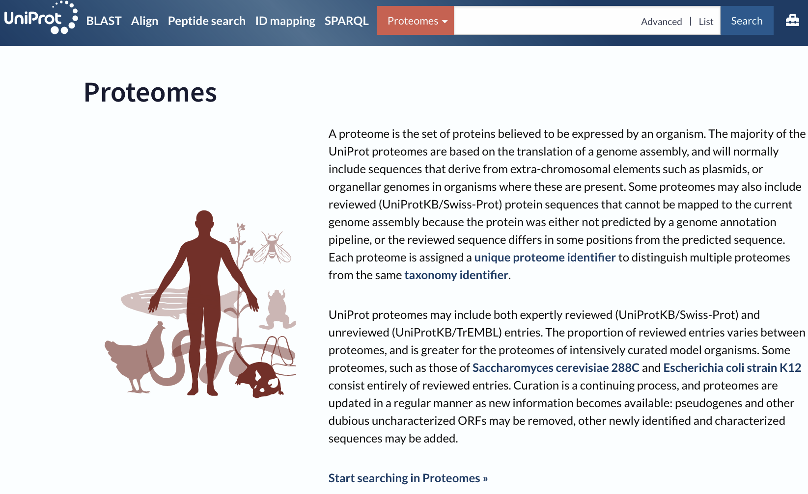

Slide 49
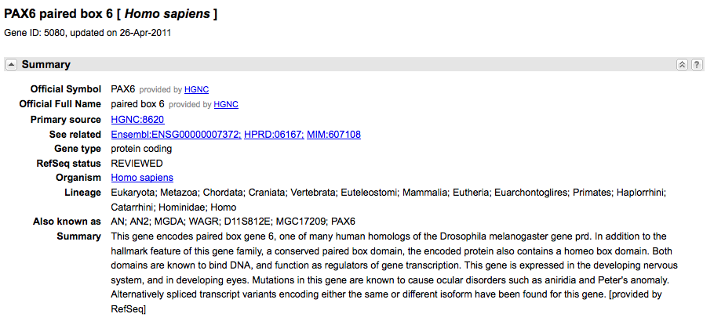
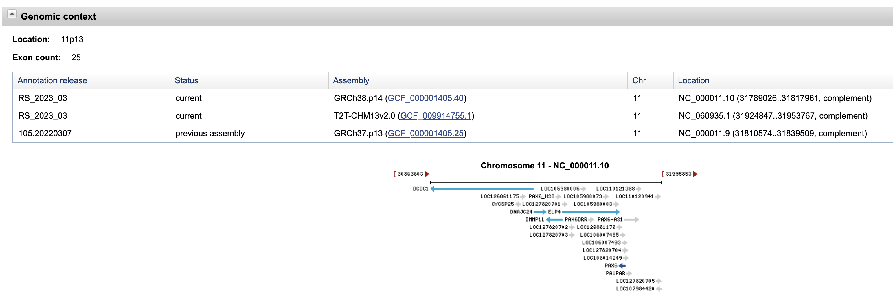
Unified interface to search for information on genetic sequences and loci.
Information on official nomenclature, accession numbers, phenotypes, MIM numbers, UniGene clusters, homology, map locations and links to other websites.
NCBI GENE

Slide 50
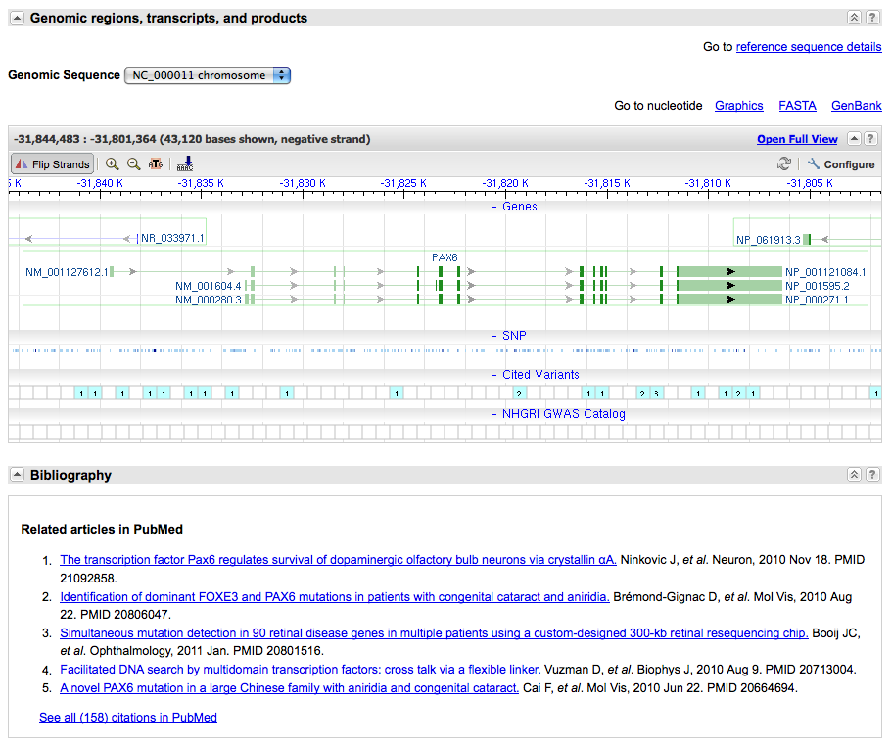
NCBI GENE

Slide 51
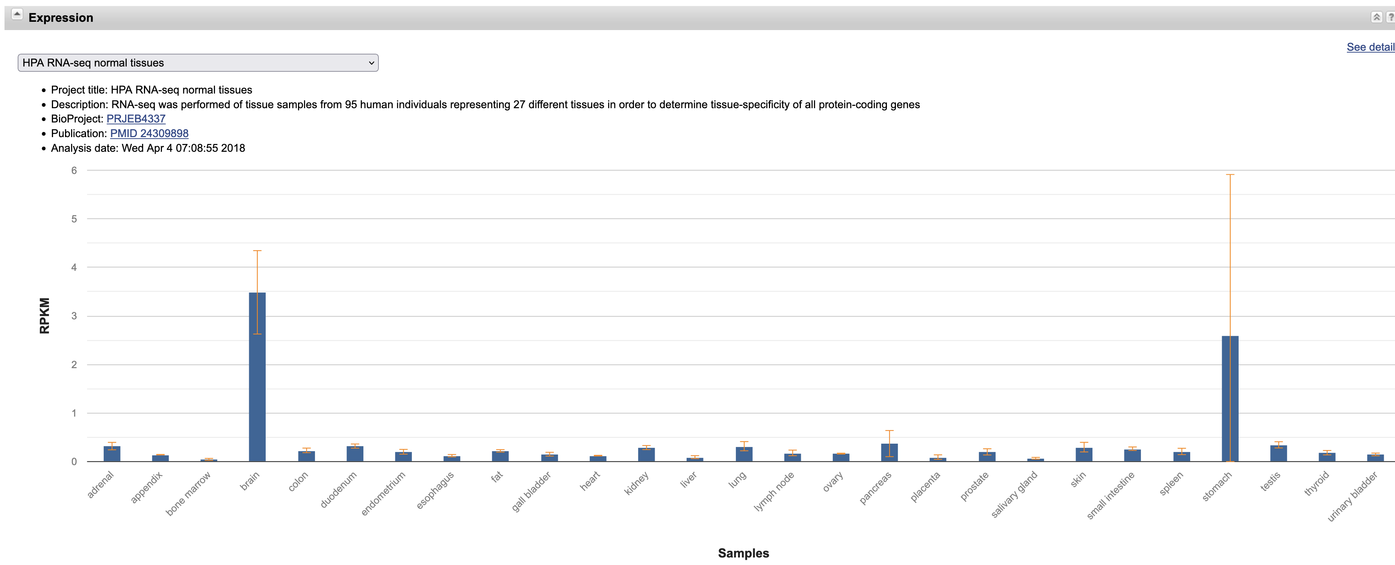

Slide 52
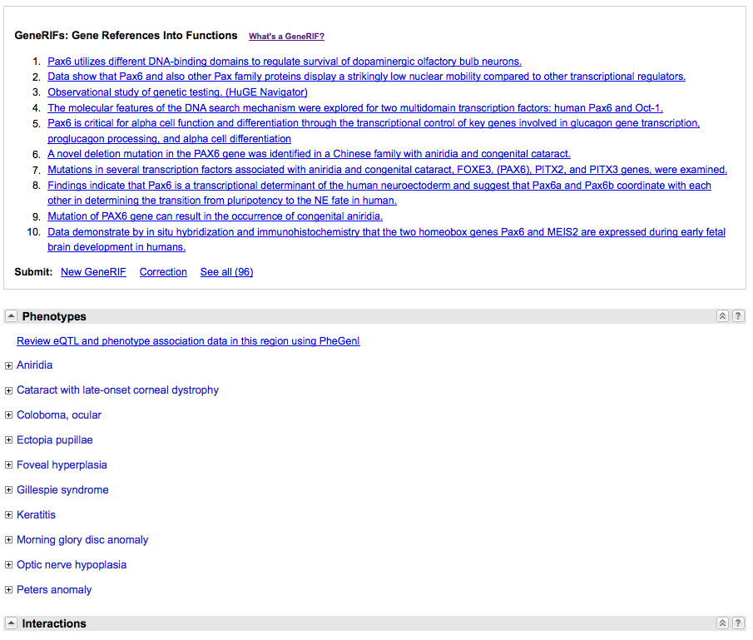
NCBI GENE

Slide 53
RefSeq
Reference Sequence collection of genomic DNA, transcripts, and proteins
Distinguishing Features:
non-redundancy
explicitly linked nucleotide and protein sequences
updates to reflect current knowledge of sequence data and biology
data validation and format consistency
accessions with '_' character
curation by NCBI staff and collaborators, with reviewed records indicated

Slide 54
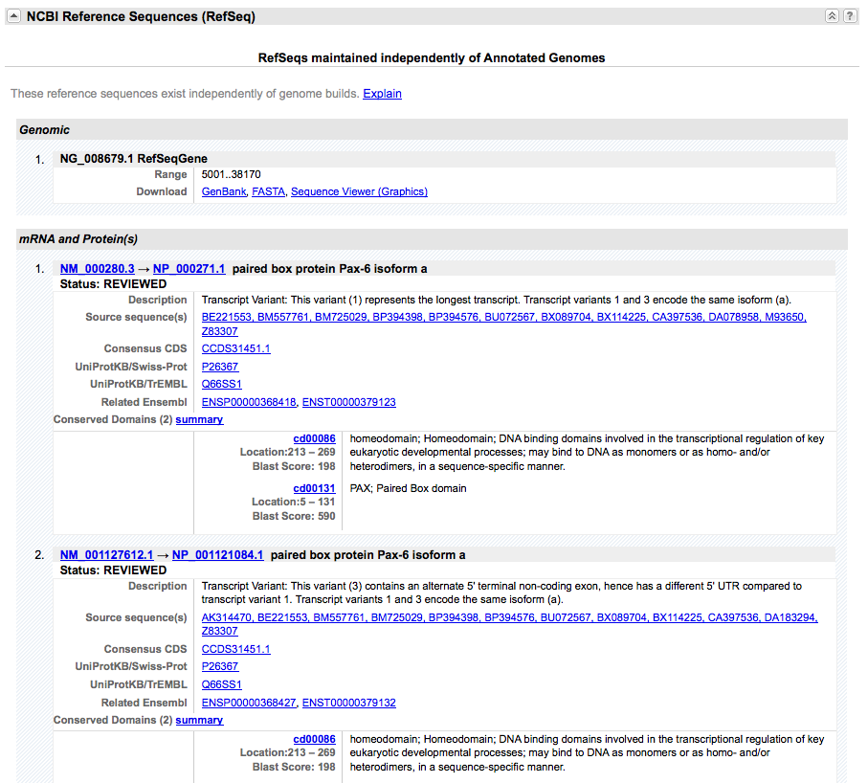
NCBI GENE

Slide 55


Slide 56
SECONDARY DATABASES
NCBI - Information retrieval system
Developed at the NCBI to allow access to molecular biology data and bibliographic citations. It exploits the concept of "neighbouring": the possibility of linking different objects from different databases to each other, regardless of whether they are directly "cross-referenced". Typically, it allows access to databases of nucleotide sequences, protein sequences, chromosome and genome mapping, 3D structure, bibliography (PubMed) and many more.

Slide 57

SECONDARY DATABASES
NCBI - Information retrieval system

Slide 58


PubMed

Slide 59


Bookshelf

Slide 60
Molecular Structures DBs
SECONDARY DATABASES
PFAM, CATH, SCOP
Secondary databases derived from PDB
Structures organized according to hierarchical, evolutionary and structural similarity criteria

Slide 61
Proteins contain conserved regions
Based on the conserved regions, proteins are classified into families, and subfamilies
A protein family is a group of evolutionarily-related proteins
Superfamily
Family 1
Family 3
Family2
Subfamily 1
Subfamily 2

Slide 62
Domains can be considered as building blocks of proteins
Some domains can be found in many proteins with different functions, while others are only found in proteins with a certain function
The presence of a particular domain can be indicative of the function of the protein

Slide 63

Cyclophilins
Peptidylprolyl isomerases
Accelerate the folding of proteins
Cyclosporin binding-protein modulating immunosuppression
Structures of isomerase domains of human cyclophilin family members

Slide 64

Most proteins include two or more domains
Nucleic
acid-binding
tRNA^{Asp}
Yeast
Aspartyl-tRNA Synthetase 1
- Two domains
- Each domain belongs to a distinct family
ATP bound in the active site
Catalytic
Matthew Bashton, Cyrus Chothia 2007
The Generation of New Protein Functions by the Combination of Domains
Class II aaRS and biotin synthetases superfamily
Notes:
tRNA loading or amminacylation, adelynation of the aa for activation and then charging of the tRNA with the aa covalent (ester) bond of the carbonyl carbon to the 3’ end

Slide 65

Many proteins comprise multiple independent structural and functional domains.
Due to evolutionary shuffling, different domains in a protein evolve independently.
Focus on families of protein domains. Many online resources are devoted to identify and catalog such domains.

Slide 66
Pfam
The Pfam database is a large collection of protein domain families.
Each family is represented by multiple sequence alignments and hidden Markov models (HMMs), useful also to classify in this context new sequences.
→ HMM (Hidden Markov Models) are probabilistic models used here to describe the evolution and conservation of protein families
Provides links to external databases like PDB, SCOP, CATH etc.

Slide 67

Markov Models (or Markov chains) are statistical models that describe series (sequences) of states in which the probability of a certain state depends only on the previous state or previous ones.
A Markov model describes the probabilistic relationship between different states.
To model the probability of transitioning from one state to another we can create a matrix which describes the probability of being in state i at time t and being in state j at time t+1.
Now one question we may ask given a Markov model is: what is the probability that our model generated a particular sequence of states?

Slide 68
Markov Models
Possible states:
The process goes from one state to another, generating a sequence of states:
Properties of Markov Chains: the probability of a certain state depends only on what the previous state is:
To define a Markov model, we need to define the following probabilities:
transition probabilities initial probabilities

Slide 69
Example of a Markov Model
0.3
0.7
Two states : ‘Rain’ and ‘Dry’
Transition probabilities:
P(‘Rain’|‘Rain’)=0.3 , P(‘Dry’|‘Rain’)=0.7 ,
P(‘Rain’|‘Dry’)=0.2, P(‘Dry’|‘Dry’)=0.8
Initial probabilities: say P(‘Rain’)=0.4 , P(‘Dry’)=0.6
Rain
Dry
0.2
0.8

Slide 70
Example of a Markov Model
0.3
0.7
Two states : ‘Rain’ and ‘Dry’
Transition probabilities:
P(‘Rain’|‘Rain’)=0.3 , P(‘Dry’|‘Rain’)=0.7 ,
P(‘Rain’|‘Dry’)=0.2, P(‘Dry’|‘Dry’)=0.8
Initial probabilities: say P(‘Rain’)=0.4 , P(‘Dry’)=0.6
Rain
Dry
0.2
0.8
Suppose we want to calculate a probability of a sequence of states in our example, {‘Dry’,’Dry’,’Rain’,’Rain’}.
P({‘Dry’,’Dry’,’Rain’,’Rain’} ) = P(‘Rain’|’Rain’) P(‘Rain’|’Dry’) P(‘Dry’|’Dry’) P(‘Dry’) = 0.3*0.2*0.8*0.6=0.288

Slide 71
Hidden Markov Model
0.3
0.7
States (Hidden)
Observations
Low
High
0.2
0.8
0.6
0.4
0.4
0.6
Rain
Dry
In Hidden Markov Models the observations are related to states, but we don't know them. The system states are hidden, and we can deduce their probability from the observations.
The model is defined by:
matrix of transition probabilities A=(a_{ij}), a_{ij}= P(s_{i} | s_{j})
vector of initial probabilities
matrix of observation probabilities B=(b_{i} (v_{m} )), b_{i}(v_{m} ) = P(v_{m} | s_{i})
(probability that of each state to produce a certain observation)

Slide 72
Hidden Markov Models are used to describe multiple alignments of protein families
In the context of multiple alignments of proteins from the same family HMM can be used:
to represent the statistical profile of the sequence family;
To find the most likely alignment between a sequence and the profile representing the family.
Hidden states “generate” the observed sequence alignment, thus the alignment process becomes a way to find the most probable path among the states that could have produces the given biological sequences.

Slide 73


Hidden Markov Models are used to describe multiple alignments of protein families

Slide 74

Multiple alignment→ HMM profile
ACA - - - ATG
TCA ACT ATC
ACA C - - AGC
AGA - - - ATC
ACC G - - ATC
insertion
Transition probabilities
Output Probabilities
A HMM model for a DNA motif alignments. The transitions are shown with arrows whose thickness indicate their probability. In each state, the histogram shows the probabilities of the four bases.
Next, use the model to calculate probability of a given sequence
E.g. P(ACACATC) = (0.8 * 1)*(0.8*1)*(0.8*0.6)*(0.4*0.6)*(1*1)*(0.8*1)*(0.8)
A C A C A T C

Slide 75

Creating a Pfam model is an iterative process
and alignment of curated example sequences (i.e. seed alignment), which is used to calculate a profile hidden Markov model (HMM)
This profile HMM is then used to search against a reference proteomes database to find additional matching members that pass the inclusion thresholds. Thresholds are adjusted to avoid inclusion of false positives.
The information in this new set of sequences (full alignment) is used to improve the probabilities in the model which may then lead to a slightly different alignment.
4) This adjusted full alignment is refined (through the determination of boundaries and minimisation of redundancy) to produce a new seed, and a new profile HMM is generated. This iterative process is repeated until no more homologs are detected in the sequence database search (i.e. the search has converged).

Slide 76
Pfam classification
Family
A collection of related protein regions
Family: Domain
A structural unit
Repeat
A short unit which is unstable in isolation but forms a stable structure when multiple copies are present
Motif
A short unit found outside globular domains
Related Pfam entries are grouped together into clans; the relationship may be defined by similarity of sequence, structure or profile-HMM.

Slide 77

Pfam entry types

Slide 78
Two sections:
Pfam-A → Seed and full alignments
Pfam-B → "Incomplete" families

Slide 79
Pfam-B families are un-annotated and of lower quality as they are generated automatically from the non-redundant clusters of the latest ADDA (Automatic Domain Decomposition Algorithm) database release.
Although of lower quality, Pfam-B families can be useful for identifying functionally conserved regions when no Pfam-A entries are found.

Slide 80


AA PROB. PER POSITION IN THE FAMILY
Pfam
HMM logo
Seed alignment
INSERTIONS

Slide 81
CATH Protein Structure Classification Database at UCL
Classification of proteins based on domain structures
Each protein chopped into individual domains and assigned into homologous superfamilies.
Hierarchial domain classification of PDB entries.

Slide 82
CATH hierarchy
Class – derived from secondary structure content is assigned automatically
Architecture – describes gross orientation of secondary structures, independent of connectivity and homology (based on known structures)
Topology – clusters structures according to their topological connections and numbers of secondary structures
Homologous superfamily – this level groups together protein domains which are thought to share a common ancestor and can therefore be described as homologous

Slide 83

Class, C-level
mainly-alpha, mainly-beta and alpha-beta (including alternating alpha/beta structures and alpha+beta structures) plus a fourth class with low secondary structure content.
Architecture, A-level
Overall shape; ignores the connectivity between the secondary structures. Assigned manually using literature for well-known architectures (e.g the beta-propellor or alpha four helix bundle) as reference.
Topology (Fold family), T-level
Structures are grouped into fold families at this level depending on both the overall shape and connectivity of the secondary structures. This is done using the structure comparison algorithm SSAP.

Slide 84

CATH – Human serine hydroxymethyltransferase major domain

Slide 85
SCOP Structural Classification of Proteins
Description of structural and evolutionary relationships between all the proteins with known structures
Uses the PDB entries
Search using keywords or PDB identifiers

Slide 86
Hierarchy in SCOP
While the four major levels of CATH are class, architecture, topology and homologous superfamily SCOP uses:
Class (all α, all β, α/β, α + β)
Fold
Superfamily
Family
Species
SCOP database is mainly based on expert knowledge, while CATH grounds more on automation
Notes:
one with mostly parallel sheet(s), called alpha/beta, and one with mostly antiparallel sheet(s), called alpha + beta

Slide 87
What about Genomic databases? They will be covered in the part of the course concerning Genomics

Slide 88


Homework: Explore the NAR DB issue 2025

Slide 89



Just a few examples

