Slide 1
A.A. 2025-2026 Master degree in Evolutionary Biology School of Science University of Padova MOLECULAR METHODS and BIOINFORMATICS Prof. STEFANIA BORTOLUZZI

Slide 2
LECTURE OVERVIEW
Introduction to bioinformatics
Biosequences, genes, genome and transcriptome
High-throughput methodologies

Slide 3
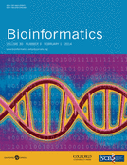
BIOINFORMATICS - DEFINITIONS
The application of computer technology to organize and analyze biological data
Analysis of proteins, genes, and genomes using computer algorithms
NIH: “research, development, or application of computational tools and approaches for expanding the use of biological, medical, behavioral or health data, including those to acquire, store, analyze, or visualize such data”

Slide 4
BIOINFORMATICS
Bioinformatics
Medical Informatics
Computational Biology
Genomics
Proteomics
Pharmacogenomics
Evolutionary Biology

Slide 5
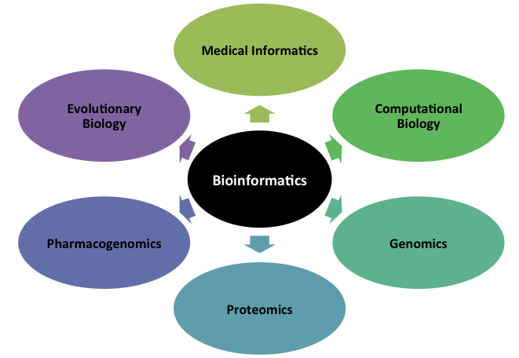
BIOINFORMATICS
The study and application of computing methods for classical biology
Notes:
SINONIMO BIOINFORMATICS
A SUA VOLTA MOLTE DISCIPLINE FIGLIE

Slide 6
BIOINFORMATICS
Analysis and comparison of the entire genome of a single species or of multiple species
Notes:
Computational and Statistical Genetics.

Slide 7
BIOINFORMATICS
Study of how the genome is expressed in proteins, and of how these proteins function and interact

Slide 8
BIOINFORMATICS
The application of genomic methods to identify drug targets, for example, searching entire genomes for potential drug receptors
Notes:
Pharmacogenomics is the study of how genes affect a person’s response to drugs.
This relatively new field combines pharmacology (the science of drugs) and genomics (the study of genes and their functions) to develop effective, safe medications and doses that will be tailored to a person’s genetic makeup.

Slide 9
BIOINFORMATICS
Study of the evolutionary processes that produced the diversity of life, the descent of species, and the origin of new species.

Slide 10
BIOINFORMATICS
The study and application of computing methods to improve communication, understanding, and management of medical data
Notes:
Biomedical informatics (BMI) is the interdisciplinary, scientific field that studies and pursues the effective uses of biomedical data, information, and knowledge for scientific inquiry, problem solving and decision making, motivated by efforts to improve human health.

Slide 11
BIOINFORMATICS: Main areas
Development and implementation of software to store, disseminate and process different types of information
Development of new algorithms and statistical methods to integrate different data, search and study different types of relationships and interactions in large datasets
Analysis and interpretation of various types of data, such as biosequences, structures, interactions, gene expression profiles, up to multi-modal omics data

Slide 12
BIOINFORMATICS: Aims
Databases (design, handling, ...)
Sequence data analysis
Understading evolution
Study population dynamics
Analysis of gene expression data
Prediction of structures
Prediction of gene functions
Identification of risk factors for diseases
Identification of drug targets and drug design
Increase understanding of biology at a functional level
Model the functioning of cells and organisms, e.g. through regulatory and metabolic networks

Slide 13
ORGANISM
TREE OF LIFE
CELL

Slide 14
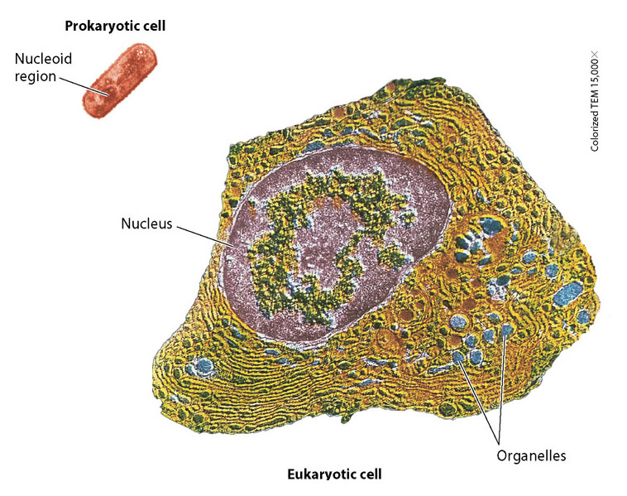
CELL

Slide 15
The role of bioinformatics
CELL
These billions of sequences present challenges and opportunities, to study many different biological problems, such as:
Cell states in relation to cell cycle, differentiation, disease etc.
Process regulation, …

Slide 16
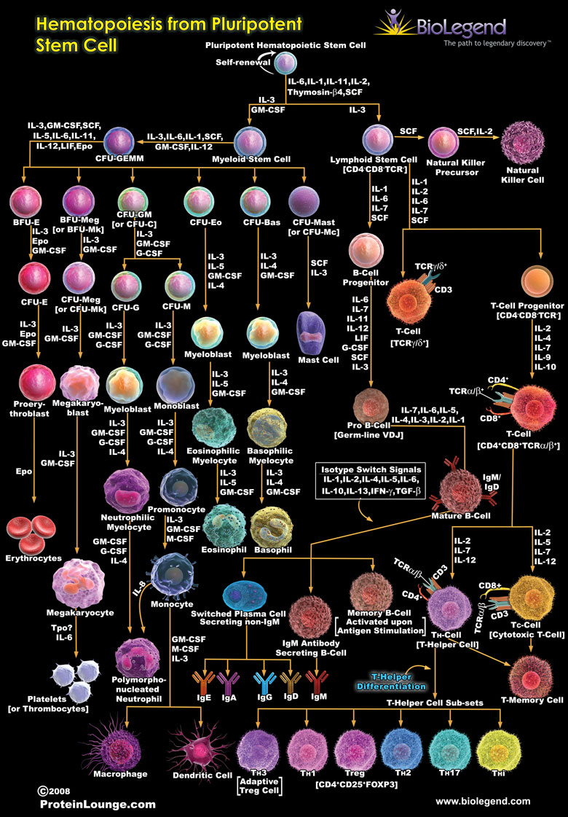
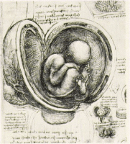
ORGANISM
TIME
Development
Differentiation
Space and state
Body region, physiology,
pathology, pharmacology

Slide 17
ORGANISM
The role of bioinformatics
Study of the genome, and particularly the set of genes expressed in RNA transcripts and protein products.
Bioinformatic tools can be used to describe qualitative and quantitative changes in the elements considered:
During development
In relation to the different areas of the body
In a very broad range of physiological or pathological states
With cell and spatial resolution

Slide 18
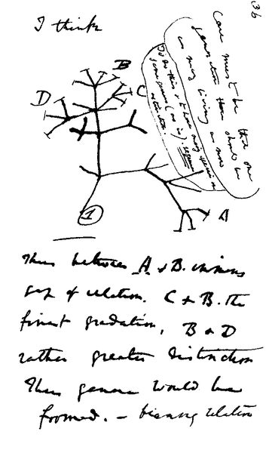
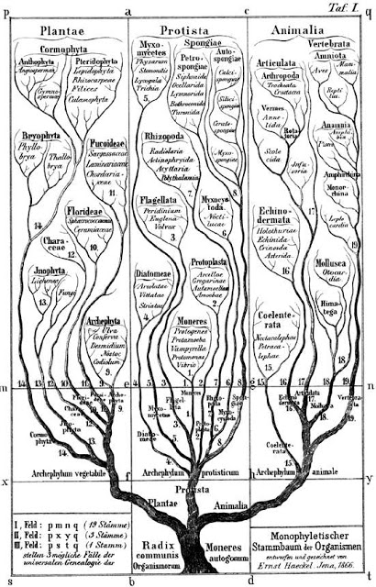
TREE OF LIFE
Darwin (1837) Haeckel (1866)
“The green and budding twigs may represent existing species; and those produced during former years may represent the long succession of extinct species.”

Slide 19
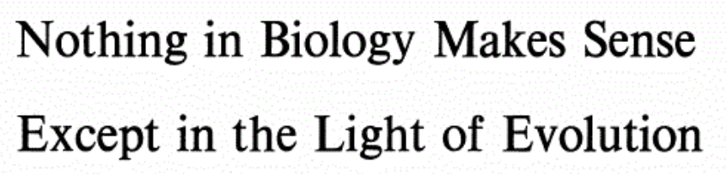
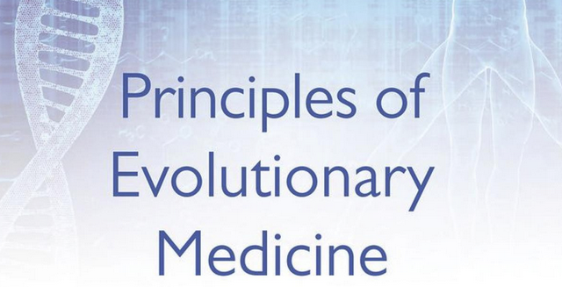
TREE OF LIFE
(Dobzhansky, 1973)
The idea of evolution in the conceptualization of biological phenomena and its progressive redefinition on the basis of theoretical and technical developments in the biological sciences are among the most significant intellectual achievements of science
Notes:
The idea of evolution in the conceptualization of biological phenomena and its progressive redefinition on the basis of theoretical and technical developments in the biological sciences are among the most significant intellectual achievements of science

Slide 20
The role of bioinformatics
TREE OF LIFE
Historically, molecular evolution was the first biology area that resorted to computer science -> birth of bioinformatics
Study evolutionary processes (from macro- to micro-evolution)
Reconstruct past history
Understand evolutionary pressures in relation to functional information and vice versa

Slide 21
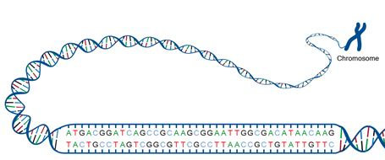
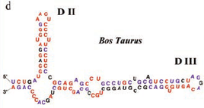
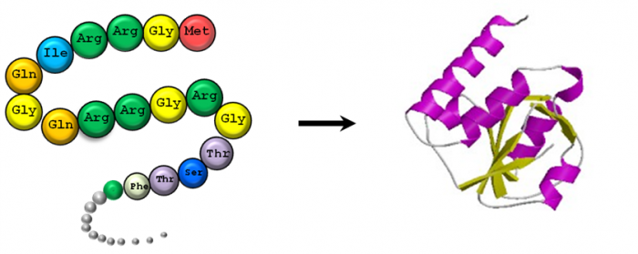
DNA and RNA are linear polymers of nucleotides, specialized in the storage, transmission and use of genetic information
Proteins are aa polymers
These molecules fold in 3D space, and perform different activities (e.g. catalysis, regulatory functions)
NUCLEIC ACIDS AND PROTEINS ARE LINEAR POLYMERS → BIOSEQUENCES under a MOLECULAR ALPHABET

Slide 22
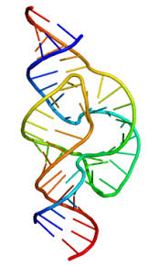
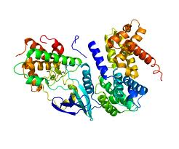
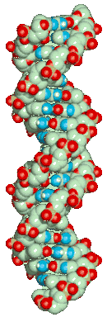
CENTRAL DOGMA OF MOLECULAR BIOLOGY
DNA
RNA
Protein
Transcription
Translation
Genome
Transcriptome
Proteome
CENTRAL DOGMA OF BIOINFORMATICS AND GENOMICS
Notes:
22

Slide 23
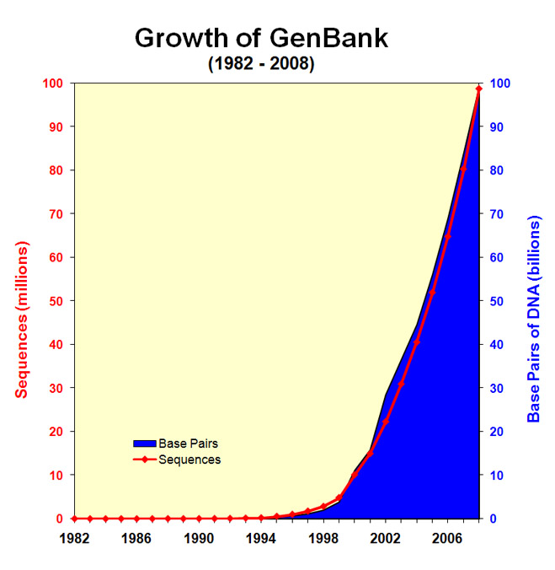
CELL

Slide 24
BIOINFORMATICS: WHICH DATA?
Sequence
Structural information
Expression
Molecular interaction
Mutation
Phenotypic
Imaging
DATA

Slide 25
BIOINFORMATICS: WHICH DATA?

Slide 26
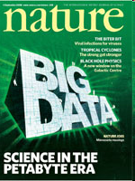
THE BIG DATA ERA
“Researchers need to be obliged to document and manage their data with as much professionalism as they devote to their experiments.”
→ Importance of data:
Retrieval
Integration
Analysis
Nature journal Issue of 4 2008
→ An at least basic knowledge of bioinformatic methods in unavoidable also for experimental researchers
→ Bioinformatics
from basic methods for managing biosequences to systems biology models

Slide 27
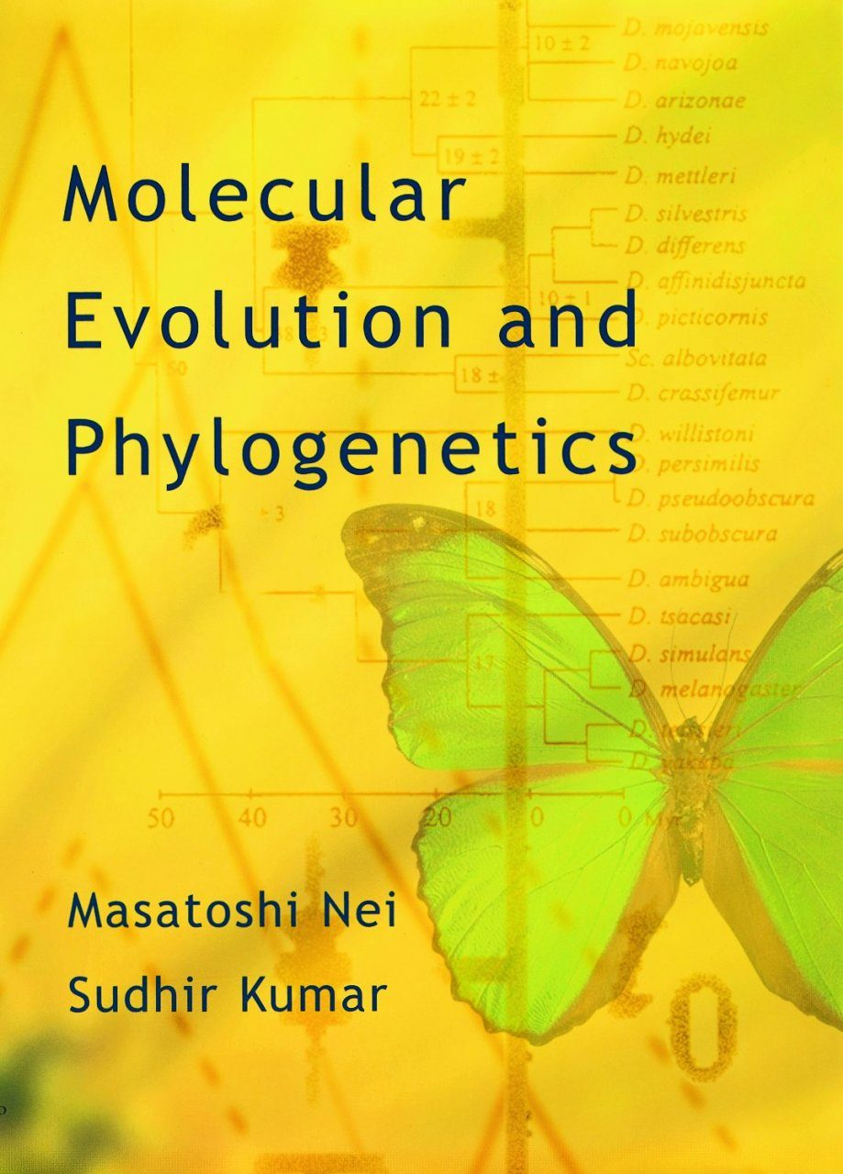
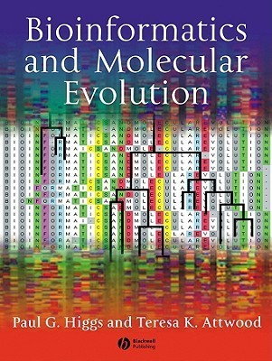
THE BIG DATA ERA
Big data became pervasive in biology several years ago and they came to stay
High-throughput experimental methodologies allow studying many processes on a genomic scale, or using comparative genomics
The availability of experimental data and knowledge requires quantitative approaches based on computer science and statistics to study biological phenomena

Slide 28
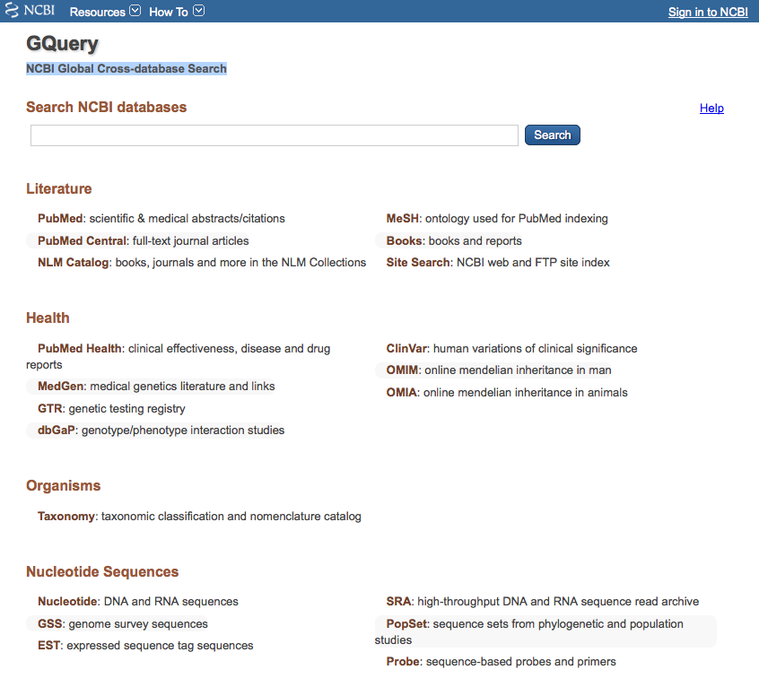
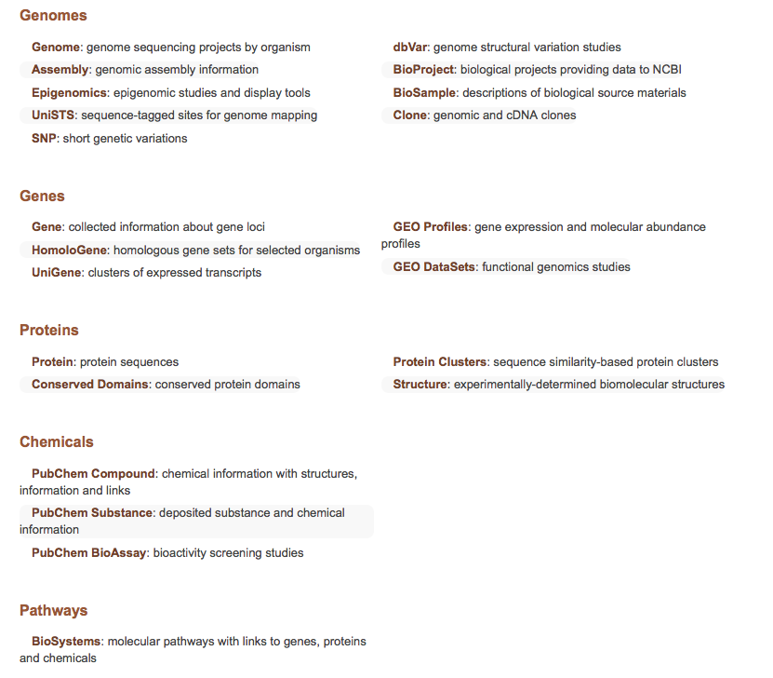
DATABASES AND DATA RETRIEVAL
Biosequences and Gene-related info

Slide 29
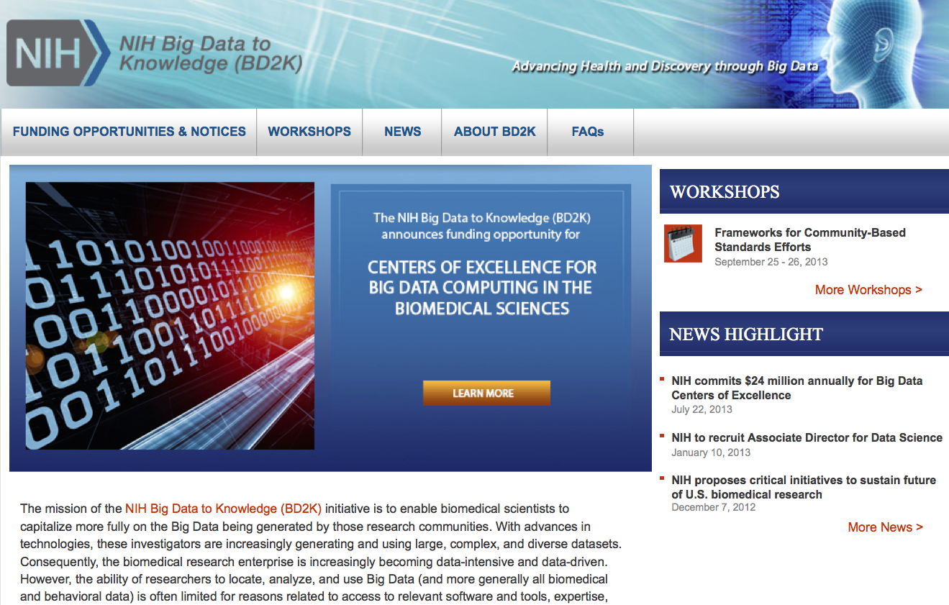
NIH BIG DATA to Knowledge (BD2K)
With advances in technologies, investigators are increasingly generating and using large, complex, and diverse datasets.
Consequently, the biomedical research enterprise is increasingly becoming data-intensive and data-driven.
However, the ability of researchers to locate, analyze, and use Big Data (and more generally all biomedical and behavioral data) is often limited for reasons related to access to relevant software and tools, expertise, and other factors.
D2K aims to develop the new approaches, standards, methods, tools, software, and competencies that will enhance the use of biomedical Big Data by supporting research, implementation, and training in data science and other relevant fields.

Slide 30
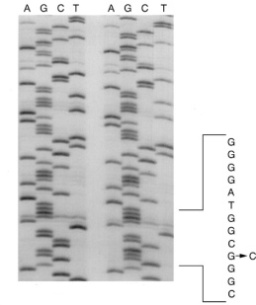
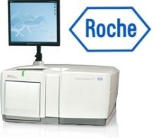
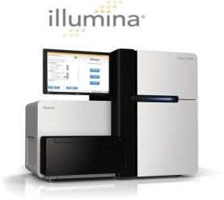
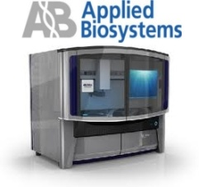
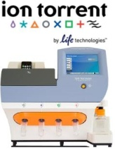
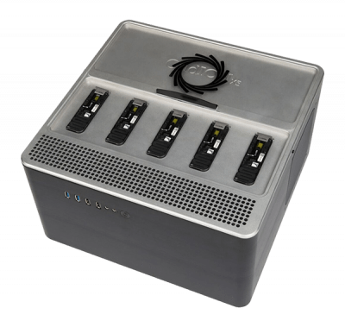
Evolution of DNA sequencing technologies
Deep sequencing
1° generation:
2° generation:
3° generation:
Standard Sanger
Next Generation Sequencing (NGS)
Real time single molecule,
Nanopore, sequencing
GridION X5
Roche/454
Illumina/Solexa
ABI/Solid
LifeTechnologies’ IonTorrent
Oxford Nanopore
Since: ‘70s 2004 today
Read length: 1000 bp 35-1000 bp 100-150 bp up to 4Mb
Throughput: 300 Kb/run 700-50 Mb/day >30 Gb/day 200 Gb
Notes:
Cominciamo con uno scorcio sull’evoluzione delle tecnologie di sequenziamento.
Fin dagli anni settanta (‘75 o ‘77) è stato utilizzato il metodo Sanger. (chain termination method, dideoxynucleotides ddNTPs) Questa tecnica nel corso degli anni è stata perfezionata ed automatizzata fino a raggiungere sequenze, o reads, lunghe fino a mille paia di basi, e fino ad un totale di trecento (384) sequenze per esperimento. Il metodo Sanger richiede però lunghi tempi di preparazione dei campioni (clonazione) e la quantità di paia di basi sequenziate è relativamente bassa.
A partire dal 2004 sono state introdotte le tecnologie di sequenziamento chiamate Next Generation Sequencing, o NGS, sviluppate da compagnie come Roche/454 , Applied Biosystems/Solid o Illumina/Solexa. La caratteristiche principali di queste tecnologie sono la brevità delle reads sequenziate, in un range tra 35 e 1000 paia di basi a seconda della macchina utilizzata, e l’alto parallelismo automatizzato dei processi di sequenziamento, che permette di ottenere un’enorme quantità di basi sequenziate per ogni esperimento. Per questa caratteristica ci si riferisce al Next generation Sequencing anche con il termine di Massive Parallel Sequencing. Confrontando con il metodo della prima generazione vediamo come il numero di paia di basi sequenziate è da uno a due ordini di grandezza superiore.
Già dallo scorso anno sono state presentate nuove tecnologie che rappresentano un’ulteriore evoluzione dei metodi NGS, come l’Ion Torrent della Life Technologies o l’ Oxford Nanopore, che puntano alla riduzione dei costi e al miglioramento della qualità dei sequenziamenti, non rinunciando all’elevato throughput che caratterizza i metodi NGS.

Slide 31


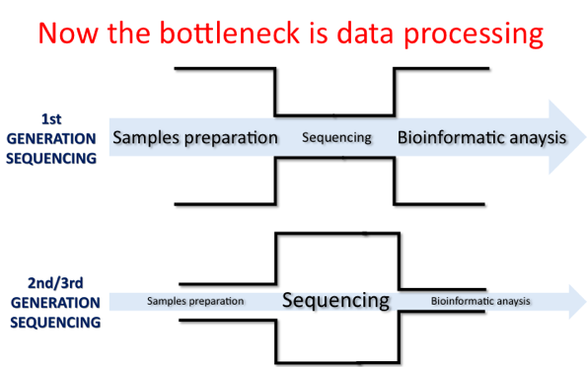
Millions of sequences
(raw reads)
per sample

Slide 32

DNA and RNA seq
GENOME
TRASCRIPTOME
DE-NOVO
RE-SEQUENCING
LONG
SHORT
AMPLICON
EXOME
WHOLE
GENOME
CODING
NON CODING
miRNA
OTHER
Pros
Lot of data
High discovery power
Many applications
Cons
Lot of data
Complex analysis
Different biological questions

Slide 33
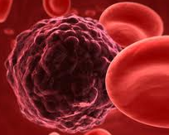
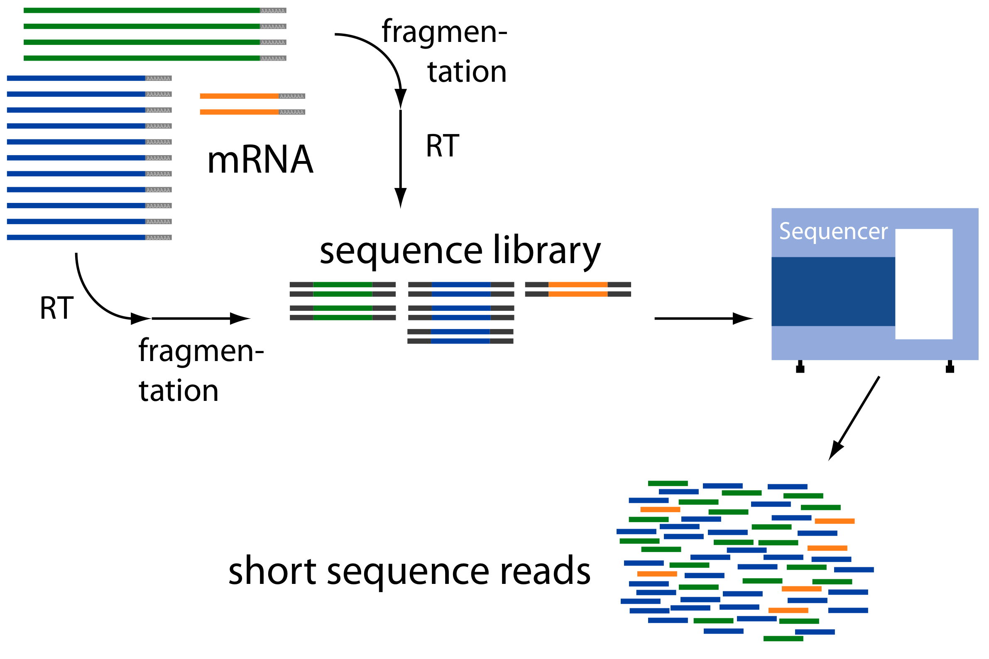
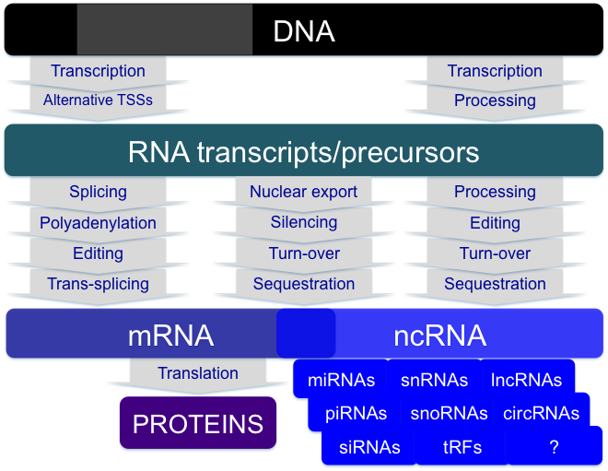
RNA-seq for Reverse Engineering of the genome state
Cells/Biosamples
Library preparation
Sequencing
Computational analysis
for reverse engineering

Slide 34
Genome
< 3% of the human genome encodes for proteins
>70% of the genome is pervasively transcribed (genomic-tiling array analysis; transcriptome sequencing data) in:
Coding RNA (→ mRNA)
Many other transcripts including short and long RNAs with scarce coding potential
Most eukaryotic DNA in non coding
ENCODE project production phase showed that >80% of the genoma is active and play (mainly regulatory) functions

Slide 35
The non-coding transcriptome
RNA molecules can simultaneously contain sequence information and possess structural plasticity
RNAs can both interact with DNA and other RNAs by complementary base pairing and provide binding sites for proteins
Well known non coding RNAs:
rRNA and tRNA in translation
snRNA and snoRNA in mRNA processing
ribozymes
“RNA world” (W. Gilbert 1986)

Slide 36
DNA
Transcription
<3% of the genome is important since transcribed/coding
abundant “junk DNA”
RNA
Processing
mRNA
ncRNA
Translation
proteins

Slide 37
>70% transcribed in “dark matter”
DNA
Transcription
Transcription
Alternative TSSs
Processing
RNA transcripts/precursors
Splicing
Nuclear export
Processing
Polyadenylation
Silencing
Editing
Editing
Turn-over
Turn-over
Trans-splicing
Sequestration
Sequestration
mRNA
ncRNA
Translation
miRNAs
snRNAs
lncRNAs
proteins
piRNAs
snoRNAs
circRNAs
Diverse functional roles for ncRNAs uncovered
siRNAs
tRFs
?
Notes:
Da transcibed dark matter a increase appreciation of the biological role or RNAs and integractions thereof
Concept of “transcribed dark matter”, i.e. transcripts with unknown function and meaning

