Slide 1
A.A. 2024-2025
Master degree in Evolutionary Biology
School of Science
University of Padova
MOLECULAR METHODS and BIOINFORMATICS
Prof. STEFANIA BORTOLUZZI

Slide 2
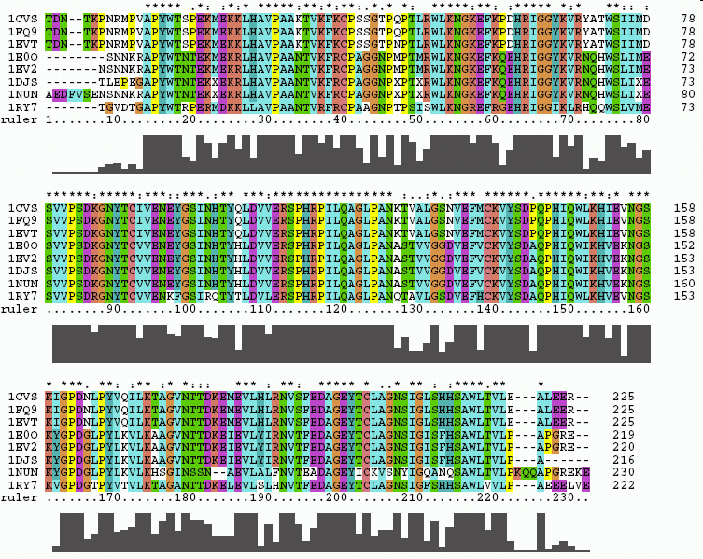
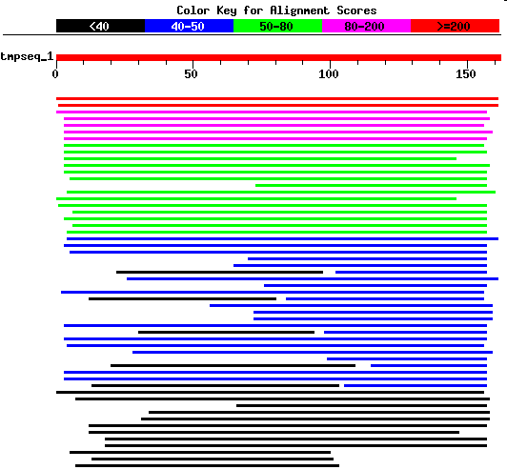
WORKING WITH BIOSEQUENCES
Alignments and similarity search

Slide 3
WORKING WITH BIOSEQUENCES
Alignments and similarity search
Sequence alignment
Dynamic programming
Global Alignment
Local alignment

Slide 4
SEQUENCE ALIGNMENT
Procedure for comparing two or more sequences, aimed at establishing a set of one-to-one relationships between pairs of residues of the sequences considered that maximize the similarity between the sequences themselves
Similarity (%) = (Identical residuals aligned) / (Alignment length) * 100
Alignment between two biological sequences is useful for discovering functional, structural and evolutionary information

Slide 5
What does it mean to align two sequences (proteins or nucleic acids)?
Write two sequences horizontally so as to have the greatest number of identical or similar symbols in the vertical register also by introducing intervals (gaps – insertions/deletions – indels)
  seq1: TCATG
  seq2: CATTG
TCAT-G
.CATTG
4 matches
1 insertion/deletion

Slide 6
Aligning DNA Sequences
Alignment : 2 x k matrix ( k ≥ m, n )
V = ATCTGATG
n = 8
W = TGCATAC
m = 7
match
mismatch
V
A | T |  | C |  | T | G | A | T | G
 | T | G | C | A | T |  | A |  | C
4
matches
mismatch
indels
1
W
5
indels
deletion
insertion
k = 10

Slide 7
SEQUENCE ALIGNMENT
PAIRWISE
AGTTTGAATGTTTTGTGTGAAAGGAGTATACCATGAGATGAGATGACCACCAATCATTTC
||||||||||||||||||| |||||||| ||| | |||||| |||||||||||||||||
AGTTTGAATGTTTTGTGTGTGAGGAGTATTCCAAGGGATGAGTTGACCACCAATCATTTC
MULTIPLE
KFKHHLKEHLRIHSGEKPFECPNCKKRFSHSGSYSSHMSSKKCISLILVNGRNRALLKTl
KYKHHLKEHLRIHSGEKPYECPNCKKRFSHSGSYSSHISSKKCIGLISVNGRMRNNIKT-
KFKHHLKEHVRIHSGEKPFGCDNCGKRFSHSGSFSSHMTSKKCISMGLKLNNNRALLKRl
KFKHHLKEHIRIHSGEKPFECQQCHKRFSHSGSYSSHMSSKKCV----------------
KYKHHLKEHLRIHSGEKPYECPNCKKRFSHSGSYSSHISSKKCISLIPVNGRPRTGLKTs

Slide 8
GLOBAL or LOCAL ALIGNMENT
GLOBAL → considers the similarity between two sequences throughout their length
LOCAL → only considers specific similar REGIONS between some parts of the sequences under analysis
Global alignment
LTGARDWEDIPLWTDWDIEQESDFKTRAFGTANCHK
||. | | | .| .| || || | ||
TGIPLWTDWDLEQESDNSCNTDHYTREWGTMNAHKAG
Local alignment
LTGARDWEDIPLWTDWDIEQESDFKTRAFGTANCHK
||||||||.||||
TGIPLWTDWDLEQESDNSCNTDHYTREWGTMNAHK

Slide 9
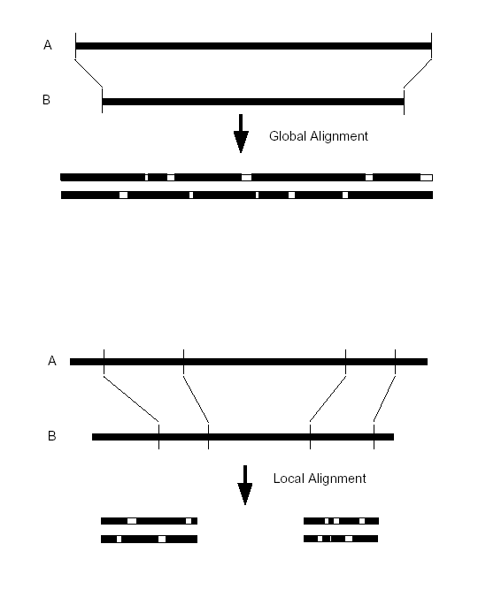
GLOBAL ALIGNMENT
LOCAL ALIGNMENT

Slide 10
Manual alignment based on maximizing the number of identical aligned residuals
Number of possible alignments of two seqs of length N
N=250 → 10¹⁴⁹
seq1 AACCGTTGACTTTGACC
Seq2 ACCGTAGACTAATTAACC
AACCGTTGACT..TTGACC
| ||||.|||| ||.|||
A.CCGTAGACTAATTAACC
Only feasible for a few very short sequences!
Multiple "equivalent" alignments can exist
AACCGAAGGACTTTAATC
AAGGCCTAACCCCTTTGTCC
AA..CCGAAGGACTTTAATC AACCGAAGGACT TTAATC
|| |..||...||||...| | |||.|| ||..||
AAGGCTAAACCCCTTTGTCC A AGGCCTAACCCCTTTGTC

Slide 11
A very simple and useful method for comparing two sequences:
the DOT PLOT MATRIX
A|X X X
T| X X
G| X
T| X X A T C A C T G T A
C| X | | | | | | |
A|X X X A T C A - - G T A
C| X
T| X X
A|X X X
+-------------------
A T C A G T A

Slide 12
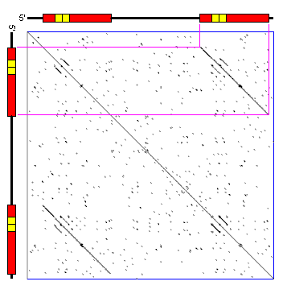
Dot plot matrix – Graphic representation of an alignment Retrovirus vector sequence against itself
The main diagonal represents the sequence's alignment with itself
Lines off the main diagonal represent similar or repetitive patterns within the sequence
Nearly identical long terminal repeats at each end (red)

Slide 13
Dot plot matrix – Graphic representation of an alignment Retrovirus vector sequence against itself
Two nearly identical long terminal repeats at each end (red)
Additional (4) small repeats (yellow)

Slide 14
ALIGNMENT SCORING
Given a pair of sequences Sa and Sb aligned
For each pair of elements a_{i} e b_{j} of Sa e Sb a score is defined s(a_{i},b_{j})
s(a_{i},b_{j}) = α se a_{i} = b_{j}
s(a_{i},b_{j}) = β se a_{i} ≠ b_{j} , con α > β
Each gap is assigned a score given by:
W_{k} = γ + δ(k-1)
Dove W_{k} It is a linear function that assigns a constant penalty to the presence of the gap (γ, ad es. -10) and a penalty proportional to the length of the gap minus one.
(gap opening penalty, GOP)
δ (gap extension penalty, GEP)
The overall score will be:
Σ (s(a_{i},b_{j}) ) + Σ (W_{k})
SIMILARITY SCORE
MATCHES
MISMATCHES
GAP PENALTY
GAPS

Slide 15
ALIGNMENT SCORING EXAMPLE
Sequences: Possible alignment:
ATTCCGAG
AGAC
Score schema definition:
Match: +2
  Mismatch: -1
  GOP: -5
  GEP: -2
MATCHES 3 3 x 2 = 6
MISMATCHES 1 1 x –1 = -1
SIMILARITY SCORE → 6 –1 = 5
GAPS 1 (4 nucleotides long) GOP + GEP X 3
GOP -5 GEP -2 x 3
GAP PENALTY → -5 + (3 x –2) = -11
FINAL SCORE 5 – 11 = -6
ATTCCGAG
| ||
A----GAC

Slide 16
MEASURES OF IDENTITY AND SIMILARITY
The simplest way to define similarity relationships between nucleotides is based only on IDENTITY and DIVERSITY.
The simplest similarity matrix for nucleotides is the “UNITARY SCORING MATRIX”, that assigns a score of 1 to pairs of identical residues and 0 to mismatches.
A C G T
---------
A | 1 0 0 0
C | 0 1 0 0
G | 0 0 1 0
T | 0 0 0 1
Many other criteria for giving a non-zero weight to matches between non-identical residues …
F.i. Weigth transitions and transversions differently

Slide 17
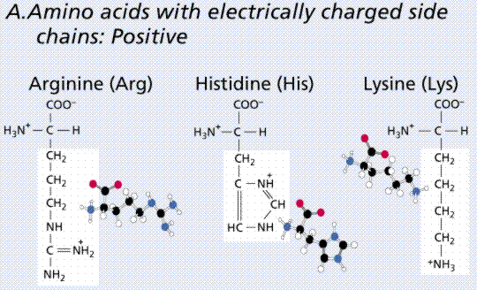
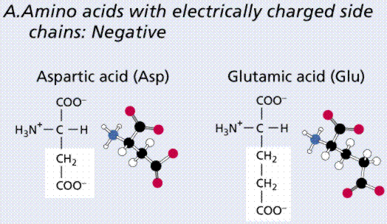
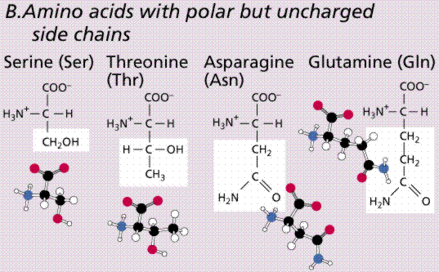
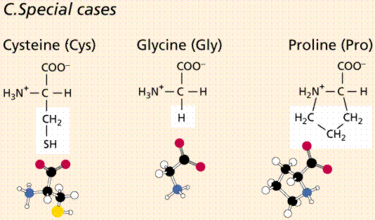
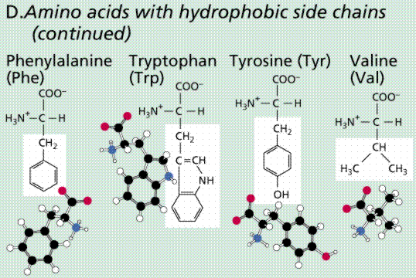
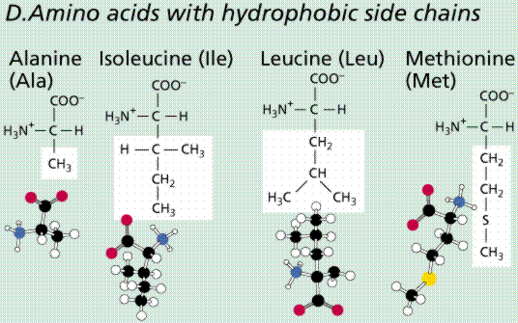
PROTEINS: 20 PROTEINOGENIC AMINO ACIDS

Slide 18
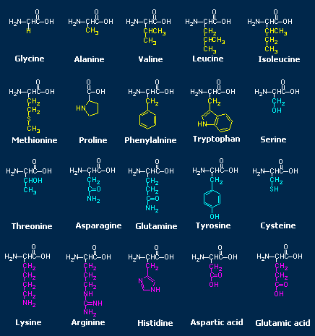
Example of a substitution matrix for AA
Although K and R are two different amino acids, they have a positive score.
Why?
They are both positively charged amino acids.
A R N K
 | A | R | N | K
A | 5 | -2 | -1 | -1
R | - | 7 | -1 | 3
N | - | - | 7 | 0
K | - | - | - | 6
AKRANR
KAAANK
-1 + (-1) + (-2) + 5 + 7 + 3 = 11

Slide 19
Conservation
Come
  Polar → polar
    aspartate → glutamate
  Non polar → non polar
    alanine → valine
  "Similar" residues
  leucine → isoleucine
How can we measure similarity?

Slide 20
SUBSTITUTION MATRICES are used for scoring
Substitution matrices are based on biological evidence
The differences observed between homologous sequences in alignments are due to mutation events
Some of these mutations have negligible effects on the structure/function of the protein
“We exploit the effects of past selection processes”
Notes:
PAM matrices (Point Accepted Mutation matrices) are matrices that quantify the likelihood of amino acid substitutions occurring over evolutionary time.

Slide 21
SUBSTITUTION MATRICES
One way to measure the similarity between amino acids is based on observed frequencies of specific amino acid substitutions in selected alignment groups.
The similarity between two specific amino acids (F.i. A and G) is proportional to the frequency with which the corresponding substitution (A->G) is observed in proein evolution.
The most known SUBSTITUTION MATRICES are:
PAM (or Dayhoff Mutation Data, MD) Matrices)
BLOSUM (Blocks Substitution Matrices)
GONNET by Cohen and Benner (1992): based on an exhaustive sequence alignment analysis
Notes:
SCORING O SUBSTITUTION MATRICES

Slide 22
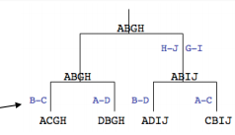
Accepted mutations
PAM MATRICES
(Dayhoff et al. 1978)
They are based on the concept of Point Accepted Mutation (PAM)
The first PAM matrices were compiled based on the analysis of the substitutions observed in a dataset consisting of different groups of homologous proteins:
1572 substitutions observed in 71 groups of homologous protein sequences with very high similarity (85% of identity)
The choice of very similar proteins was due to:
- the simplicity of alignment
- the possibility of neglecting corrections for multiple hits (replacements such as A->G->A or A->G->N)

Slide 23
The analysis of the alignments showed that different amino acid substitutions occurred with very different frequencies.
Substitutions that do not "seriously" alter the function of the protein, those "accepted" by selection, are observed more frequently than "destructive" ones.
The observed frequency for each specific substitution (F.i. a_{i}→ a_{j}) out of the total substitutions is used to estimate the probability of the corresponding transition in an alignment of homologous proteins.
The probabilities of all possible substitutions are shown in the PAM matrix.
Thus, PAM matrices quantify amino acids similarity as the likelihood of amino acid substitutions occurring over evolutionary time.

Slide 24
The basic PAM1 matrix defines the probability of transition of one amino acid into another amino acid that allows 99% of the sequence to be retained.
PAM = unit of evolution
→ 1 PAM = 1 mutation/100 amino acids
PAM1→proteins with an evolutionary distance of 1% mutation/position
PAM50 → idem for 50% mutations/position
PAM250 → 250% mutations/position
→ Long time: a position could mutate several times, thus PAM250 = more or less 20% identity left

Slide 25
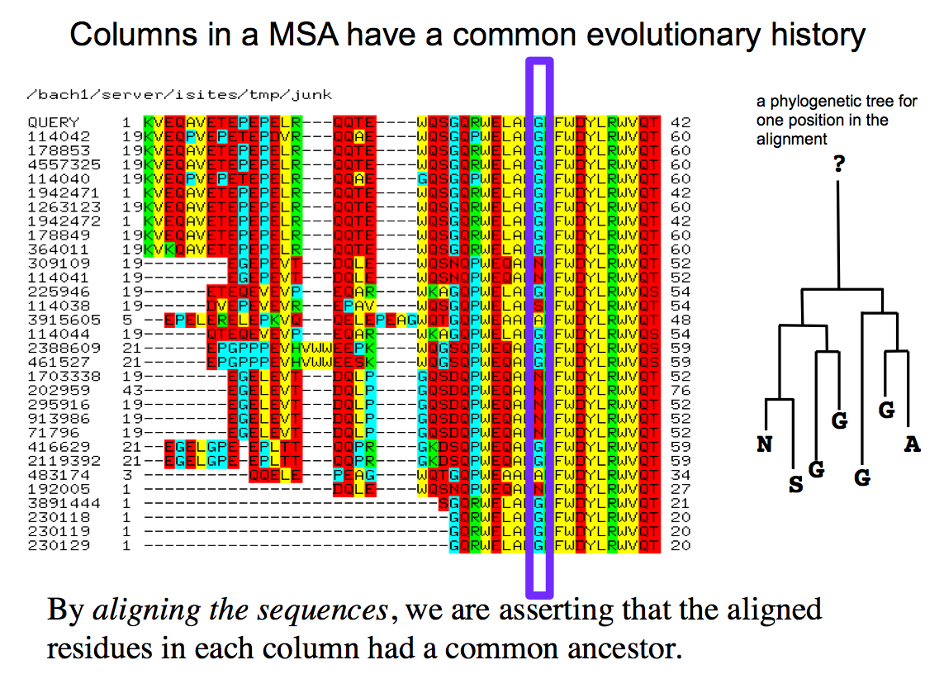

Slide 26
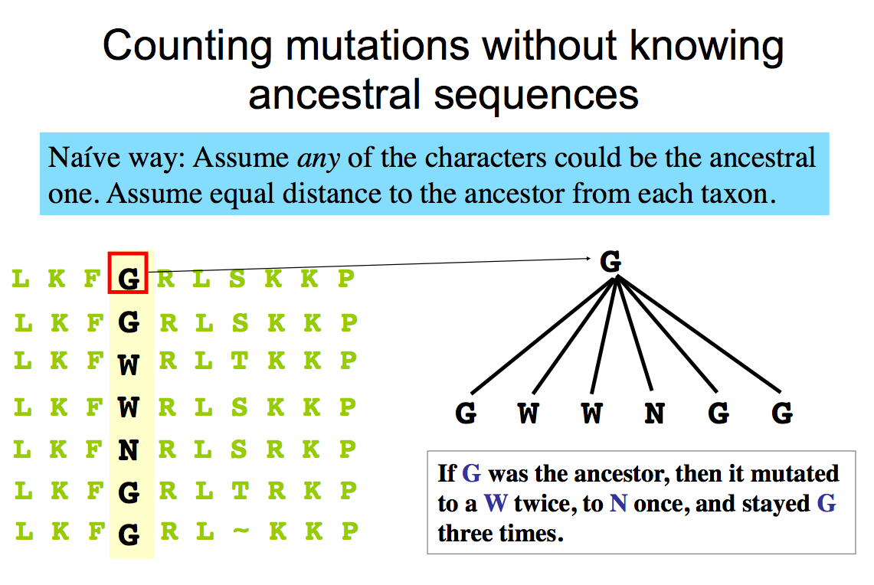

Slide 27
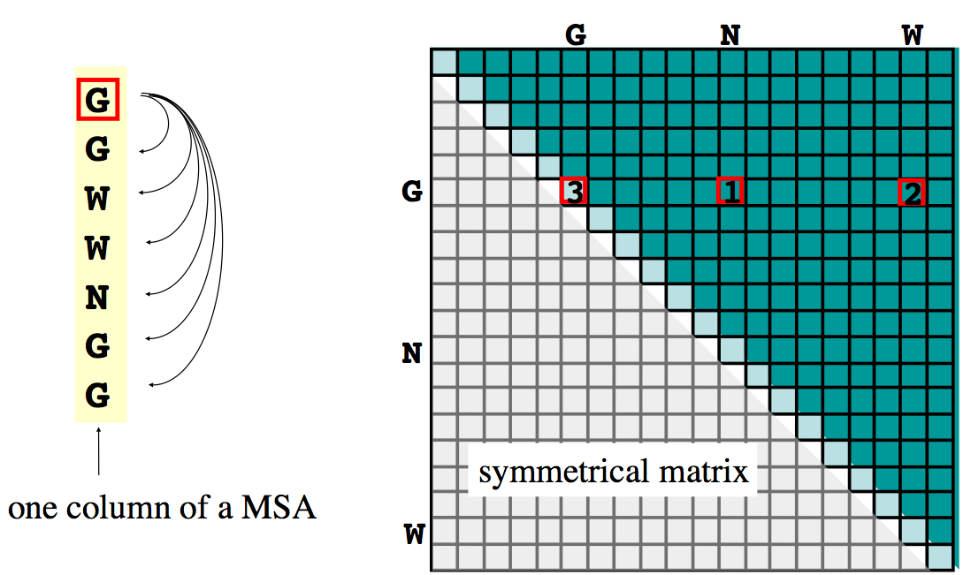
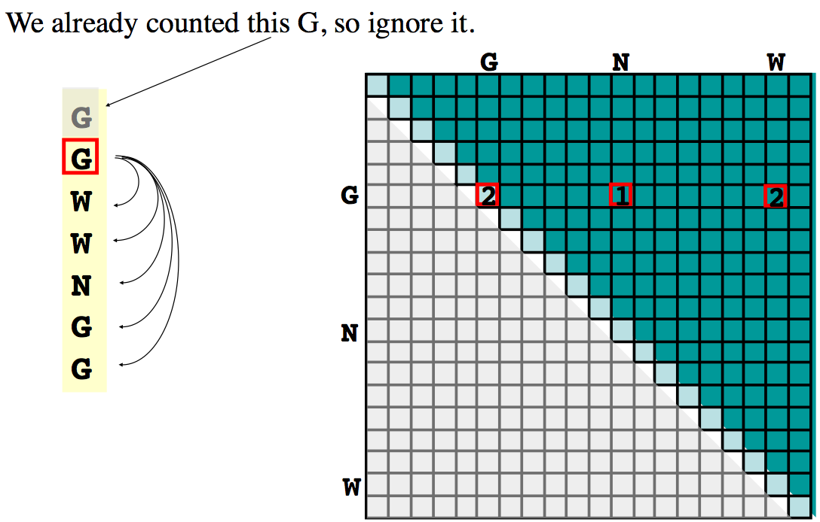
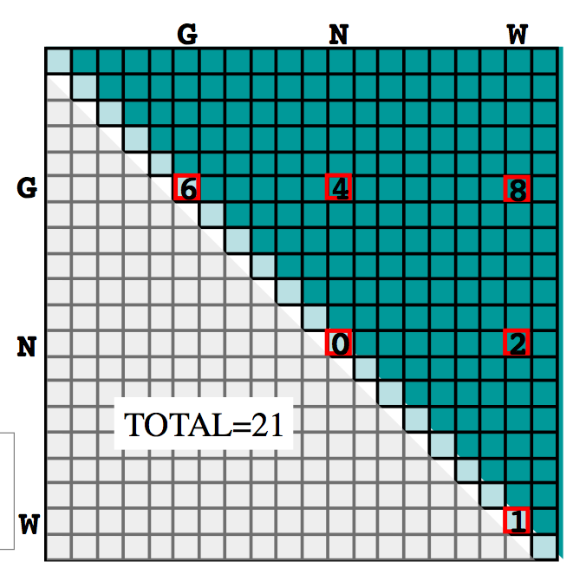
Mutation probability matrix
1
PAM 1 MATRIX
logarithm of the ratio between the probability of observing substitution in evolutionarily related sequences and the probability of observing it by chance
log odds ratio = log2(observed/expected )
Calculation of probability ratios such as likelihood ratios or log odds
2
3
4
…
Cumulative Matrix of Accepted Mutations
Notes:
HMM PER STIMA MATRICI PAM >1

Slide 28
The RELATIVE MUTABILITY of an AA measures its tendency to mutate more or less than expected based on its exposure to the mutation.
f_{i} =a_{i}/A_{tot} frequency a_{i} in the sample
n_{ij} = n_{ji} Number of exchanges a_{i} <->a_{j} (f.i. Val-Ala; Data accumulation matrix)
n_{i} = Σ_{i≠j}n_{ij} Total number of exchanges involving a_{i}
n_{tot} = Σ_{i}n_{i} Total number of exchanges in the sample
Exposure to mutation of a_{i} n_{tot} f_{i}
Relative mutability of a_{i} : ratio between the number of mutations in which it is involved and its exposure to mutation m_{i} = 100*n_{i} / (n_{tot} f_{i})
Different AAs have different relative mutability
Used to calculate mutation probabilities

Slide 29
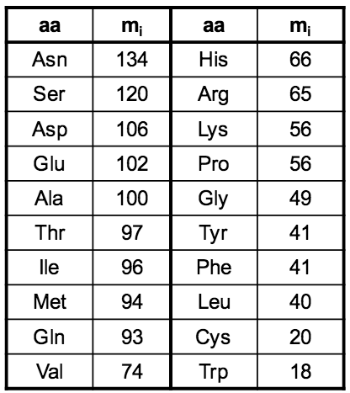
Relative mutability of the different AAs (Ala=100)
Very mutable
Less
mutable

Slide 30
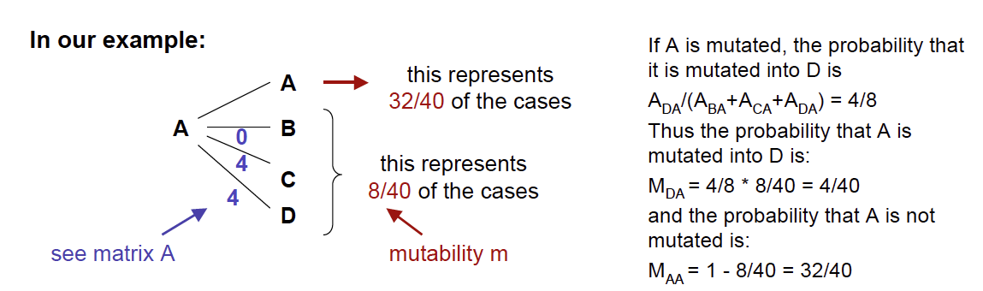
Beyond the probability that a certain AA will mutate, we would like to know the probabilities associated with each substitution
We obtain M_{ij} , the mutation probability matrix
M_{ij} = (n_{ij} /n_{i} ) m_{i} = 100 * (n_{ij} /n_{i} ) n_{i} / (n_{tot} f_{i})
= 100 * n_{ij} / (n_{tot} f_{i})
M_{ij} provides the probability that a_{i} mute and mute in a_{j} in 1 PAM time interval
Si normalizza quindi la mutabilità relativa a un periodo corrispondente a PAM1
32

Slide 31
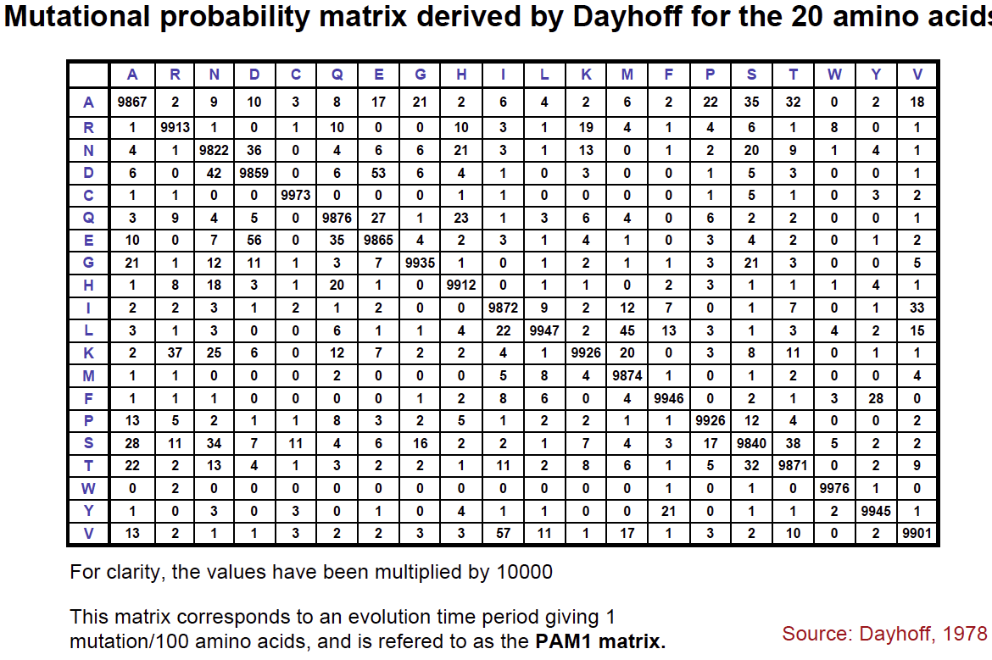
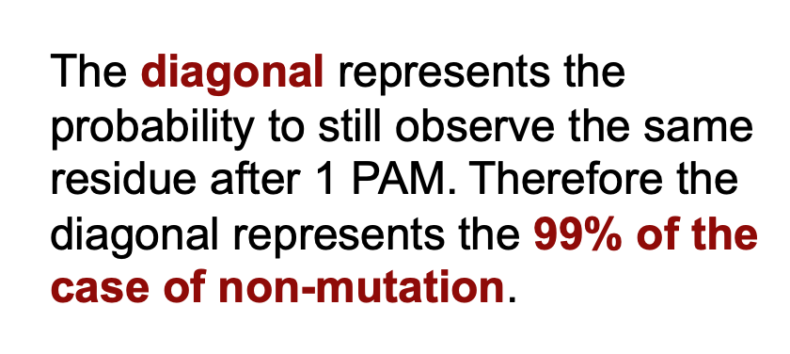

Slide 32
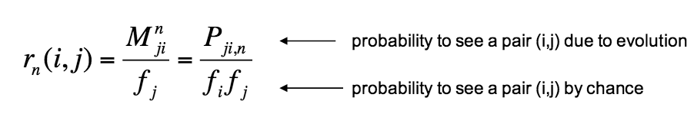
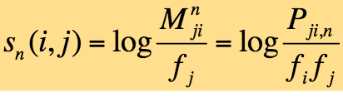
From probability to score
Finally, we consider the ratio between the probability of observing a change i->j as evolutionary event and by chance in an alignment between any two seq.
Calculation of probability ratios (likelihood ratios, log odds)
Positive score =
accepted mutation
Negative score =
Unfavorable mutation

Slide 33
To obtain matrices suitable for longer evolutionary distances:
M_{ij} (probability of mutation in the interval of 1 PAM)
then normalized in order to estimate the mutability in a longer period corresponding (PAM>1) by multiplying the matrix by itself.
How do you get PAM2? Asn →?→ Thr
P A→ B after two "evolutionary cycles" is the sum of the product of the probabilities of all the possible steps that may have generated A → B

Slide 34
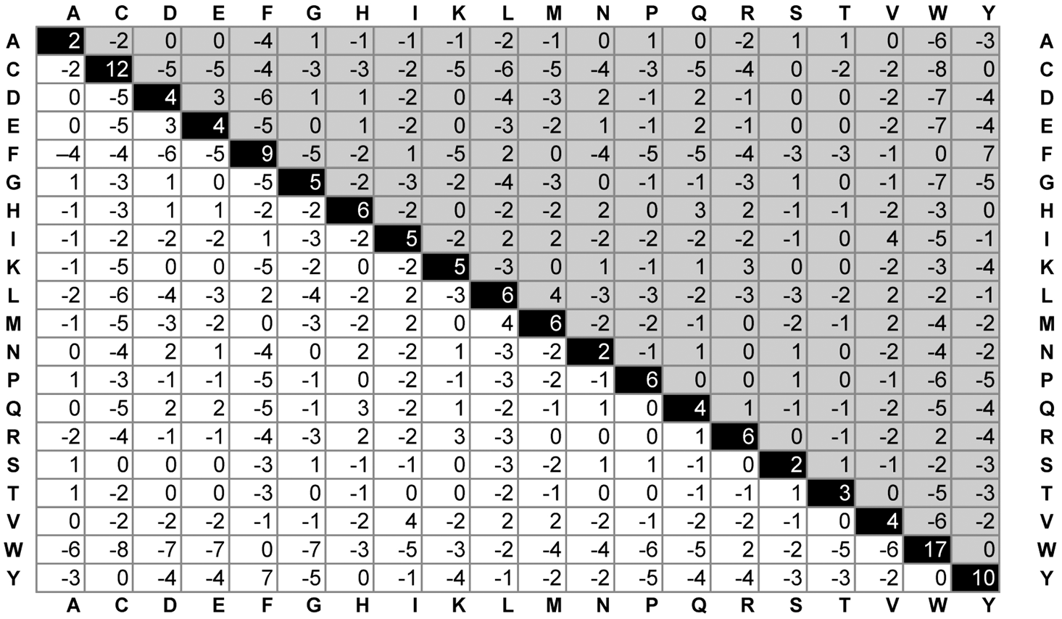
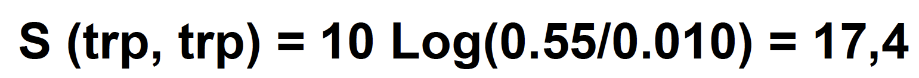
PAM 250
?
The probability of having a W unchanged in real sequences is over 50 times greater than to observe it by chance

Slide 35
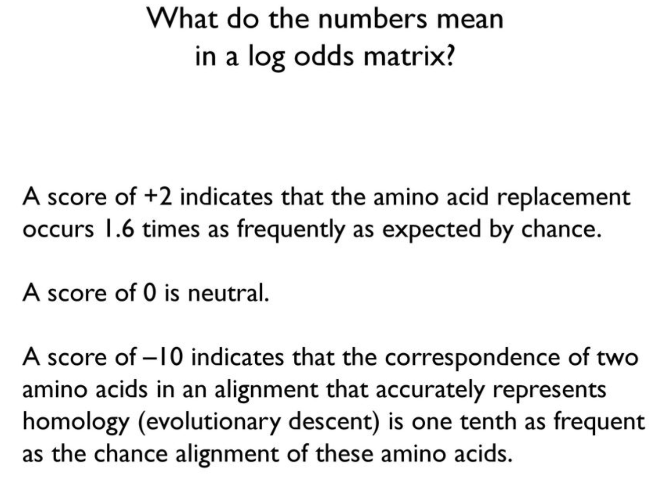
PAM 250
?
The probability of having a W unchanged in real sequences is 50 times greater than to observe it by chance

Slide 36
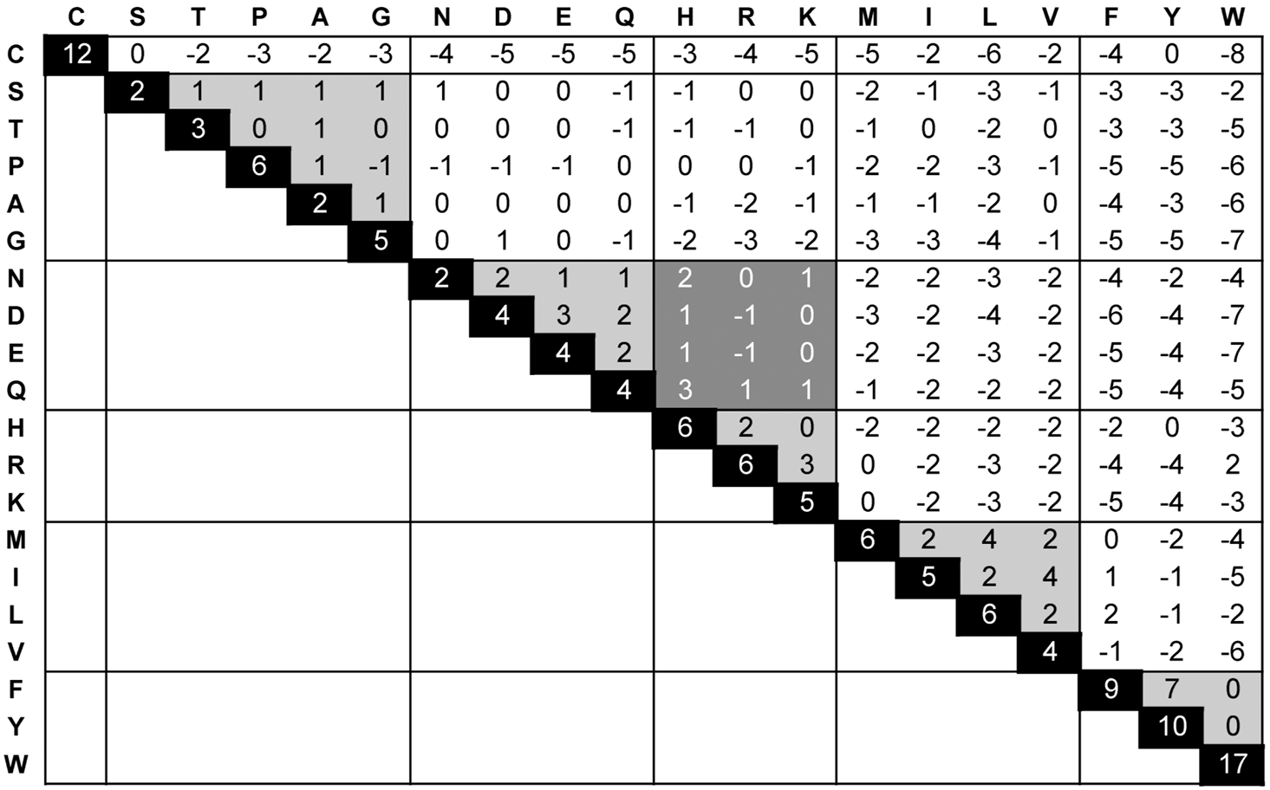
PAM 250 (AAs grouped by type)

Slide 37
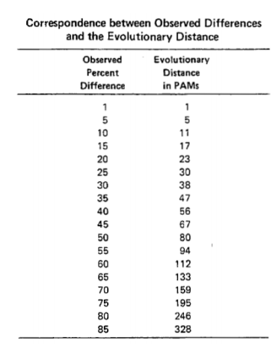
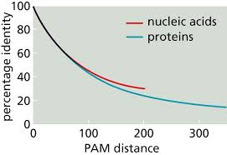
PAM distance vs IDENTITY
Substitutions occurred vs Percentage of mutated residues

Slide 38
BLOSUM - Blocks Substitution Matrix
(Henikoff and Henikoff, 1992)
Substitution matrices derived from the analysis of more than 2000 blocks of multiple sequence alignments, representing LOCAL ALIGNMENTS of conserved regions of related sequences
Block IPB013510A
ID Pept_M9A/M9B_C; BLOCK
AC IPB013510A; distance from previous block=(97,246)
DE Peptidase M9A/M9B, collagenase C-terminal
BL RYY; width=16; seqs=40; 99.5%=844; strength=1218
O67990|O67990_VIBMI ( 98) LENYGEFIRAAYYVRY 35
Q1HLC4|Q1HLC4_VIBPA ( 145) LEALYLYLRAGYYAEF 31
Q1V816|Q1V816_VIBAL ( 98) LENLGEFIRAAYYVRY 27
Q1VDQ5|Q1VDQ5_VIBAL ( 145) LETLFLYLRAGYYAEF 27
Q3ERN8|Q3ERN8_BACTI ( 161) IQTFTEVLRSAFYLAF 21
Q3QAL4|Q3QAL4_9GAMM ( 247) LESHIYFVRAALYVQF 49
Q4FAC5|Q4FAC5_VIBAL ( 145) LETLFLYLRAGYYAEF 27
Q4MQT1|Q4MQT1_BACCE ( 161) IQTFTEVLRSAFYLAF 21
Q4V1V2|Q4V1V2_BACCZ ( 160) IETFVELLRSAFYVGY 38
Q84IM4|Q84IM4_CLOSG ( 142) IDTLVEILRSGFYLGF 46
Q84IM7|Q84IM7_CLOSE ( 121) IAELSEVLRAGFYLGF 51
…
Q73DU5|Q73DU5_BACC1 ( 161) IQTFTEVLRSAFYLAF 21
Q7MBR8|Q7MBR8_VIBVY ( 102) IENLGEYVRAAYYVRY 25
Q7MFW4|Q7MFW4_VIBVY ( 129) IYYLAEFIKAAYKNRH 100
Q7NT10|Q7NT10_CHRVO ( 154) LVNLTLYLRAGYYLAS 54
Q81AN3|Q81AN3_BACCR ( 157) IETLVEVLRSGFYLGF 20
Q81BJ6|Q81BJ6_BACCR ( 160) IETFVEVLRSAFYVGY 21
Q81I63|Q81I63_BACCR ( 152) IQTFTEVLRSAFYLAF 21
Q81NB3|Q81NB3_BACAN ( 160) IETFVEVLRSAFYVGY 21
Q81YS7|Q81YS7_BACAN ( 161) IQTFTEVLRSAFYLAF 21
Q87Q10|Q87Q10_VIBPA ( 145) LEALYLYLRAGYYAEF 31
Q8D4D6|Q8D4D6_VIBVU ( 125) IYYLAEFIKAAYKNRH 100
Q8EJ34|Q8EJ34_SHEON ( 174) IESHIYFVRAALYVQF 48
//

Slide 39
Matrici BLOSUM - Blocks Substitution Matrix
(Henikoff and Henikoff, 1992)
To reduce the contribution of amino acid pairs of highly correlated proteins, groups of very similar sequences were treated as if they were single sequences and the average contribution of each position was calculated.
Using different cut-offs for the grouping of similar sequences, different BLOSUM matrices were obtained BLOSUM62, BLOSUM80, …
BLOSUM r
The matrix built from blocks with less than r% of similarity
F.i. BLOSUM62 was created using sequences that had no more than 62% identity

Slide 40
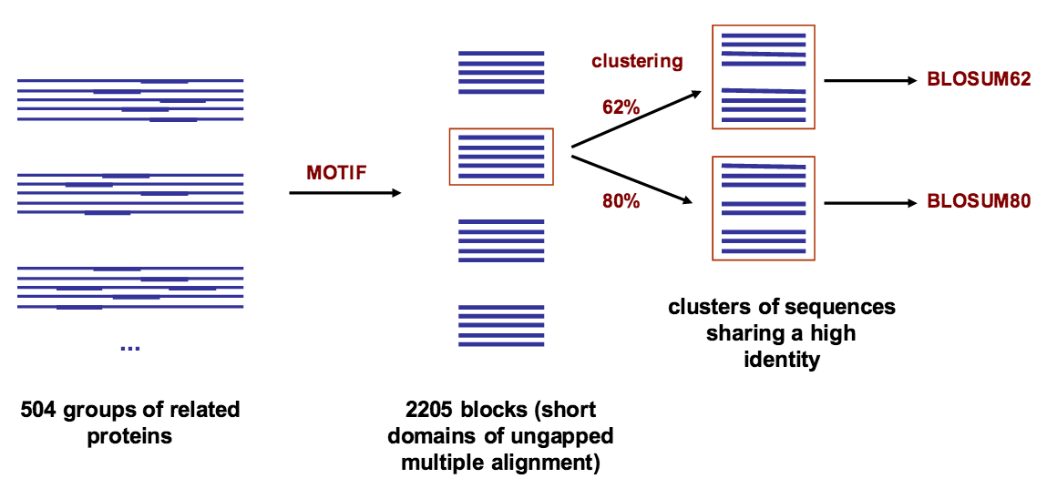
Using different cut-offs for the grouping of similar sequences, different BLOSUM matrices were obtained

Slide 41
BLOSUM62 Substitution Matrix
BLOSUM62
The scores represent the log-odds score for each substitution:
→ logarithm of the ratio between the probability of observing a substitution in evolutionarily related sequences and the probability of observing it by chance

Slide 42
Using the appropriate similarity matrix for each analysis is crucial to obtain good results.
In fact, important relationships from a biological point of view can be indicated by a weak statistical significance.
Sequences
slightly divergent → → → → very divergent
BLOSUM80 BLOSUM62 BLOSUM45
PAM1 PAM120 PAM250

Slide 43
SEQUENCE ALIGNMENT ALGORITHMS
Needleman & Wunsch Algorithm
→ Global Alignment
Smith & Waterman Algorithm
→ Local Alignment
They use DYNAMIC PROGRAMMING!

Slide 44
Dynamic Programming (DP): A Problem-Solving Approach
Strategy developed in the 50s in the field of optimization problems That is, when it is necessary to find the optimal solution among all the feasible solutions
Problems with multiple solutions
Solutions with measurable goodness
The optimal solution is sought, with respect to the goodness index
Trying all possible solutions can be too long

Slide 45
Dynamic Programming
As in the DIVIDE AND CONQUER strategy, complex problems are divided into many smaller and easier to solve problems
The DIVIDE AND CONQUER strategy breaks the problem into independent problems
In DYNAMIC PROGRAMMING, when problems are not independent, shared parts are solved only once

Slide 46
Dynamic Programming (DP): A Problem-Solving Approach
Dynamic programming is a technique used to solve complex problems by breaking them down into smaller, overlapping subproblems.
It's particularly effective for problems that exhibit the following characteristics:
Overlapping Subproblems: The same subproblems are encountered repeatedly.
Optimal Substructure: The optimal solution to the overall problem can be constructed from the optimal solutions to its subproblems.

Slide 47
Dynamic Programming (DP): A Problem-Solving Approach
How it Works:
Divide and Conquer: The problem is broken down into smaller subproblems.
Store Results: The solutions to subproblems are stored in a table or memorization structure.
Bottom-Up or Top-Down Approach:
  Bottom-Up (Tabulation): Start with the smallest subproblems and work your way up to the larger ones, filling the table as you go.
  Top-Down (Memorization): Start with the original problem and recursively break it down into smaller subproblems. If the solution to a subproblem is already known, look it up in the table.
Notes:
Key Advantages:
Efficiency: Avoids redundant calculations by storing intermediate results.
Clarity: The solution is often easier to understand and implement.
Versatility: Applicable to a wide range of problems.

Slide 48

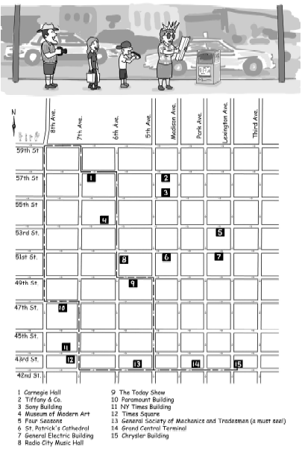
Manhattan
Tourist
Problem
(MTP)
We are in Manhattan!
We have a lot of things to visit and only one-way streets.
We want to determine the route that takes us from one end of the neighborhood to the other and that allows us to visit the maximum number of attractions

Slide 49
Manhattan Tourist Problem
(MTP)
Imagine seeking a path from source to sink
to travel (only eastward and southward)
with the highest number of attractions (*) in the Manhattan grid
Source
*
*
*
*
*
*
*
*
*
*
*
Sink

Slide 50
MTP: Greedy Algorithm Is Not Optimal
I adopt the "greedy" algorithm: Always move along the arc with maximum value
The resulting path that will most likely be different from the optimal one, i.e. the one that corresponds to the maximum global score (at the end of the path).
Alternatively, I can compose a path that takes into account the value totaled as you go along the selected arcs (dynamic programming: partial scores are calculated, stored in a table and reused)
Starting from the end, I go backwards following the path that maximizes the sum of the scores, i.e the Optimal path
source
1
2
5
5
3
10
5
promising start, but leads to bad choices!
2
1
5
3
5
3
1
2
3
4
0
0
5
2
22
0
0
0
sink
18

Slide 51
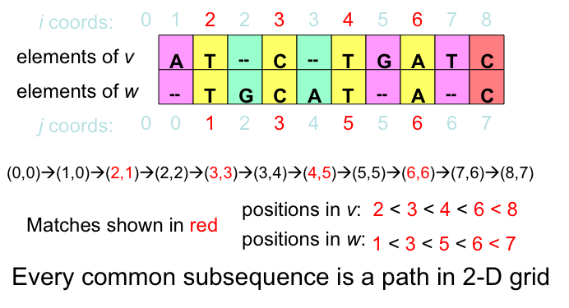
Longest Common Subsequence (LCS) – Alignment without Mismatches

Slide 52
LCS Problem as Manhattan Tourist Problem
j
A
T
C
T
G
A
T
C
0
1
2
3
4
5
6
7
8
Every path is a common subsequence.
Every diagonal edge adds an extra element to the common subsequence
LCS Problem: Find a path with maximum number of diagonal edges
i
0
T
1
G
2
C
3
A
4
T
5
A
6
C
7

Slide 53
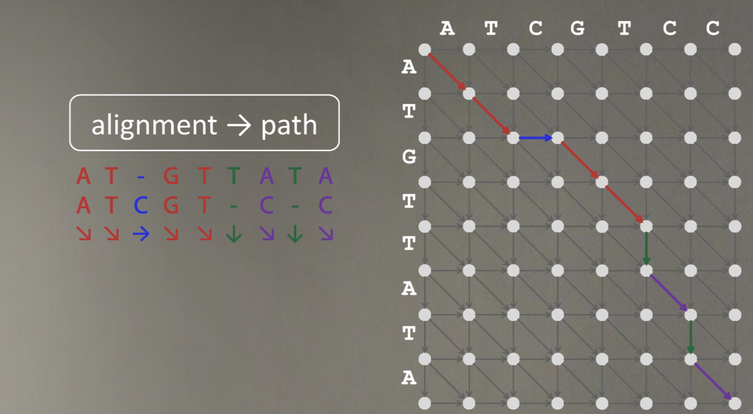

Slide 54
NEEDLEMAN & WUNSCH ALGORITHM
FOR GLOBAL ALIGNMENT
Aim to determine the optimal global alignment
Uses a computational interpretation of the dotplot matrix: the sequences are compared through a 2D matrix (1=match; 0=mismatch)
The optimal alignment is calculated recursively for progressively longer subsequences, thanks to the independence and additivity of the "subalignment" scores
With a series of successive sums of the scores contained in the cells, the optimal alignment is defined

Slide 55
NEEDLEMAN & WUNSCH ALGORITHM
FOR GLOBAL ALIGNMENT
An example of dynamic programming:
the optimal path (alignment) is identified by the gradual extension of locally optimal subpaths
Three steps
  Determination of identical residues
  For each cell, look for the maximum value in the paths that lead from the cell to the beginning of the sequence and give the cell the value of the maximum scoring pathway
  Build the optimal alignment, going back from the cell with the highest score to the beginning of the matrix

Slide 56
Needleman-Wunsch Algorithm – STEP 1
Similarity values
Matrix Initialization:
- value 1 or 0 to each cell, based on the similarity of the corresponding residues
Here:
  match = +1
  mismatch = 0

Slide 57
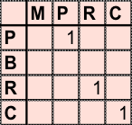
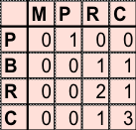
Needleman-Wunsch Algorithm – STEP 2
From "top left" to "bottom right" in the matrix
For each cell, determine the maximum possible value for an alignment that ends at the cell itself
Search for the cells belonging to the column and row that precede those in the cell to find the maximum value in them
Add this value to the current cell value

Slide 58
Needleman-Wunsch Algorithm – STEP 2

Slide 59
Needleman-Wunsch Algorithm – STEP 3
Alignment definition
The alignment score is cumulative (I can add up along the paths in the established direction)
The best alignment has the highest score (i.e. the maximum number of matches)
This number will be found in the last rows or columns
The alignment is defined by going back to cell (1,1) starting from the bottom right cell with maximum score
MP-RCLCQR-JNCBA
| || | | | | |
-PBRCKC-RNJ-CJA

Slide 60
Needleman-Wunsch Algorithm – recap
MP-RCLCQR-JNCBA
| || | | | | |
-PBRCKC-RNJ-CJA

Slide 61
Needleman-Wunsch Algorithm
What about indels?
When aligning sequences, introducing gaps in the sequences can allow an alignment algorithm to match more terms than a gap-less alignment can.
However, too many gaps can cause an alignment to become meaningless.

Slide 62
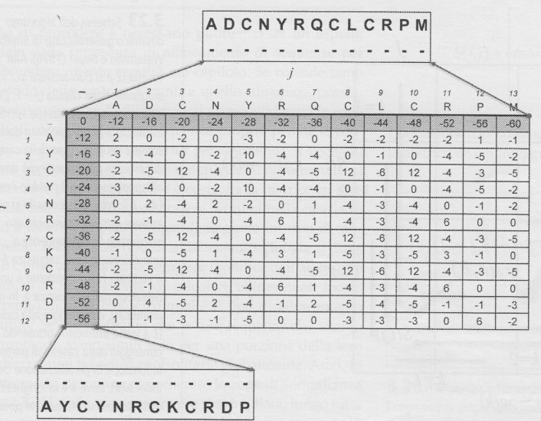
Needleman-Wunsch Algorithm Extension
Gap penalty function (Smith, Waterman and Beyer, 1976)
Indel weighted according to their length (affine)
  W_{k} = γ + δ(k-1)
Added margin to the body of the array with indel penalty values
The shaded row and column contain the score that the sequence would have if aligned to a deletion that is as long as the corresponding cell
We set
γ=-12 and δ=-4
W_{k} = -12 - 4(k-1)
if k=1 W_{k}= -12-4(1-1) = -12
if k=12 W_{k}= -12-4(12-1) = -12-44= -56

Slide 63
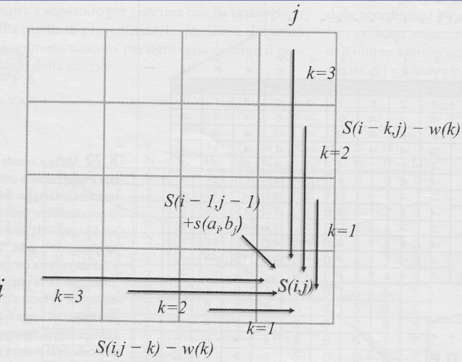
Needleman-Wunsch Algorithm Extension
No indel, go diagonally
→Score given by: Score
of the starting square + score of the square (i,j) according to the initialization matrix (as in NW)
Indel: vertical move
Score given by: starting square score – Wk Penalty function
As in NW, the best scoring path is then chosen

Slide 64
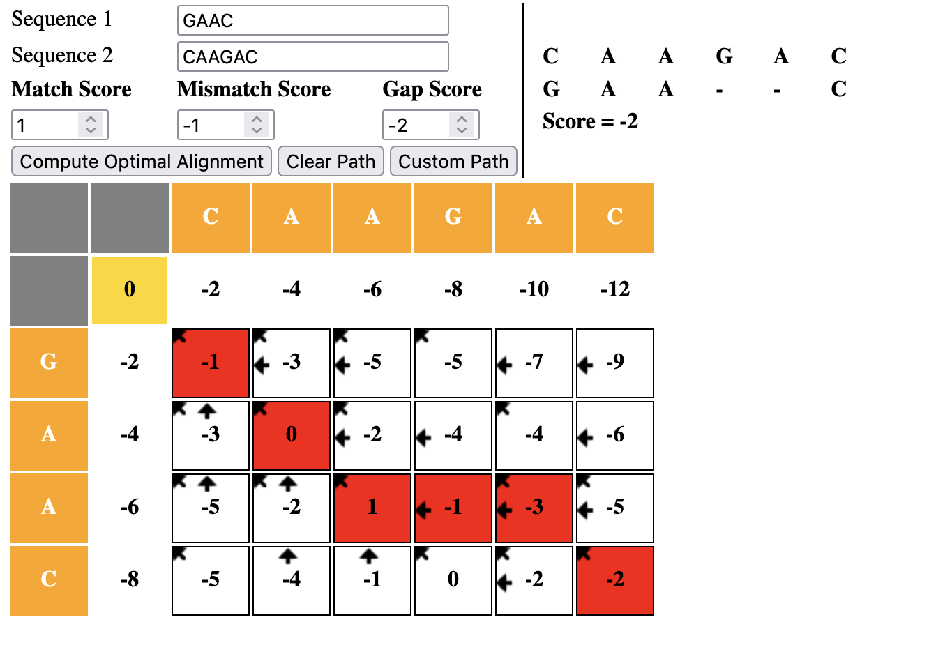
Interactive demo for Needleman-Wunsch algorithm
http://experiments.mostafa.io/public/needleman-wunsch/

Slide 65
There are many GAP PENALTY functions
Constant (Just GOP) W_{k} = γ
Linear W_{k} = δk
Affine W_{k} = γ + δ(k-1)
Profile based

Slide 66
Local alignment. Why?
Different sequences may have one or more short regions of similarity while being different in the remaining regions.
These may not be well aligned with a method for global alignment of sequences.

Slide 67
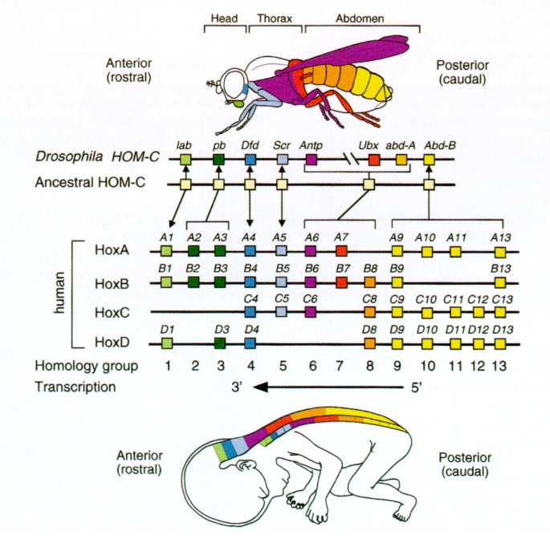
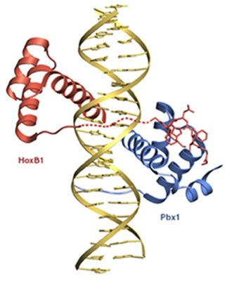
Homeobox genes
Example:
  Homeobox genes exhibit a highly conserved sequence region, encoding the Homeodomain, a DNA-binding domain.
  A global alignment between sequences of different transcription factors with homeodomain may not identify the corresponding region of similarity, while a local alignment will.

Slide 68
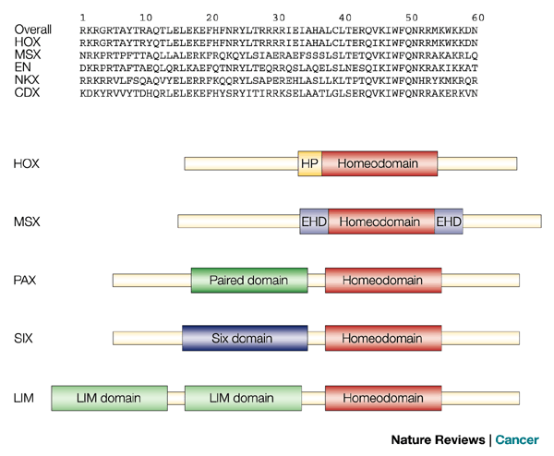
Local alignment: homeodomains of 5 proteins
The 5 proteins show similarity only in their Homeodomain regions
These domains are combined with one or more different domains in different proteins

Slide 69
SMITH & WATERMAN ALGORITHM FOR LOCAL ALIGNMENT
The purpose of the local alignment algorithms of two sequences is to find the longest region of the first sequence that produces an optimal alignment, given certain parameters, with a region of the second.

Slide 70
SMITH & WATERMAN ALGORITHM FOR LOCAL ALIGNMENT
Smith and Waterman's method uses a matrix to compare the two sequences, and N&W
The numeric value contained in each cell represents the score of the local alignment that ends at the two corresponding residuals
Values less than 0 are set to 0
Thus, the identification of the highest scores in the matrix allows to find the best local alignment(s) between the two sequences

Slide 71
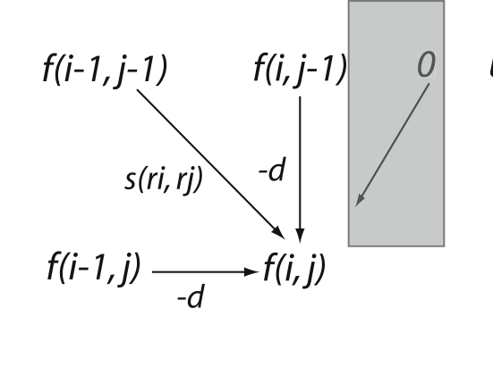
The Smith-Waterman algorithm implements a very straightforward variation of the Needleman-Wunsch algorithm:
→ the overall score of the alignment is replaced by zero if it takes negative values for all alternative paths
The grey box represents the additional parcel of the Smith Waterman algorithm

Slide 72

LINK https://docs.google.com/spreadsheets/d/1szZEsW9qRdZ-xXPf9k2Cm6yCAq4EF_fJvw-RcJ9BDyo/edit?usp=sharing

