Slide 1
  A.A. 2023-2024
  CORSO DI METODI MOLECOLARI E BIOINFORMATICA per il CLM in BIOLOGIA EVOLUZIONISTICA
  Scuola di Scienze, Università di Padova
Prof. STEFANIA BORTOLUZZI

Slide 2
GENOME SEQUENCING
AND RESEQUENCING

Slide 3
Outline
Genome sequencing
Genomes resources
NGS and applications

Slide 4
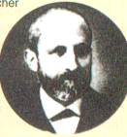
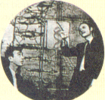
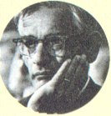
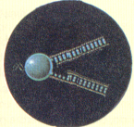
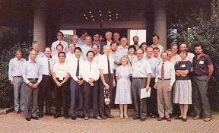
La Biologia Moderna e i Progetti Genoma
1869
1953
1968
1983
1988
Watson e Crick scoprono la struttura del DNA
(Nobel per la medicina 1962)
Viene fondata la HUGO, comincia il Progetto Genoma
Mullis inventa la tecnica PCR per analizzare sequenze di DNA
(Nobel per la chimica 1993)
Miescher isola la nucleina, il DNA allora sconosciuto
Khorana e altri 12 ricercatori producono il primo gene sintetico (Nobel per la medicina, 1968)

Slide 5
Scopi del progetto genoma (1993 - 1998)
Mappa genetica a risoluzione da 2 a 5 cM entro 1995
Mappa fisica STS a risoluzione 100 kb
Sviluppo tecnologico (sviluppo tecnologie genomiche)
Organismi modello
Informatica
Implicazioni etiche, legali e sociali (ELSI)

Slide 6
Scopi del progetto genoma (1998 – 2003)
La sequenza del genoma umano
Migliorare le tecnologie di sequenziamento
Variazioni delle sequenze del genoma umano
Tecnologie per la genomica funzionale
Genomica comparata
Bioinformatica e biologia computazionale

Slide 7
Pietre miliari nella storia della Bioinformatica
1970 --> Needleman-Wunsch algorithm
1981 --> Smith-Waterman algorithm developed
1981 --> The concept of a sequence motif (Doolittle)
1982 --> GenBank Release 3 made public
1982 --> Phage lambda genome sequenced
1988 --> National Center for Biotechnology Information (NCBI)
1990 --> BLAST: fast sequence similarity searching
1991 --> EST: expressed sequence tag sequencing
1993 --> Sanger Centre, Hinxton, UK
1994 --> EMBL European Bioinformatics Institute, Hinxton, UK
1995 --> First bacterial genomes completely sequenced
1996 --> Yeast genome completely sequenced
1998 --> Worm (multicellular) genome completely sequenced
1999 --> Fly genome completely sequenced

Slide 8
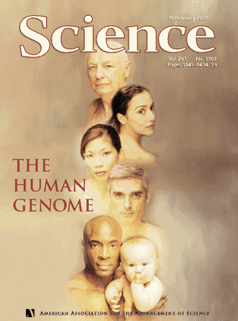
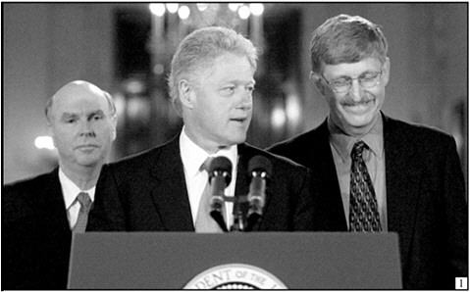
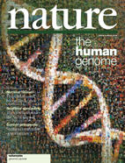
…fino ad arrivare al Genoma Umano
1999 (Dicembre) Pubblicata su Nature la sequenza completa del cromosoma 22.
2000 (Maggio) Pubblicata su Nature la sequenza completa del cromosoma 21.
2000 (26 Giugno) Francis Collins e Craig Venter annunciano congiuntamente di aver completato la "bozza" del genoma Umano.
2001 La bozza completa del genoma umano (working draft) è pubblicata su Nature (quella del consorzio pubblico) e su Science (quella della Celera).
Celera Genomics – C. Venter
Consorzio internazionale
2000-2001

Slide 9
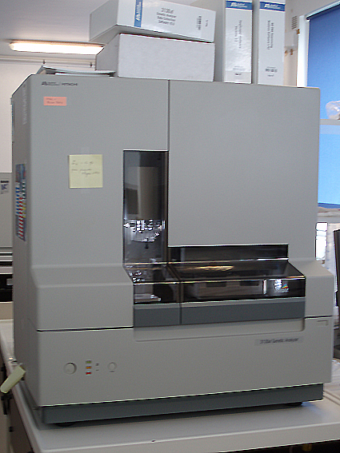
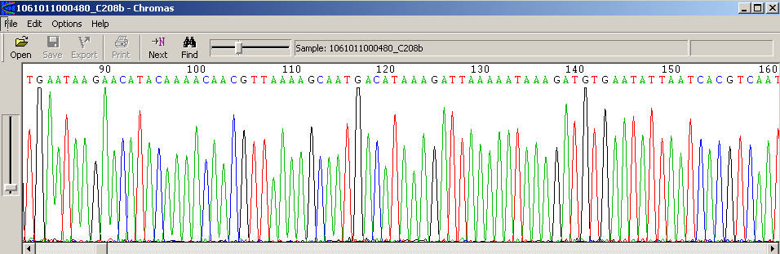
Strategia alla base del sequenziamento globale
La strategia che sta alla base del sequenziamento globale dei genomi viene definita “shotgun sequencing strategy”
Creazione --> di un libreria RANDOM di frammenti di DNA
Sequenziamento di un numero SUFFICIENTEMENTE ALTO di frammenti selezionati in maniera random
Assemblaggio dei CONTIGS

Slide 10
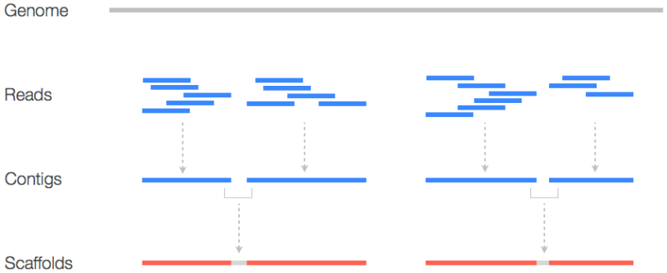

Slide 11
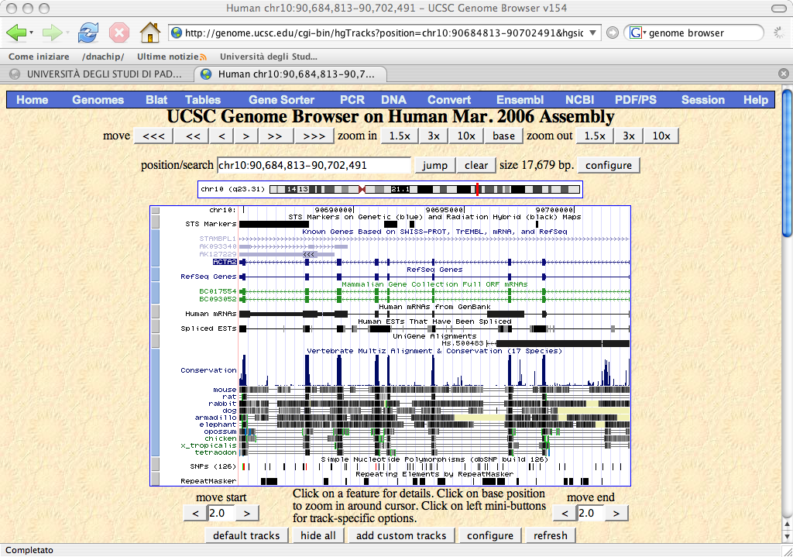
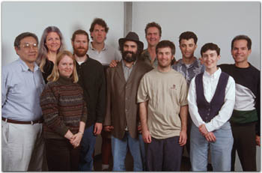
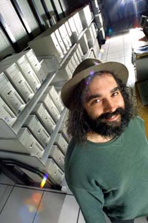
The Human Genome Superman: Jim Kent
“I used 100 800 MhZ Pentium processors with 256 Mb RAM each, running Linux, the gcc compiler, the vim editor, a whiteboard, and occasional ice packs for the wrists” Jim Kent

Slide 12
La sequenza primaria del genoma non è sufficiente…
Annotazione del genoma
E’ necessario riportare sull’assembly le informazioni e i dati sperimentali già ottenuti.
Riconciliare e integrare l’assembly con le mappe fisiche, genetiche e citogenetiche
Gli STS sono mappati sulla sequenza usando e-PCR
La corrispondenza con la mappa citogenetica utilizzando FISH sistematica di BAC.
L’annotazione dei geni è attuata con metodi leggermente diversi dai 3 “genome browser”
  L’NCBI allinea mRNA di RefSeq, mRNA di GenBank utilizzando MegaBlast.
  Ensembl allinea tutte le proteine umane note di SP/Trembl utilizzando un suo algoritmo
  UCSC allinea mRNA di Refseq e GenBank e dalle ultime release SP/Trembl con BLAT

Slide 13
Annotazione dei geni
ab initio, in base a “sensori”, funzioni che tentano di dedurre la presenza di una caratteristica genica in base a motivi o proprietà statistiche del DNA.
  Sensori per TSS (G+C)
  Sensori per siti splicing (AG-GT)
  Sensori che misurano la composizione in basi di esoni putativi
L’output dei vari sensori è combinato per generare un “modello genico”
metodi basati sulla similarità: l’allineamento di una regione genomica con un cDNA o un EST sono una buona evidenza.
Lo splicing alternativo complica l’interpretazione degli allineamenti tra DNA genomico, cDNA e ESTs
I dati di similarità sono incompleti: trascritti poco espressi o espressi transientemente sono assenti…
I programmi come Grail/Exp, Genie EST, GenomeScan combinano predizioni ab inizio con dati di similarità ottenendo risultati migliori

Slide 14
What next?
Post Genomic era
  Comparative Genomics
  Functional Genomics
  Structural Genomics

Slide 15
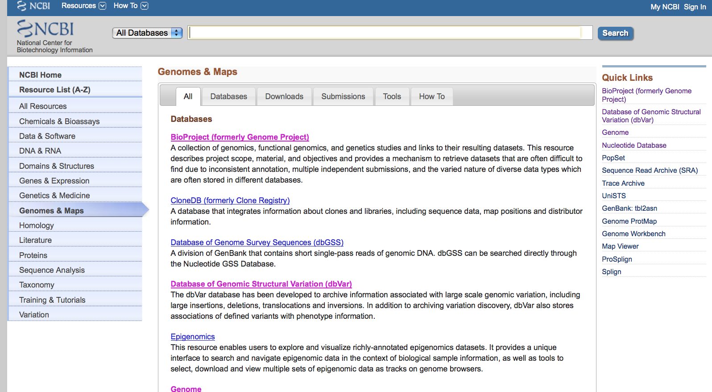
Viral Genomes

Slide 16
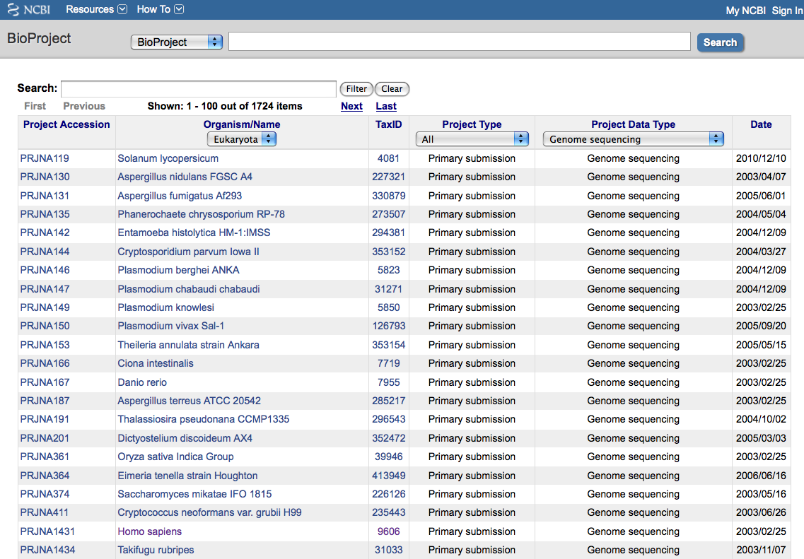
Viral Genomes

Slide 17
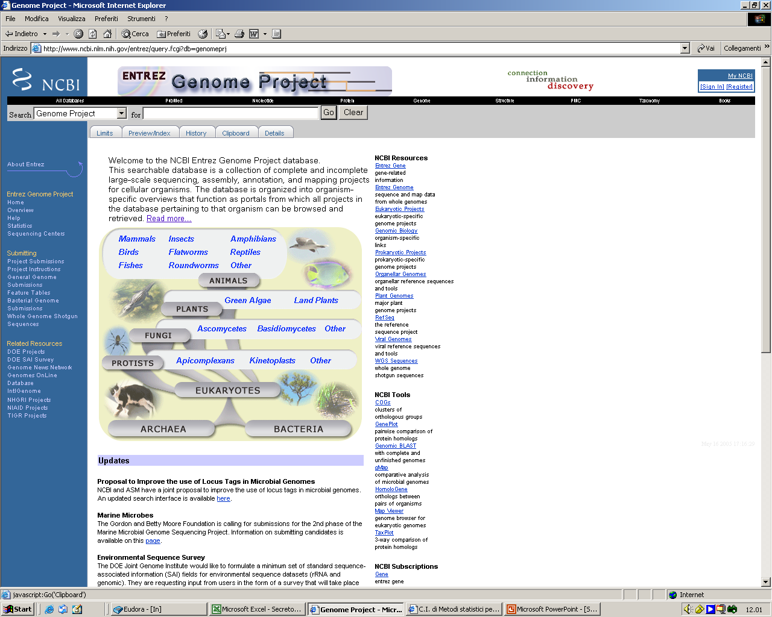
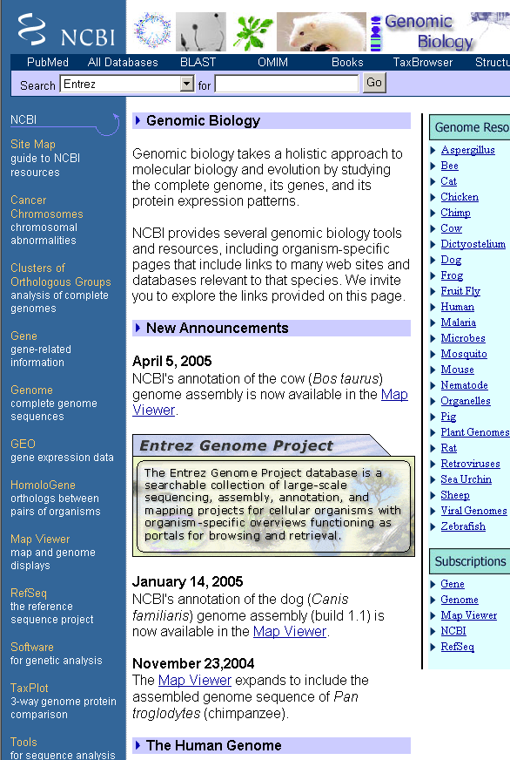
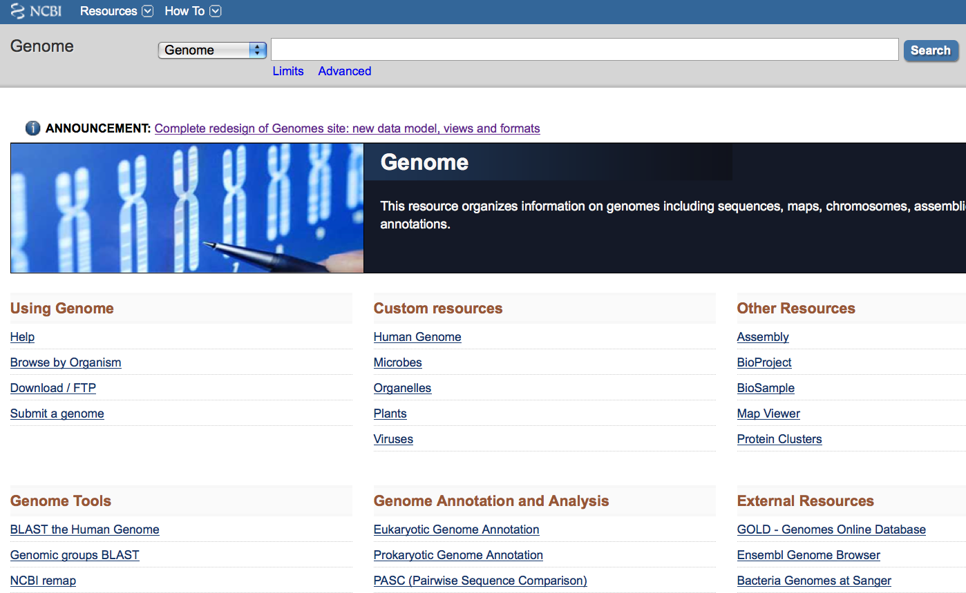
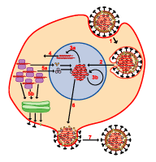
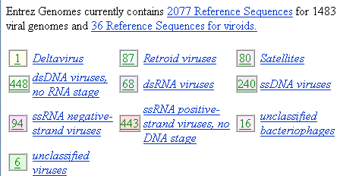
Viral Genomes

Slide 18
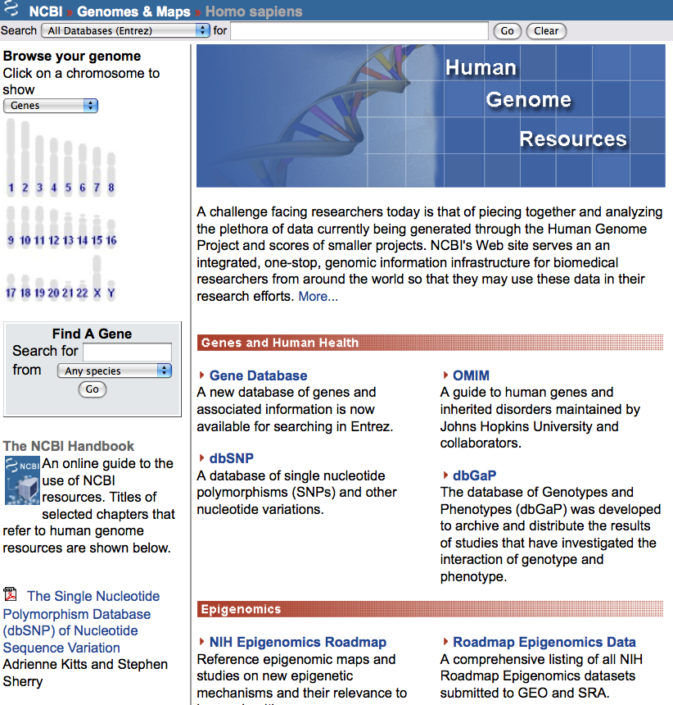
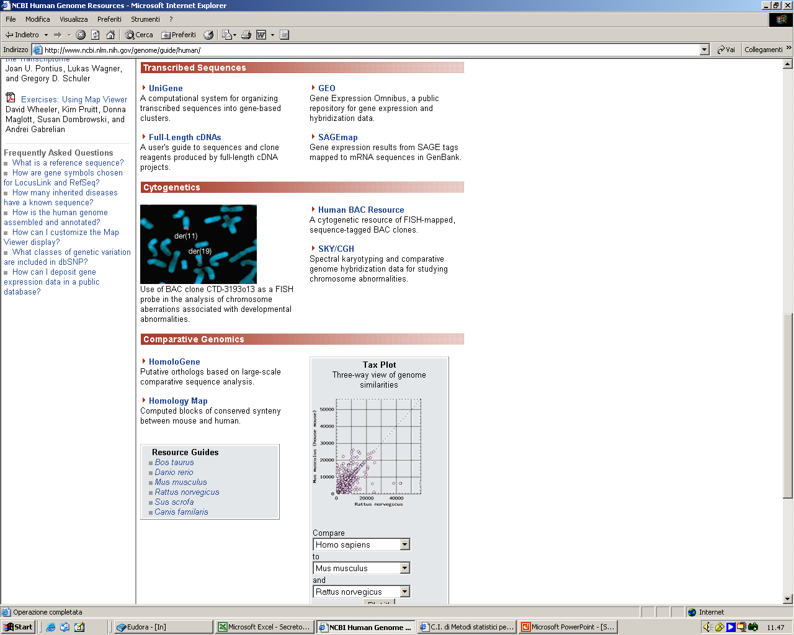
Viral Genomes

Slide 19
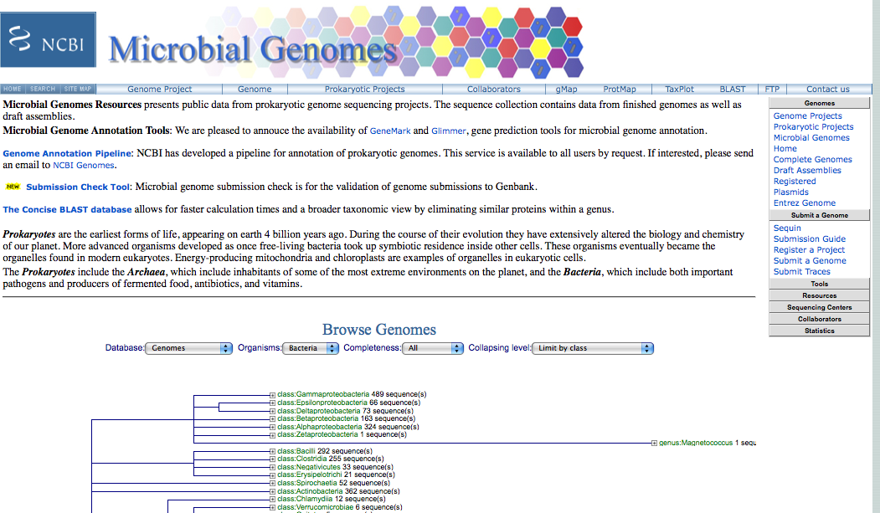
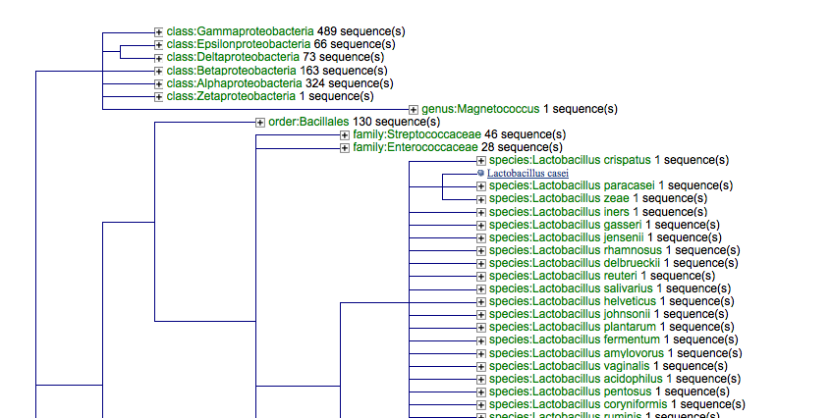
Viral Genomes

Slide 20
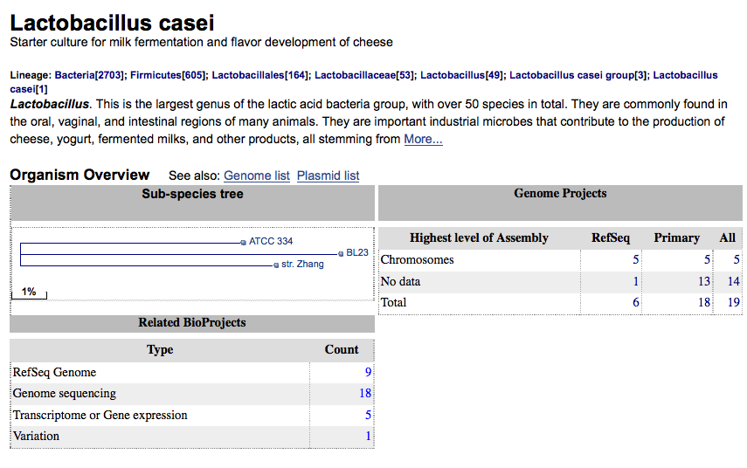
Viral Genoes

Slide 21
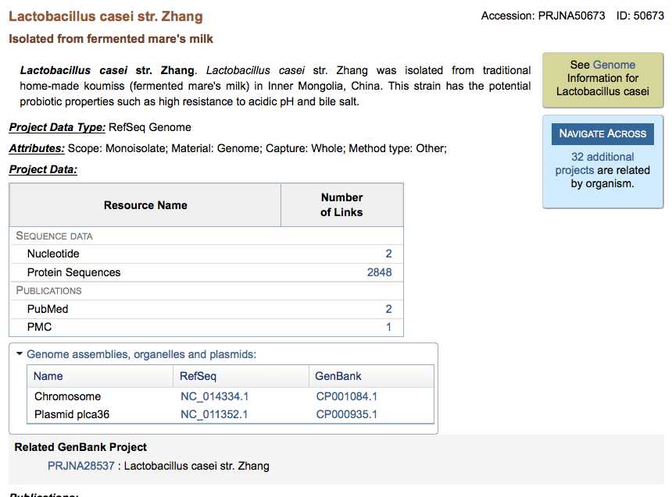
Viral Genoes

Slide 22
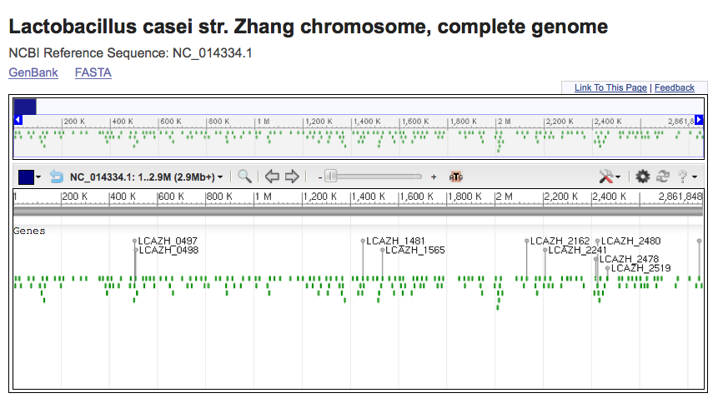
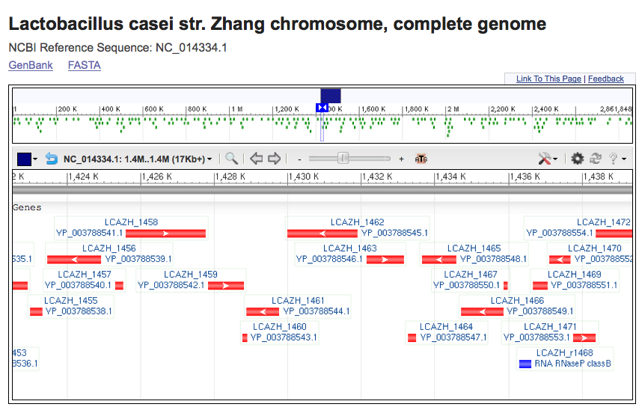
Viral Genoes

Slide 23
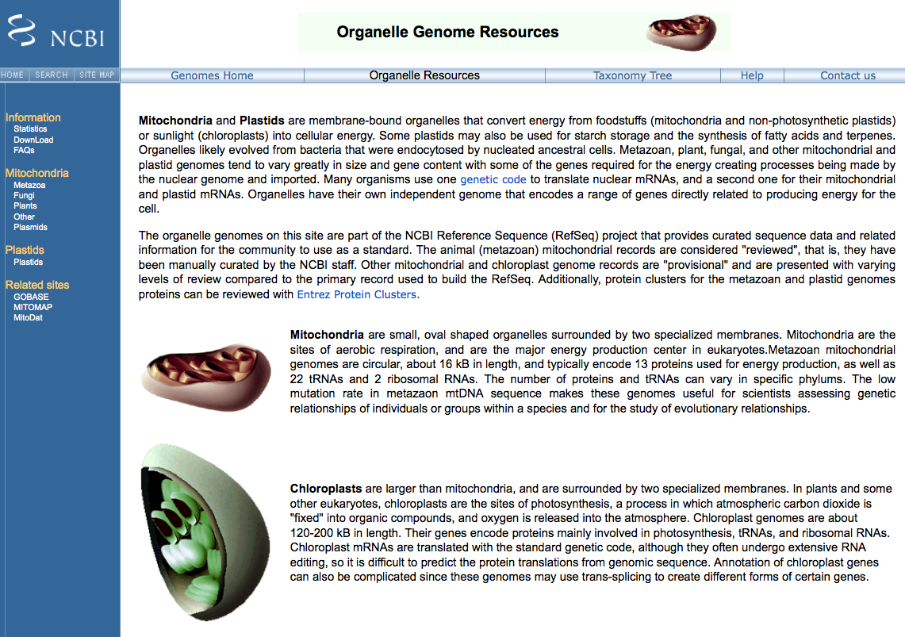
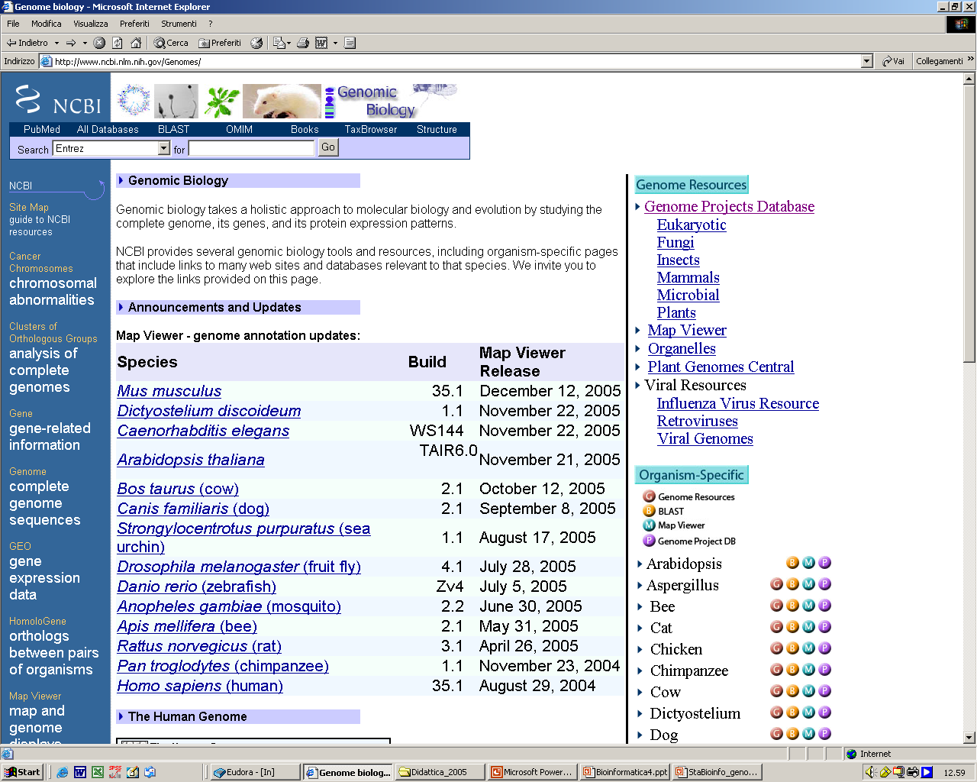
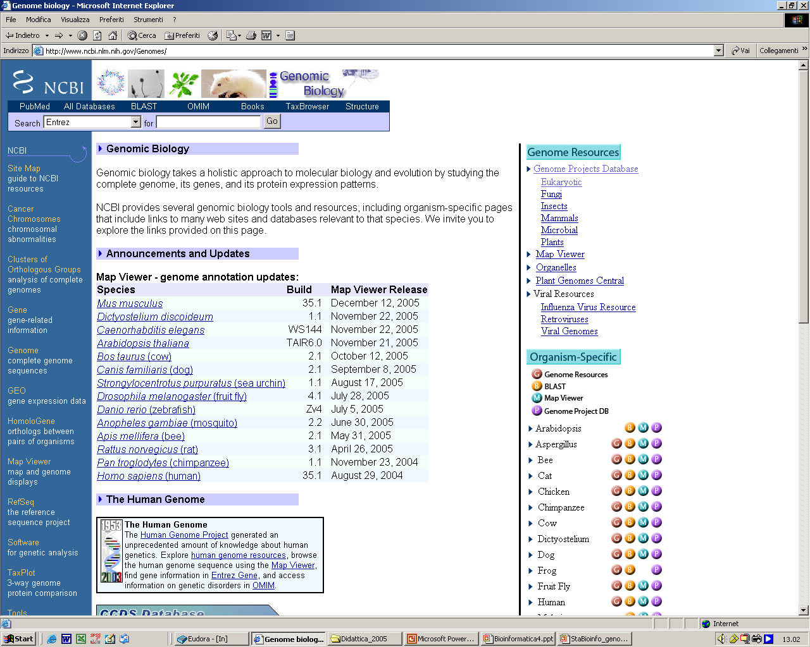

Slide 24
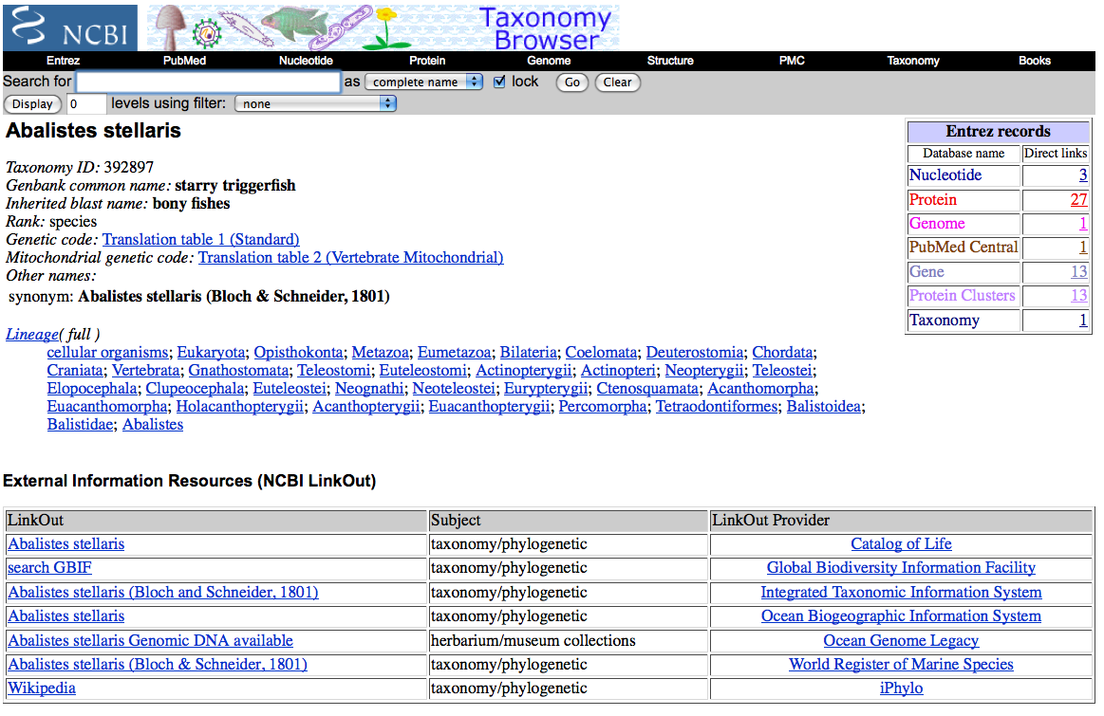
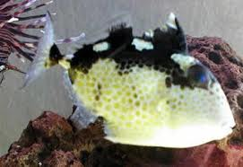

Slide 25
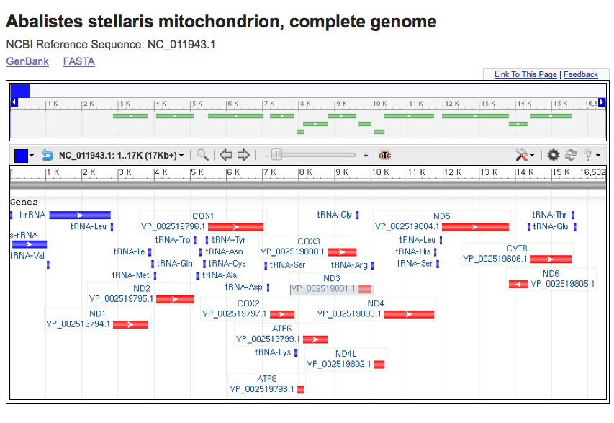
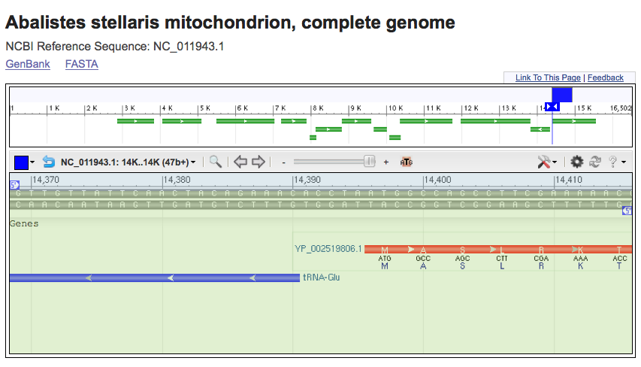

Slide 26
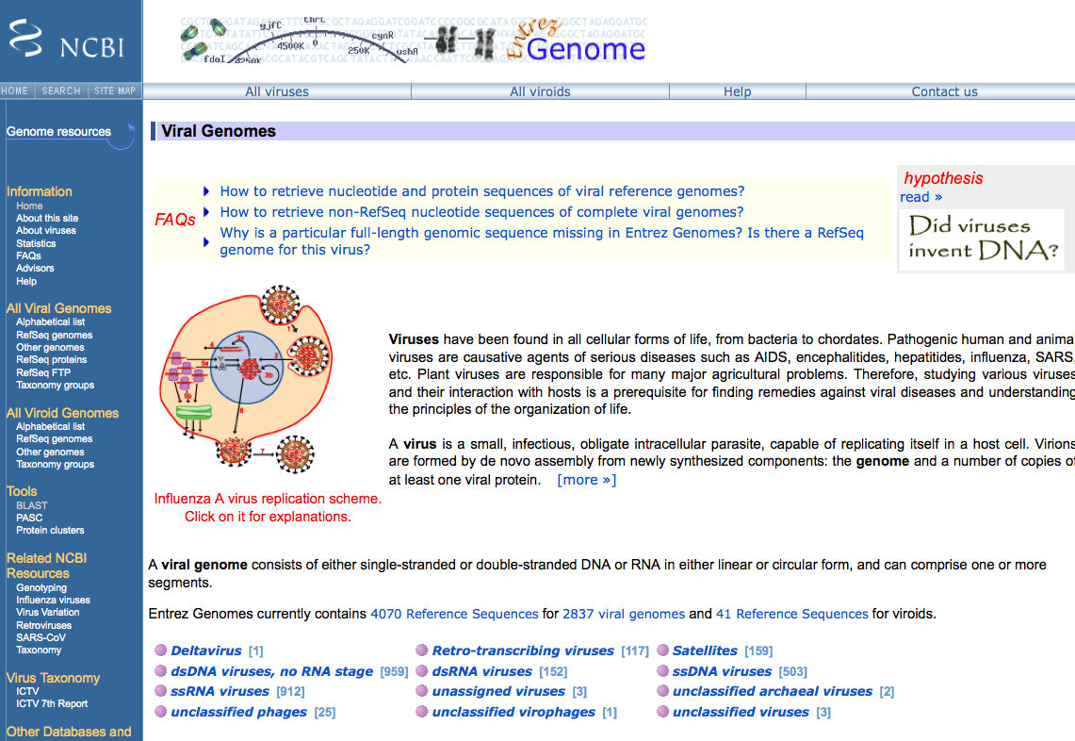

Slide 27
3 milioni di basi in formato testo = nessuna utilita’
Servono:
Annotazione dell’informazione sulla sequenza
Possibilita’ di recuperare velocemente la sequenza di regioni specifiche del genoma in base a criteri di
  Contenuto di informazione
  Caratteristiche di sequenza
Genomi
disponibili
Human
  Homo sapiens assembly
  99% delle regioni contenenti geni
  accuratezza 99.99%
  2.84 Gb finite “highly contiguous”
Species
A. gambiae
A. mellifera
C. briggsae
C. elegans
C. intestinalis
Chicken
Chimp
Cow
D. ananassae
D. erecta
D. grimshawi
D. melanogaster
D. mojavensis
D. persimilis
D. pseudoobscura
D. sechellia
D. simulans
D. virilis
  UCSC Genome Browser
Sistema per la “navigazione” della sequenza e dell’annotazione di genomi, che permette la visualizzazione dell’informazione a “diverso ingrandimento” ed il recupero di porzioni di sequenza con associate le informazioni di annotazione, come:
Geni noti e geni predetti
ESTs, mRNAs
Isole CpG
assembly gaps e coverage, bande cromosomiche
Omologia con altri genomi
…
D. yakuba
Dog
Fugu
Human
Mouse
Opossum
Rat
Rhesus
S. purpuratus
SARS
Tetraodon
X. tropicalis
Yeast
Zebrafish

Slide 28
  UCSC Genome Browser
  Molte possibilita’ per la ricerca di una regione specifica:
chr7 un cromosoma intero
20p13 una regione (banda p13 del cr. 20)
chr3:1-1000000 il primo milione di basi del cr. 3 dal ptel
D16S3046 regione intorno al marcatore (100,000 basi per lato)
RH18061;RH80175 regione tra i due marcatori
AA205474 regione genomica che si allinea con la sequenza con questo GB accession number
PRNP regione del genoma che comprende il gene PRNP
NM_017414
NP_059110
11274 --> (LLID)
--> Oppure di liste di regioni:
pseudogene mRNA Lists transcribed pseudogenes, but not cDNAs
homeobox caudal Lists mRNAs for caudal homeobox genes
zinc finger Lists many zinc finger mRNAs
huntington Lists candidate genes associated with Huntington's disease

Slide 29
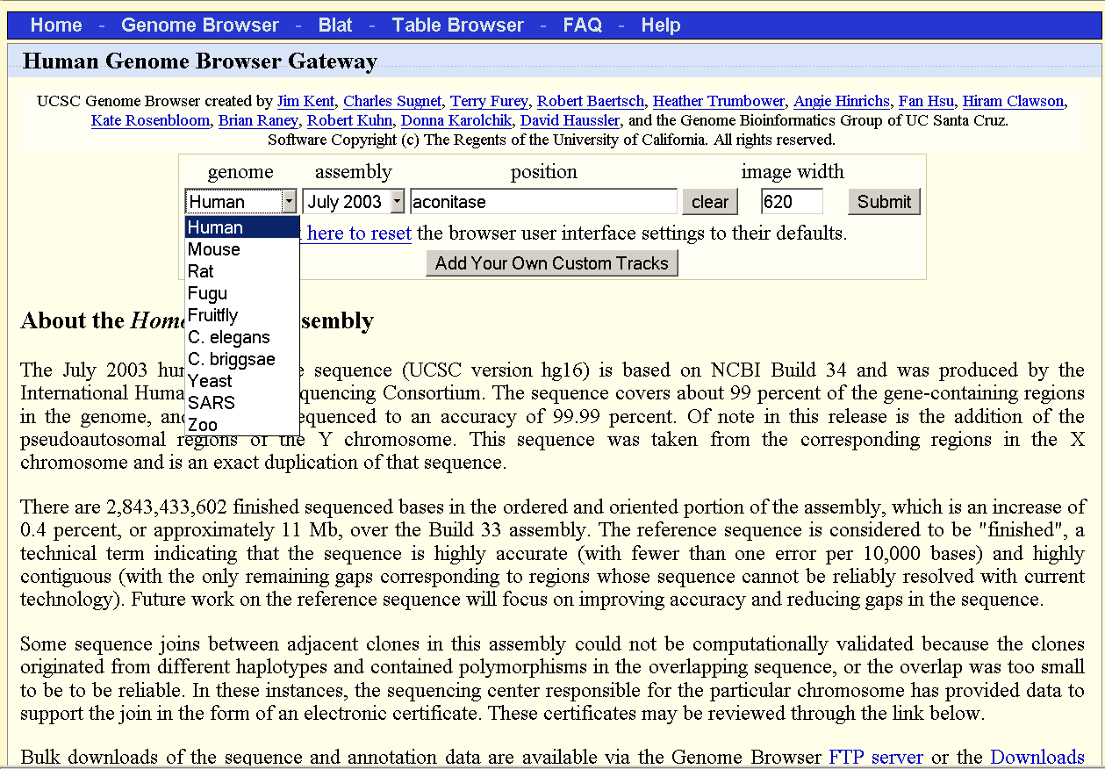

Slide 30
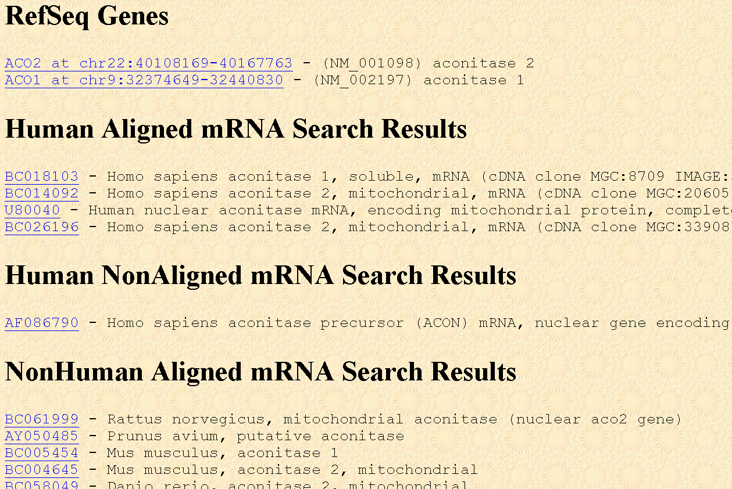

Slide 31
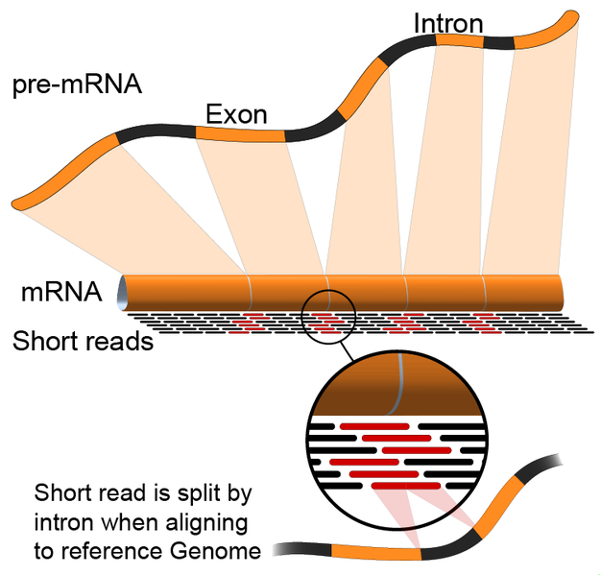

Slide 32
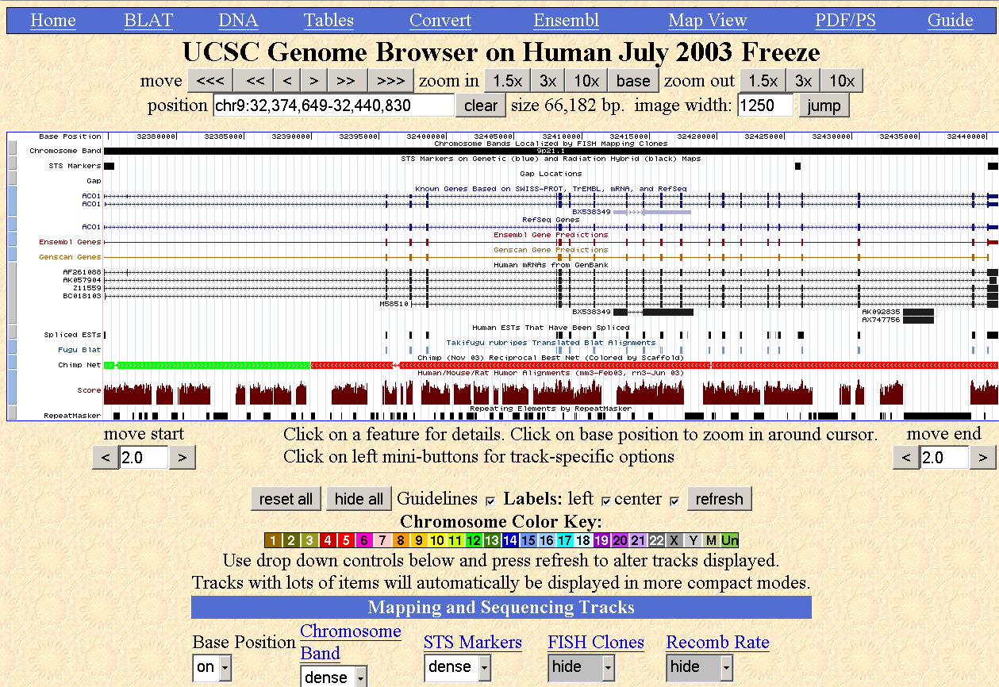

Slide 33
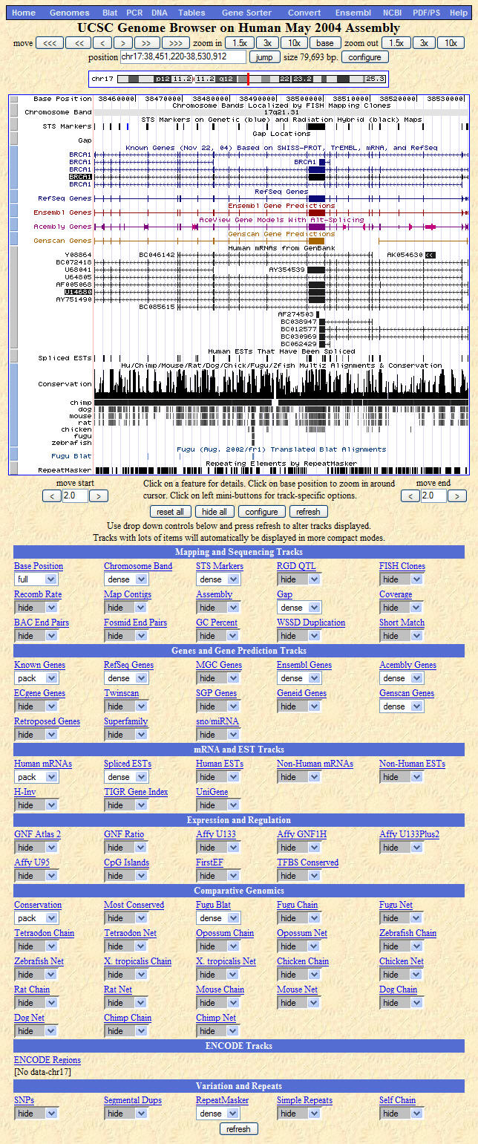
Overview of the whole
Genome Browser page
(mature release)
}
Genome viewer section
Groups of data
Mapping and Sequencing Tracks
Genes and Gene Prediction Tracks
mRNA and EST Tracks
Expression and Regulation
Comparative Genomics
ENCODE Tracks
Variation and Repeats
Notes:
I wanted to just demonstrate an overview of a Genome Browser page at a mature stage of this assembly. --> You can see that there are many track and image controls seen down at the bottom of the page. --> At the very beginning of a release—there is only a CORE set of tracks at first, not all of the tracks are available. --> Over time these will be added to the browser—so the actual track options you see will accumulate over time. --> Tracks take time to create—within UCSC, and from other contributors all over the world. -->
But I wanted to use this slide to illustrate one of the major organizational concepts of the Genome Browser. --> At the bottom of the page, you will find that the data is organized into GROUPS. --> --> These are groups of similar data, such as Mapping and Sequencing Tracks, Genes and Gene Prediction tracks, and so on. --> Each GROUP contains the individual TRACKS, or the lines of annotation. A group at the bottom of the page corresponds to a section in the viewer. --> In the viewer the separate GROUPs are indicated by the color change along the left side of the image area, from gray to blue and so on. --> Understanding this Group and Track organization will also help you to understand the Table Browser functions later.

Slide 34
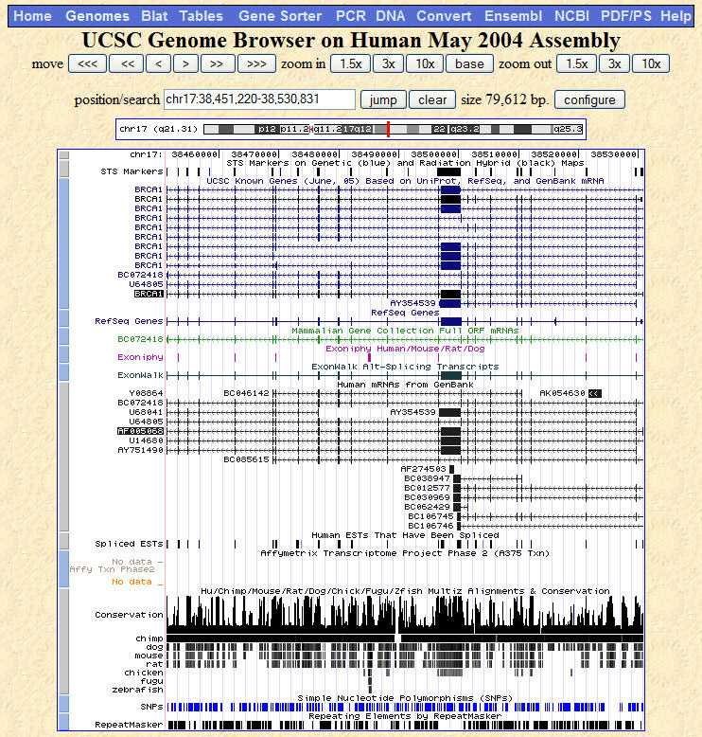
Sample Genome Viewer image, BRCA1 region
Genome backbone
STS markers
Known genes
RefSeq genes
MGC clones
Gene predictions
GenBank mRNAs
GenBank ESTs
conservation
SNPs
repeats
Notes:
At this time, I would like to focus on the viewer section of the Genome Browser. --> This is the default view, after a search for BRCA1. --> I wanted to quickly orient you to the things that you are seeing when you look at the default setup of the genome viewer. --> One of the first things to notice is that we can see that we are in the position of the genome that we expected by looking at the label on the side of the known gene track, which indicates the BRCA1 gene location—which I have highlighted in RED.
At the very top of the image there is a track called BASE POSITION, which I have been calling the genome backbone. --> This is the actual base number of every single piece of the genome backbone. --> As you can see, were are around base number 38 million something-something-something….
As you look down the viewer, you will see many different data types are represented…STS markers, known genes, gene predictions, mRNAs, ESTs, evolutionary relationships, and repeats. --> This is just the default view, though—other data types are available for you to display.
But what you can see right away is that you have a great deal of context about the BRCA1 position in the human genome.

Slide 35

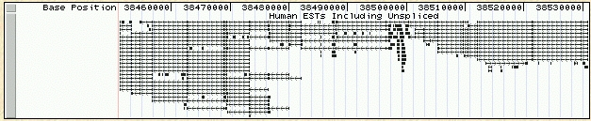
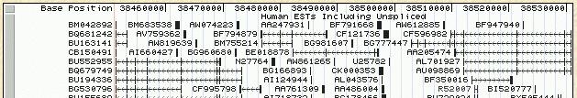
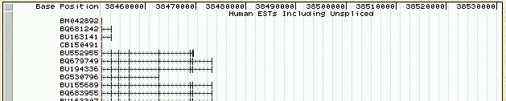
Annotation Track options, defined
Hide: removes a track from view
Dense: all items collapsed into a single line
Squish: each item = separate line, but 50% height + packed
Pack: each item separate, but efficiently stacked (full height)
Full: each item on separate line
Notes:
This slide just quickly defines the choices from the pulldown menus. --> You don’t need to memorize these—you can always refer back to the documentation or a Quick Reference Card for a refresher. --> But quickly, here are the choices, with some sample images of the same track and region with the different options:
Hide: completely removes a track from your image
Dense: all items become collapsed into a single line—fuses all the rows of data into one.
Squish: each item is --> on a separate line, but at 50% of its regular height.
Pack: each item is separate, but efficiently stacked like sardines. However, they are full height—which makes it different from squish.
Full: each item is on a separate line. -->
To choose any of these options, just highlight it in the pulldown menu. --> To make the changes happen, you have to click the REFRESH button that appears in the middle of the genome browser page. --> We’ll spend a little more time on the mid-page controls in a minute.
Then we’ll move on to the last couple of features that you can use to adjust the images. --> Next slide.

Slide 36
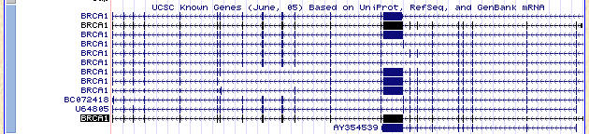
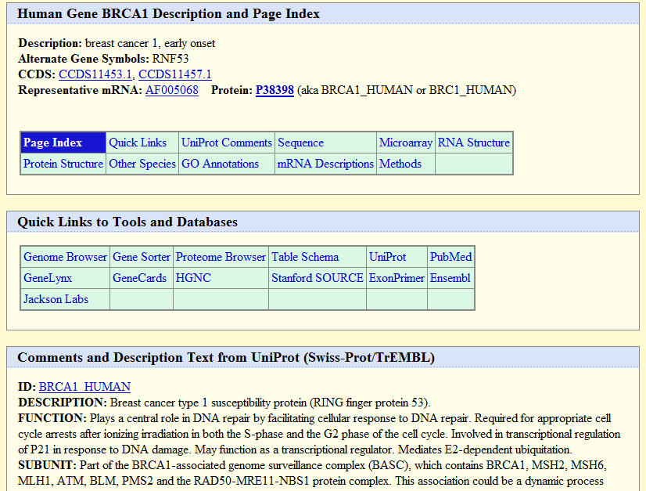
Clicking an annotation line, new page of detailed information
You will get detail for that single item you click
Example: click on the BRCA1 Black “Known Genes” line
Click the line
New
web page
opens
Many details
and links
to more data
about BRCA1
Notes:
Here I’ve just shown the small area of the annotation track image that I clicked, and a screen shot of the web page that you get from this click event.
As you can see, the new web page says that you are looking at the detail for a KNOWN GENE [red box] --> It also gives you links out to other databases where you can learn more about this specific sequence—NCBI, PDB, SwissProt, OMIM, PubMed, mouse orthologs, and so on. --> We’ll take a closer look at that page in the next slide.
The point is that one click away—on any item in the Genome Viewer--there is a LOT of more information available to you.
One note: sometimes, if you click on an annotation track that is actually a compressed track, instead of going to a new web page the track will spread out. --> You have to click a second time to see the new web page in cases like that.

Slide 37
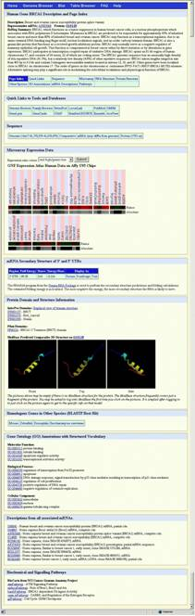
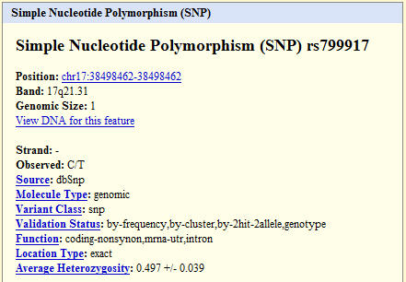
Click annotation track = BRCA1 “Known gene” detail page
informative
description
other resource links
Not all genes have
This much detail.
Different
annotation tracks
carry different detail
data.
links to sequences
microarray data
mRNA secondary structure
protein domains/structure
SNP
detail page
sample
homologs in other species
Gene Ontology™ descriptions
mRNA descriptions
pathways
Notes:
As I showed on the previous slide, one level down there are information pages that contain LOTS of extra information about that gene (or predicted gene, or SNP, or other item) in the viewer. --> I’m going to just show one sample here of the detailed information on the human BRCA1 known gene page. --> But the other types of data also have lots of additional information one layer down as well. -->
This page is actually quite huge, and I know that you won’t be able to see all the details right now. --> But later you should go and see for yourself. --> There is extensive information about this gene, and links to many other resources as well. --> Practially one-stop shopping for known genes!
One thing to know: --> not all gene will have this level of detail, and not every species will have all this information. --> Some genes won’t have protein structures, some won’t have pathway information. --> But if the data is available, it will be available to you on these detail pages. -->
I attached here a small part of a SNP detail page—position, sequence, validation status, function….and so on. --> Different data types will have different details pages. --> You just have to click on the item in the viewer to get to these details pages.

Slide 38




Getting the sequences
Get DNA, with Extended Options; or Details pages
Use the DNA link at the top
Plain or Extended options
Change colors, fonts, etc.
Notes:
So—we have seen visual cues, and lots of text-based data. --> But one Frequently Asked Question that people have is “where is the sequence”? --> So I just want to spend a couple of slides on that topic so that you will know that you can get to the sequence level data. --> As I mention here, there are 2 handy ways to get the sequence information.
First, from your BRCA1 viewer, you could simply click the link in the blue navigation bar at the top of the page [red box]. --> The link that says DNA will bring you to a new GET DNA web page, shown in the center. --> As you can see, the position you were looking at is specified. --> And on this page you have a bunch of options to format the sequence. -->
--You can tweak the output by adding some bases on either side.
--You can get the sequence in upper or lower case.
--You can mask repeated, low complexity regions.
--Or you can get the other strand. -->
Just click the GET DNA button [red box] to get the sequence in a new web page, like I’ve shown here.
The second option is the same in the beginning, but you can do even more to customize the output DNA.
If you click the EXTENDED CASE/COLOR OPTIONS button, you’ll get a new page that lets you change the case of individual items, change their colors, underline specific things, and so on. --> --> The choices that you will see in the list are based on the things actively shown in the Genome Viewer window you were looking at. --> If that’s too much, go back and turn off some tracks….This is a really cool way to look at your sequence of interest! --> As you can see in a sample output, different features look different by color, case, or underlines.
These two options that I just describe deal with getting the whole region of DNA from your viewer. --> But you have a 3rd option—you can get just the part you want from an annotation track; that’s what we’ll look at in the next slide.

Slide 39

Accessing the BLAT tool
BLAT = --> BLAST-like Alignment Tool
Rapid searches by INDEXING the entire genome
Works best with high similarity matches
Notes:
In the UCSC browser, the tool you will use for sequence searching is called BLAT. --> Many of you will be familiar with the alignment tool called BLAST® or BLAST2, which stands for BASIC LOCAL ALIGNMENT SEARCH TOOL. --> {I swear I found the ® at ncbi: http://www.ncbi.nlm.nih.gov/BLAST/blast_overview.html} --> If you have used the NCBI databases, and searched for similar sequences, you have probably used BLAST. -->
But BLAT is different—it is the Blast-like alignment tool. --> It goes about searching the database slightly differently than BLAST. --> But in the end you will have a pair of sequences that are lined up next to each other so you can compare the matches. -->
Blat is really really fast—it has been optimized to search the whole genomes more quickly than BLAST does. --> For those people who care about this, it’s because the UCSC folks have created an INDEX of all the unique 11mers if it’s DNA, 4mers if protein (or stretches of 11nucleotides or 4 amino acids). --> Then when you throw a query sequence at it, it just looks down its index of 11mers, finds a match and works out from there. --> Blast does it the other way—it indexes your query and then runs your smaller index over everything…that’s the essential difference in the algorithm. -->
It works best with sequences with high identity—but don’t let that scare you, you can find more distant matches as well. --> Directly from the UCSC documentation:
“On DNA queries, BLAT is designed to quickly find sequences with 95% or greater similarity of length 40 bases or more. It may miss genomic sequences that are more divergent or shorter than these minimums, although it will find perfect sequence matches of 33 bases and sometimes as few as 22 bases. The tool is capable of aligning sequences that contain large introns. On protein queries, BLAT rapidly locates genomic sequences with 80% or greater similarity of length 20 amino acids or more. In general, gene family members that arose within the last 350 million years can generally be detected.”
But for you algorithm hounds, you will realize that what I have said is really a simplification of the detailed algorithm, and I encourage you to investigate the details between the two methods by reading the papers for these.
BLAST (original paper): -->
Altschul SF, Gish W, Miller W, Myers EW, Lipman DJ. Basic local alignment search tool.
J Mol Biol. 1990 Oct 5;215(3):403-10.
http://www.ncbi.nlm.nih.gov/entrez/query.fcgi?db=PubMed&cmd=Retrieve&list_uids=2231712&dopt=Abstract
BLAT (original paper):
W. James Kent (2002) BLAT - The BLAST-Like Alignment Tool, Genome Res 12:4 656-664.
And for the more casual BLAT user, check out the documentation at the UCSC web site for a little more detail about the way BLAT works without tremendous amounts of mathematical equations….
For many people it will be enough to know that there is a means of searching for your region of interest in the database by starting with a sequence! --> So we’ll talk about how to use a sequence to get where you want now, using the BLAT software.
Okay, so now we know a little bit about the BLAT tool. --> How do we get to it? --> Let’s start at the UCSC Genome Browser homepage, as I have shown here.
There are a couple of ways, like we’ve seen before. --> You can use the Navigation bars at the top or at the side of the UCSC home page. --> Select the links called BLAT or BLAT search to get started.
These will bring you to a BLAT web page, as shown in the next slide.

Slide 40

BLAT tool overview: www.openhelix.com/sampleseqs.html
Make choices
Paste one or more sequences
DNA limit 25000 bases
Protein limit 10000 aa
25 total sequences
Or upload
Submit
Notes:
Here is the starting page for using BLAT to search the genomes at the UCSC browser. --> As you can see along the top there are a few parameters you can change—some choices you have to make. --> [red box 1] --> First, you must choose 1 species to search. --> Then you choose an assembly. -->
Next, you may let the BLAT tool guess whether you have entered nucleotides or amino acids, or you can tell it which one you are using. --> Sort output—on default settings here—will list the best scoring matches first. --> Output type specifies whether you want the output to be in the browser form, or in files you can use later. --> Hyperlink is the default which displays in the browser, and that’s what I’ll be using for this example.
There is a big text box where you can paste your sequence. [red box 2] --> You can paste 1 or more sequences, but there are limits to how much BLAT you can do, as it is a large burden on the servers. --> I have displayed 2 partial sequences here that I will use in my example. --> These are in the FASTA format, which you have to use if you are going to use multiple sequences.
And there is also an option to upload your sequence (or sequences). --> [red box 3]
Finally, you click SUBMIT to send your query to the database.
There is a special new button—the “I’m Feeling Lucky” button. --> If you click that—just like in Google—you will be taken to the position of your best match right away, in the Genome Viewer. --> But I’ll be demonstrating the plain old SUBMIT button right now.

Slide 41

BLAT results, with links
sorting
Results with demo sequences, settings default; sort = Query, Score
  Score is a count of matches—higher number, better match
Click browser to go to Genome Browser image location (next slide)
Click details to see the alignment to genomic sequence (2nd slide)
Notes:
Here we see the results of a BLAT search against the human genome, using the sample human mRNA sequences I showed. -->
As you can see, we have sorted the list by the query and score [long red boxes ]. --> You can see we have a really really high scoring match up at the --> top. --> After that they appear to be less good matches—pretty small regions, probably. -->
Now, you’ll remember that we asked for hyperlinked results, right? --> You can see that there are 2 columns of links for us. --> One says BROWSER, one says DETAILS. -->
The first thing that I would do is click the BROWSER link for the matches [red box 2]. --> This will link me to the position of this match in the Genome Viewer. I will show a sample of that on the next slide.
Later we will click on the DETAILS link for the best match. --> That will give us a new page with sequence information, as you’ll see a couple of slides from now.

Slide 42


BLAT results, alignment details browser
Click to flip frame
query
matches
From browser click in BLAT results
A new line with your Sequence from BLAT Search appears!
Watch out for reading frame! --> Click - - - > to flip frame
Base position = full and zoomed in enough to see
amino acids
Notes:
When you link from the BLAT results to the BROWSER—you get a special track!
Just down from the top there is a new line on the browser—it says YOUR SEQUENCE FROM BLAT SEARCH. --> And the name of my query sequence is listed over on the left….
And if you look at the known genes, or refseq genes, you can see that we have matched the CXCL5 gene, which is what we would have expected from the BLAT query. --> On the known genes, you can see the Methionines indicated in green. --> Also, note the direction of this gene—it is on the negative strand, therefore runs from right to left in this case. --> But beware—the 3 frame translation at the top is running the other way. --> If you want to compare the methionines, you have to flip the frame translation.
So—we have used a sequence as a starting point to search the genome. --> We get to see the actual alignment data, and we get to see the location of our match on the Genome Browser. -->
So BLAT is another good place to start searching for your genes of interest in the UCSC Genome Browser tool. -->
One special tip here: --> when you are zoomed in enough on a sequence, you can see the amino acids in the display. --> But be careful of the reading frame direction—check your known gene arrowheads. --> If you have to flip the frame—because the default is the 3 frames in the 5’ to --> 3’ direction, click the small arrow underneath BASE POSITION to flip the nucleotide or amino acid direction.

Slide 43



BLAT results, alignment details
Your query
Genomic match, color cues
Side-by-side alignment
Notes:
Here I show the outcome if you clicked the DETAILS link from the BLAT results page. --> I know it’s impossible to see the whole alignment page—even with my tiny little query sequence this is a really big web page that you get.
You can see the page is divided into several parts. --> The top part shows the query sequence you put in (in this case our human CXCL5 DNA sequence).
The middle part of the page shows the match up of your sequence (in blue) capital letters, to the genomic sequence. --> This gives you a really quick look at the exon/intron structure—right? --> It’s a nice way to see which parts are the exons in an mRNA (if that’s what you started with), and the introns in black text.
The bottom part shows you the actual nucleotide-for-nucleotide matches—this may be more like the BLAST results you are used to seeing. --> I magnified the top of the side-by-side alignment so you can see where my query sequence on the top (starts with number 000001), lines up with the genomic sequence. --> You can judge the quality of the match yourself in this section.
Okay—I’m convinced that this sequence matched up perfectly with the genomic sequence, and that’s the region I want to examine in the genome browser. --> So, if you use the back button on your browser to get back to your results list, you can now select the other link to go directly to the genome viewer for this match region. -->

Slide 44
Table Browser
To get the data associated with a track in text format, to calculate intersections between tracks, and to retrieve DNA sequence covered by a track

Slide 45

Table Browser Query

Slide 46

Table Browser Results

Slide 47
In Silico PCR
In-Silico PCR searches a sequence database with a pair of PCR primers
Returns: a sequence output file in fasta format containing all sequence in the database that lie between and include the primer pair

Slide 48

In Silico PCR Query
Two primer sequence
Max product size
Number of matches

Slide 49

In Silico PCR Results
Forward primer
Reverse primer
Match in uppercase
Mismatch in lowercase
Melting temperature

Slide 50

Ensembl Genome Browser

Slide 51

Ensembl Genome Browser

Slide 52


VEGA E ENCODE:
annotazione dettagliata dei genomi
Progetti sperimentali per una maggiore caratterizzazione funzionale di elementi di DNA (ENCODE) o prevedono comunque una fase supplementare di curation manuale dei dati relativi a geni e trascritti (VEGA).

Slide 53


ENCyclopedia of DNA Elements
Consortium of
International researchers
Notes:
Following the major sequencing of the human genome, a new project was launched to take a closer look at the elements that comprise the genome sequence features. --> This international research consortium, sponsored by the National Human Genome Research Institute (or NHGRI), is called ENCODE: ENCyclopedia Of DNA Elements. -->
UCSC has been designated as the Data Coordination Center (DCC)—a repository for submission and retrieval of ENCODE Consortium data. -->
Next we’ll briefly describe some background and framework for the ENCODE project. -->

Slide 54


ENCODE Background
Pilot phase, or phase I
Selected regions of the genome: 1%, 30 MB
Notes:
Rather than providing exhaustive understanding of human genomics, the completion of the human genome project made it apparent that merely having the nucleotide sequence of the genome wouldn’t provide complete knowledge of the genome organization and function. --> The ENCODE project was devised to catalog all of the functional elements in the human genome, and to rigorously examine them to gain a better understanding of their roles in the cell. --> This began with a pilot project, and information about the pilot phase can be obtained at the URL shown.
To accomplish this, data has been generated using cutting-edge technologies. This data is at the forefront of our genomic knowledge, moving beyond the mere transcription of known genes into more in-depth questions on chromatin remodeling, transcription factor binding, transcription of non-coding RNA genes, and more.
The first phase of the ENCODE project was referred to as the “pilot” phase. --> In the pilot phase, selected regions of the genome were chosen for detailed examination. --> Approximately 30 megabases, representing 1% of the genome, was defined as the target. --> Half of the regions included well-studied gene-rich or known feature-rich areas with substantial similarity in other species. --> Half were randomly selected—so the features would be less well-known or understood.

Slide 55







ENCODE Discoveries
“Marker” papers: Nature and issue of Genome Research
Changes to our conceptual framework for the genome
Notes:
The ENCODE pilot phase was completed in 2007. --> The results were published—as a whole project overview “marker” paper in Nature, and as individual papers by research teams that describe their specific data focus in a special issue of Genome Research. Scores of important insights were generated and are highlighted in the Nature paper. --> These include:
There is abundant transcription beyond the known protein-coding genes: both intragenic and intergenic transcription, including both non-coding RNA and transcribed pseudogenes. --> This had been observed before, but the ENCODE pilot phase conclusively demonstrated this.
At the same time, known protein-coding genes revealed unexpected complexity: distal untranslated region (UTR) exons as many as 200 kilobases away, overlapping or interleaved loci, antisense transcription. This has all really challenged the conventional definition of a "gene".
Patterns of histone modification and DNase sensitivity reveal "domains" of packed or accessible chromatin, and these accessibility patterns correlate well with rates of transcription, DNA replication, and regulatory protein factors binding to the DNA. --> This underscores the regulatory importance of epigenetic factors.
These items, and many more which can be explored in great detail in the individual papers by the research teams, resulted in changes to our conceptual framework for understanding the organization and functional aspects of the genome. -->

Slide 56





ENCODE Production Phase Focus
chromatin
transcriptome/
genes
promoters/
regulatory sites
DNase sites
ENCODE is now genome-wide
Specific cell types and new technologies being applied
Project focus topics selected, then supplemented
Notes:
The genome-wide production phase of the ENCODE project is proceeding now. -->
A key feature of the production phase is that several cell types have been selected to form the main data collection efforts. --> All project teams will use these same cells in their work for consistency. --> The cell types are organized into tiers: 1, 2, and 3 to prioritize the experimental investigations. --> This will enable better coordination of the studies and interpretation of the results. --> It might also be something for researchers to consider for their own experiments, as there will be a great deal of supporting data for these cell types that might be informative. --> The cell types are publicly available from a variety of providers. --> More can be learned about them from the ENCODE project site or the UCSC portal.
Several areas of focus have been funded. --> These include chromatin organization and DNase hypersensitive sites. --> Detailed studies of gene structures, and the transcriptome as a whole, are underway. --> Exploration of regulatory elements, including transcription factor binding sites, is ongoing. --> These topics will help us to understand much more about genomic mechanisms.
In October 2009, a number of new ENCODE groups were funded as part of the NIH American Recovery and Reinvestment Act grants. --> These newer groups will expand the scope of ENCODE research to the mouse genome, and will provide new assays (such as proteo-genomics and epitope-tagging protein binding) to supplement results produced during the first two years of the project. -->
We’ll provide you with the information on how to identify and use ENCODE project data that comes from additional methods as we proceed.

Slide 57



Slide 58


Slide 59





ENCODE Data Types
Mapping data
Genes
Expression
Regulation
Variation
ENCODE Tracks identified with icon
Notes:
As we described in the last section, various types of data are now being submitted to the UCSC ENCODE DCC from numerous different providers. --> Here we will provide an overview of these data types as they are organized in the UCSC Genome Browser “track groups” area, and mention some key features. These are the data types present at the time we created this tutorial—more ENCODE data is flowing in regularly, and you may find more as you examine the site.
ENCODE data is identified in the tracks area by the ENCODE NHGRI helix icon, a few examples of which are indicated on the slide. Most participating research groups have provided several tracks for any data set, and generally only selected data from each research group is displayed by default. Track details can be accessed by clicking any of the hyperlinked track names on the web page. This will open a window providing details of all the available tracks and data features available to view. This report will also provide the full details of any data type, including a description and associated references.
ENCODE data can be found in the Mapping and Sequencing Tracks group, Genes and Gene Predictions group, Expression, Regulation, and Variation at this time. --> Next we will briefly discuss each of these data types.

Slide 60




ChIP-seq Data for TFBS
TP53
cell types + antibodies
stronger signals
Yale TFBS
Sample display near TP53 in “dense” visibility mode
Chip-seq graphic adapted from: wikipedia.org/wiki/ChIP-on-chip
Notes:
As an example of a specific ENCODE data set, we will now specifically examine the Yale TFBS set of data. The data will be described briefly, and then we will look at the available display features. --> The principles of access, usage, and display that we cover will be true for all of the new ENCODE data.
The new techniques and data types being submitted may require new graphical displays or controls than other data. --> And each project will have different aspects. --> We will use this first data set as an example. This data is ChIP-seq data for identifying Transcription Factor Binding Sites. We are focusing on an area around the start of the TP53 gene for this sample. If the Yale TFBS data in the “Regulation” tracks is displayed in “dense” mode, it will appear as shown on this slide. -->
Here the underlying premise for identifying transcription factor binding sites with the ChIP-seq methods is shown graphically. --> Cells for the ENCODE project are grown. --> Cross-linking agents bind transcription factors to genomic DNA. --> The DNA is fragmented. The proteins of interest (or POI) bound with DNA fragments can be captured by different antibodies—for example, an antibody for the c-FOS factor or one for the Pol2 protein. --> Then immunoprecipitation pulls out the complexes. --> The DNA sequences can then be isolated and high-throughput sequencing technologies can be used to identify the specific sequence. -->
The sequences can then be mapped to the genomic reference sequence and indicated on the browser. --> Shown is a segment near the beginning of the TP53 gene. --> It looks as if there are positive signals from this technique, near the beginning of this gene, in certain cell types, and with certain antibodies to that transcription factor. That suggests that the transcription factor may bind in some conditions to this region. -->
To understand more about the display and ways to view and understand the data, one can refer to the description page. --> The hyperlink above the menu for Yale TFBS links to that page, and will be examined next.

Slide 61



Slide 62






Expression Data: RNA Localization
http://en.wikipedia.org/wiki/MRNA
RNAs molecules, location in various cell types and fractions
Notes:
A number of interesting data tracks are available in the Expression group. --> A variety of techniques are being used to locate and characterize the messenger RNA molecules in the ENCODE cell types. -->
Some projects are looking at the subcellular localization of mRNAs. --> The diagram on the left illustrates some of the regions where one might expect to find mRNA molecules in various stages of their lifespan. --> Researchers can take the cells and fractionate them, and then determine which pieces of the mRNAs are found. --> For example, the nuclear fraction may have different characteristics than mRNAs out in the cytoplasm. -->
One can choose to display the different cell types and the different fractions on the track details pages. --> Shown here is a simple example of a region of the TPTE gene, and the composition of the mRNAs observed. The pattern is different in the cytosol and in the nucleus.
[Image from: http://en.wikipedia.org/wiki/MRNA; gene sample is TPTE gene region on chromosome chr21:9,911,130-10,020,902]

Slide 63








Expression Data: Presence of RNA or Exons
http://en.wikipedia.org/wiki/MRNA
RNAs of various types
Special look for long mRNAs and exons
Notes:
In addition to the subcellular localization, various groups are looking to identify new mRNAs or confirm the presence of known mRNAs. Using different technologies and strategies—some with extra effort to obtain longer mRNAs which are technically challenging—data providers will offer an extensive look at mature mRNAs and their corresponding exons. -->
As always, one can examine the track details to learn more about the technology and the data involved.

Slide 64


Comprehensive catalogue of protein-coding, non-coding genes and pseudogenes

Slide 65






Regulation Data
Image from NIH
Regulation data
Structure: modifications, open vs. closed chromatin
Notes:
A major focus of the ENCODE project is to investigate regulatory components and features of the genome. --> A wide range of tools and methods are being used to investigate this.
Some projects have the goal of looking at structural aspects of the genome organization. --> For example, the position and modification of histones can provide clues about which regions of the genome are accessible or inaccessible. --> DNA fragments can be chemically bound to histones and then isolated and the corresponding DNA can be sequenced to determine the location. --> Leads on promoters, enhancers, silencers, and various other types of functional elements may be gleaned from this type of data.
Commonly the data will show strong signal regions in summary form, and the more dispersed pattern from the signal data.
Again, the data description page provides additional details on the methods and displays.
[sample region: chr21:9,939,013-9,949,270]
[Image credit http://www.genome.gov/Images/press_photos/highres/20150-300.jpg]

Slide 66





Regulation Data II
TATA bound to DNA
Transcription factor binding sites, TFBS
RNA binding proteins
Notes:
The binding of proteins to possible regulatory elements is also a key focus of the ENCODE work. --> A number of projects are studying the binding of proteins to either genomic DNA, or to mRNA, to learn more about various aspects of regulation. We will provide an example of that type of data in an upcoming tutorial section, when we describe the Yale TFBS project. -->
Several additional strategies to examine transcription factor binding sites (or TFBS) are underway. --> Other work is looking at other features of possible promoter regions—such as bi-directional promoters between two genes. --> Negative regulatory elements, another interesting and important aspect of regulation, are also being pursued. -->
RNA binding proteins may provide further clues to regulation of gene expression. -->
[Sample region: chr21:29,281,340-29,292,754]
[Image credit: http://en.wikipedia.org/wiki/File:TATA-binding_protein.png]

Slide 67



Variation Data
Copy Number Variation (CNV) Data
Notes:
Understanding variation is also crucial to complete interpretations of genomics data. --> Copy number variation, or CNVs, had been elusive before we had a reference genome sequence and the appropriate technologies for their detection. But researchers have recently become more aware of these structural variations of the genome that can impact the functions of cells. -->
Some CNVs appear to be present in humans without a detectable impact on health status. --> Others may be important in disease. --> In the framework of the ENCODE project, it is important to know in the cell lines under examination if they have extra or missing copies of genomic segments. -->
Copy number variations may include amplification or duplication of a segment. It may mean deletion of a piece of the genomic region with respect to the reference genome. --> These types of variation are present in this data set. --> Pairs of chromosomes may include alteration on one, or both of the members of a pair, and therefore the deletions may be scored as heterozygous or homozygous deletions.
Such data can be investigated using the Common Cell CNV track data. --> The example shows a region on the X chromosome, with observable patterns indicating the presence and absence of segments on one or both chromosomes, and amplifications in some cases. Normal segments are also indicated. If a gene of interest is in a region with variation, this could be crucial information about these cells.
With the strategies we have described in this tutorial for locating and using the ENCODE data types researchers will have the skills to access and visualize any new data types that come along. --> The ENCODE icon and details pages can be examined for further guidance.
[sample image: chrX:45,908,749-80,283,771, front menu on pack, both details page views set to pack]

Slide 68


Manual Sanger sequencing based “chain termination”, radioactive labellin and gel electrophoresis
2 giorni di lavoro: lettura e inserimento dei dati fatti a mano, approssimativamente 300 basi!

Slide 69


Automatic sequencing… putting it all together
Hood & Hunkapiller released the 1st semi-automated sequencer based on Sanger’s method (1986).
Both chemistry and data-gathering were improved:
As the labeled fragments migrated through the gel, a laser beam stimulated the fluorescent labels, causing them to glow. The light they emitted was picked up by a lens and photomultiplier, and transmitted as digital information directly into a computer.
radioactive labels replaced by fluorescent dyes specifically color-coding each of the 4 ddNTPs (4 dye / 1 lane strategy).
integration of laser and computer technology eliminated the tedious process of information-gathering by hand at the end of the process.
30 years of constant improvement resulted into an automated 96-capillary instrument with state-of-the art performances (ABI 3730xl):
96 sequences/2 h run; ≤1000 bp/rxn --> ➔ --> ≤ 1Mbp/day
Cost: $1/Q₂₀ kb (based on averaged 800 bp reads)

Slide 70
Sequencing of the human genome
Public Consortium
Many years of hard work
More than 20.000 BAC clones
Each containing about 100kb fragment
Together provided a tiling path through each human chromosome
Amplification in bacterial culture
Isolation, select pieces about 2-3 kb
Subcloned into plasmid vectors, amplification, isolation
recreate contigs
Refinement, gap closure, sequence quality improvement
(less 1 error/ 40.000 bases)
BAC based approaches toward WGS

Slide 71
“Next Generation” Sequencing
1. In 2004, 454 Life Sciences (now part of Roche Diagnostics) commercialized the ﬁrst next-generation sequencing instrument
2. The parallel nature of this technology allows simultaneous measurement of more than 200 000 DNA sequences totaling 20 40 million base pairs
3. In December 2006, 454 Life Sciences introduced the second-generation instrument, Genome Sequencer FLX (GS FLX)
4. 100 million base pairs and an average read length of more than 240 bases
5. Through April 2008, more than 200 peer-reviewed articles have been published, demonstrating the utility of 454 Sequencing in a broad range of research applications

Slide 72
“Next Generation” High-throughput
Sequencing
methods
Parallelizazione del processo
di sequenziamento
Sequencing by synthesis (or by ligation)
Migliaia di milioni di reads
prodotte contemporaneamente
Pyrosequencing: Roche's (454) GS FLX Genome Analyzer
Sequencing by synthesis: Illumina's sequencers
Sequencing by ligation: Applied Biosystem's SOLiD system
Semiconductor sequencing: Ion Torrent

Slide 73






Sequencing technology evolution
NGS
Next Generation Sequencing, High-throughput, Ultramassive
ABI/Solid
Illumina/Solexa
LifeTechnologies’ IonTorrent
Roche/454
Sanger
Read length (nt)
1000 100 50
THROUGHPUT
Mb Gb
1 700 1 30 (short time) 60 600
THROUGHPUT
Illumina/Solexa
ABI/Solid
LifeTechnologies’ IonTorrent
Roche/454
Sanger
Notes:
Different sequencing technologies are available, producing reads of different length and with very different throughput
High-throughput sequencing technologies, also called Next Generation Sequencing techniques allowed the massive parallel sequencing of many short DNA molecules in a single experiment
In last years this field experienced a continuous and rapid increase of sequencing output and a corresponding dramatic decrease of the cost of sequencing per base
With Sanger Sequencing we are able to obtain sequences of up to one thousands bases, whereas most deep sequencing technologies produce reads around 100 bp long, with Roche technology reaching around 500 bp of good sequence
Regarding the throughput, the range is from less than one Gigabase with Roche to from 30 to 600 gigabases with most massive technologies, that actually differ also for sequencing time

Slide 74

Roche 454 pyrosequencing technology

Slide 75
Emulsion PCR
Templates
Primer coated beads

Slide 76

Roche 454 pyrosequencing technology
Notes:
The pyrosequencing method is based on detecting the activity of DNA polymerase (a DNA synthesizing enzyme) with another chemoluminescent enzyme. Essentially, the method allows sequencing a single strand of DNA by synthesizing the complementary strand along it, one base pair at a time, and detecting which base was actually added at each step. The template DNA is immobile, and solutions of A, C, G, and T nucleotides are sequentially added and removed from the reaction. Light is produced only when the nucleotide solution complements the first unpaired base of the template. The sequence of solutions which produce chemioluminescent signals allows the determination of the sequence of the template.
This incorporation releases pyrophosphate (PPi).
ATP sulfurylase converts PPi to ATP in the presence of adenosine 5´ phosphosulfate. This ATP acts as a substrate for the luciferase-mediated conversion of luciferin to oxyluciferin that generates visible light in amounts that are proportional to the amount of ATP. The light produced in the luciferase-catalyzed reaction is detected by a camera and analyzed in a program.
Unincorporated nucleotides and ATP are degraded by the apyrase, and the reaction can restart with another nucleotide

Slide 77



The Illumina/Solexa platform
Tons of reads !!
Modified nucleotides with fluorescent tag and a reversible terminator
Bridge amplification
Notes:
Vediamo ora un esempio di tecnologia di NGS: la piattaforma Illumina.
Le fasi per ottenere le sequenze sono qui rappresentate:
Dai campioni viene estratto il materiale che subisce una fase di amplificazione per la preparazione di una libreria, ad esempio l’RNA messaggero viene isolato, trasformato in cDNA e frammentato. Alle estremità dei frammenti vengono applicati (legati) degli adattatori che servono a “fissare” i frammenti alla piastra (flow cell). In seguito i frammenti subiscono un’ulteriore fase di amplificazione, che per la piattaforma illumina si chiama bridge amplification . Questa fase è quella che determina il limite alla lunghezza dei frammenti sequenziabili. La bridge amplification genera dei cluster di frammenti omogenei sulla piastra. Il passo successivo è quello dell’effettivo sequenziamento dei frammenti: vengono ripetuti ciclicamente l’aggiunta di nucleotidi marcati con un’etichetta fluorescente (che impedisce impedisce la sintesi di ulteriori nucleotidi) che estendono i filamenti, con una DNA polimerasi, un nucleotide ad ogni ciclo. Dopo l’aggiunta di ogni nucleotide viene emesso un laser sulla flow cell che genera dei puntini luminosi per ogni cluster, di colore diverso a seconda di quale nucleotide che è stato aggiunto; l’immagine della flow cell viene analizzata e per ogni coordinata viene memorizzato il nucleotide nella sequenza e alla fine del ciclo viene lavato via l’adattatore fluorescente (così si può attaccare un nuovo nucleotide al ciclo successivo). Per frammenti di 100 basi vengono eseguiti 100 cicli. In questo modo otteniamo le reads, cioè le sequenze, dei filamenti presenti nella flow cell.
fluorescent tag and a reversible terminator
Sequencingtechnology:
Library preparation
Machine (ex: HiSeq2000)
Bridge amplification
Sequencing by synthesis
Paired end reads

Slide 78





Illumina Sequencing Workflow
1
Library Preparation
Fragment DNA
Repair ends
Add A overhang
Ligate adapters
Purify
2
Cluster Generation
Hybridize to flow cell
Extend hybridized template
Perform bridge amplification
Prepare flow cell for sequencing
Sequencing
3
Perform sequencing
Generate base calls
Data Analysis
4
Images
Intensities
Reads
Alignments

Slide 79

Illumina Solexa

Slide 80










Illumina Sequencing Technology Workflow
3’
5’
DNA
(0.1-5.0 μg)
A
T
C
G
C
T
T
G
A
G
C
C
A
G
A
T
G
C
A
A
T
C
G
C
C
C
G
Single molecule array
A
T
C
G
A
5’
A
Library Preparation
Cluster Growth
Sequencing
1
2
3
4
5
6
7
8
9
T G T A C G A T …
Image Acquisition
Base Calling

Slide 81
The Illumina/Solexa platform
Some numbers:
  Reads length: 35-150bp
  Many clusters per flow cell: MiSeq---15 Million reads → HiSeq X: 3 Billions
  Time per run: 2 to 11 days
  Platform specific sequencing error:
    base miscalling ~1%
  Cost: 5-150$ per 1 billion bases
Notes:
Con l’illumina HiSeq2000 in 11 giorni si possono sequenziare 2 flow cells da 3 miliardi di clusters di frammenti lunghi fino a 100 paia di basi, per un totale di (2x3x10e9x10e2) 600miliardi di basi sequenziate.
Da notare è il livello d’errore caratteristico di questa tecnologia che è circa dell’un per cento, cioè ogni cento nucleotidi letti abbiamo un errore di lettura

Slide 82



Slide 83
454 vs Illumina
 | 454 | Illumina
Cost per 1 billion bases | 10,000$ | 10$
Reads per run | 1.000.000 (24h) | Up to 3 billions (1/2 weeks)
Error pattern | Homopolymers | Substitutions errors (more in correspondence to specific profiles)
Applications | De novo assembly, metagenomics | WGS, WES, RNA-seq, small RNA-seq
Notes:
$2400

Slide 84

The third generation: REAL TIME LONG READS
DNA (OR RNA) SEQUENCING
OXFORD NANOPORE SEQUENCING
Oxford Nanopore’s DNA library preparation and sequencing process.
A. DNA library preparation. Adaptors are added to the target DNA and a motor protein binds and delivers the DNA to a nanopore on the flow cell. Each nanopore is embedded in a electro-resistant membrane and is associated to an elecrtode connected to a channel in a senso chip. B. Motor protein unwinds the dsDNA and pushes it through the nanopore. C. Fluctuations in current as the DNA is pushed through the nanopore are recorded and analyzed.
Notes:
A MinION flow cell contains 512 channels with 4 nanopores in each channel, for a total of 2,048 nanopores used to sequence DNA or RNA. The wells are inserted into an electrically resistant polymer membrane supported by an array of microscaffolds connected to a sensor chip. Each channel associates with a separate electrode in the sensor chip and is controlled and measured individually by the application-specific integration circuit (ASIC). Ionic current passes through the nanopore because a constant voltage is applied across the membrane, where the trans side is positively charged. Under the control of a motor protein, a double-stranded DNA (dsDNA) molecule (or an RNA–DNA hybrid duplex) is first unwound, then single-stranded DNA or RNA with negative charge is ratcheted through the nanopore, driven by the voltage. As nucleotides pass through the nanopore, a characteristic current change is measured and is used to determine the corresponding nucleotide type at ~450 bases per s (R9.4 nanopore).

Slide 85


Slide 86

MinION
https://nanoporetech.com/platform/technology

Slide 87



Slide 88



Slide 89




Slide 90



Further reading
Notes:
$2400

Slide 91
Formats: FASTA
>unique_sequence_ID My sequence is pretty cool
ATTCATTAAAGCAGTTTATTGGCTTAATGTACATCAGTGAAATCATAAATGCTAAAAA
Deceptively simple format (e.g. there is no standard)
However in general:
  Header line, starts with ‘>’
  followed directly by an ID
  … and an optional description (separated by a space)
Files can be fairly large (whole genomes)
Any residue type (DNA, RNA, protein), but simple alphabet

Slide 92

NGS output
Millions of sequences (Large file of several Gbytes)
Output formats:
  FASTQ ≈ FASTA + quality score
    Quality score = goodness of base call (higher is better)
FASTQ file example:
Read 1
Read 2
Read 3
Read 4
1) ‘@’ sequence identifier and description
2) Raw sequence (in letters)
…
3) ‘+’ sequence identifier (again) – opt.
4) Quality score per nucleotide, charachter encoded
May be ‘raw’ data (straight from sequencing) or processed (trimmed)
Variations: Sanger, Illumina, Solexa (Sanger is most common)
Notes:
Tutte queste reads sequenziate sono memorizzate in formato digitale in uno o più files di testo che possono raggiungere dimensioni dell’ordine di grandezza di GigaBytes.
Ci sono dei formati che possiamo definire standard per la rappresentazione, sono il formato FASTA che immagino sia noto a tutti, con cui si può riportare la sequenza grezza dei nucleotidi e un identificativo per ogni sequenza.
Un altro formato è il tipo FASTQ:
Tale formato si può vedere come fosse un’estensione del formato FASTA, in cui viene riportata anche l’affidabilità della lettura effettuata per ogni singola base. La ‘Q’ di FASTQ sta infatti per ‘Quality’ e la qualità non è altro che una misura della probabilità che il sequenziatore abbia commesso un errore nella lettura di una base. Valori alti corrispondono ad alta qualità, alta affidabilità.
Vediamo qui un esempio di come è strutturato un file FASTQ:
È sostanzialmente un file di testo in cui ogni read è rappresentata in quattro linee. La prima linea deve cominciare sempre con un carattere chiocciola (‘at’) a cui segue un identificatore, il nome, della sequenza e opzionalmente una descrizione;
La seconda linea riporta la sequenza dei nucleotidi, A,C,G,T in lettere, come nel formato FASTA;
La terza linea deve cominciare con il carattere ‘più’, seguito opzionalmente dall’identificatore della read;
Nella quarta linea sono riportate le qualità delle basi, un carattere per ogni base, nello stesso ordine e in corrispondenza della sequenza della seconda linea. Per risparmiare spazio i numeri delle qualità sono codificati con dei caratteri ASCII, in modo da avere un singolo carattere di qualità per ogni base.
Quello che si ottiene alla fine sono M di seqeunze
che occupano spazio su disco fisso
Codificate secondo i formati FASTA che conosciamo
e FASTQ che è formato da…
‘@’ sequenceidentifier
rawnucleotidessequence
‘+’ sequenceidentifieragain (optional)
qualityscores (encoded)

Slide 93

Phred Quality Score
Each base call is associated with a quality score (Q)
where P is the probability that a base call is erroneous
Phred Quality Score | Prob. Of Incorrect Base Call | Base Call Accuracy
10 | 1 in 10 | 90%
20 | 1 in 100 | 99%
30 | 1 in 1000 | 99.9%
Charachter encoded score
the charachter whose ASCII code is Q+33
? = 63 in ASCII code (= Q 30)
(Sanger Institute standard)

Slide 94

Phred Quality Score
Charachter encoded score
the charachter whose ASCII code is Q+33
? = 63 in ASCII code (= Q 30)
(Sanger Institute standard)

Slide 95
Challenges from NGS
We have
We need
Tons of raw data
Short reads data
High error rates
Different aims of sequencing problem (experiment design)
CPU time to process one run
CPU time for analysis
Algorithms
Predictive methods
Storage
High performance computing
Notes:
Le difficoltà che riscontriamo con il sequenziamento di seconda generazione sono il dover maneggiare grandissime quantità di dati. Questi dati hanno la forma di brevi sequenze nucleotidiche, su cui non abbiamo altra informazione se non la sequenza stessa. Le sequenze inoltre non sono totalmente affidabili poiché il tasso di errore nel processo di sequenziamento è alto. E un’ulteriore difficoltà è data dal fatto che a diversi scopi corrispondono diversi tipi di disegno dell’esperimento di sequenziamento, che può far variare sia la quantità di dati, sia la lunghezza delle reads, sia il tipo stesso di materiale sequenziato e i campioni da cui è ricavato. Per far fronte a tali problematiche abbiamo quindi bisogno di spazio su dischi rigidi per immagazinare i dati, sia di partenza che delle varie fasi di analisi; c’è bisogno di dedicare risorse di calcolo sia per il processamento preliminare dei dati di ogni esperimento che per l’analisi. Tali risorse di calcolo devono avere alte prestazioni e possibilmente essere parallelizzate per ottenere risultati in tempi ragionevoli. E ancora c’è la necessità di algoritmi efficienti e metodi predittivi per ricavare la maggior quantità possibile di informazione contenuta nei dati e indirizarci.

Slide 96
NGS applications
Genome sequencing
De novo
Whole genome
Whole exome
Targeted/Amplicon
Resequencing
Alternative splicing analysis
SNPs/variants detection
Expression quantification
Vs. reference genome
Vs. unknown genome (de novo)
Transcriptome (RNA-seq)
Gene discovery
Assembly + annotation
Assembly + annotation
Notes:
Una volta ottenuti i dati possiamo cominciare a pensare per quali applicazioni li possiamo usare.
In questo schema ne ho riportato alcune:
Se abbiamo sequenziato materiale genomico possiamo averlo fatto per ricavare informazioni su un genoma che ancora non conosciamo, per esempio se lo vogliamo sequenziare e ricostruire per la prima volta. Oppure possiamo risequenziare un genoma già noto per ricavare ulteriori informazioni: in questo caso potremmo risequenziare l’intero genoma o risequenziare solo le parti corrispondenti agli esoni, oppure risequenziare solo determinate regioni di interesse.
Nel caso dell’RNA-seq viene sequenziato il trascrittoma di un organismo o tessuto. I dati di trascrittoma possono riferirsi sia ad un genoma non ancora conosciuto, sia ad un genoma di riferimento. Con un genoma di riferimento, come ad esempio quello di maiale, ma in verità anche nel caso di un genoma non ancora noto, e con i dati NGS alcune analisi interessanti che possiamo effettuare sono la quantificazione dell’espressione, dei geni e dei trascritti, l’individuazione di variazioni e snips, analisi di splicing alternativo e si possono anche scoprire nuovi geni.
Cosa si può effettivamente indagare con i dati NGS?...
Quantificazione dell’espressione genica e più in generale dei trascritti di un tessuto
Le variazioni e gli snps
Ed in più c’è la possibilità di poter scoprire nuove regioni …
Genomesequencing
De novo
Resequencing
ALL Wholegenome
EXONS WholeExome
REGIONS targeted/amplicon
Transcriptome
Vs. unknowngenome
Vs. referencegenome
Expressionquantification
SNPs detection
Gene idscovery
Alternative splicing

Slide 97

Sequencing DEPTH AND COVERAGE
  DEPTH = number of bases sequenced
  Often the number of reads sequenced of fixed lengt: e.g. 120 million reads (100 bp long) per sample
  COVERAGE is a factor that estimates the depth of sequencing for genomes
    How many times do the total sequenced nucleotides “cover” the genome
    Average coverage on all genome positions (e.g. 20x)

Slide 98
  READS ALIGNMENT
millions of very short reads, rather than a few long
ones, have to be mapped to the genome
dominant cause for mismatches is read errors, not
substitutions
base-call quality information (“phred scores”) are more important
only small gaps are expected (indel)
Many tools for short-read alignment to reference seq.:
Bowtie, BWA, SSAHA2, Soap, RMAP, SHRiMP, ZOOM, NovoAlign, Mosaik, Slider
Several efficient methods use the burrows-wheeler transform (BWT):
Bowtie (Langmead et al., Univ. of Maryland)
BWA (Li et al., Sanger Institute) very fast, good accuracy
STAR, ultrafast universal RNA-seq aligner (Dobin et al. 2013)

Slide 99
Sequence Alignment/Map - SAM
A common standard format for alignment output
Containing info on alignment and metadata
HEADER (metadata as source of the reads, reference genome,
Aligner, …)
ALIGNMENT SECTION (a table describing the alignment)
SAMtools to
• convert between SAM and BAM
SAM: a human-readable text file
BAM: a binary version of a SAM file, for fast processing
• sort and merge SAM files
• Index SAM and FASTA files for fast access
• view alignments (“tview”)
• produce a “pile-up”, i.e., a file showing local coverage
• mismatches and consensus calls
• indels

Slide 100


