Slide 1
  A.A. 2021-2022
  CORSO DI METODI MOLECOLARI E BIOINFORMATICA per il CLM in BIOLOGIA EVOLUZIONISTICA
  Scuola di Scienze, Università di Padova
Prof. STEFANIA BORTOLUZZI

Slide 2
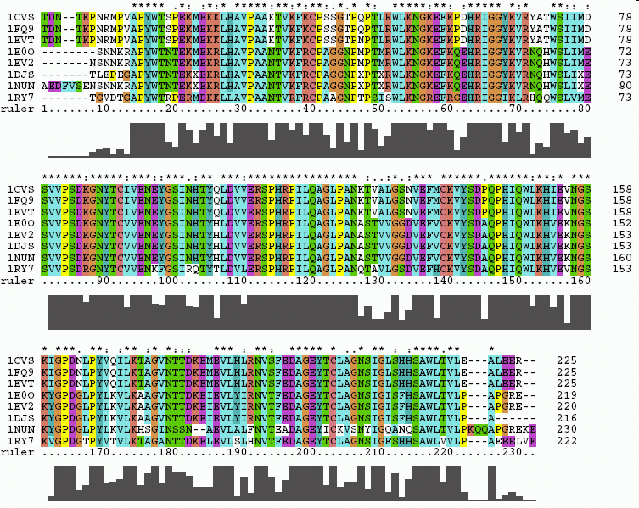
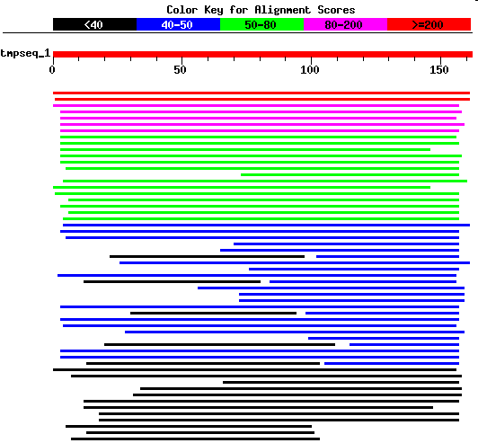
WORKING WITH BIOSEQUENCES
Alignments and similarity search

Slide 3
WORKING WITH BIOSEQUENCES
Alignments and similarity search
Multiple alignments
Clustal Omega
Tcoffee

Slide 4
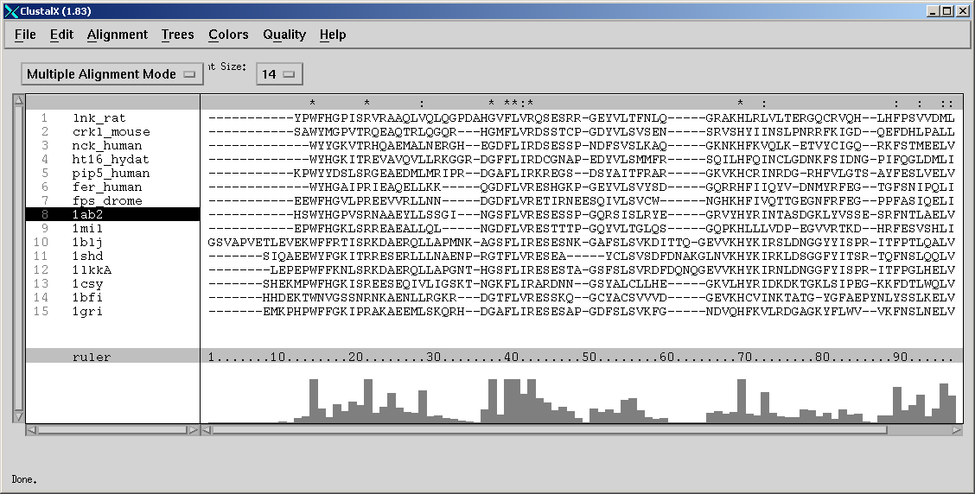
Allineamento multiplo di sequenze: MSA
a representation of a set of sequences, where equivalent residues (e.g. functional, structural) are aligned in columns
Example: part of an alignment of SH2 domains from 14 sequences
lnk_rat
crk1_mouse
nck_human
ht16_hydat
pip5_human
fer_human
1ab2
1mil
1blj
1shd
1lkkA
1csy
1bfi
1gri
* conserved identical residues
: conserved similar residues

Slide 5
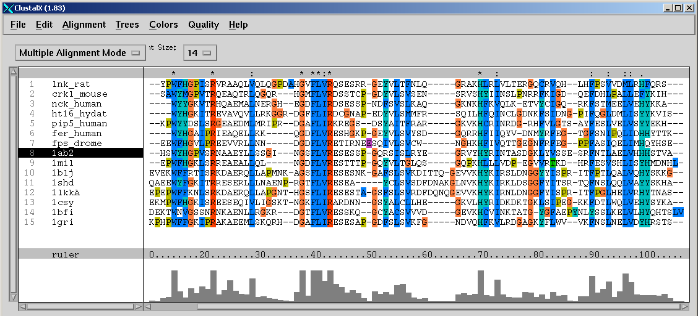
conserved residues
conservation profile
secondary structure

Slide 6
Allineamento multiplo di sequenze
>Hs_jun-B
MCTKMEQPFYHDDSYTATGYGRAPGGLSLHDYKLLKPSLAVNLADPYRSLKAPGARGPGPEGGGGGSYFS
GQGSDTGASLKLASSELERLIVPNSNGVITTTPTPPGQYFYPRGGGSGGGAGGAGGGVTEEQEGFADGFV
KALDDLHKMNHVTPPNVSLGATGGPPAGPGGVYAGPEPPPVYTNLSSYSPASASSGGAGAAVGTGSSYPT
TTISYLPHAPPFAGGHPAQLGLGRGASTFKEEPQTVPEARSRDATPPVSPINMEDQERIKVERKRLRNRL
AATKCRKRKLERIARLEDKVKTLKAENAGLSSTAGLLREQVAQLKQKVMTHVSNGCQLLLGVKGHAF
>Pt
MCTKMEQPFYHDDSYTTTGYGRAPGGLSLHDYKLLKPSLAVNLADPYRSLKAPGARGPGPEGGGGGSYFS
GQGSDTGASLKLASSELERLIVPNSNGVITTTPTPPGQYFYPRGGGSGGGAGGAGGGVTEEQEGFADGFV
KALDDLHKMNHVTPPNVSLGATGGPPAGPGGVYAGPEPPPVYTNLSSYSPASASSGGAGAAVGTGSSYPT
TTISYLPHAPPFAGGHPAQLGLGRGASTFKEEPQTVPEARSRDATPPVSPINMEDQERIKVERKRLRNRL
AATKCRKRKLERIARLEDKVKTLKAENAGLSSTAGLLREQVAQLKQKVMTHVSNGCQLLLGVKGHAF
>Bt
MCTKMEQPFYHDDSYAAAGYGRTPGGLSLHDYKLLKPSLALNLSDPYRNLKAPGARGPGPEGNGGGSYFS
SQGSDTGASLKLASSELERLIVPNSNGVITTTPTPPGQYFYPRGGGSGGGAGGAGGGVTEEQEGFADGFV
KALDDLHKMNHVTPPNVSLGASGGPPAGPGGVYAGPEPPPVYTNLSSYSPASAPSGGAGAAVGTGSSYPT
ATISYLPHAPPFAGGHPAQLGLGRGASAFKEEPQTVPEARSRDATPPVSPINMEDQERIKVERKRLRNRL
AATKCRKRKLERIARLEDKVKTLKAENAGLSSTAGLLREQVAQLKQKVMTHVSNGCQLLLGVKGHAF
>Clf
MCTKMEQPFYHDDSYAAAGYGRAPGGLSLHDYKLLKPSLALNLADPYRSLKAPGARGPGPEGSGGSSYFS
GQGSDTGASLKLASSELERLIVPNSNGVITTTPTPPGQYFYPRGGGSGGGAGGAGGGVTEEQEGFADGFV
KALDDLHKMNHVTPPNVSLGASSGPPAGPGGVYAGPEPPPVYTNLNSYSPASAPSGGAGAAVGTGSSYPT
ATISYLPHAPPFAGGHPAQLGLGRGASTFKEEPQTVPEARSRDATPPVSPINMEDQERIKVERKRLRNRL
AATKCRKRKLERIARLEDKVKTLKAENAGLSSTAGLLREQVAQLKQKVMTHVSNGCQLLLGVKGHAF

Slide 7
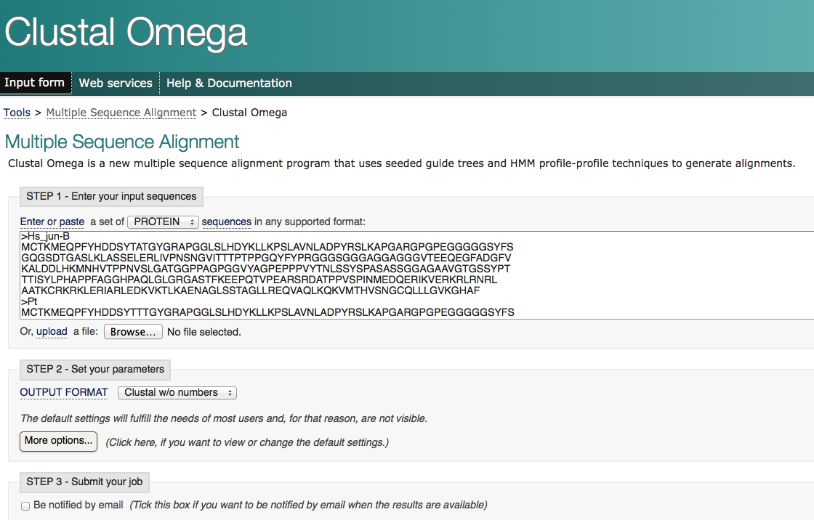
Allineamento multiplo di sequenze
Clustal Omega

Slide 8
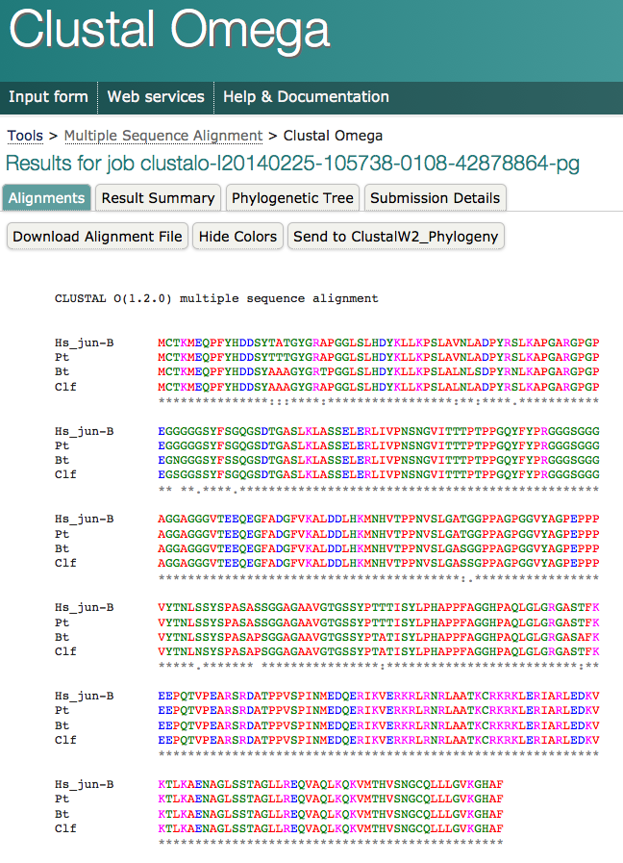

Slide 9
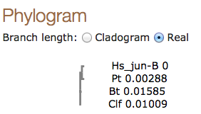
Ricostruzione Albero filogenetico
Motivi di sequenza conservati
…
Predizione della struttura delle proteine

Slide 10
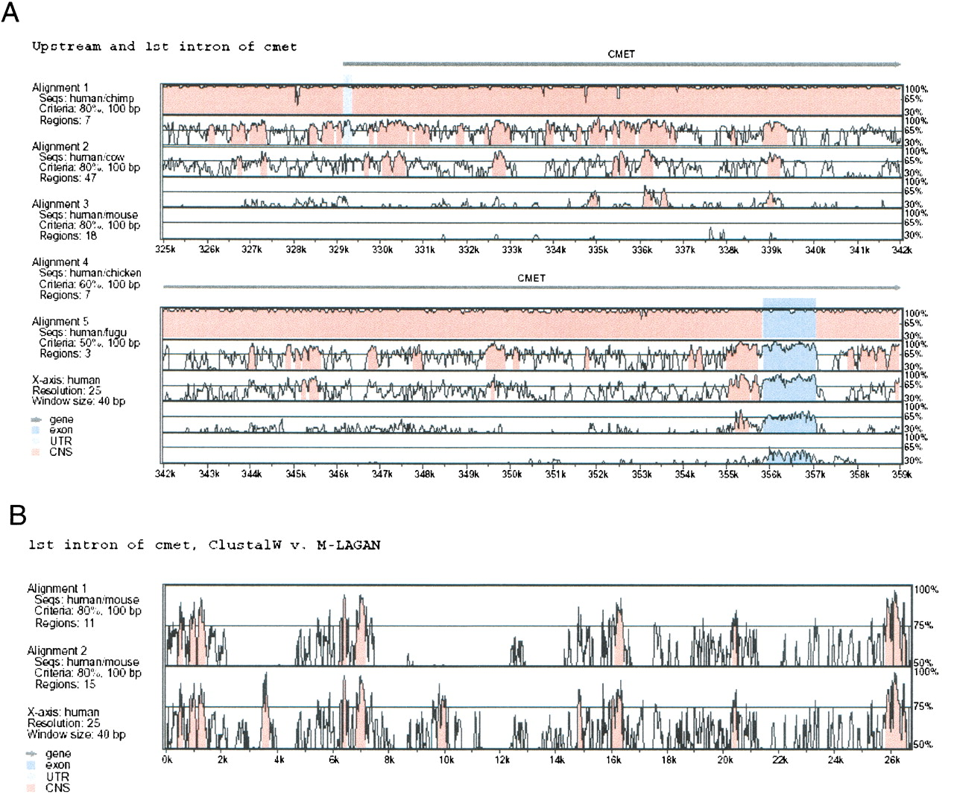
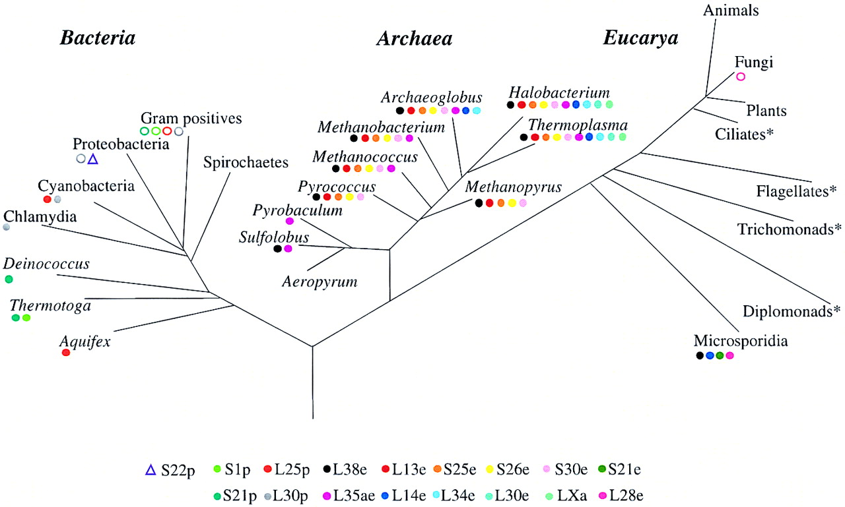
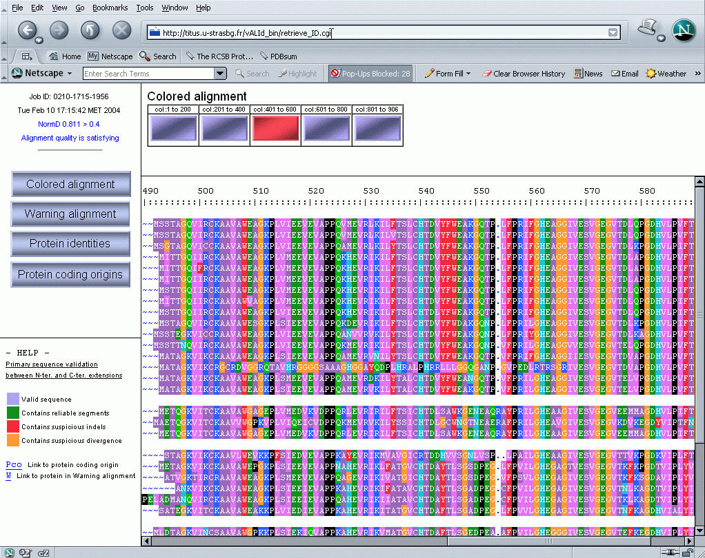
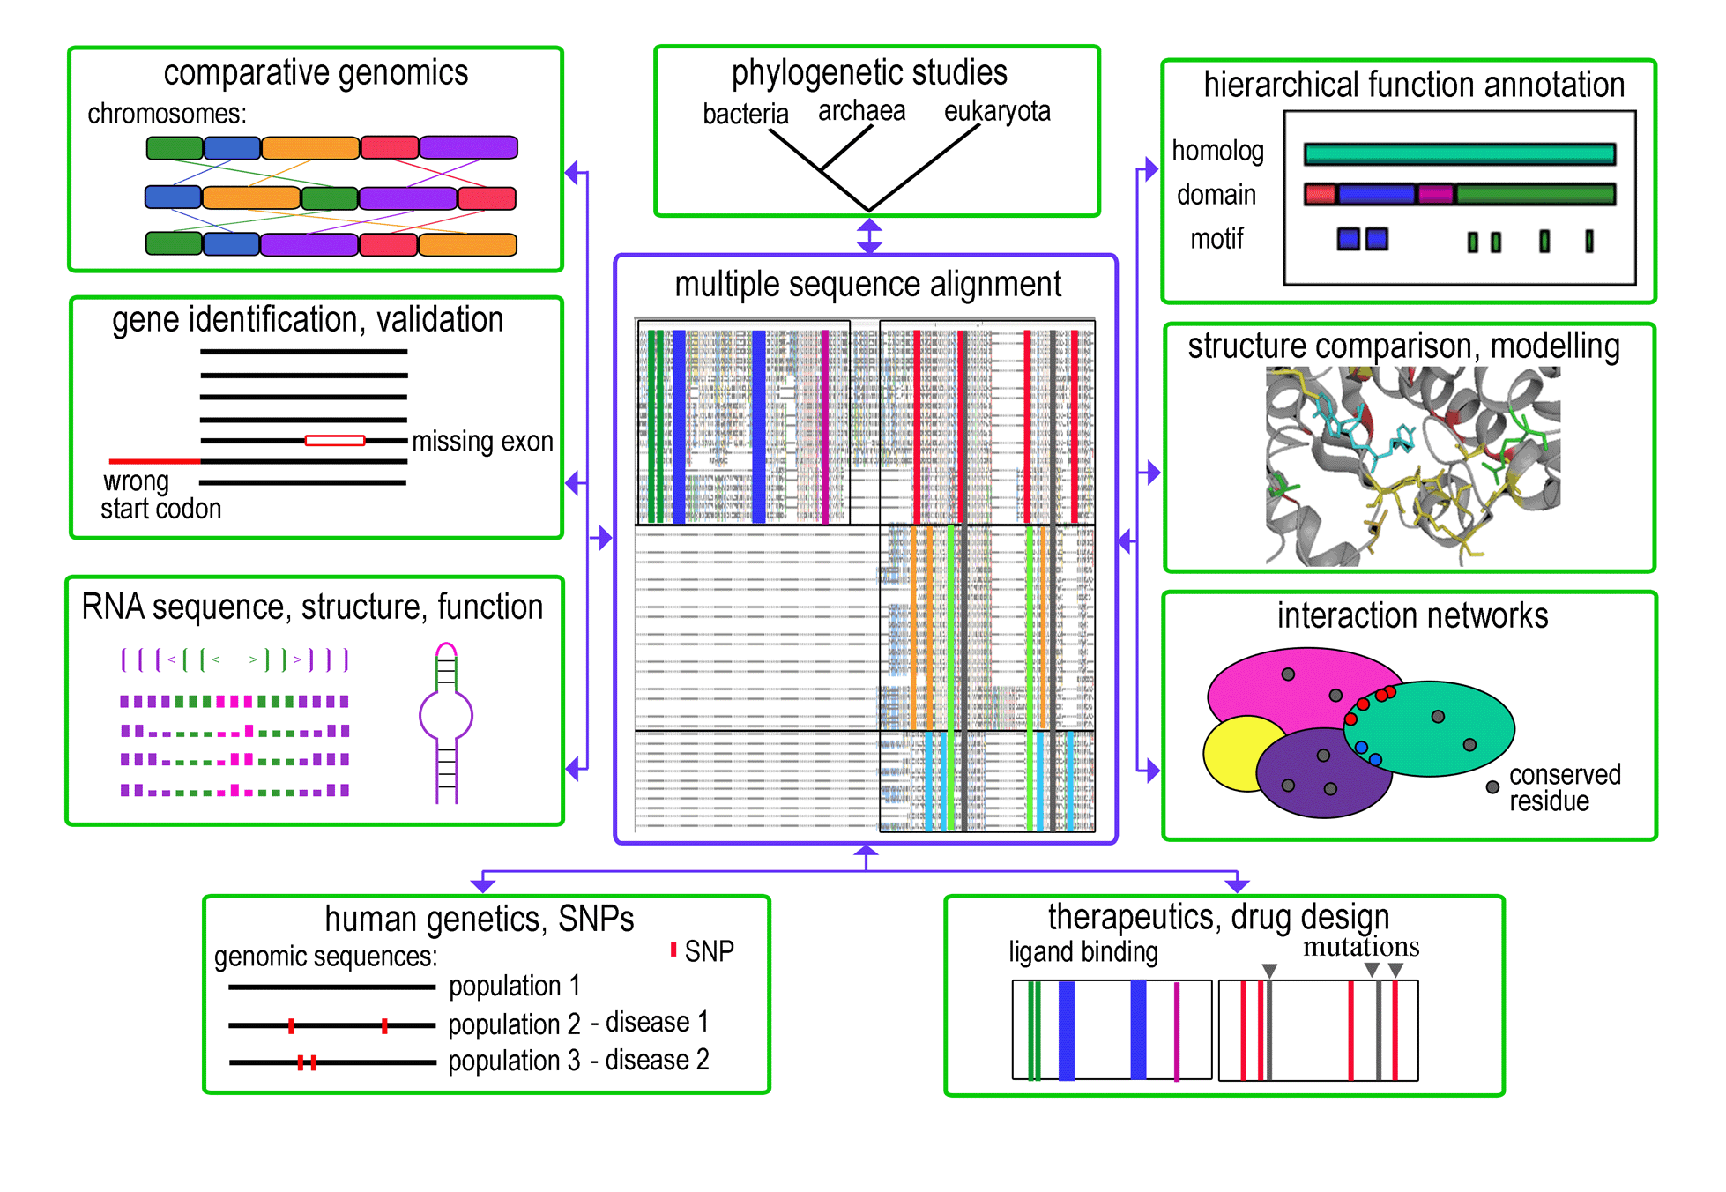
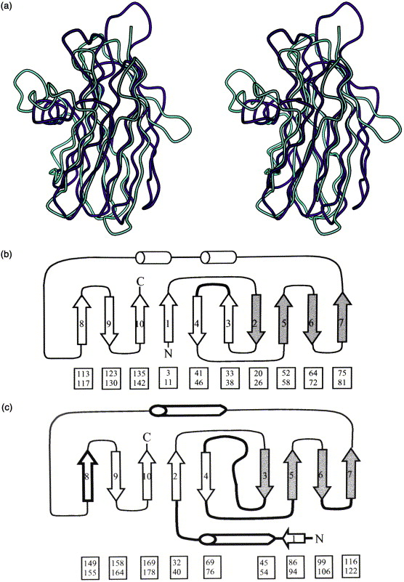
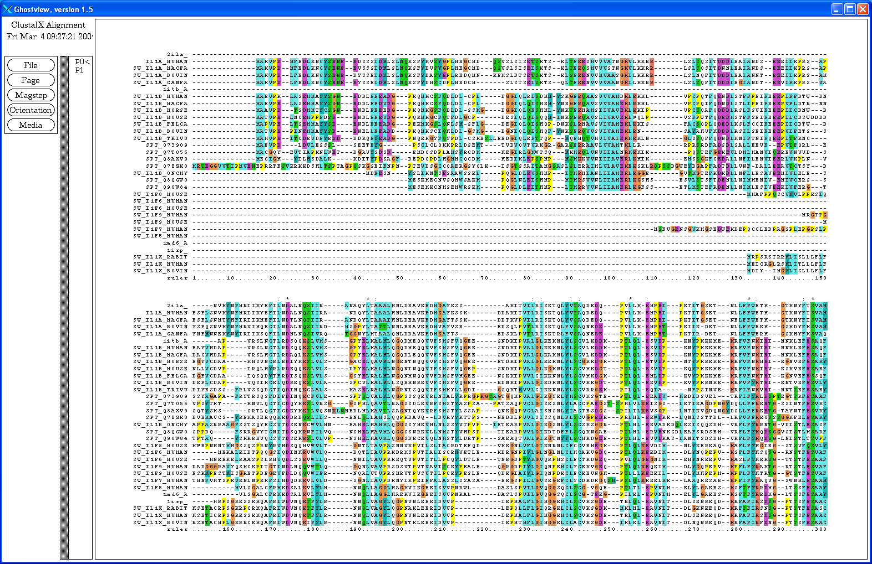
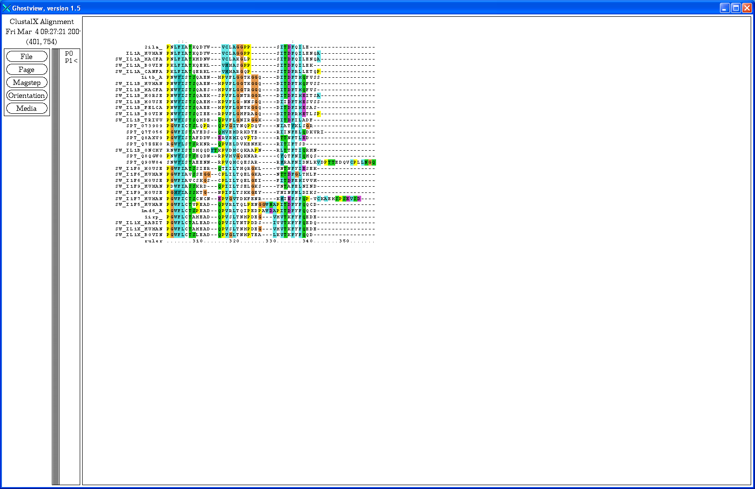
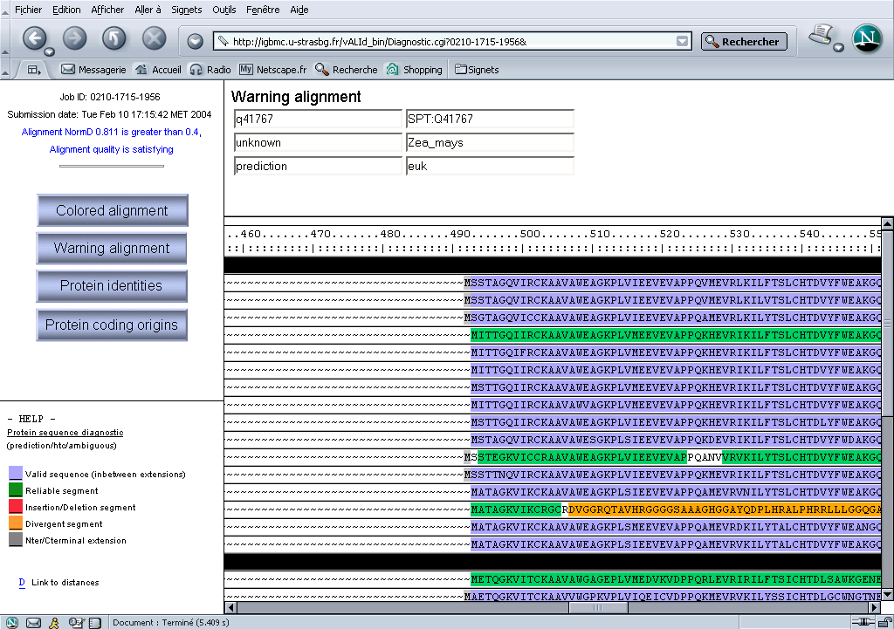
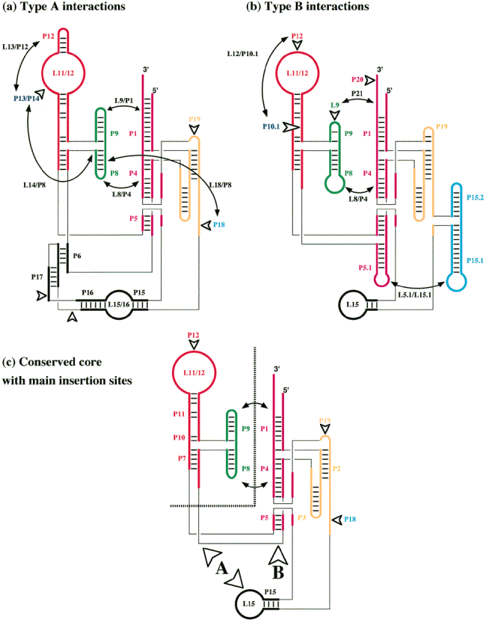
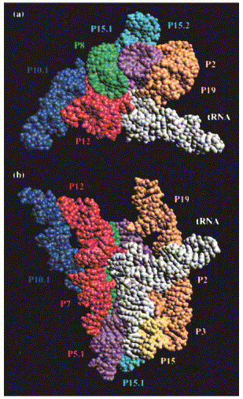
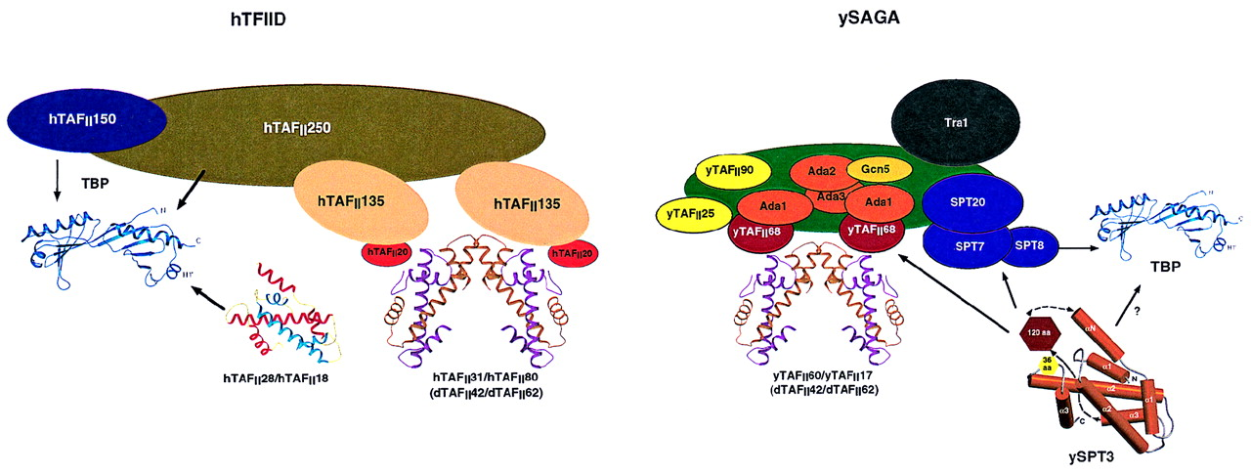
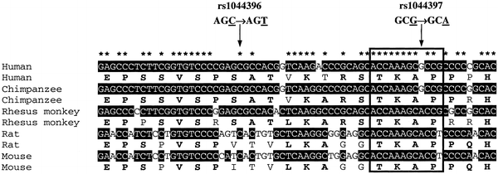
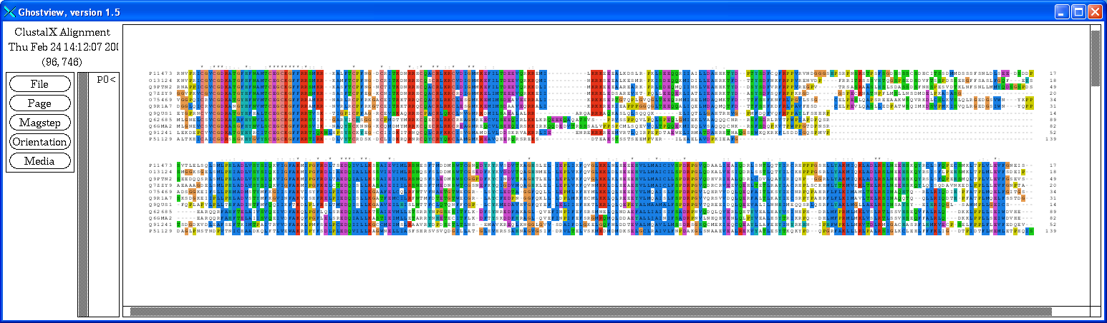
MSA: a central role in biology (and medicine)
Comparative genomics
Phylogenetic studies
Hierarchical function annotation:
homologs, domains, motifs
Gene identification, validation
Multiple alignment
Structure comparison, modelling
RNA sequence, structure, function
Interaction networks
Human genetics, SNPs
Therapeutics, drug design
DBD
insertion domain
Therapeutics, drug discovery
LBD
binding sites / mutations

Slide 11
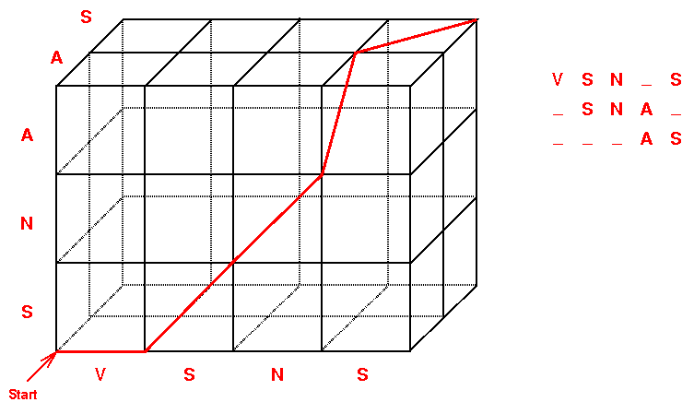
OPTIMAL MULTIPLE ALIGNMENT
Extension of dynamic programming for 2 sequences => N dimensions
Example : alignment of 3 sequences
For 3 seqs. of length N, time is proportional to N³
Problem: calculation time and memory requirements
Time proportional to N^{k} for k sequences of length N

Slide 12
OPTIMAL MULTIPLE ALIGNMENT is computationally demanding both in terms of time and memory requirements
Time proportional to N^{k,} for k sequences, of length N
k=3 N=1000 Time=1*10⁹
k=4 N=1000 Time=1*10¹²
k=5 N=1000 Time=1*10¹⁵
k=3 N=5000 Time=1.25*10¹¹
Exact multiple alignment is feasible only for a handful of short sequences

Slide 13
ALGORITMI PER ALLINEAMENTO MULTIPLO
Algoritmi euristici
Strategia dell’allineamento progressivo (estensione gerarchica dell’allineamento a coppie):
    Comparazione sequenze a coppie con un algoritmo dinamico
    Matrice di distanze
    Costruzione dell’Albero guida
    Allineamenti progressivi in cui, in diverse iterazioni, le sequenze sono aggiunte man mano, seguendo l’ordine dato dall’albero guida

Slide 14
STEPS IN MULTIPLE ALIGNMENT
    Pairwise alignment
    Distance matrix
    Order of alignment
    Progressive multiple
    alignment
local or global method
dynamic programming or heuristic method
xxxxxxxxxxxxxxx
xxxxxxxxxxxxxxx
xxxxxxxxxxxxxxx
xxxxxxxxxxxxxxx
xxxxxxxxxxxxxxx
xxxxxxxxxxxxxxx
xxxxxxxxxxxxxxx
xxxxxxxxxxxxxxx
xxxxxxxxxxxxxxx

Slide 15
STEPS IN MULTIPLE ALIGNMENT
    Pairwise alignment
    Distance matrix
    Order of alignment
    Progressive multiple
    alignment
E.g. in ClustalW/X:
Pairwise distance = 1-
PAIRWISE DISTANCE MATRIX
Many other measures can be used (gaps, Kimura correction for multiple substitutions, …)
No. identical residues
No. aligned residues
Sequence | A | B | C
A | - | 0.2 | 0.3
B |  | - | 0.4
C |  |  | -

Slide 16
STEPS IN MULTIPLE ALIGNMENT
    Pairwise alignment
    Distance matrix
    Order of alignment
    Progressive multiple
    alignment
Progressive alignment using sequential branching
Hba_human
1
Hba_horse
2
Hbb_horse
3
Hbb_human
4
Glb5_petma
5
Myg_phyca
6
Lgb2_lupla
Progressive alignment following a guide tree
.081
Hbb_human
.226
2
.061
.084
Hbb_horse
3
F.i. Guide tree constructed from distance matrix using Neighbour Joining method for clustering
.055
Hba_human
.015
4
.219
1
.065
Hba_horse
.062
5
.398
Myg_phyca
6
.389
Glb5_petma
.442
Lgb2_lupla

Slide 17
STEPS IN MULTIPLE ALIGNMENT
    Pairwise alignment
    Distance matrix
    Order of alignment
    Progressive multiple
    alignment
xxxxxxxxxxxxxxx
xxxxxxxxxxxxxxx
xxxxxxxxxxxxxxx
xxxxxxxxxxxxxxx
xxxxxxxxxxxxxxx
xxxxxxxxxxxxxxx
xxxxxxxxxxxxxxx
xxxxxxxxxxxxxxx

Slide 18
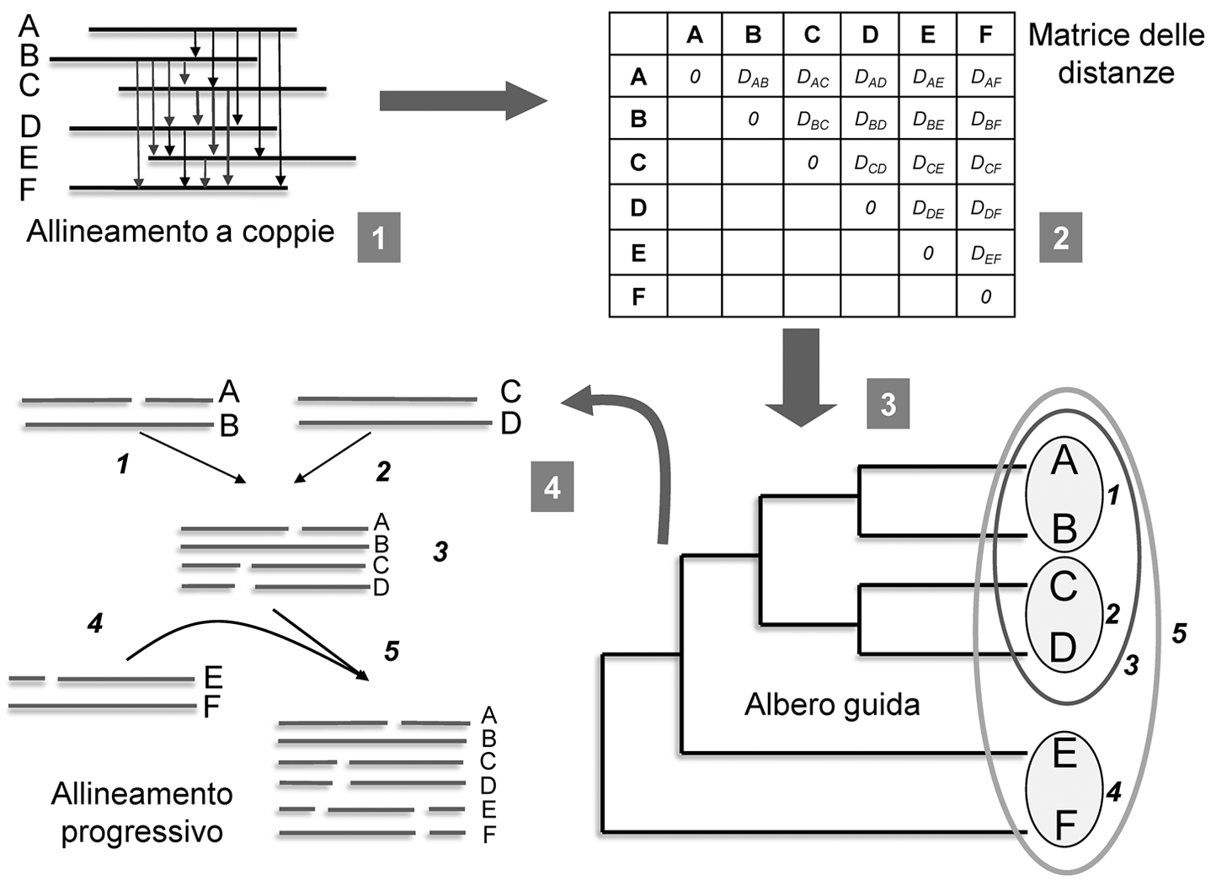
UN ALGORITMO CLASSICO: ClustalW
    Comparazione a coppie con un algoritmo dinamico
    Matrice di distanze
    Costruzione dell’Albero guida con metodo Neighbour-Joining
    Allineamenti progressivi in cui, in diverse iterazioni, le sequenze sono aggiunte una dopo l’altra, seguendo l’ordine dato dall’albero guida

Slide 19
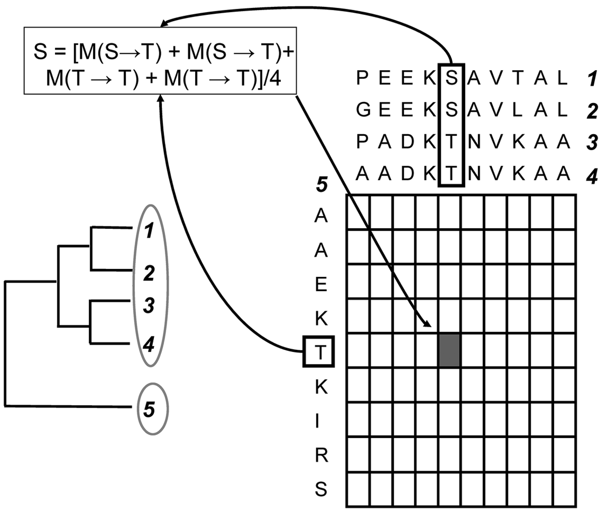
    L’inizializzazione della matrice di punteggio, durante la fase di costruzione progressiva dell’allineamento multiplo, prevede che per ogni casella sia inizializzato come score (S) il valore medio ottenuto dalla comparazione delle diverse sequenze usando una certa matrice di scoring
M (score a coppie) dipende dalla matrice di scoring scelta (PAM250, …)
1,2,3,4 già allineate
Inizializziamo la matrice per allineare 5

Slide 20
UN ALGORITMO CLASSICO: ClustalW
LIMITI
    Progressività: una volta che un allineamento è stato completato viene congelato
    Non è possibile correggere errori a posteriori (problema del “minimo locale”)
    Allineamenti meno accurati all’aumentare della divergenza
    → Accorgimenti per migliorare l’accuratezza

Slide 21
      ACCORGIMENTI PER MIGLIORARE L’ACCURATEZZA
      Le sequenze più simili possono contenere meno informazione
      L’allineamento tra sequenze simili può influenzare l’allineamento finale
      Le sequenze più divergenti sono difficili da allineare
    Pesatura delle sequenze in modo proporzionale dalla distanza dalla radice dell’albero guida
    Inserimento di pesi nel calcolo della matrice dinamica

Slide 22
      ACCORGIMENTI PER MIGLIORARE L’ACCURATEZZA
    Il corretto posizionamento delle indel è critico
    Improbabile avere molte indel vicine
    Sequenze di lunghezza molto diversa?
    Correzione della funzione di penalizzazione delle indel
    Penalizzazione variabile in base a:
    Divergenza (+ divergenti, peso -)
    Lunghezza seq. più corta (+ lunga, peso + ad es. con Log)
    Differenza lunghezza sequenze (+differenza, peso -)
    Similarità molto diversa tra le diverse seq da allineare?
    Variazione della matrice di punteggio
    Le varie fasi dell’allinemento progressivo possono usare matrici divese per l’inizializzazione

Slide 23
Clustal Omega
    Uses a modified version of mBed (complexity of O(N log N) ) to produce guide trees that are just as accurate as those from conventional methods.
    mBed works by ‘emBedding' each sequence in a space of n dimensions where n is proportional to log N.
    Each sequence is then replaced by an n element vector, where each element is simply the distance to one of n ‘reference sequences.'
    These vectors can then be clustered extremely quickly by standard methods such as K-means or UPGMA.
    Alignments are then computed using the very accurate HHalign package which aligns two profile hidden Markov model
    Additional features for adding sequences to existing alignments or for using existing alignments to help align new sequences.
    Users can specify a profile HMM that is derived from an alignment of sequences that are homologous to the input set.

Slide 24
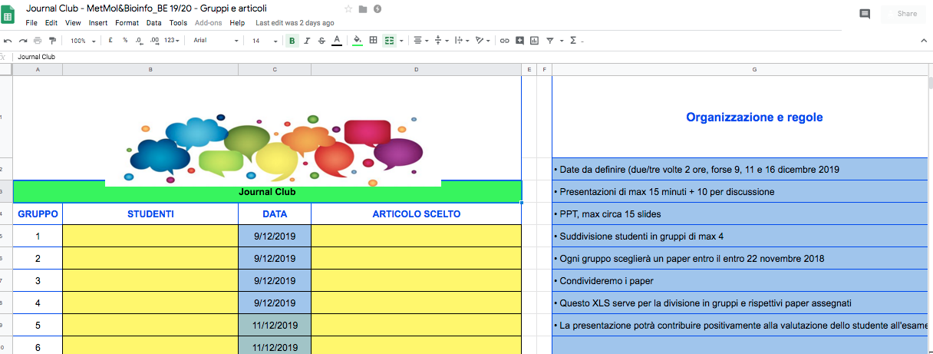

Slide 25
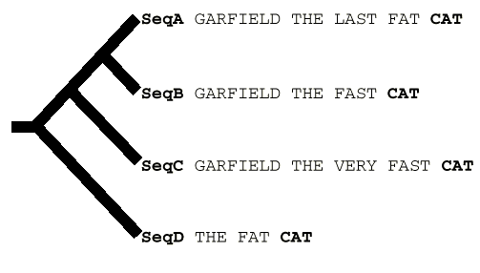
Progressive Alignment Principle and its Limitations…
The tree indicates the order in which the sequences are aligned when using a progressive method such as ClustalW.
The resulting alignment is shown, with the word CAT misaligned.
CLUSTALW (Score=20, Gop=-1, Gep=0, M=1)
SeqA GARFIELD THE LAST FA-T CAT
SeqB GARFIELD THE FAST CA-T ---
SeqC GARFIELD THE VERY FAST CAT
SeqD -------- THE ---- FA-T CAT
CORRECT (Score=24)
SeqA GARFIELD THE LAST FA-T CAT
SeqB GARFIELD THE FAST ---- CAT
SeqC GARFIELD THE VERY FAST CAT
SeqD -------- THE ---- FA-T CAT
Notes:
The library extension. (a) Progressive alignment. Four sequences have been designed. The tree indicates the order in which the sequences are aligned when using a progressive method such as ClustalW. The resulting alignment is shown, with the word CAT misaligned. (b)

Slide 26
GARFIELD THE LAST FAT CAT
GARFIELD THE LAST FAT CAT
GARFIELD THE FAST CAT ---
GARFIELD THE FAST CAT
GARFIELD THE LAST FA-T CAT
GARFIELD THE FAST CA-T ---
GARFIELD THE VERY FAST CAT
-------- THE ---- FA-T CAT
GARFIELD THE VERY FAST CAT
GARFIELD THE VERY FAST CAT
-------- THE ---- FA-T CAT
THE FAT CAT

Slide 27
PRINCIPIO DELLA COERENZA
Programmi cooperativi come T-coffee (Tree-based Consistency Objective Function For alignmEnt Evaluation)
Si cerca di utilizzare l’informazione sull’allineamento sin dai primi stadi dell’algoritmo
Consistency (Coerenza):
Se abbiamo A, B e C, e allineiamo A con B, e B con C, implicitamente risulta definito l’all. di A con C.
Ma questo può risultare diverso (incoerente) da quello ottenibile allineando A con C direttamente
Si cerca quindi un allineamento che massimizzi la consistenza tra tutti gli allineamenti a coppie contenuti nell’allineamento multiplo e quelli ottenuti direttamente

Slide 28
T-coffee
Libreria primaria: allineamenti a coppie tra tutte le N seq da allineare (N(N-1)/2), ottenuti sia con algoritmi globali (Clustal) e locali (FASTA; top 10 non intersecting local align.)
Gli allineamenti sono rappresentati nella libreria come pairwise residue matches (residuo x della seq A allineato con residuo y della seq B)
usati poi come vincoli
Questi vincoli sono pesati in base all’affidabilità degli allineamenti da cui provengono, ovvero alla bontà dell’allineamento in termini di identità
A X
|
B Y
A X
| 80
B Y
A X
| 90
C Y

Slide 29
T-coffee
Estensione della libreria:
Le librerie primarie potrebbero essere usate così come sono per generare gli allineamenti
Vengono migliorate prendendo in considerazione l’informazione disponibile nella libreria primaria in maniera globale, mediante un algoritmo euristico:
Approccio basato su triplette: per ogni coppia di residui si prende in considerazione l’allineamento di questi con residui delle rimanenti sequenze

Slide 30
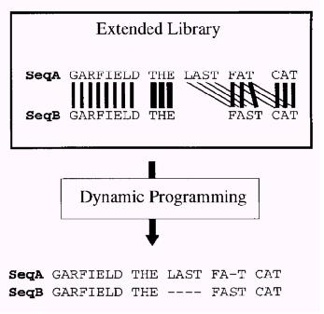
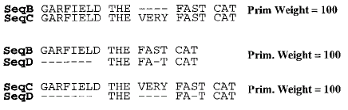
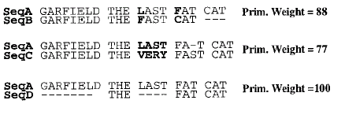
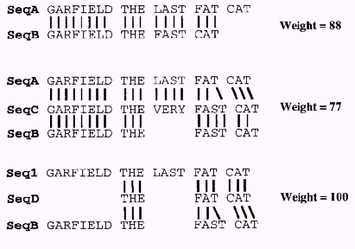
The Extended Library Principle…
Weighting. Each pair of aligned residues is associated with a weight = average identity among matched residues within the complete alignment (mismatches in bold) → Primary library
2. Library extension, Using Information from Other Sequences. Three possible alignments of sequence A and B (A and B, A and B through C, A and B through D) are combined to produce the position-specific library
3. The position-specific library is resolved by dynamic programming to give the correct alignment. The thickness of the lines indicates the strength of the weight.
Notes:
Primary library. Each pair of sequences is aligned using ClustalW. In these alignments, each pair of aligned residues is associated with a weight equal to the average identity among matched residues within the complete alignment (mismatches are indicated in bold type). (c) Library extension for a pair of sequences. The three possible alignments of sequence A and B are shown (A and B, A and B through C, A and B through D). These alignments are combined, as explained in the text, to produce the position-specific library. This library is resolved by dynamic programming to give the correct alignment. The thickness of the lines indicates the strength of the weight.
GG match of A and B W 88
GGG match using C seq has w 77 since it is the minimum among align AC CB
Poi gnli score pe rle coppie sono usati al posto delle matrici di punteggio per ottenere

Slide 31

Primary Library
In the direct alignment of A and B,
A(G) and B(G) are matched.
Therefore, the initial weight for that pair of residues can be set to 88 (primary weight of the alignment of sequence A and B, which is the percent of identity of this pair).

Slide 32
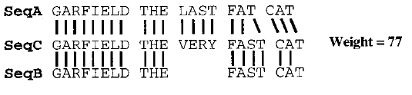
Library extension
If we now look at the alignment of sequence A and sequence B through sequence C, we can see that the A(G) and C(G) are aligned, as well as C(G) and B(G).
There is an alignment of A(G) with B(G) through sequence C. We associate that alignment with a weight equal to the minimum of :
W1 = W(A(G), C(G))
W2 = W(C(G), B(G))
Since W1 = 77 and W2 = 100, the resulting weight is set to 77.
In the extended library, this new value is added to the previous one to give a total weight of 165 (i.e. 77 + 88) for the pair A(G), B(G).

Slide 33
Library extension
The complete extension will require an examination of all the remaining triplets.
What about A(F) and B(C)?
F with C alignment not supported by triplets: no gain over 88 in the library extension phase

Slide 34
Extended Library
Obtained scores (instead of scores from standard matrices as BLOSUM) can then be used to align any two sequences from our data set using conventional dynamic programming.
Set of scores that are specific to every possible pair of residues in our two sequences.
This will allow an alignment to be carried out that will account for the particular residues in the two sequences but will also be guided towards consistency with all of the other sequences in the data set.

Slide 35
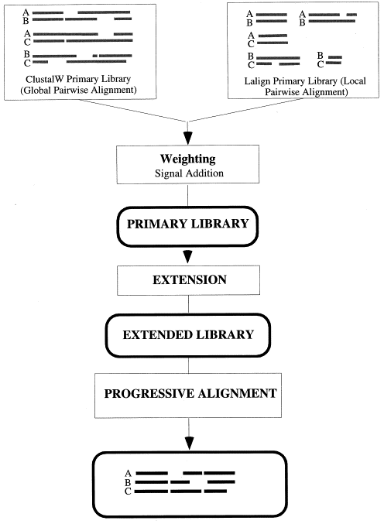
Figure 1
from Notredame et al 2000
Layout of the T-Coffee strategy; the main steps required to compute a multiple sequence alignment using the T-Coffee method.
Square blocks designate procedures. Rounded blocks indicate data structures.
Guide tree by NJ based on extended library
Alla fine, l’allineamento viene ottenuto con un metodo progressivo, però si basa su un’informazione più ricca, derivata dagli allineamenti a coppie ma anche dal principio di consistenza che tiene contro anche di tutte le altre sequenze del dataset.

Slide 36
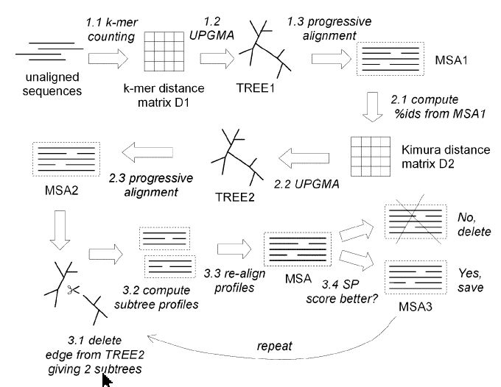
MUSCLE
Edgar (2004) NAR 32, 1792-1797
MUSCLE can align hundreds of sequences in seconds

Slide 37
Ho ottenuto un buon allineamento?
Come valutare un allineamento multiplo?
Are the sequences correctly aligned?
  Quality analysis: alignment objective functions:
    Sum-of-pairs (Carrillo, Lipman, 1988) (Sum of scores for all pairs of sequences)
    Reference Sum-of-pairs (uses gold standard alignments as reference)
    Information content (Hertz et al, 1999) (Entropy column scores (between 0 and 1), sum for all columns in the alignment)
    norMD (Thompson et al, 2001) Column scores + normalisation for sequence set to be aligned (number, length, similarity)
  Error detection and correction (RASCAL (Thompson et al, 2003), Refiner (Chakrabati et al, 2006)
Notes:
Foreachpairofsequencesinthemul-
tiple alignment a score is calculated based on the
percent identity or the similarity between the
sequences. The score for the multiple alignment is
then taken to be the sum of all the pairwise scores.
Col-umn statistics. One approach uses a standard log-
likelihood ratio statistic, assuming that the most
interesting alignments are those where the frequen-
cies of the residues found in each column are sig-
niÆcantly different from a predeÆned set of
a priori
residueprobabilities.Hertz&Stormo
20 Developed a normalized log-likelihood ratio called infor-
mation content (IC) and used the count of the
number of possible alignments to determine the
statistical signiÆcance of an alignment.
norMD, a new OF for multiple
sequence alignments based on the Mean Distance
(MD) scores introduced in ClustalX. A score for
each column in the alignment is calculated using
the concept of continuous sequence space intro-
ducedbyVingronandSibbald
22
andthecolumn
scores are then summed over the full length of the
alignment. The norMD scores also take into
account
ab initio
sequence information, such as the
number and length of the sequences in the align-
ment set, and the potential sequence similarity.
Thus, the signiÆcance of the alignment can be esti-
mated
and
alignments
of
different
sets
of
sequences can be directly compared.

Slide 38
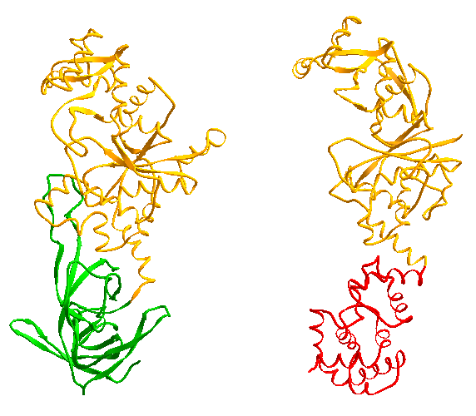
  Quality analysis: alignment objective functions:
norMD (Thompson et al, 2001)
Known three-dimensional structures
Secondary structure elements of the structures
1exd
1gln
two class I tRNA synthetases
1exd
‘HIGH’
H8
‘KMSKS’
Archeal/
Eukaryotic
GluRS
+
GlnRS
Bacterial
GluRS
1gln
1.0
0.5
Window length = 40
N-terminal
conserved Rossman fold domain
Window length = 8
conserved motifs HIGH and KMSKS
Subclass domains
Notes:
Figure 4. (a) Three-dimensional structures of two class I tRNA synthetases: a glutamyl-(GlnRS) synthetase, PDB code 1EXD and a glutaminyl-(GluRS) synthetase, PDB code 1GLN. (b) A multiple sequence alignment of 64 glutamyl- and glutaminyl-tRNA synthetases. Secondary structure elements of the structures 1EXD and 1GLN are shown above and below the alignment (red boxes, alpha helix; green arrows, beta sheet). All of the proteins share a conserved Rossman fold domain in the N-terminal part of the protein (shown in orange in the alignment and in the two structures). Two conserved motifs; HIGH and KMSKS, are shown in black boxes. The C-terminal region contains two sub-class-specific domains; a beta-barrel structure common to the archeal and eukaryotic GluRS and all GlnRS (shown in green) and an alpha-helix cage unique to the bacterial GluRS (shown in red). The norMD sliding window scores are plotted below the multiple alignment. The red plot corresponds to a window length of 8, and the black plot corresponds to a window length of 40.
Regions in an alignment that score less than the cutoff of 0.5 may be assumed to be unreliable. This may be because the sequences have been badly aligned or it may be because some of the sequences are not in fact related over their entire lengths.

Slide 39
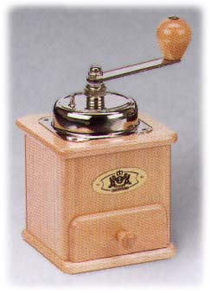
Combining Many MSAs into ONE
Un approccio di valutazione basato sulla concordanza: meta-methods (jury-based methods)
Combine the output of several alternative methods into one final output
Grounds on the empirical reasoning that errors produced by independent prediction systems should not be consistent
Thus, agreement can be an indication of correctness
ClustalW
MAFFT
T-Coffee
MUSCLE
???????

Slide 40
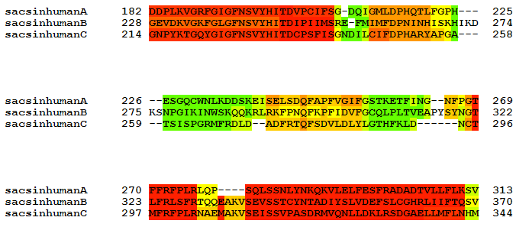
WHERE TO TRUST YOUR ALIGNMENTS
Most Methods Disagree
Most Methods Agree

Slide 41
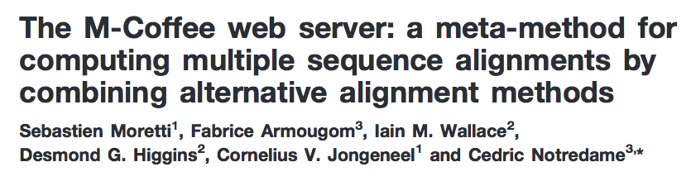
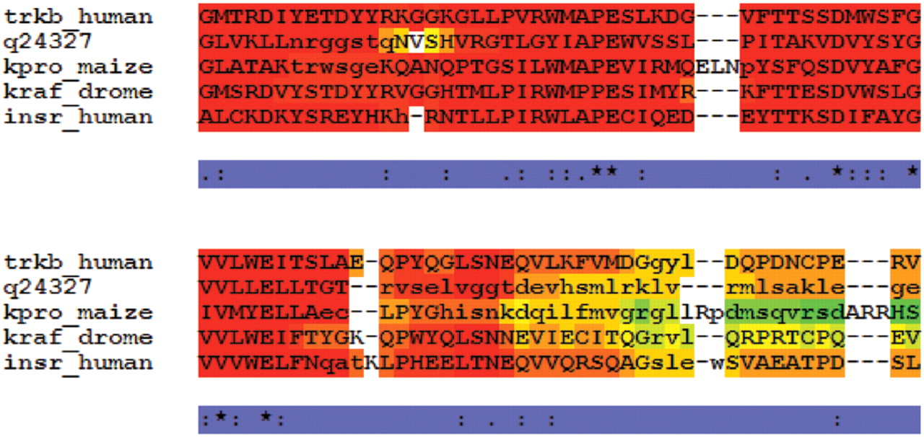
Notes:
Typical colored output. This output was obtained by using the kinase1_ref5 from BaliBase. Correctly aligned residues (as judged from the reference) are in upper case, non-correct ones are in lower case. In this colored output, each residue has a color that indicates the agreement of the individual MSAs with respect to the alignment of that specific residue. Dark red indicates residues aligned in a similar fashion among all the individual MSAs; blue indicates a very low agreement. Dark yellow, orange and red residues can be considered to be reliably aligned.

Slide 42
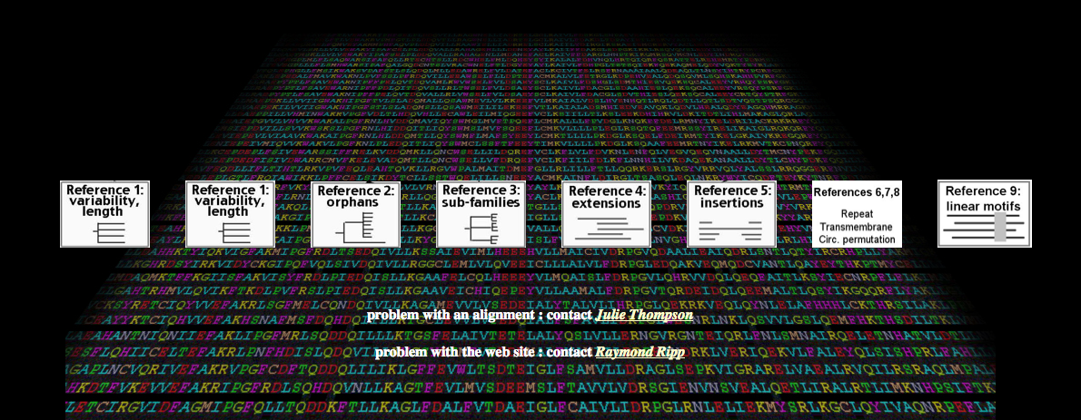
Benchmark alignment databases
BAliBASE 3.0 (Thompson et al. 2005)
collection of 141 reference protein alignments
high quality, manually refined, reference alignments based on 3D structural superpositions
five reference sets useful as test for different situations
Ref1 : equi-distant sequences of similar length
Ref2 : families of closely related sequences
Ref3 : equi-distant divergent families
Ref4 : sequences with large N/C - terminal extensions
Ref5 : sequences with large internal insertions
…

Slide 43
  Testing new methods - Improving methods
  Key words for bioinformatics:
Critical Assessment
Comparative evaluation
Benchmarking data
Software availability

Slide 44
  Testing new methods - Improving methods
  Competitions
Release of data to be predicted (true solution known but hidden to predictors)
Predictions
Evaluation
Comparison of prediction and predictors
Improvement of methods

Slide 45
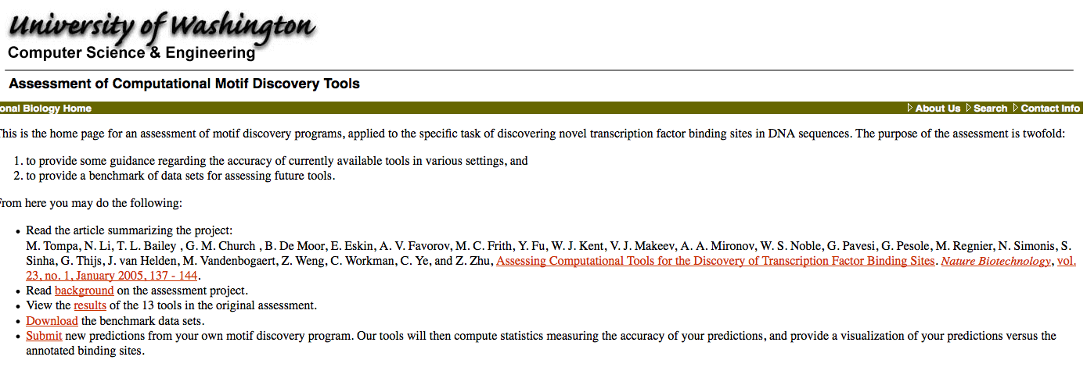
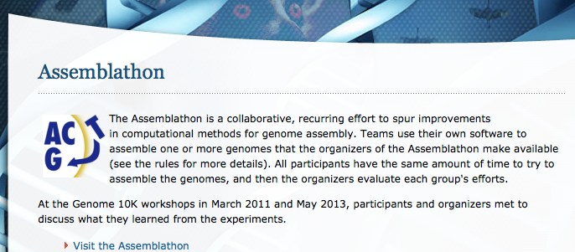

Slide 46
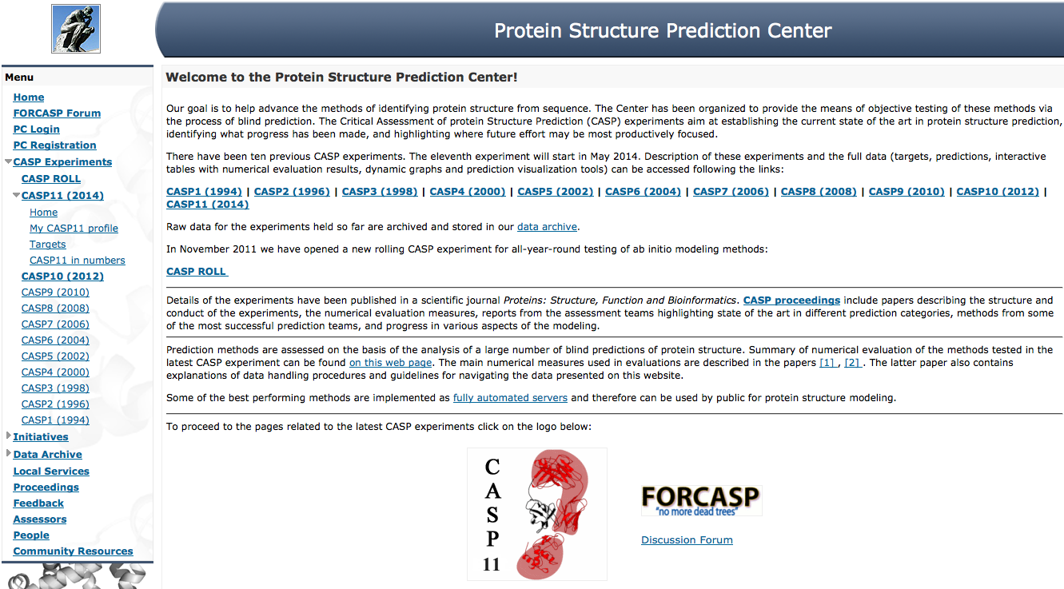
  Critical Assessment of Techniques for Protein Structure Prediction (CASP)
  Biennial competition in protein structure prediction
  “world cup” of protein structure prediction

