Slide 1
  A.A. 2021-2022
  CORSO DI METODI MOLECOLARI E BIOINFORMATICA per il CLM in BIOLOGIA EVOLUZIONISTICA
  Scuola di Scienze, Università di Padova
Prof. STEFANIA BORTOLUZZI

Slide 2
Database primari e secondari
Database di biosequenze
Dati strutturali

Slide 3
Primary Databases:
Databases consisting of data derived experimentally
such as nucleotide sequences and three dimensional structures are known as primary databases.
Secondary Databases:
Those data that are derived from the analysis, treatment or integration of primary data
such as secondary structures, hydrophobicity plots, and domain are stored in secondary databases.

Slide 4
DATABASE PRIMARI
DATABASE DI SEQUENZE NUCLEOTIDICHE
Collezioni di singoli record, ognuno dei quali contiene un tratto di DNA o RNA con delle annotazioni. Ogni record viene anche chiamato ENTRY, e ha un codice che lo identifica univocamente (ACCESSION NUMBER).
Banche dati primarie di sequenze nucleotidiche
EMBL nucleotide database, ora gestita dall’EBI (1980)
    EMBL = European Molecular Biology Laboratory (Heidelberg)
    EBI = European Bioinformatics Institute (Hinxton, UK)
GenBank = banca dell NIH gestita dal NCBI (1982)
    NIH = National Institutes of Health (Stuttura USA)
    NCBI = National Center for Biotechnology Information, Bethesda, Maryland
DDBJ = banca DNA giapponese (1986)
    DDBJ = DNA DataBase of Japan

Slide 5
SCAMBIO DI DATI: International Collaboration of DNA Sequence Databases (1988) → formato comune →scambio giornalmiero di sequenze.
SUBMISSION DIRETTA → La gran parte delle sequenze finisce in uno dei tre database perché l’autore (il laboratorio dove tale sequenza è stata ottenuta) la invia direttamente. La sequenza viene quindi inserita e il record corrispondente resta di proprietà solo di quel database, l’unico con il diritto di modificarlo. Il database che riceve la sequenza la invia poi agli altri due.
ANNOTAZIONE → Ci sono poi anche degli “annotatori” che prendono le sequenze dalle riviste scientifiche e le trasferiscono nel database.
→→→ Problema della ridondanza

Slide 6
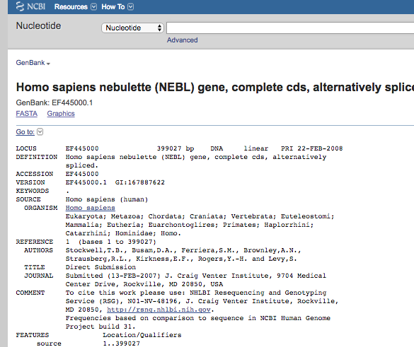
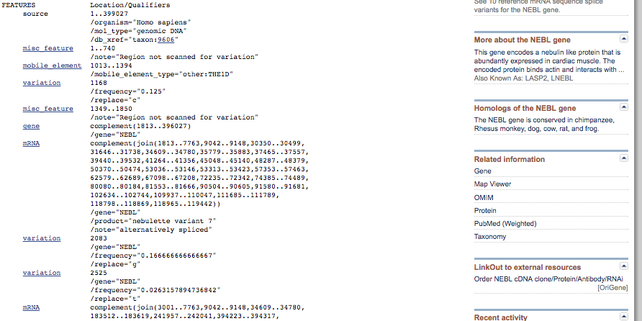

Slide 7
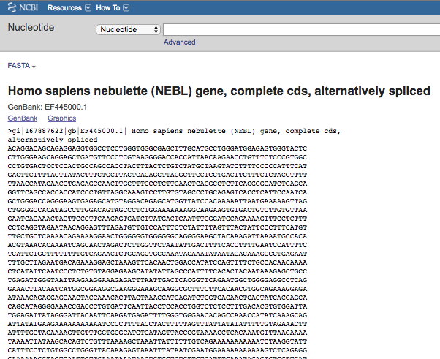

Slide 8
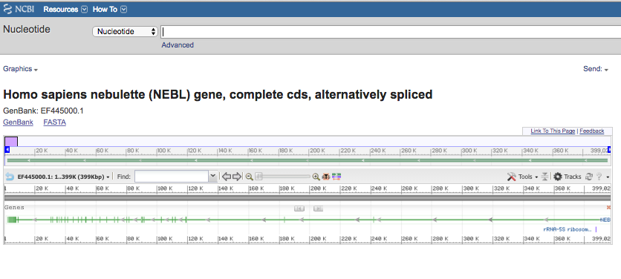

Slide 9
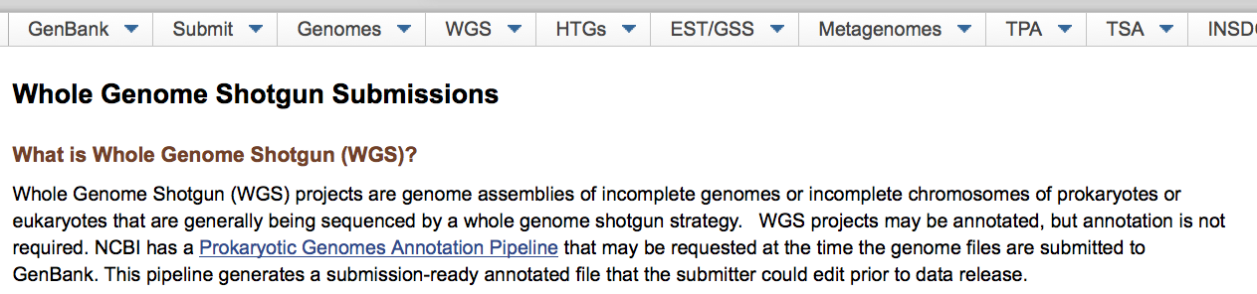
Un po’ di storia …
2002 → fondato WGS (Whole Genome Shotgun)

Slide 10
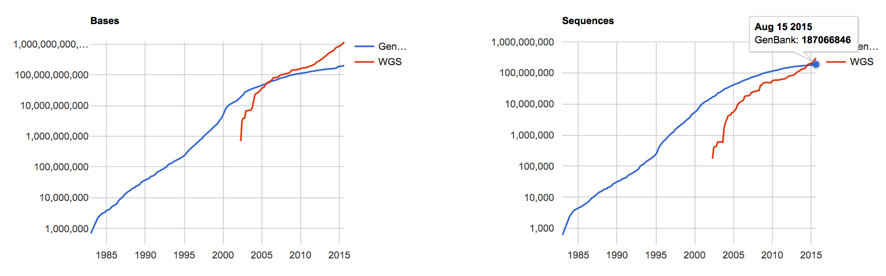
DATABASE DI SEQUENZE NUCLEOTIDICHE – GenBank
GENBANK AND WGS STATISTICS
GenBank WGS
Bases Sequences Bases Sequence
1, Dec 1982 680338 606
…
…
209, Aug 2015 199823644287 187066846 1163275601001 302955543

Slide 11
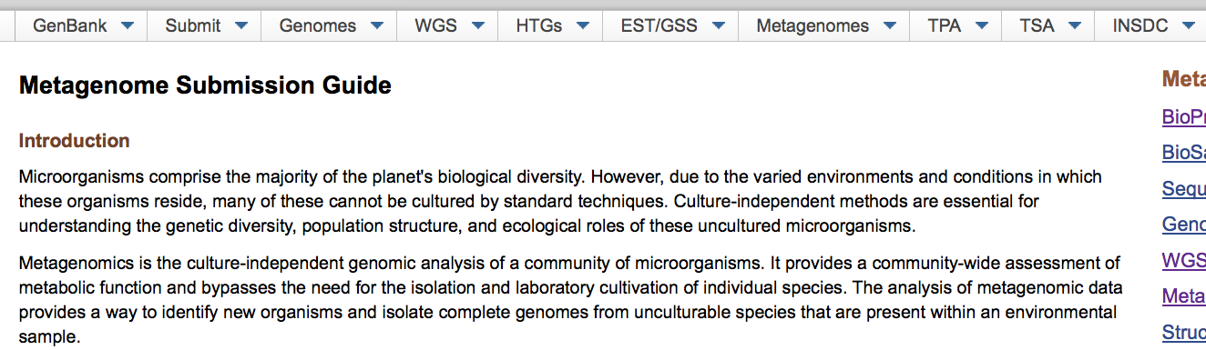
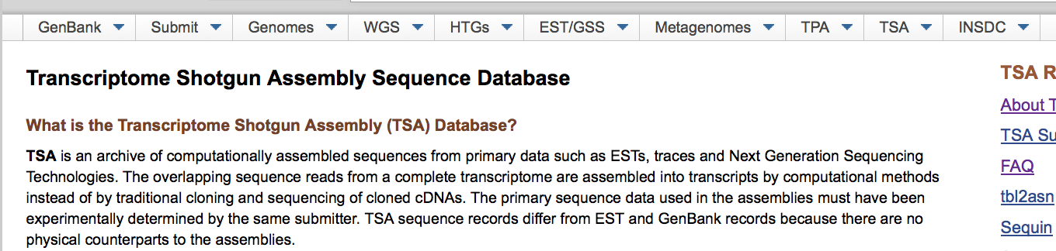
Metagenome
TSA

Slide 12
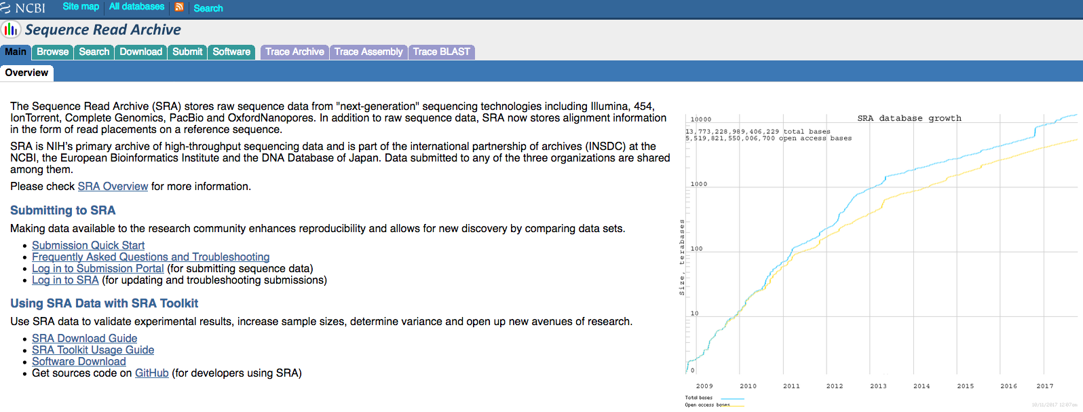
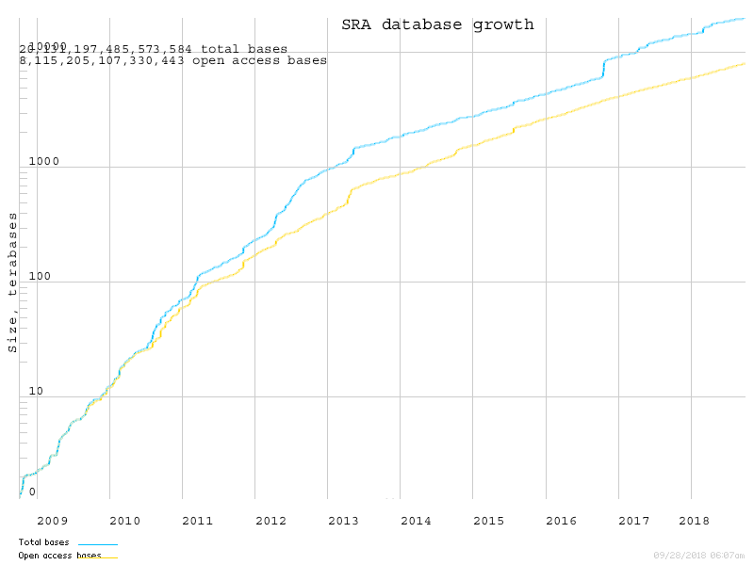
The Sequence Read Archive (SRA) stores raw sequence data from "next-generation" sequencing technologies
Illumina, 454, IonTorrent, Complete Genomics, PacBio and OxfordNanopores.
In addition to raw sequence data, SRA now stores read alignment a reference sequence.
International partnership of archives (INSDC) at the NCBI, the EBI and the DDBJ.

Slide 13
DATABASE PRIMARI
DATABASE DI SEQUENZE PROTEICHE
SWISS-PROT
Database di sequenze proteiche annotate, “scarsamente” ridondanti e cross-referenced
Contiene:
SWISS-PROT
TrEMBL, supplemento a SWISS-PROT costituito dalle sequenze annotate al computer, come traduzione di tutte le sequenze codificanti presenti all’EMBL
TrEMBL contiene due sezioni:
  SP-TrEMBL, sequenze da incorporare in SWISSPROT, con AC.
  REM-TrEMBL, remaining (immunoglobuline, proteine sintetiche, ...), senza AC.
  Oggi parte di Universal Protein Knowledgebase (UniProt)

Slide 14
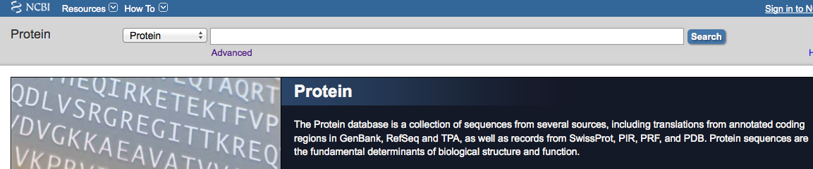
LOCUS AIL58882 140 aa linear BCT 29-AUG-2014
DEFINITION crystallin [Staphylococcus aureus].
ACCESSION AIL58882
VERSION AIL58882.1 GI:675303284
DBLINK BioProject: PRJNA240091
DBSOURCE accession CP007499.1
KEYWORDS .
SOURCE Staphylococcus aureus
ORGANISM Staphylococcus aureus
Bacteria; Firmicutes; Bacilli; Bacillales; Staphylococcus.
REFERENCE 1 (residues 1 to 140)
AUTHORS Benson,M.A., Ohneck,E.A., Ryan,C., Alonzo,F. III, Smith,H.,
Narechania,A., Kolokotronis,S.O., Satola,S.W., Uhlemann,A.C.,
Sebra,R., Deikus,G., Shopsin,B., Planet,P.J. and Torres,V.J.
TITLE Evolution of hypervirulence by a MRSA clone through acquisition of
a transposable element
JOURNAL Mol. Microbiol. 93 (4), 664-681 (2014)
PUBMED 24962815
REFERENCE 2 (residues 1 to 140)
AUTHORS Planet,P.J., Narechania,A., Shopsin,B. and Torres,V.
TITLE Direct Submission
JOURNAL Submitted (18-MAR-2014) Pediatrics, Columbia University, 650 West
168th St, New York, NY 10032, USA
COMMENT Annotation was added by the NCBI Prokaryotic Genome Annotation
Pipeline (released 2013). Information about the Pipeline can be
found here: http://www.ncbi.nlm.nih.gov/genome/annotation_prok/
##Genome-Annotation-Data-START##
Annotation Provider :: NCBI
Annotation Date :: 03/20/2014 14:06:33
Annotation Pipeline :: NCBI Prokaryotic Genome Annotation
Pipeline
Annotation Method :: Best-placed reference protein set;
GeneMarkS+
Annotation Software revision :: 2.4 (rev. 429283)
Features Annotated :: Gene; CDS; rRNA; tRNA; ncRNA;
repeat_region
Genes :: 2,836
CDS :: 2,729
Pseudo Genes :: 29
rRNAs :: 19 ( 5S, 16S, 23S )
tRNAs :: 59
ncRNA :: 0
Frameshifted Genes :: 23
##Genome-Annotation-Data-END##
FEATURES
…
FEATURES Location/Qualifiers
source 1..140
/organism="Staphylococcus aureus"
/strain="2395 USA500"
/db_xref="taxon:1280"
Protein 1..140
/product="crystallin"
Region 1..137
/region_name="IbpA"
/note="Molecular chaperone (small heat shock protein)
[Posttranslational modification, protein turnover,
chaperones]; COG0071"
/db_xref="CDD:223149"
Region 36..124
/region_name="alpha-crystallin-Hsps_p23-like"
/note="alpha-crystallin domain (ACD) found in
alpha-crystallin-type small heat shock proteins, and a
similar domain found in p23 (a cochaperone for Hsp90) and
in other p23-like proteins; cl00175"
/db_xref="CDD:260235"
CDS 1..140
/locus_tag="CH51_12820"
/coded_by="CP007499.1:2592248..2592670"
/inference="EXISTENCE: similar to AA
sequence:RefSeq:WP_001010521.1"
/note="Derived by automated computational analysis using
gene prediction method: Protein Homology."
/transl_table=11
ORIGIN
1 mnfnqfenqn ffngnpsdtf kdlgkqvfny fstpsfvtni yetdelyyle aelagvnked
61 isidfnnntl tiqatrsaky kseqlilder nfeslmrqfd feavdkqhit asfengllti
121 tlpkikpsne ttsstsipis
//

Slide 15

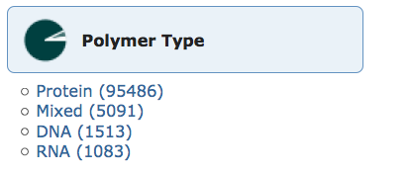
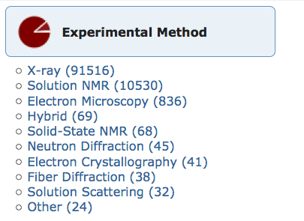
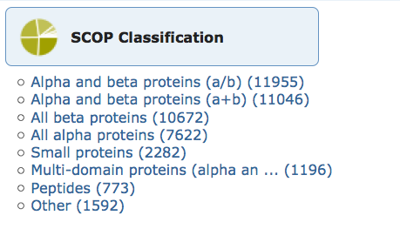
PDB
DATABASE PRIMARI
Database di strutture 3-D di proteine e acidi nucleici
Dati ottenuti sperimentalmente e sottomessi direttamente dai ricercatori
Fondato nel 1971

Slide 16
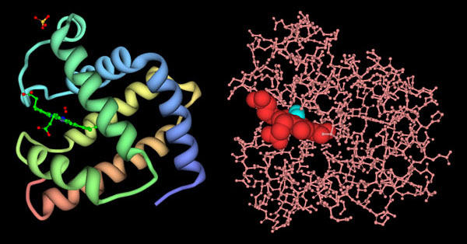
Myoglobin structure ribbon vs atom positions

Slide 17
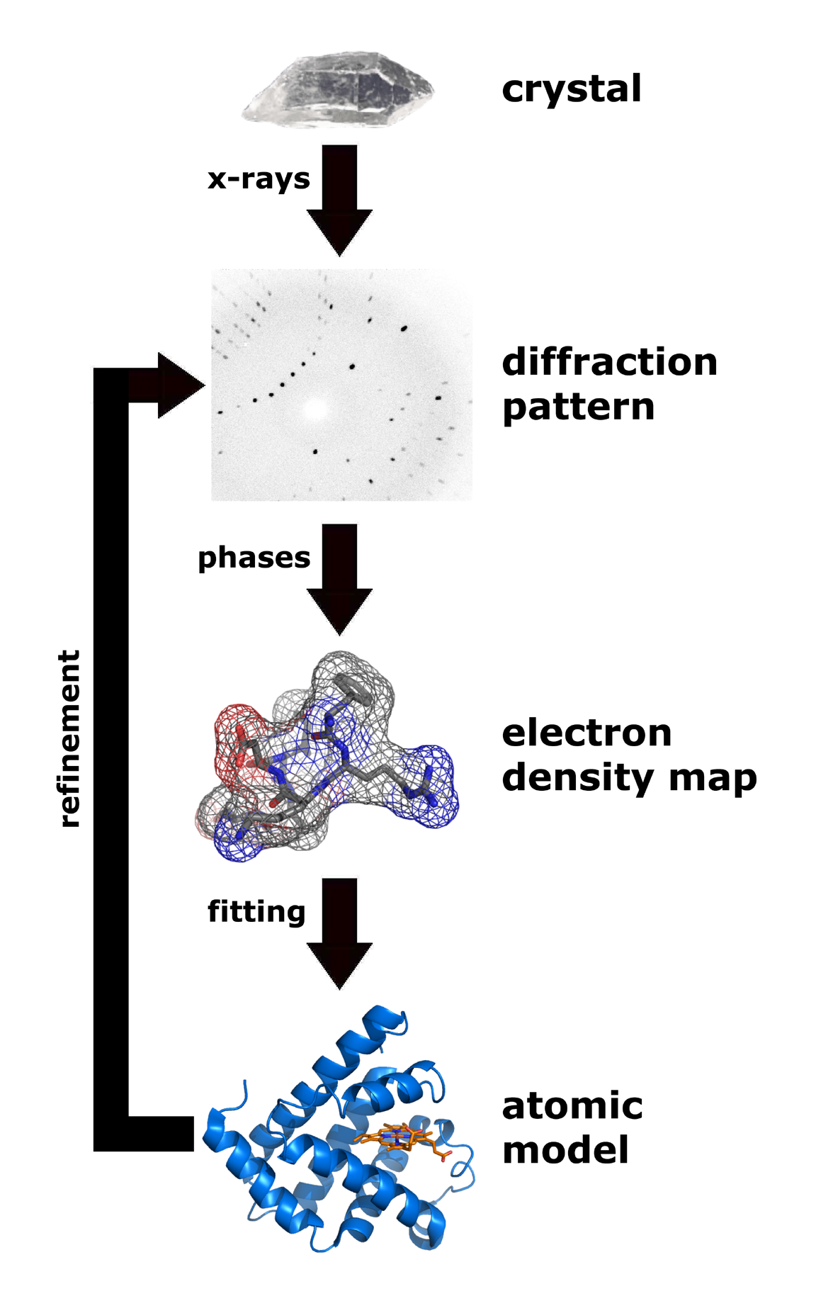
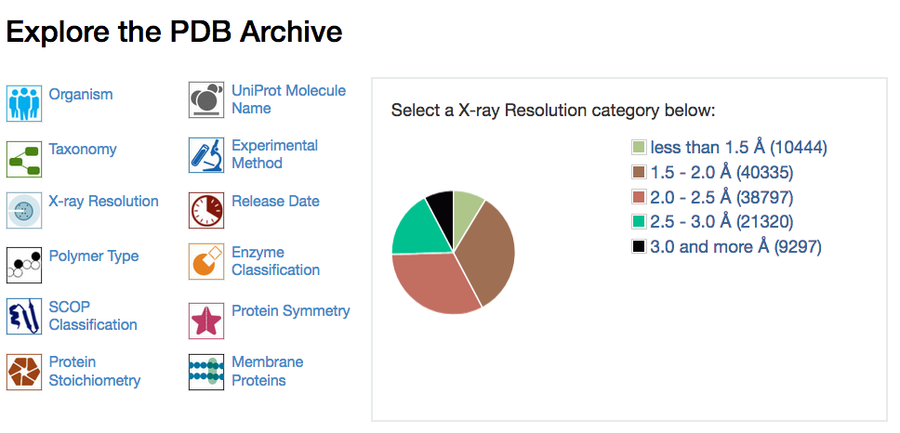
X-RAYS
crystallography
median resolution 2.05 Å
PDB stores in separate sections:
Experimental structural data
Stuctural data associated to models

Slide 18
PDB files
The most common format for storage and exchange of atomic coordinates for biological molecules is PDB file format
PDB file format is a text (ASCII) format, with an extensive header that can be read and interpreted either by programs or by people
Next slide:
PDB file format

Slide 19
nome
HEADER TRANSCRIPTION REGULATION 25-AUG-94 1RPO 1RPO 2
COMPND ROP (COLE1 REPRESSOR OF PRIMER) MUTANT WITH ALA INSERTED ON 1RPO 3
COMPND 2 EITHER SIDE OF ASP 31 (INS (A-D31-A)) 1RPO 4
SOURCE (ESCHERICHIA COLI) 1RPO 5
AUTHOR M.VLASSI,M.KOKKINIDIS 1RPO 6
REVDAT 2 15-MAY-95 1RPOA 1 REMARK 1RPOA 1
REVDAT 1 14-FEB-95 1RPO 0 1RPO 7
JRNL AUTH M.VLASSI,C.STEIF,P.WEBER,D.TSERNOGLOU,K.WILSON, 1RPO 8
JRNL AUTH 2 H.J.HINZ,M.KOKKINIDIS 1RPO 9
JRNL TITL RESTORED HEPTAD PATTERN CONTINUITY DOES NOT 1RPO 10
JRNL TITL 2 ALTER THE FOLDING OF A 4-ALPHA-HELICAL BUNDLE 1RPO 11
JRNL REF NAT.STRUCT.BIOL. V. 1 706 1994 1RPO 12
JRNL REFN ASTM NSBIEW US ISSN 1072-8368 2024 1RPO 13
REMARK 1 1RPO 14
REMARK 1 REFERENCE 1 1RPO 15
REMARK 1 AUTH M.KOKKINIDIS,M.VLASSI,Y.PAPANIKOLAOU,D.KOTSIFAKI, 1RPO 16
REMARK 1 AUTH 2 A.KINGSWELL,D.TSERNOGLOU,H.J.HINZ 1RPO 17
REMARK 1 TITL CORRELATION BETWEEN PROTEIN STABILITY AND CRYSTAL 1RPO 18
REMARK 1 TITL 2 PROPERTIES OF DESIGNED ROP VARIANTS 1RPO 19
REMARK 1 REF PROTEINS.STRUCT.,FUNCT., V. 16 214 1993 1RPOA 2
REMARK 1 REF 2 GENET. 1RPOA 3
REMARK 1 REFN ASTM PSFGEY US ISSN 0887-3585 0867 1RPO 22
REMARK 2 1RPO 29
REMARK 2 RESOLUTION. 1.4 ANGSTROMS. 1RPO 30
REMARK 1RPO 94
REMARK 999 SEQUENCE NUMBER IS ALSO THAT FROM PDB ENTRY 1RPO 95
SEQRES 1 65 MET THR LYS GLN GLU LYS THR ALA LEU ASN MET ALA ARG 1RPO 96
SEQRES 2 65 PHE ILE ARG SER GLN THR LEU THR LEU LEU GLU LYS LEU 1RPO 97
SEQRES 3 65 ASN GLU LEU ALA ASP ALA ALA ASP GLU GLN ALA ASP ILE 1RPO 98
SEQRES 4 65 CYS GLU SER LEU HIS ASP HIS ALA ASP GLU LEU TYR ARG 1RPO 99
SEQRES 5 65 SER CYS LEU ALA ARG PHE GLY ASP ASP GLY GLU ASN LEU 1RPO 100
ATOM 1 N MET 1 1.132 3.053 2.801 1.00 25.53 1RPO 115
ATOM 2 CA MET 1 2.398 3.546 2.283 1.00 27.85 1RPO 116
ATOM 3 C MET 1 3.091 2.466 1.442 1.00 21.34 1RPO 117
ATOM 4 O MET 1 2.642 1.298 1.451 1.00 19.29 1RPO 118
ATOM 5 CB MET 1 3.281 3.936 3.463 1.00 23.96 1RPO 119
ATOM 6 CG MET 1 3.718 2.760 4.291 1.00 27.52 1RPO 120
ATOM 7 SD MET 1 4.491 3.371 5.797 1.00 26.29 1RPO 121
ATOM 7 SD MET 1 4.491 3.371 5.797 1.00 26.29 1RPO 121
ATOM 8 CE MET 1 3.039 3.650 6.762 1.00 25.19 1RPO 122
ATOM 9 N THR 2 4.142 2.833 0.689 1.00 13.20 1RPO 123
ATOM 10 CA THR 2 4.851 1.806 -0.025 1.00 12.76 1RPO 124
ATOM 11 C THR 2 5.719 1.011 0.950 1.00 14.35 1RPO 125
composto
organismo
autore
referenze
risoluzione
sequenza
residuo 1
residuo 2
num.atomo
tipo atomo
tipo residuo
x
y
z
num. residuo

Slide 20
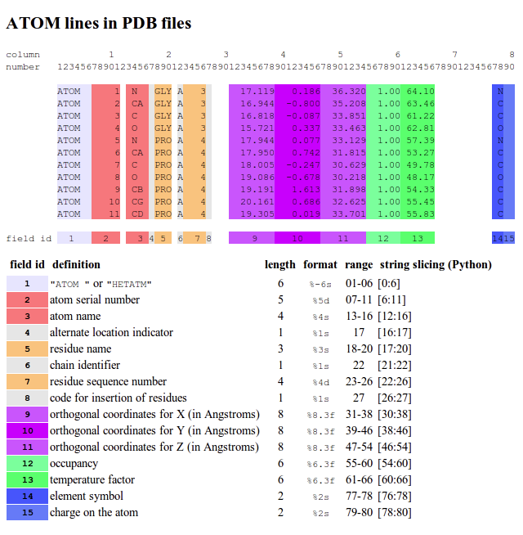
Occupancy: the fraction of unit cells that contain the atom in this particular location, usually 1.00, or all of them (can be used to represent alternative conformations of side chains);
Temperature factor: an indication of uncertainty in this atom's position due to disorder or thermal vibrations (can be used by graphics programs to represent the relative mobility of different parts of a protein)

Slide 21
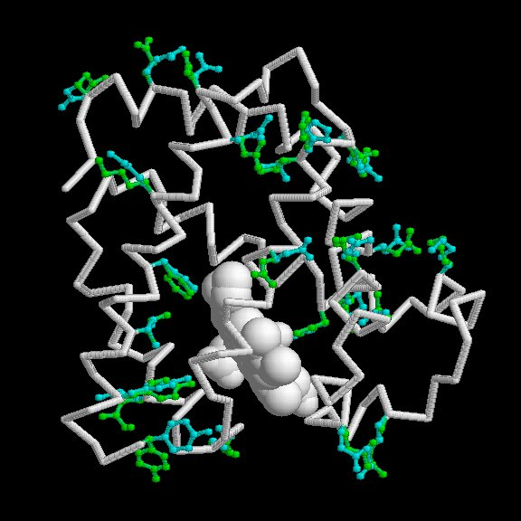
Occupancy
Alternative conformations: myoglobin aa with two conf.

Slide 22
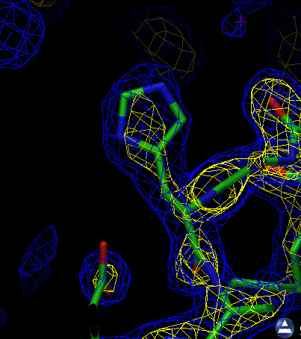
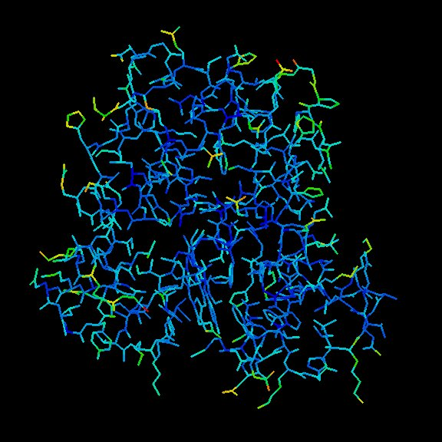
Temperature factor
Electron density depends on vibrations
Atoms colored by the temperature factors

Slide 23
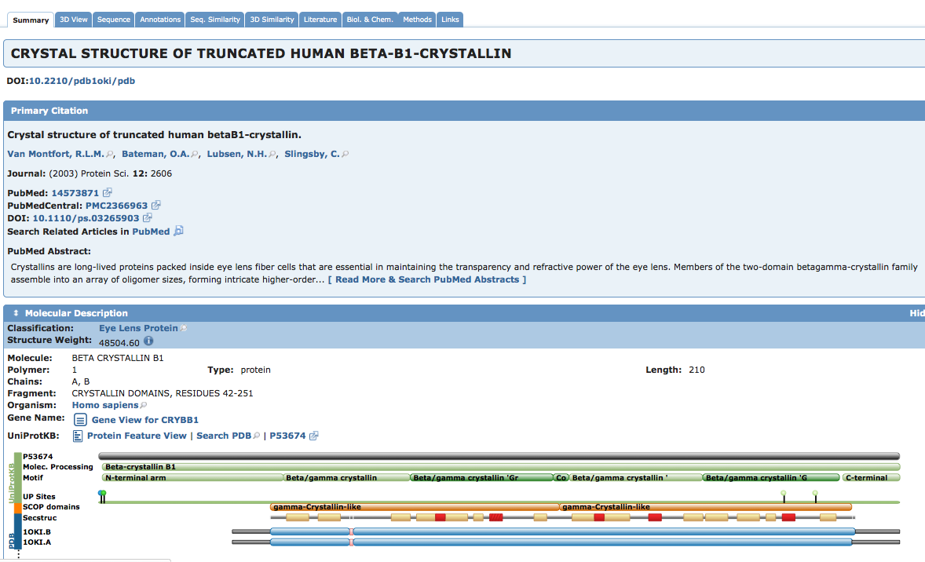

Slide 24
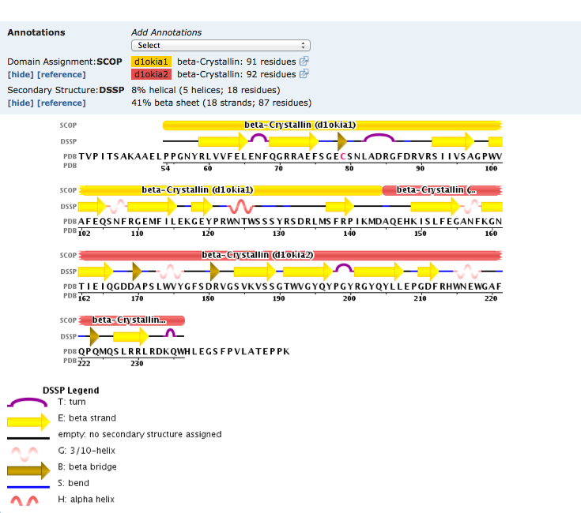
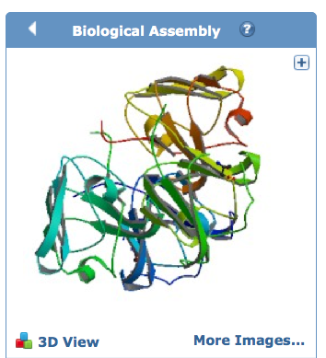
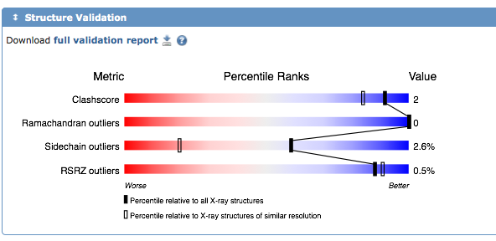

Slide 25
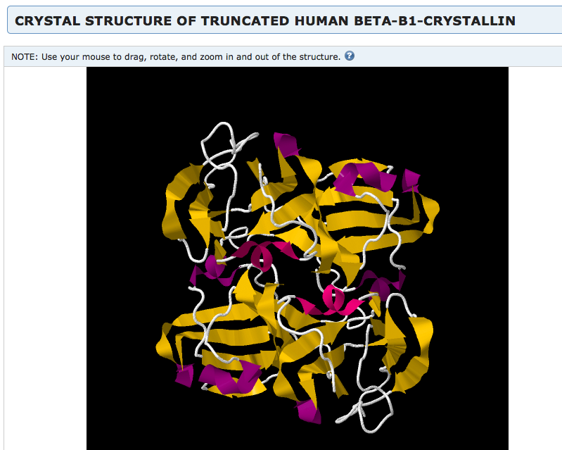
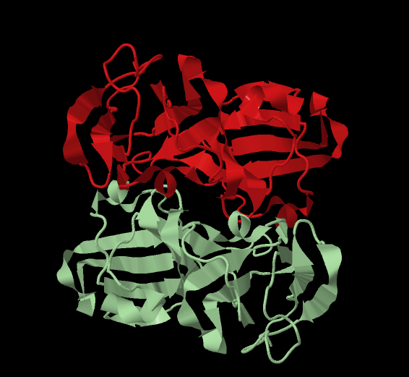
Subunits view
Interactive view

Slide 26
DATABASE SECONDARI

Slide 27
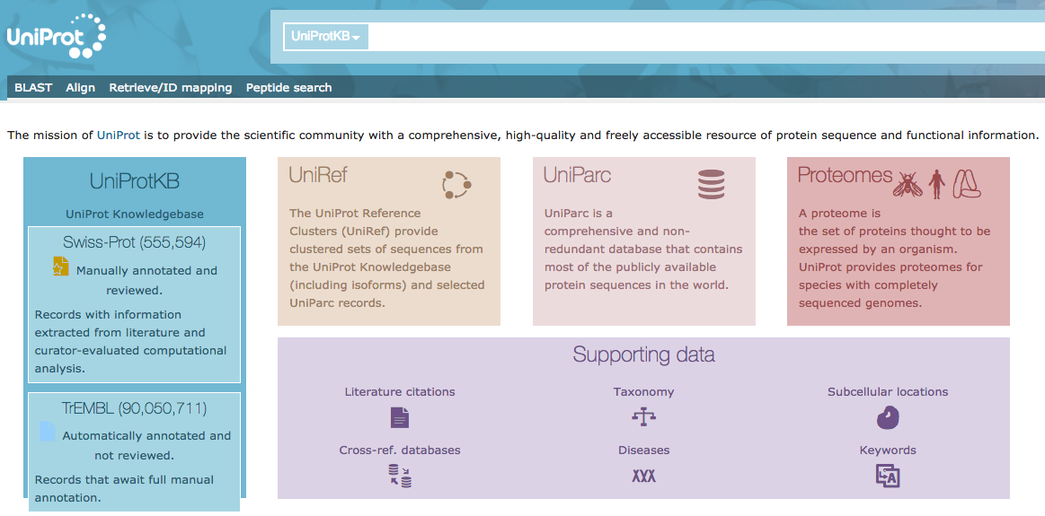
DATABASE SECONDARI
UniProt (Universal Protein Resource)
Il più grande catalogo di informazioni sulle proteine.
Contiene informazioni sulla sequenza e sulla funzione di proteine ed e’ ottenuto dall’insieme delle informazioni contenute in Swiss-Prot, TrEMBL e PIR.

Slide 28
UniProt http://www.uniprot.org/uniprot/
UniProtKB/Swiss-Prot
records annotati manualmente, informazioni dalla letteratura
UniProtKB/TrEMBL
records risultato di analisi computazionali, in attesa di annotazione completa
UniProt Knowledgebase (UniProt) is the central access point for extensive curated protein information, including function, classification, and cross-reference.

Slide 29
UniProt http://www.uniprot.org/uniprot/
UniProt Non-redundant Reference (UniRef) databases combine closely related sequences into a single record to speed searches.
UniProt Archive (UniParc) is a comprehensive repository, reflecting the history of all protein sequences.
The sequences and information in UniProt is accessible via text search, BLAST similarity search, and FTP.

Slide 30
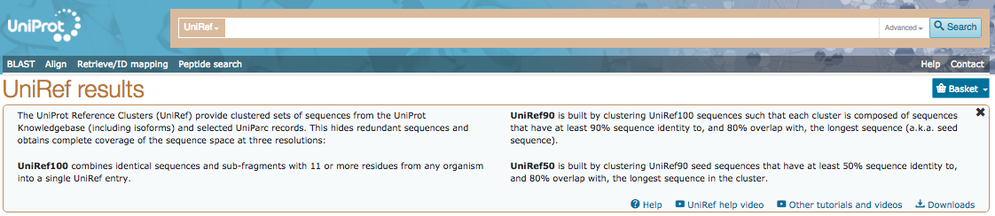

Slide 31
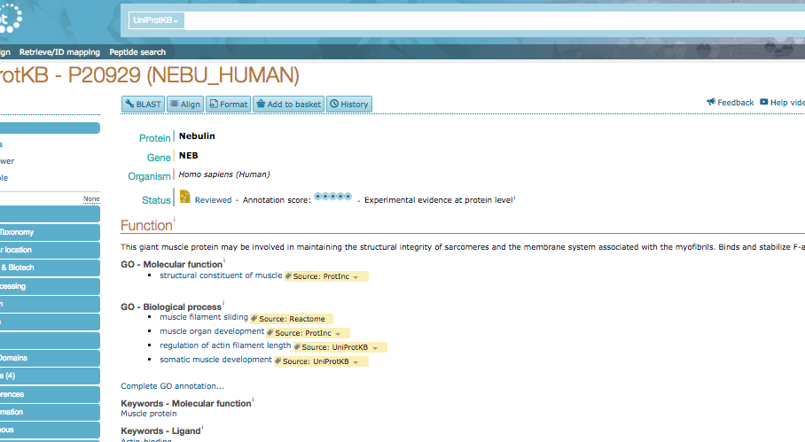

Slide 32
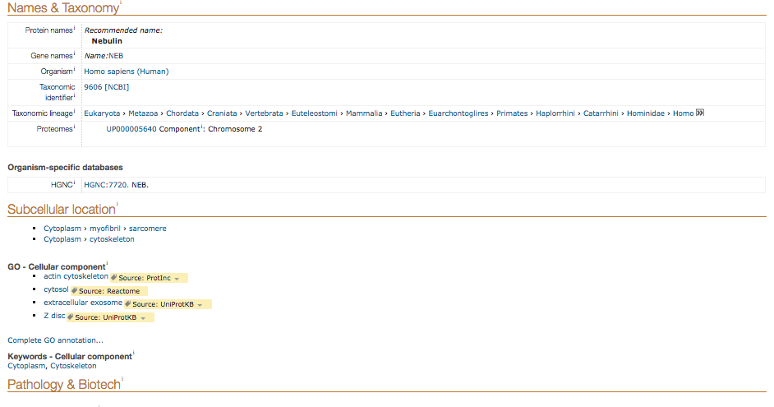

Slide 33
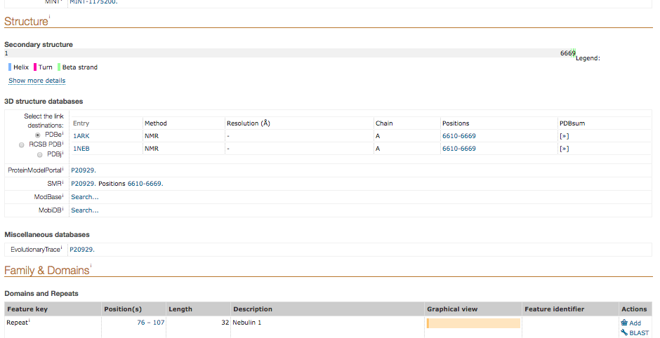

Slide 34
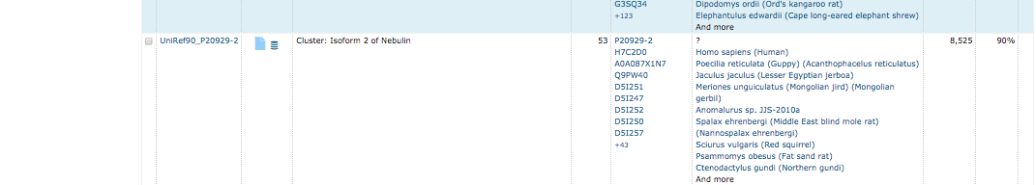
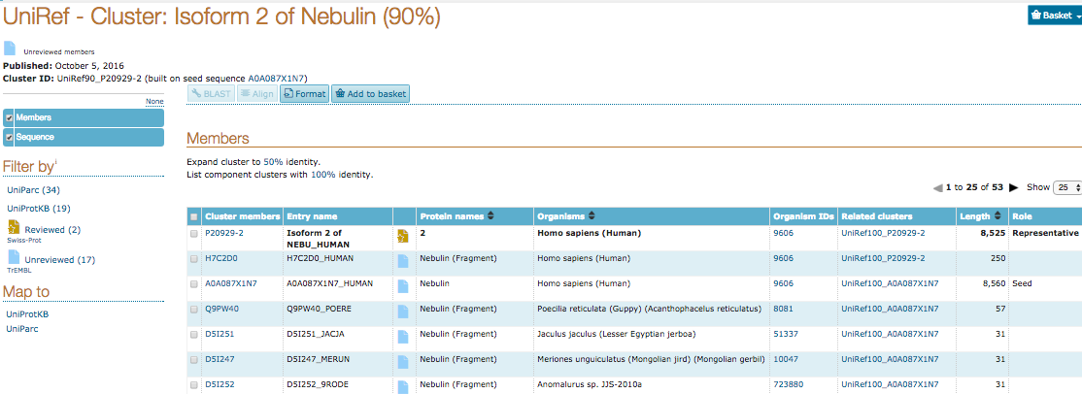

Slide 35

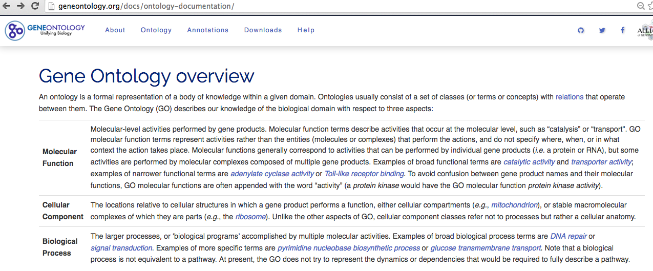
SxA
Suggerimento per Approfondimento

Slide 36
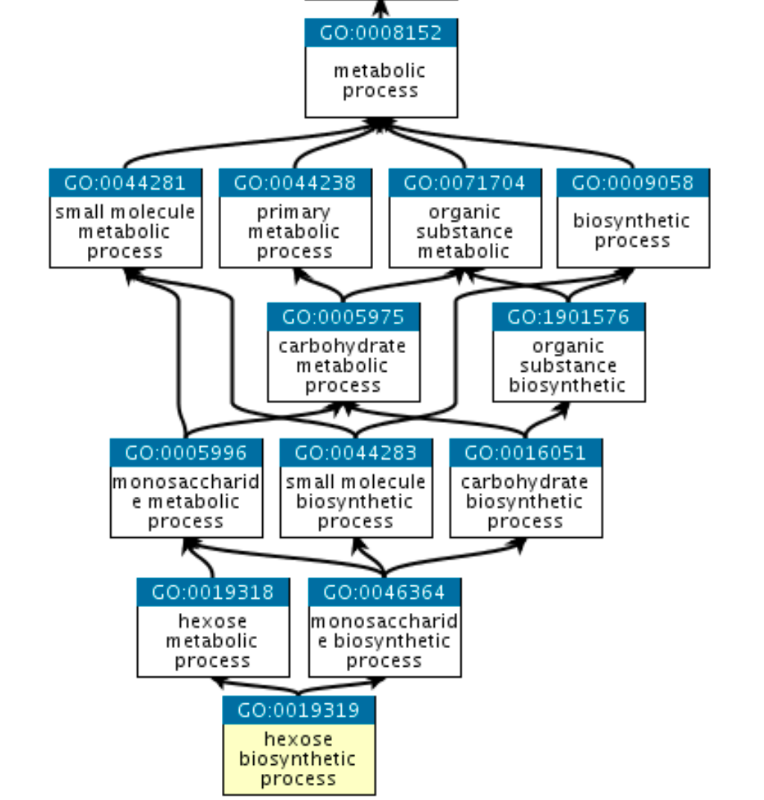

Slide 37
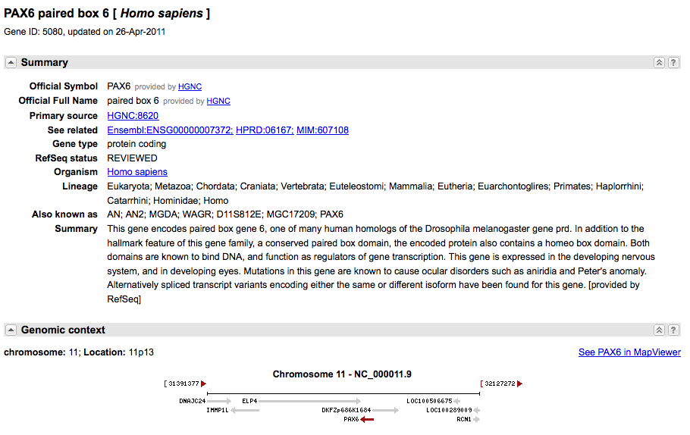
Interfaccia unificata per cercare informazioni su sequenze e loci genetici. Presenta informazioni sulla nomenclatura ufficiale, accession numbers, fenotipi, MIM numbers, UniGene clusters, omologia, posizioni di mappa e link a numerosi altri siti web.
NCBI GENE

Slide 38
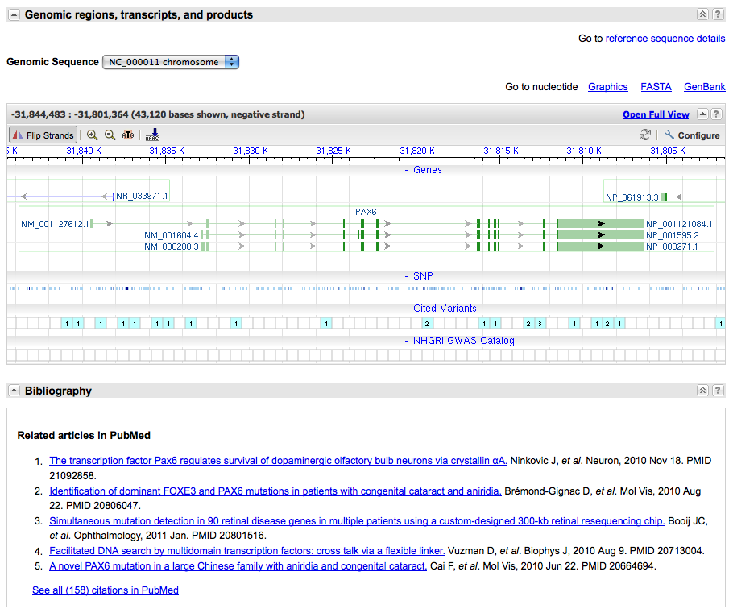
NCBI GENE

Slide 39
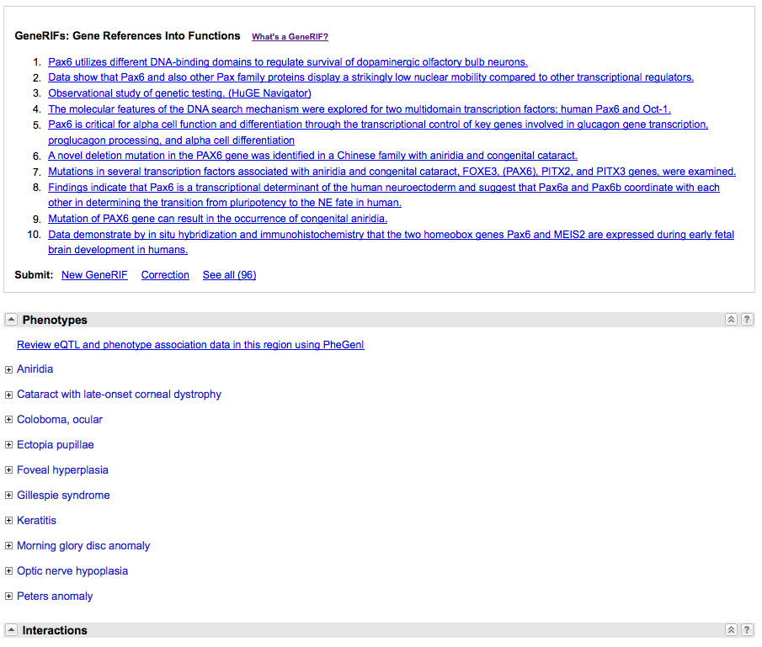
NCBI GENE

Slide 40
NCBI GENE
RefSeq - Reference Sequence collection of genomic DNA, transcripts, and proteins.
Distinguishing Features:
non-redundancy
explicitly linked nucleotide and protein sequences
updates to reflect current knowledge of sequence data and biology
data validation and format consistency
accessions with '_' character
curation by NCBI staff and collaborators, with reviewed records indicated

Slide 41
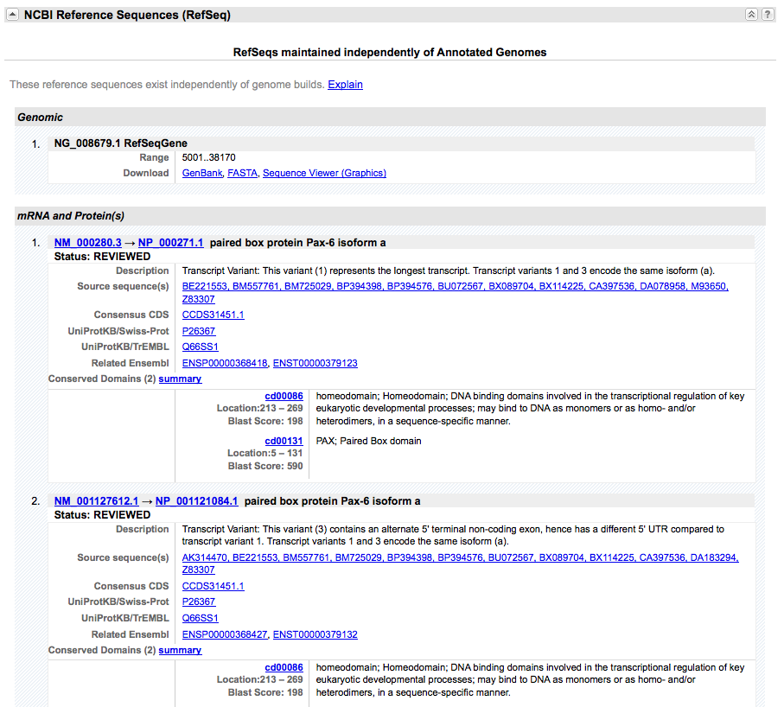
NCBI GENE

Slide 42
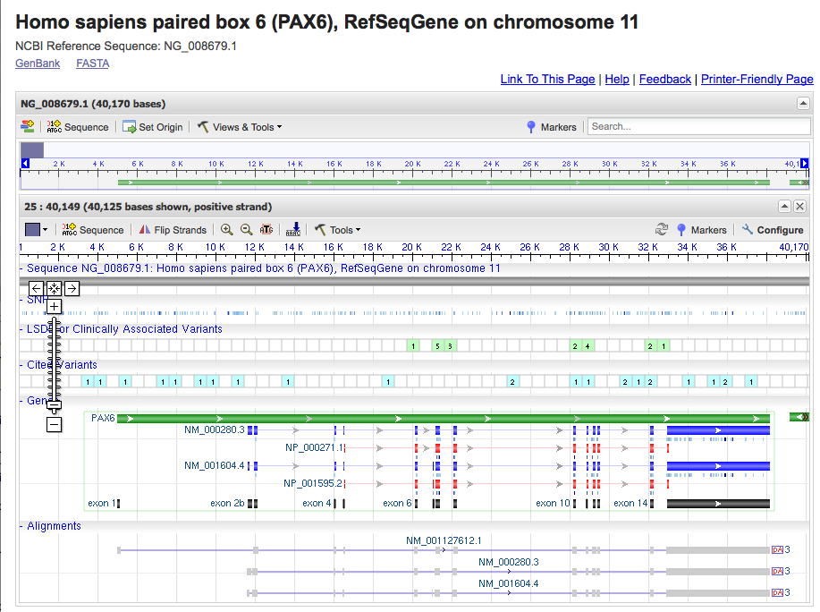

Slide 43
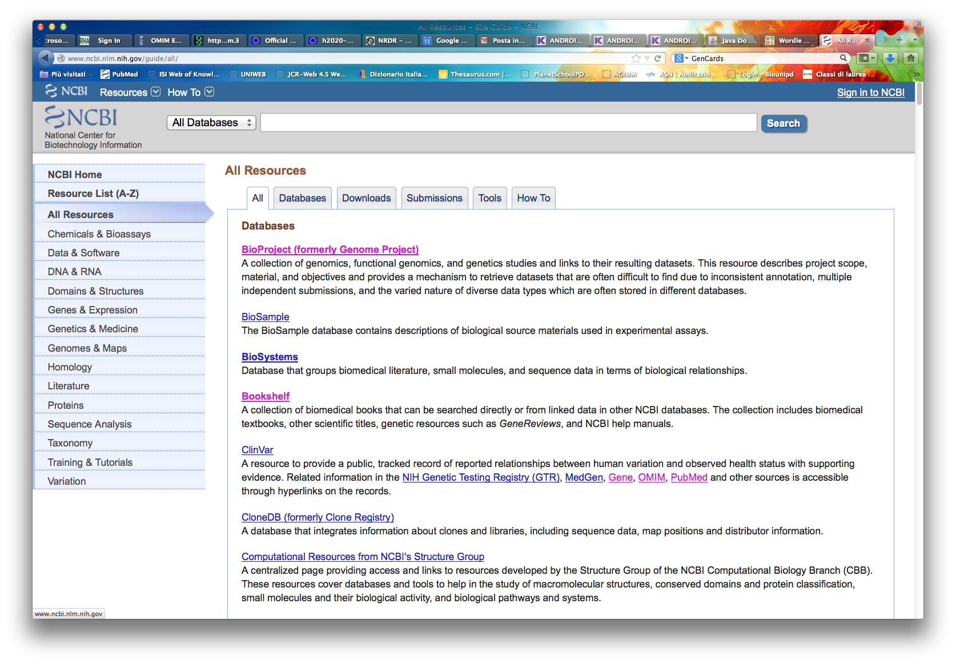
DATABASE SECONDARI
NCBI - Information retrieval system
E' stato sviluppato all’NCBI (National Center for Biotechnology Information, USA) per permettere l'accesso a dati di biologia molecolare e citazioni bibliografiche.
Sfrutta il concetto di “neighbouring”: possibilita' di collegare tra loro oggetti diversi di database differenti, indipendentemente dal fatto che essi siano direttamente “cross-referenced”.
Tipicamente, permette l'accesso a database di sequenze nucleotidiche, di sequenze proteiche, di mappaggio di cromosomi e di genomi, di struttura 3D e bibliografici (PubMed).

Slide 44
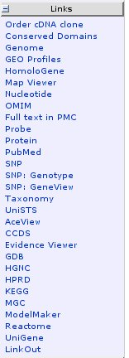
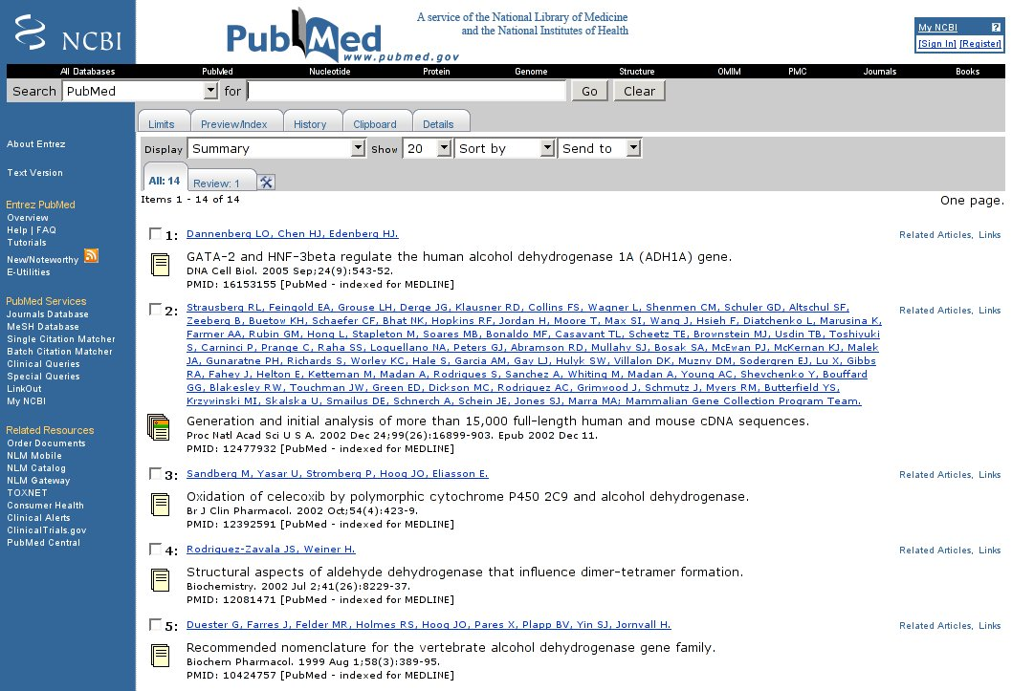
PubMed

Slide 45
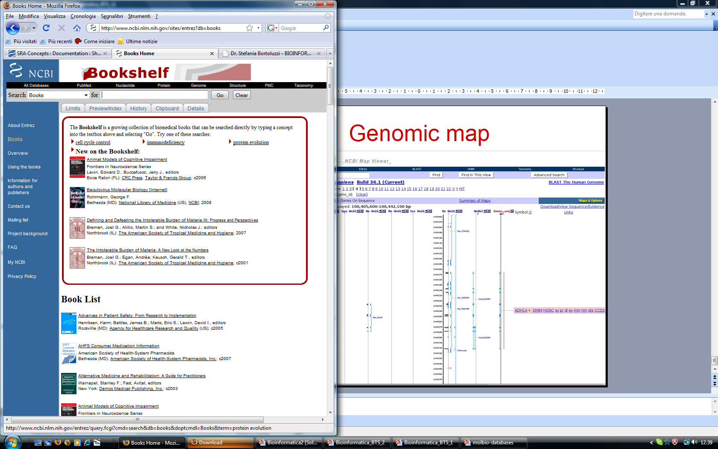
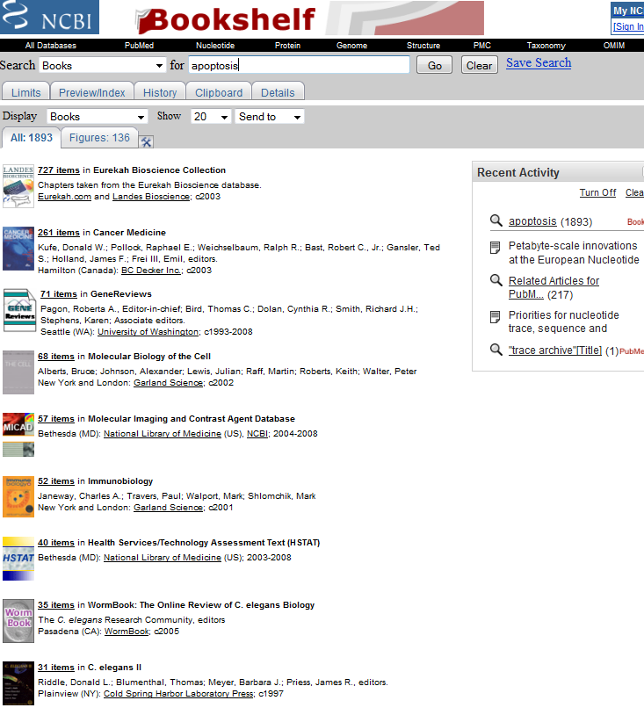
Bookshelf

Slide 46
Database secondari di strutture
PFAM, CATH, SCOP
Organizzano strutture in base a criteri gerarchici, evoluzionistici e di similarità strutturale
Banche dati secondarie derivate da PDB

Slide 47
Proteins contain conserved regions
Based on the conserved regions, proteins are classified into families
A protein family is a group of evolutionarily-related proteins
Superfamily
Family 1
Family 3
Family2
Subfamily 1
Subfamily 2

Slide 48
Domains can be considered as building blocks of proteins
Some domains can be found in many proteins with different functions, while others are only found in proteins with a certain function
The presence of a particular domain can be indicative of the function of the protein

Slide 49
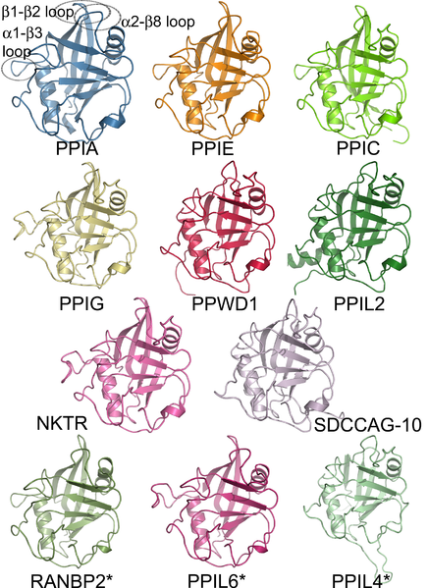
Cyclophilins
Peptidylprolyl isomerases
accelerate the folding of proteins
cyclosporin binding-protein modulating immunosuppression
Structures of isomerase domains of human cyclophilin family members

Slide 50
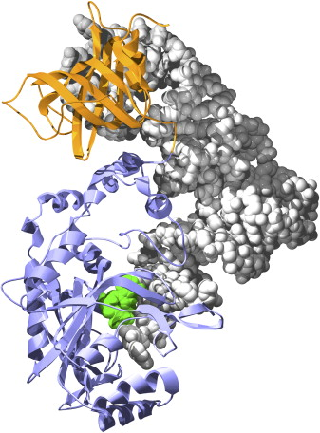
Most proteins include two or more domains
Nucleic
acid-binding
tRNA^{Asp}
Yeast
Aspartyl-tRNA Synthetase 1
- Two domains
- Each domain belongs to a distinct family
ATP bound in the active site
Catalytic
Matthew Bashton, Cyrus Chothia 2007
The Generation of New Protein Functions by the Combination of Domains
Class II aaRS and biotin synthetases superfamily

Slide 51
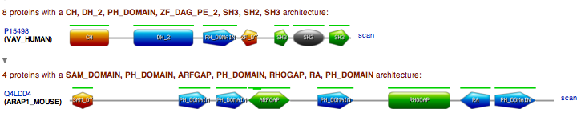
Many proteins comprise multiple independent structural and functional domains.
Due to evolutionary shuffling, different domains in a protein evolve independently.
Focus on families of protein domains. Many online resources are devoted to identify and catalog such domains.

Slide 52
Pfam
The Pfam database is a large collection of protein domain families.
Each family is represented by multiple sequence alignments and hidden Markov models (HMMs), useful also to classify in this context new sequences.
HMM (Hidden Markov Models) -> modelli probabilistici qui usati per descrivere evoluzione e conservazione di famiglie proteiche
Provides links to external databases like PDB, SCOP, CATH etc.

Slide 53
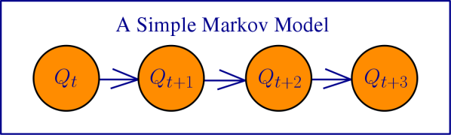
I Markov Models (o catene di Markov) sono modelli statistici che descrivono serie (sequenze) di stati in cui la probabilità di un certo stato dipende solo dallo stato precedente o dai dai precedenti.
A Markov model describes the probabilistic relationship between different states.
To model the probability of transitioning from one state to another we can create a matrix which describes the probability of being in state i at time t and being in state j at time t+1.
Now one question we may ask given a Markov model is: what is the probability that our model generated a particular sequence of states?

Slide 54
Markov Models
I Markov Models (o catene di Markov) descrivono serie (sequenze) di stati in cui la probabilità di un certo stato dipende solo dallo stato precedente o dai dai precedenti.
Insieme di stati:
Il processo va da uno stato all’altro generando una sequenza di stati:
Proprietà delle Catene di Markov: la probabilità di un certo stato dipende solo da qual è lo stato precedente:
Per definire un Markov model, dobbiamo definire le seguenti probabilità:
transition probabilities
initial probabilities

Slide 55
Example of Markov Model
0.3
0.7
Two states : ‘Rain’ and ‘Dry’
Transition probabilities:
P(‘Rain’|‘Rain’)=0.3 , P(‘Dry’|‘Rain’)=0.7 ,
P(‘Rain’|‘Dry’)=0.2, P(‘Dry’|‘Dry’)=0.8
Initial probabilities: say P(‘Rain’)=0.4 , P(‘Dry’)=0.6 .
Rain
Dry
0.2
0.8

Slide 56
Example of Markov Model
0.3
0.7
Two states : ‘Rain’ and ‘Dry’
Transition probabilities:
P(‘Rain’|‘Rain’)=0.3 , P(‘Dry’|‘Rain’)=0.7 ,
P(‘Rain’|‘Dry’)=0.2, P(‘Dry’|‘Dry’)=0.8
Initial probabilities: say P(‘Rain’)=0.4 , P(‘Dry’)=0.6 .
Rain
Dry
0.2
0.8
Suppose we want to calculate a probability of a sequence of states in our example, {‘Dry’,’Dry’,’Rain’,’Rain’}.
P({‘Dry’,’Dry’,’Rain’,’Rain’} ) = P(‘Rain’|’Rain’) P(‘Rain’|’Dry’) P(‘Dry’|’Dry’) P(‘Dry’) = 0.3*0.2*0.8*0.6=0.288

Slide 57
Hidden Markov Model
0.3
0.7
States (Hidden)
Observations
Low
High
0.2
0.8
0.6
0.4
0.4
0.6
Rain
Dry
Nei Modelli di Markov Nascosti le osservazioni che abbiamo sono collegate agli stati, ma questi non li conosciamo, sono nascosti, e possiamo dedurne la probabilità in base alle osservazioni.
Qui definiscono il modello:
matrix of transition probabilities A=(a_{ij}), a_{ij}= P(s_{i} | s_{j})
vector of initial probabilities
matrix of observation probabilities B=(b_{i} (v_{m} )), b_{i}(v_{m} ) = P(v_{m} | s_{i})
  (probabilità associata a ciascuno stato di produrre una certa osservazione)

Slide 58

Allineamento multiplo → profilo HMM
ACA - - - ATG
TCA ACT ATC
ACA C - - AGC
AGA - - - ATC
ACC G - - ATC
insertion
Transition probabilities
Output Probabilities
A HMM model for a DNA motif alignments. The transitions are shown with arrows whose thickness indicate their probability. In each state, the histogram shows the probabilities of the four bases.
Next, use the model to calculate probability of a given sequence
E.g. P(ACACATC) = (0.8 * 1)*(0.8*1)*(0.8*0.6)*(0.4*0.6)*(1*1)*(0.8*1)*(0.8)
A C A C A T C

Slide 59

Procedura per la costruzione degli allineamenti
Allineamenti seed, curati, di membri rappresentativi della famiglia
Profilo HMM dell’allineamento seed
All. full contengono tutti i membri della famiglia

Slide 60
Pfam classification
Family
A collection of related protein regions
Family: Domain
A structural unit
Repeat
A short unit which is unstable in isolation but forms a stable structure when multiple copies are present
Motif
A short unit found outside globular domains
Related Pfam entries are grouped together into clans; the relationship may be defined by similarity of sequence, structure or profile-HMM.

Slide 61
Due sezioni:
Pfam-A → Allineamenti seed e full →
Pfam-B → Famiglie “incomplete”

Slide 62
Pfam-B families are un-annotated and of lower quality as they are generated automatically from the non-redundant clusters of the latest ADDA (Automatic Domain Decomposition Algorithm) database release.
Although of lower quality, Pfam-B families can be useful for identifying functionally conserved regions when no Pfam-A entries are found.

Slide 63


AA PROB. PER POSITION IN THE FAMILY
Pfam
HMM logo
Seed alignment
INSERTIONS

Slide 64
CATH
Protein Structure Classification Database at UCL
Classification of proteins based on domain structures
Each protein chopped into individual domains and assigned into homologous superfamilies.
Hierarchial domain classification of PDB entries.

Slide 65
CATH hierarchy
Class – derived from secondary structure content is assigned automatically
  Architecture – describes gross orientation of secondary structures, independent of connectivity (based on known structures)
    Topology – clusters structures according to their topological connections and numbers of secondary structures
      Homologous superfamily – this level groups together protein domains which are thought to share a common ancestor and can therefore be described as homologous

Slide 66

Class, C-level
mainly-alpha, mainly-beta and alpha-beta (including alternating alpha/beta structures and alpha+beta structures) plus a fourth class with low secondary structure content.
Architecture, A-level
Overall shape; ignores the connectivity between the secondary structures. Assigned manually using literature for well-known architectures (e.g the beta-propellor or alpha four helix bundle) as reference.
Topology (Fold family), T-level
Structures are grouped into fold families at this level depending on both the overall shape and connectivity of the secondary structures. This is done using the structure comparison algorithm SSAP.

Slide 67

CATH – dominio maggiore serina idrossimetiltransferasi umana

Slide 68
SCOP
Structural Classification of Proteins
Description of structural and evolutionary relationships between all the proteins with known structures
Uses the PDB entries
Search using keywords or PDB identifiers

Slide 69
Hierarchy in SCOP
While the four major levels of CATH are class, architecture, topology and homologous superfamily SCOP uses:
    Class (all α, all β, α/β, α + β)
      Fold
      Superfamily
      Family
        Species
        SCOP database is mainly based on expert knowledge, while CATH grounds more on automation
Notes:
one with mostly parallel sheet(s), called alpha/beta, and one with mostly antiparallel sheet(s), called alpha + beta

Slide 70
What about Genomic databases?
Saranno trattati nella parte del corso riguardante la Genomica

Slide 71

Homework: articoli scelti dal NAR DB issue 2018

Slide 72


